Slide 1
CPOPC December 2022
Alan White – December 10, 2022

Slide 2
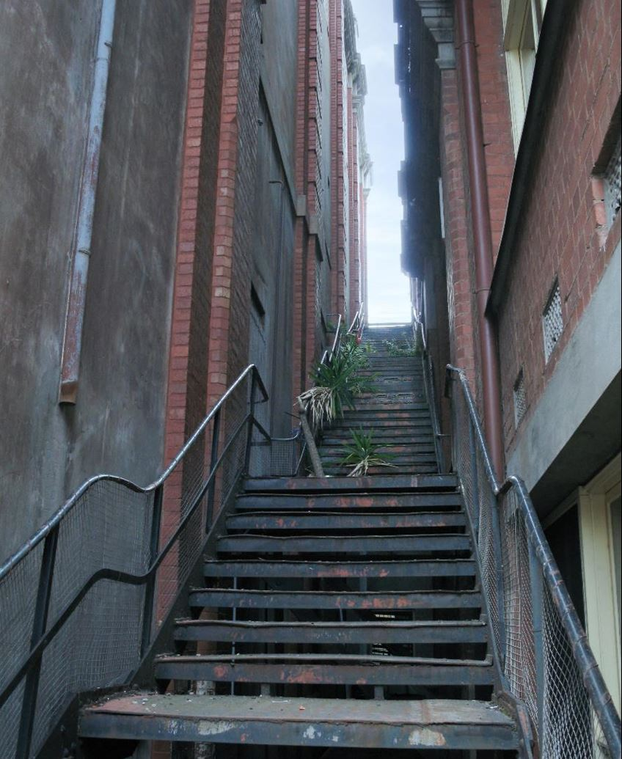
Welcome
Acknowledgement of guests and prospective members
Membership dues reminder
Zoom difficulties? - Email John Miner john@miner.ca
10 min break between 10:30 and 11am
John Miner

Slide 3
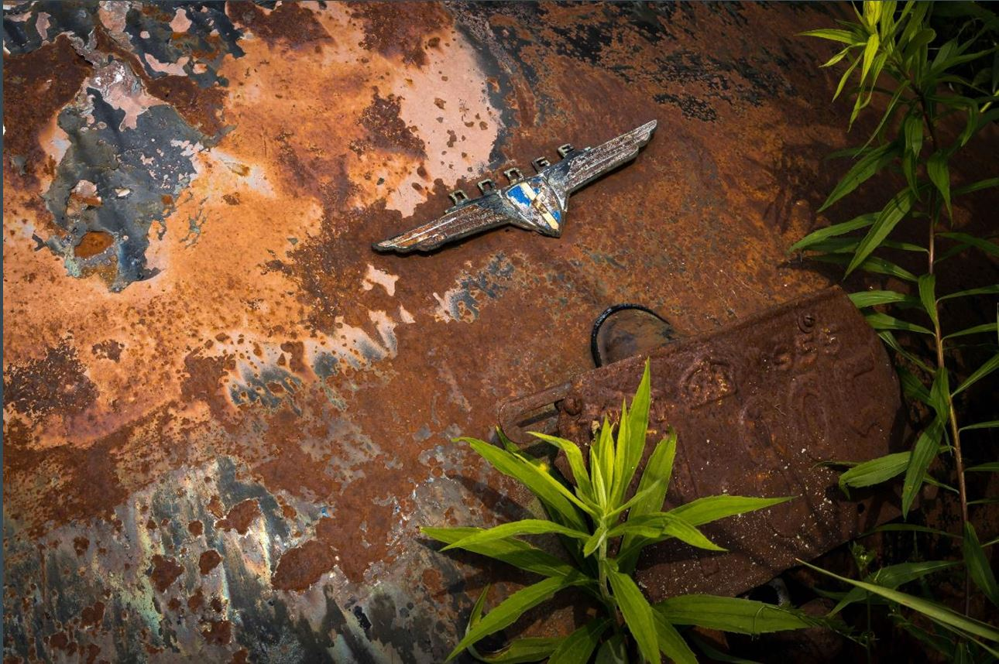
December 2022
Agenda topics
Fall Competition and Critique
January Challenge & Spring Competition
Resumption of in-person meetings ?
Upcoming Social Event – December 17
Scavenger Hunt Showing
Member Contributions
Cumberland Museum Outing
December Technique Review – High Key
Photography 101- Taking group photos
Notices
Next Meeting
Jean Francois Riel

Slide 4
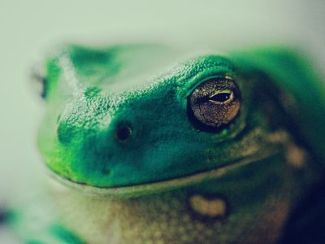
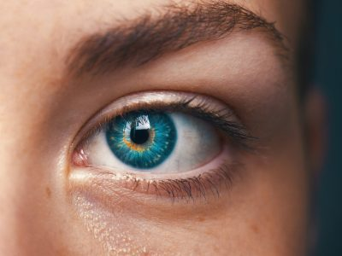
Fall Competition – Close Up
Jason Leung on Unsplash
A tightly cropped shot that shows a subject (or object) up close and with perhaps more detail than the human eye usually perceives
Images must have been taken since June 2022 AGM
Submit up to three images
Submission deadline: Saturday Nov 19, 2022 (midnight)
Paul Kapischka on Unsplash
Amanda Dalbjorn on Unsplash

Slide 5
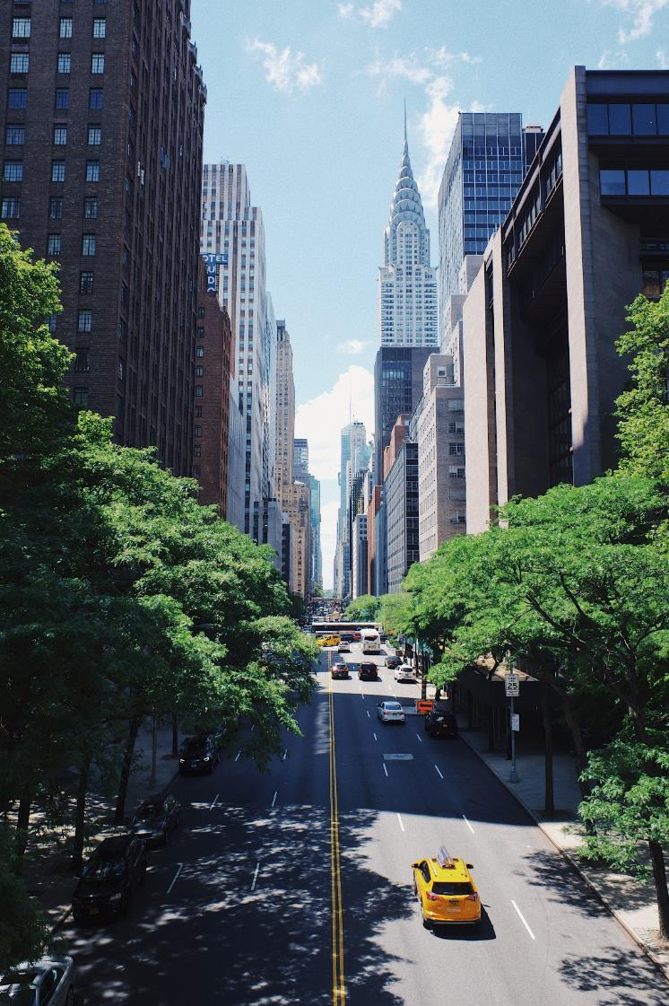
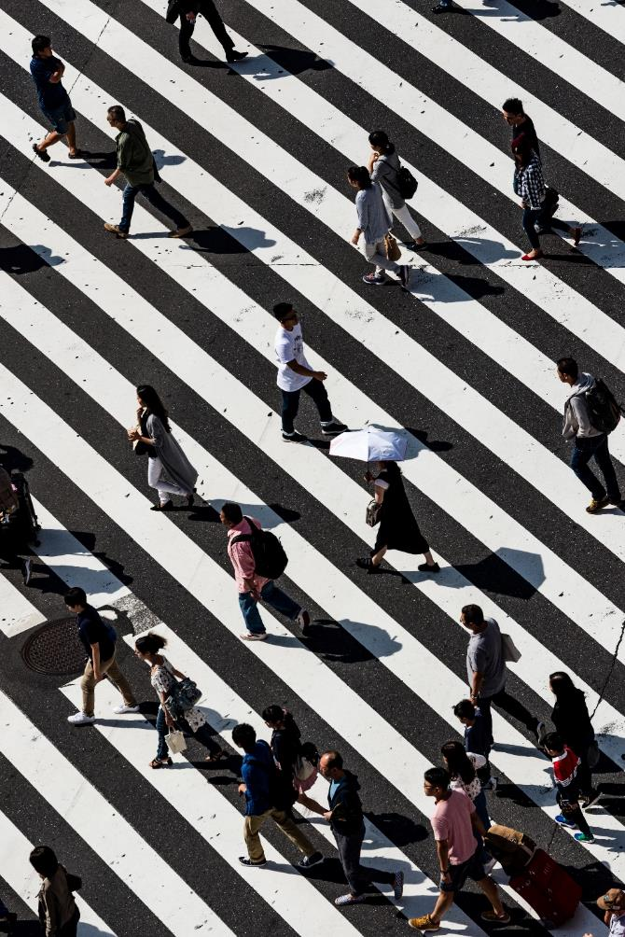
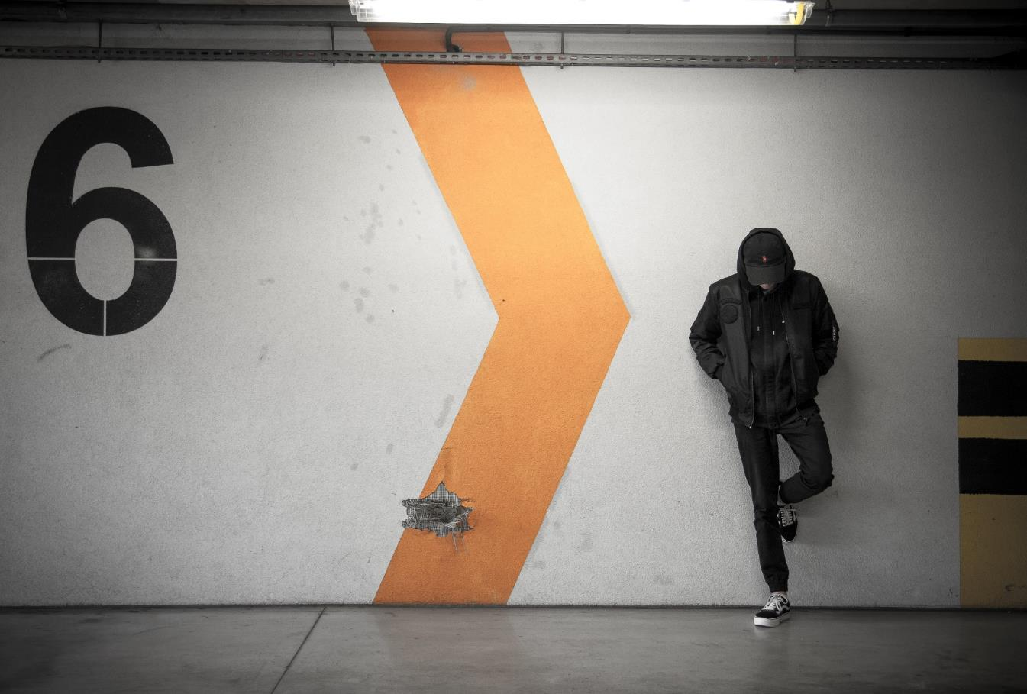
January challenge – Urban life
Robert Bye on Unsplash
Capture the spontaneous encounters of life in cities or towns. Image must include a live person, animal or plant.
Off topic: Clear rural indicators, e.g. open fields, silo, country lane, etc.
Submission deadline: Saturday, Jan 7, 2023 (midnight)
All archived images are allowed.
Ryoji Wata on Unsplash
Dawid Zawila on Unsplash

Slide 7
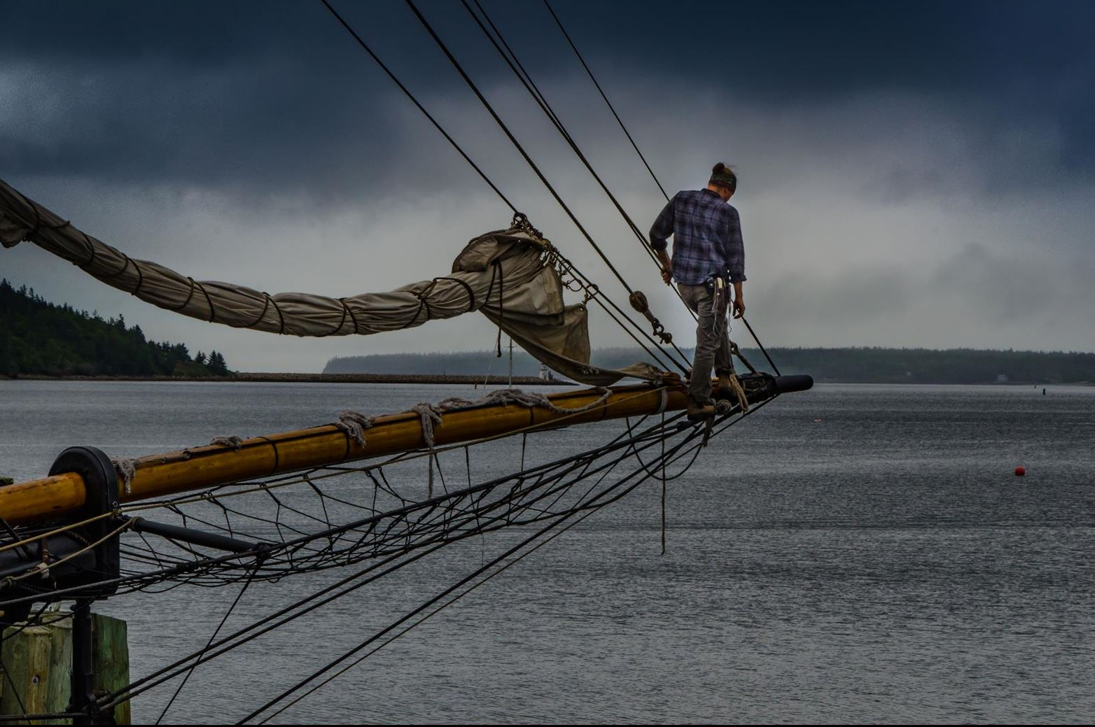
Resumption of In-Person or Hybrid meetings? President; Alan White
DECISION
Continuing for now with online monthly meetings via Zoom
Planning more in-person workshops and outings
More in-person social events
CONSIDERATIONS
In-person only meetings are still unacceptable to many members
Hybrid meetings are technically feasible at Queenswood Heights, but….
Additional equipment for hybrids would cost approximately $1000
Camera Club of Ottawa has shared their experience of running hybrid meetings
Attendance is split 50/50, even with incentives to go in person
Workload for the organisers is increased greatly
Pierre Roy

Slide 8
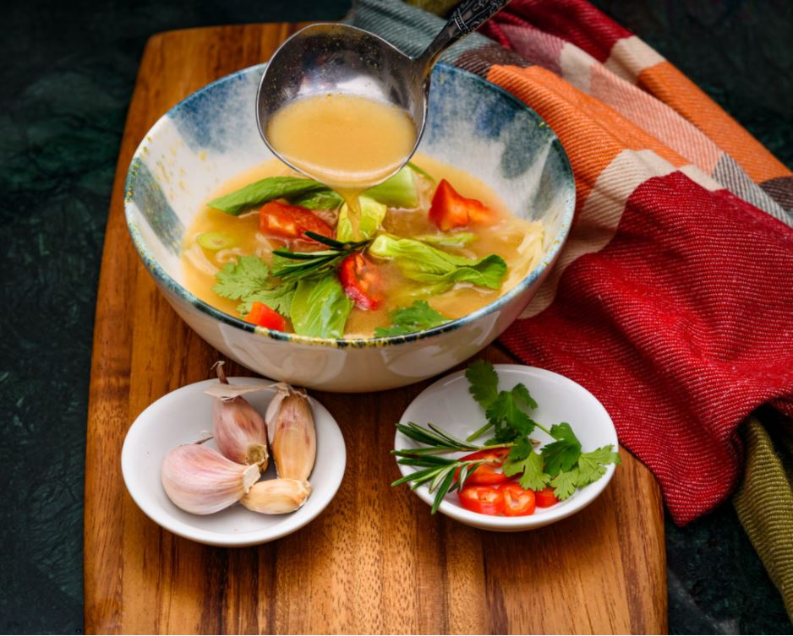
Upcoming Social Event Programs Director; Marianne Pethke
Christmas POT LUCK, social event and equipment swap
Saturday, December 17 at Queenswood Heights Community Centre, 10.30am to 1pm
Not a replacement for the regular meeting but a chance to meet old friends and share in the holiday spirit.
Guests are welcome!
Enjoy a comprehensive slide show of member’s images
Bring along any equipment for sale or give away
Pick up your well-earned ribbons
Club will provide beverages
Registration is open – please give us a preview of attendance numbers
Yoline Joseph-Hoskins

Slide 9
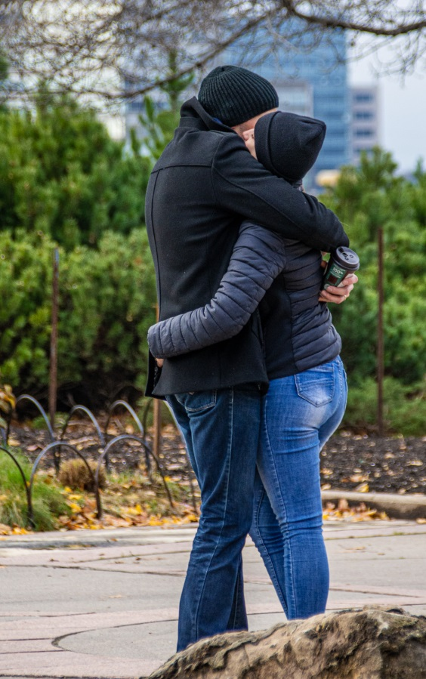
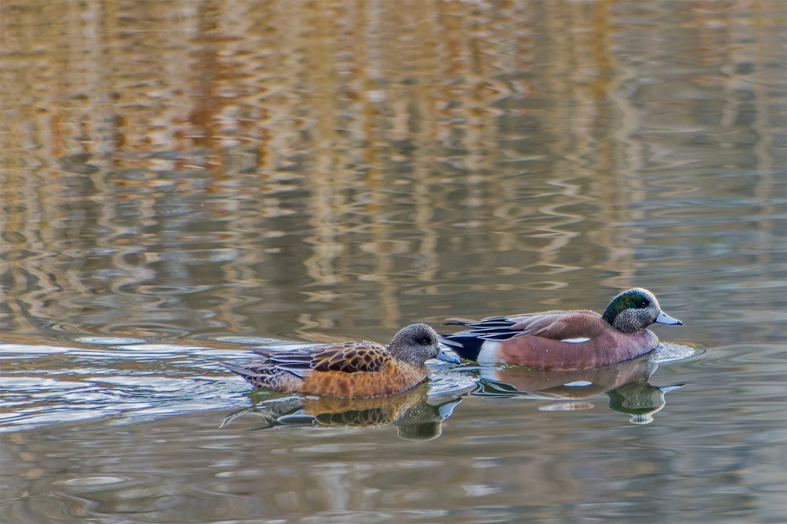
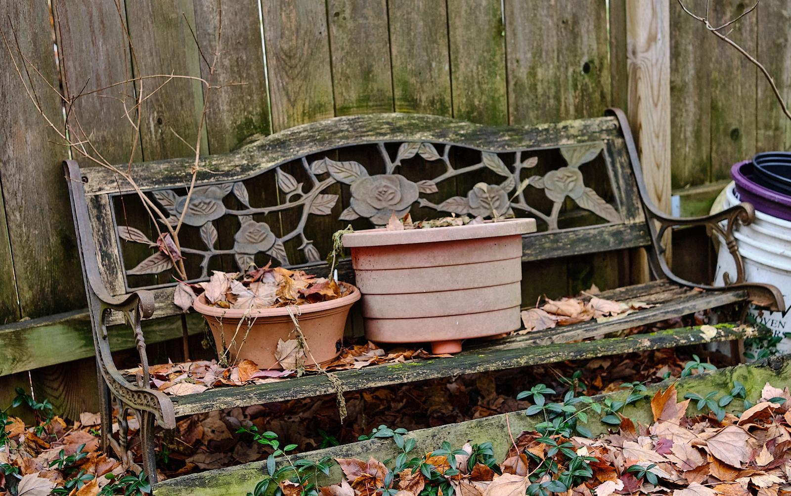
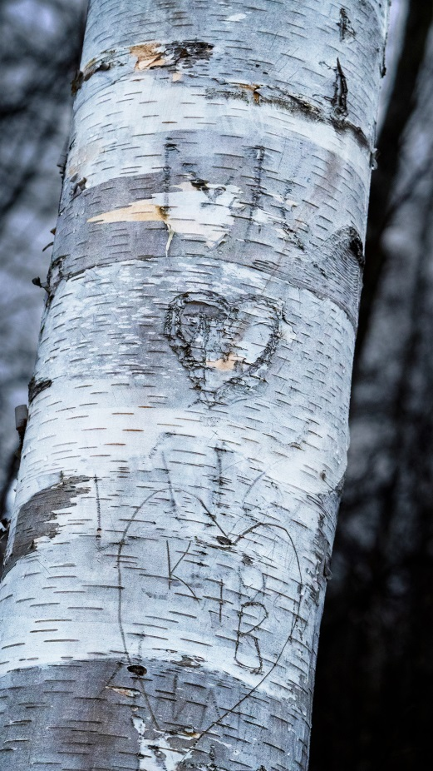
Presentations and Workshops
Scavenger Hunt 2022
Looking Up
Beverly Dawson
Love & friendship
No need to register
24 Topics to be released by email at 6pm on Friday 18 November
Your shooting to be completed over the weekend of 19,20 November
Post processing is allowed
Choose your best 6 pictures (one per topic)
Submit on website page by midnight November 30
All submissions will be shown during the December meeting
No judging, no prizes, just for fun!
Images are from 2021 Scavenger Hunt
Beverly Dawson
Kathy Burke
Ramesh Chauhan
Abandonment
Ken Udle

Slide 10
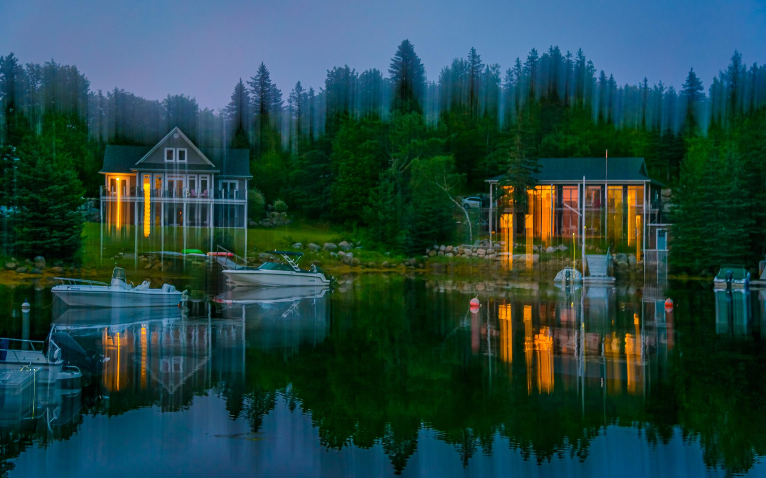
Member contributions - ICM
Yoline Joseph-Hoskin

Slide 11
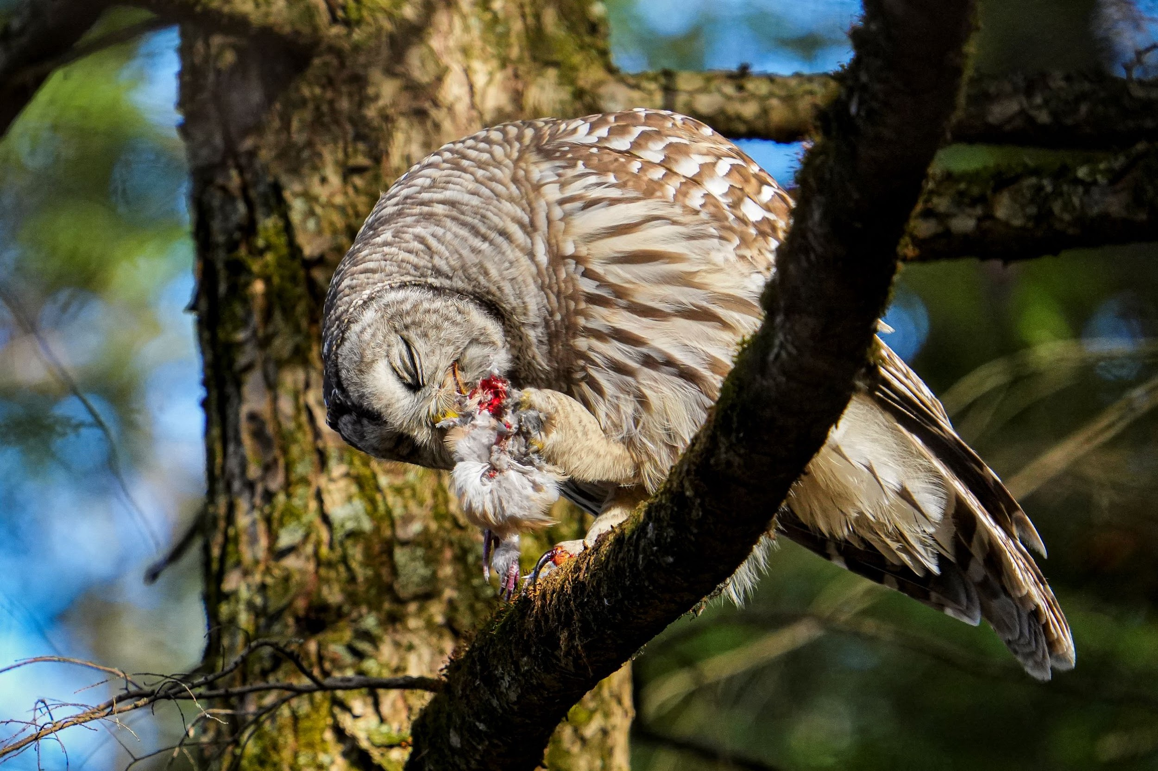
Member contributions - general
John Ingold

Slide 12
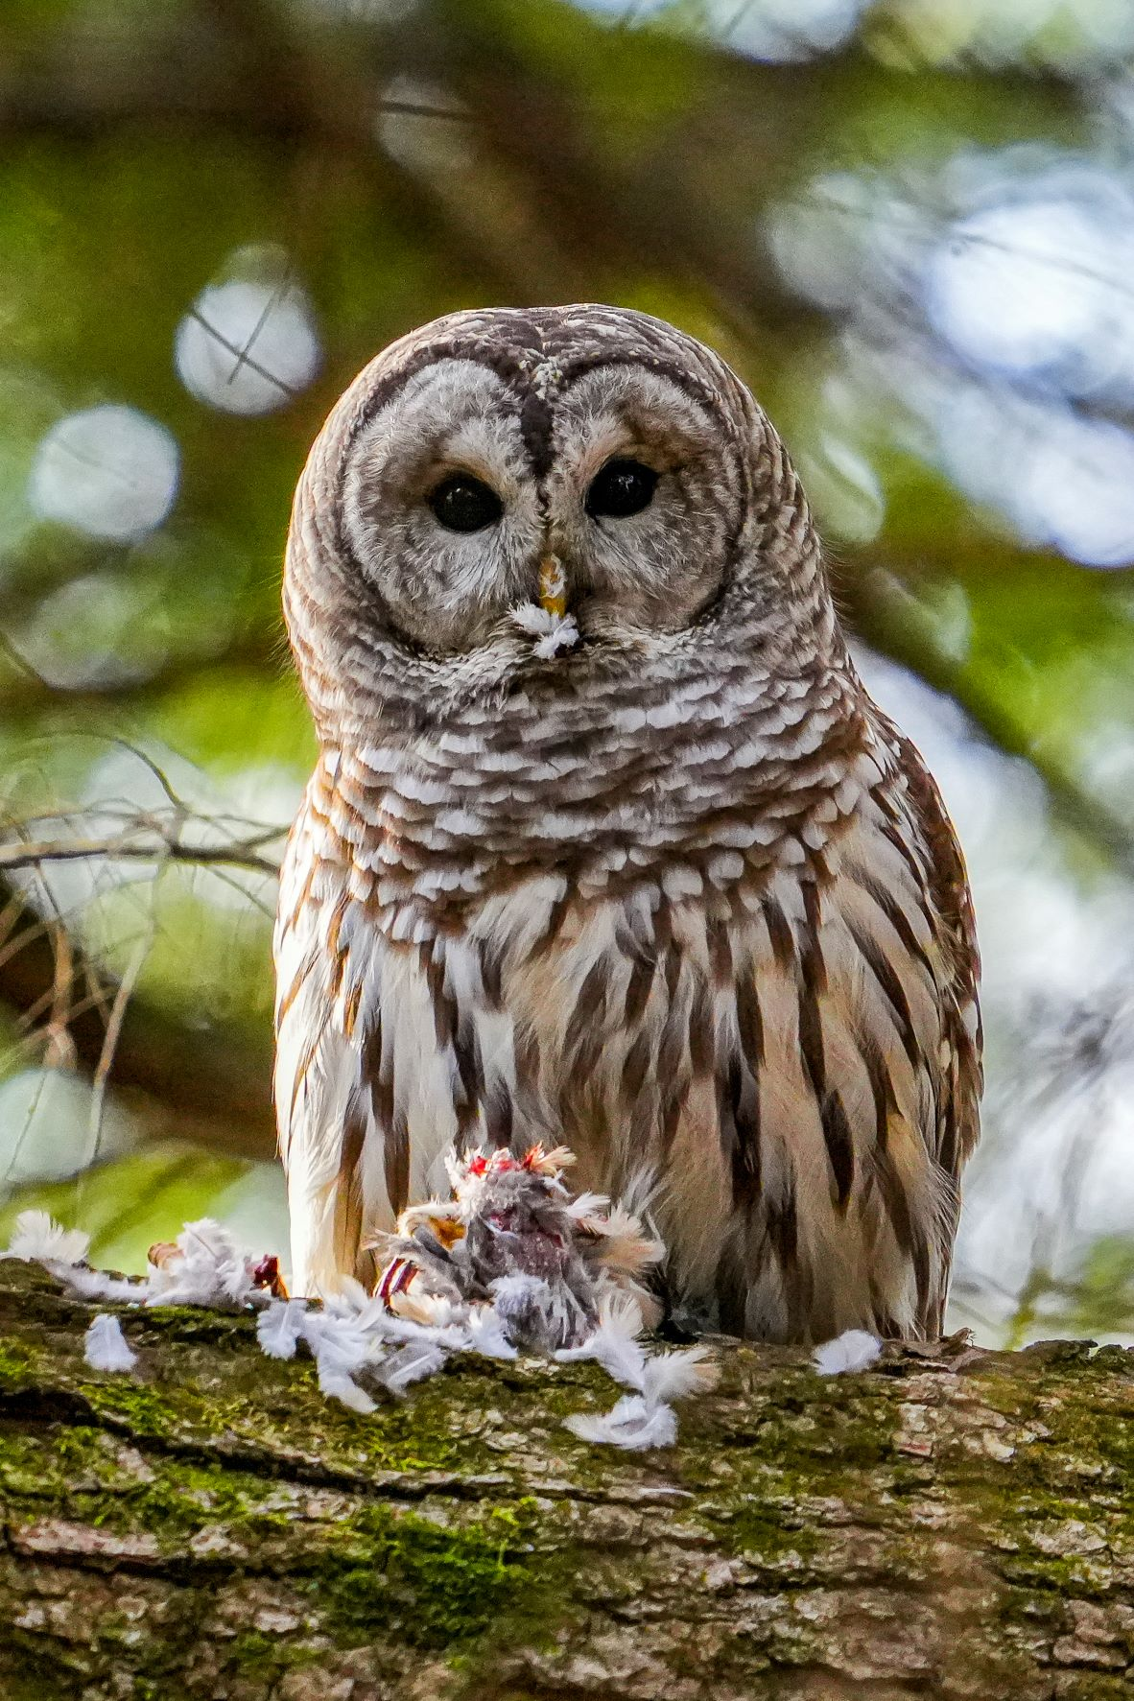
John Ingold

Slide 13
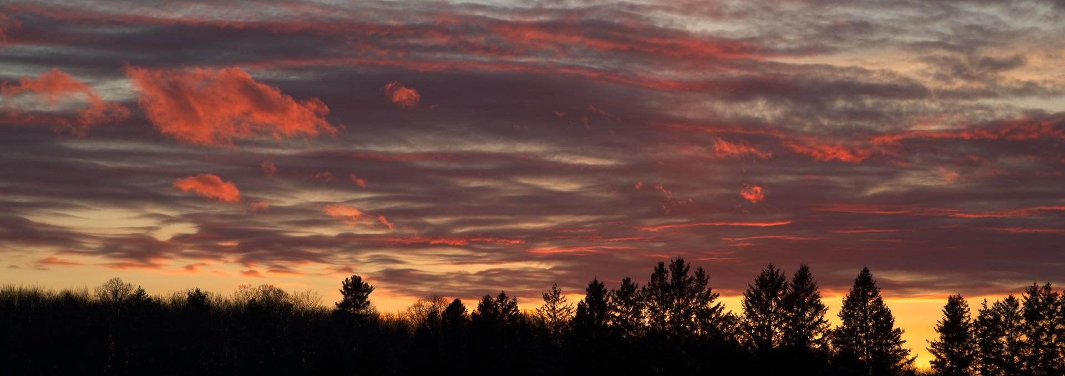
Member contributions
Cumberland Museum Outing
Chris Taylor

Slide 14
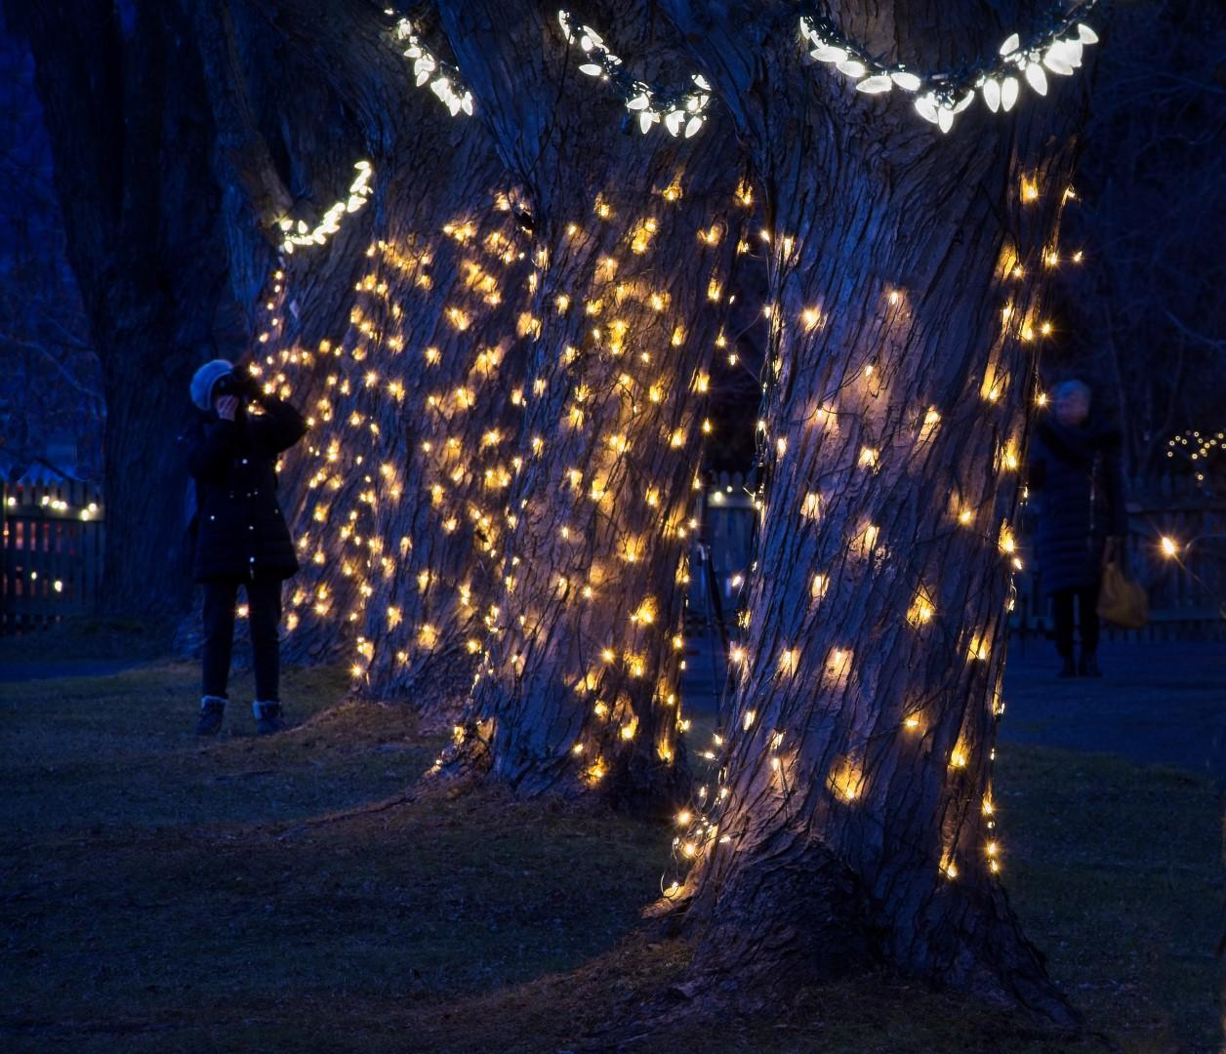
Chris Taylor

Slide 15
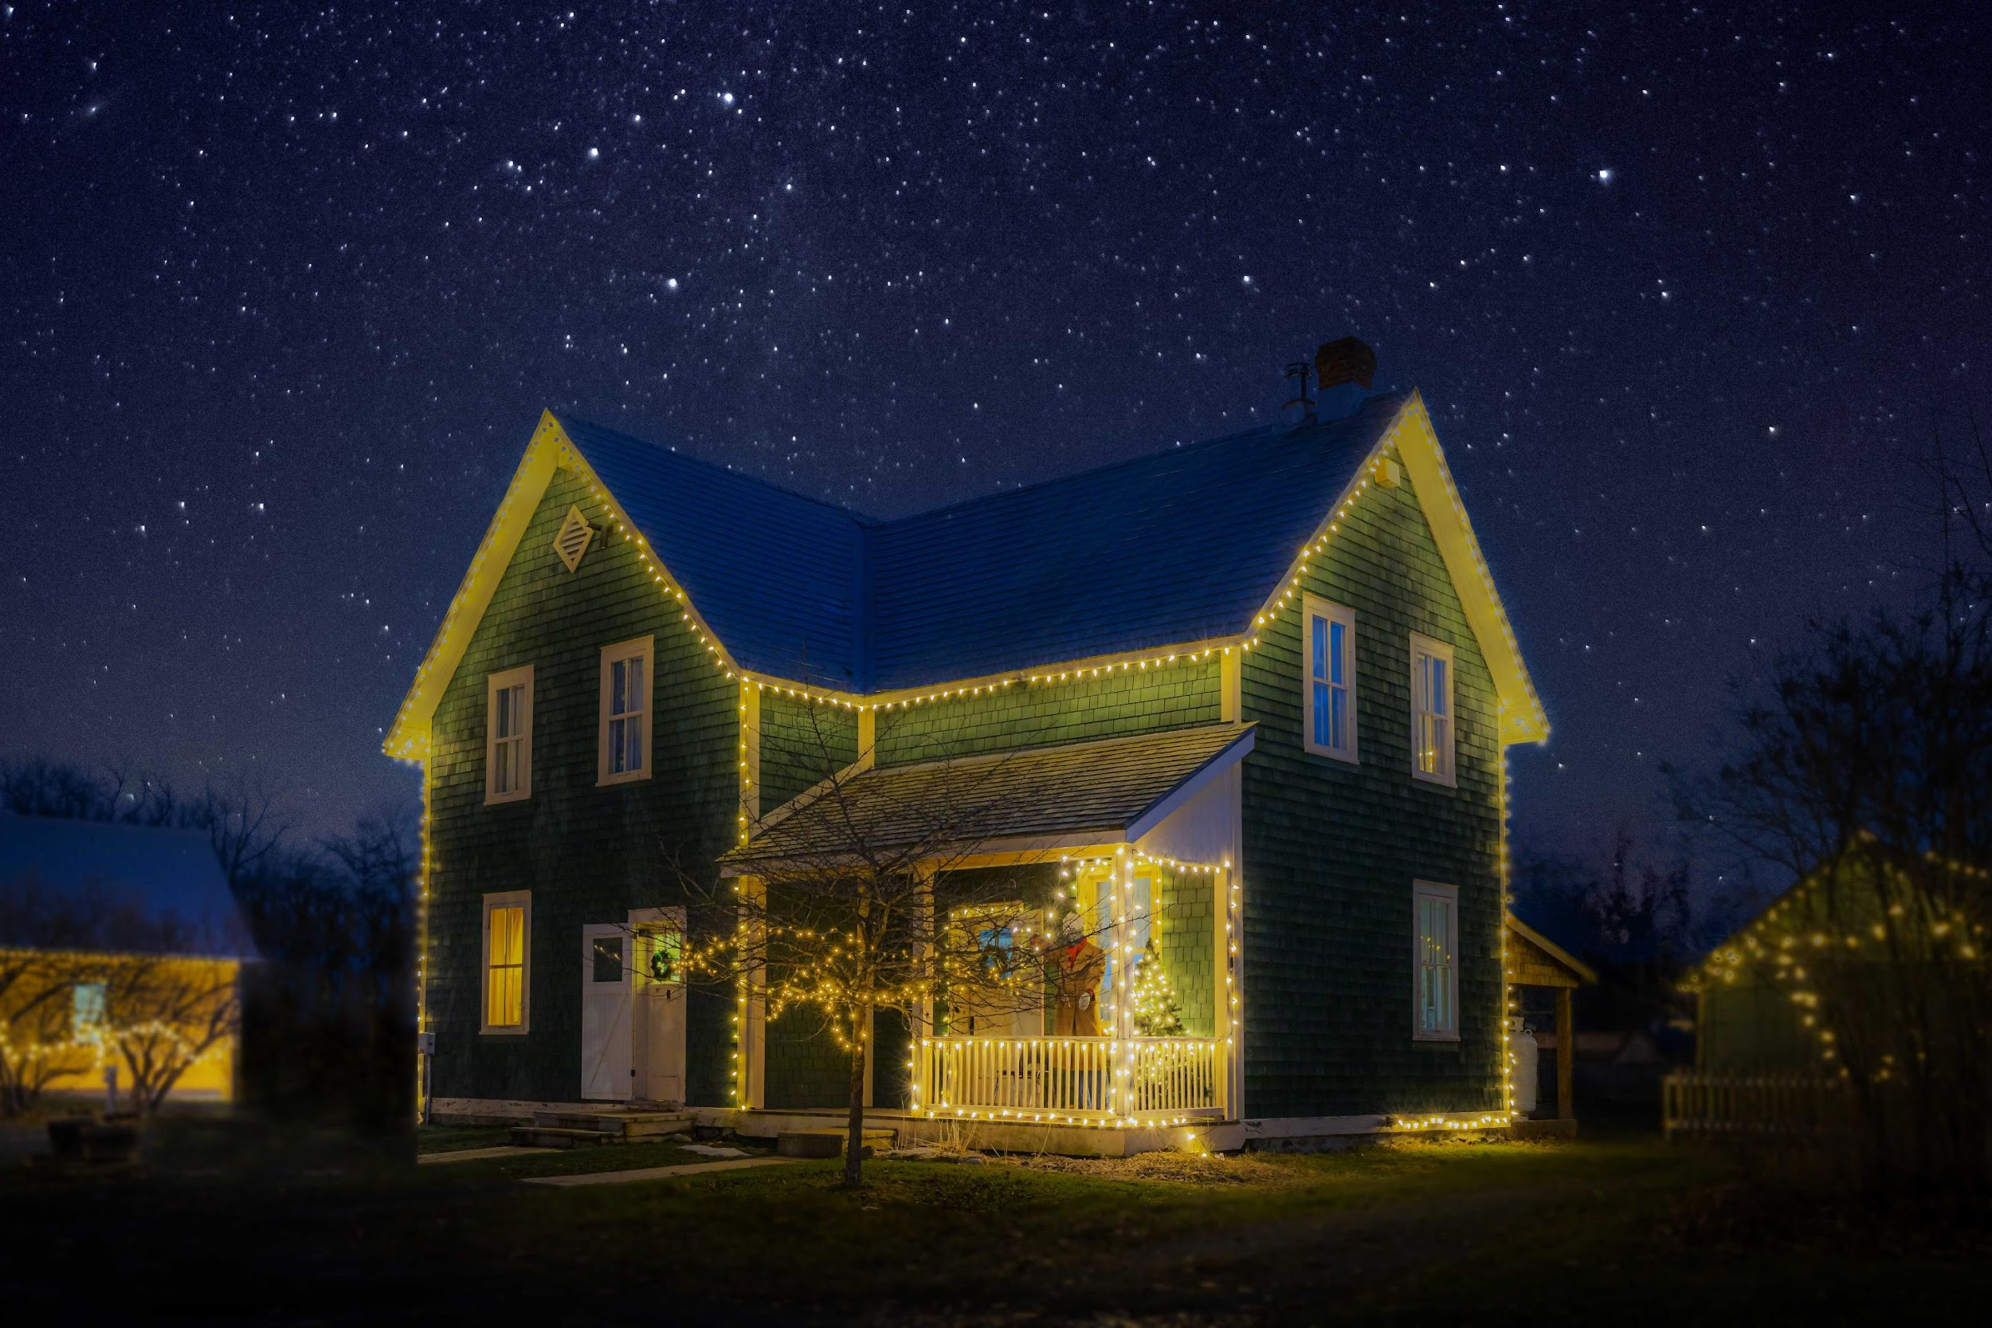
Jean-François Riel

Slide 16
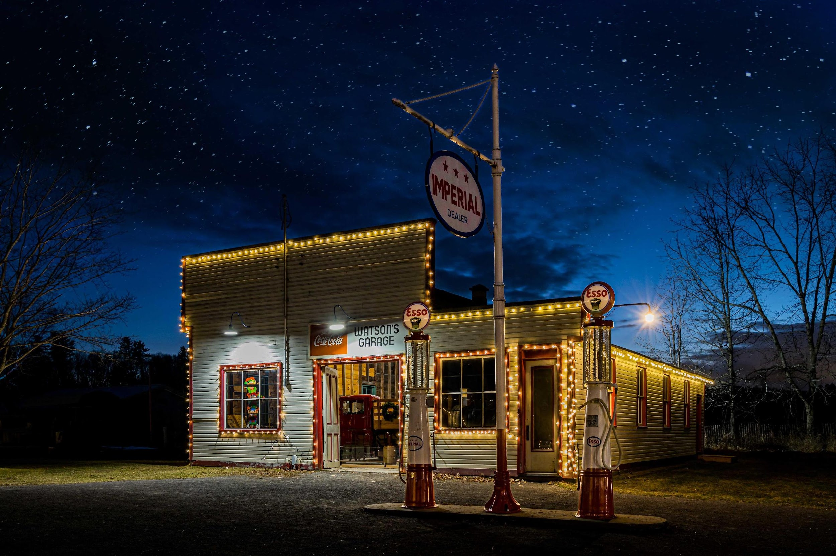
Jean-François Riel

Slide 17
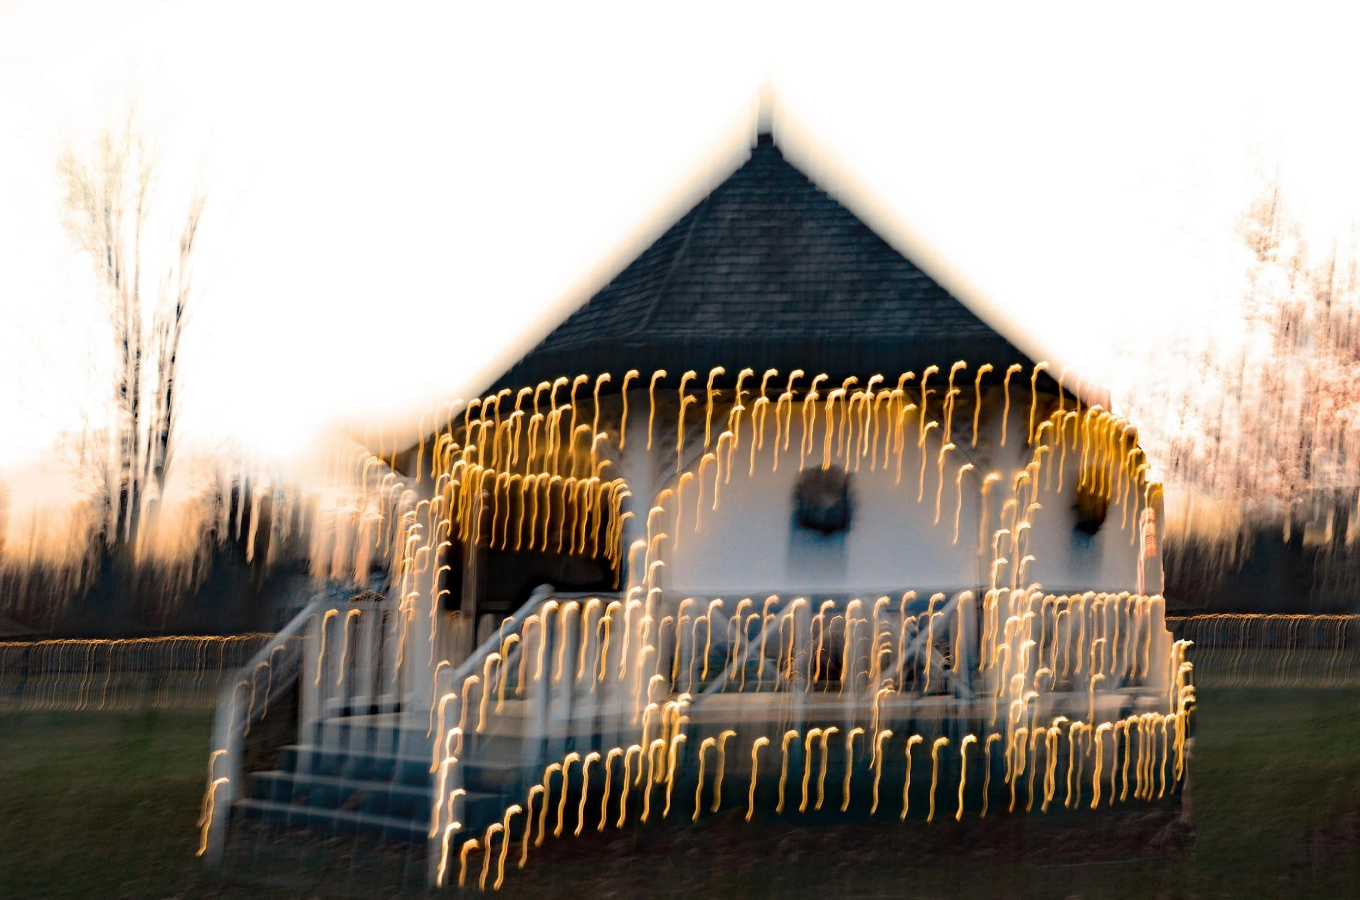
Sharon Fry

Slide 18
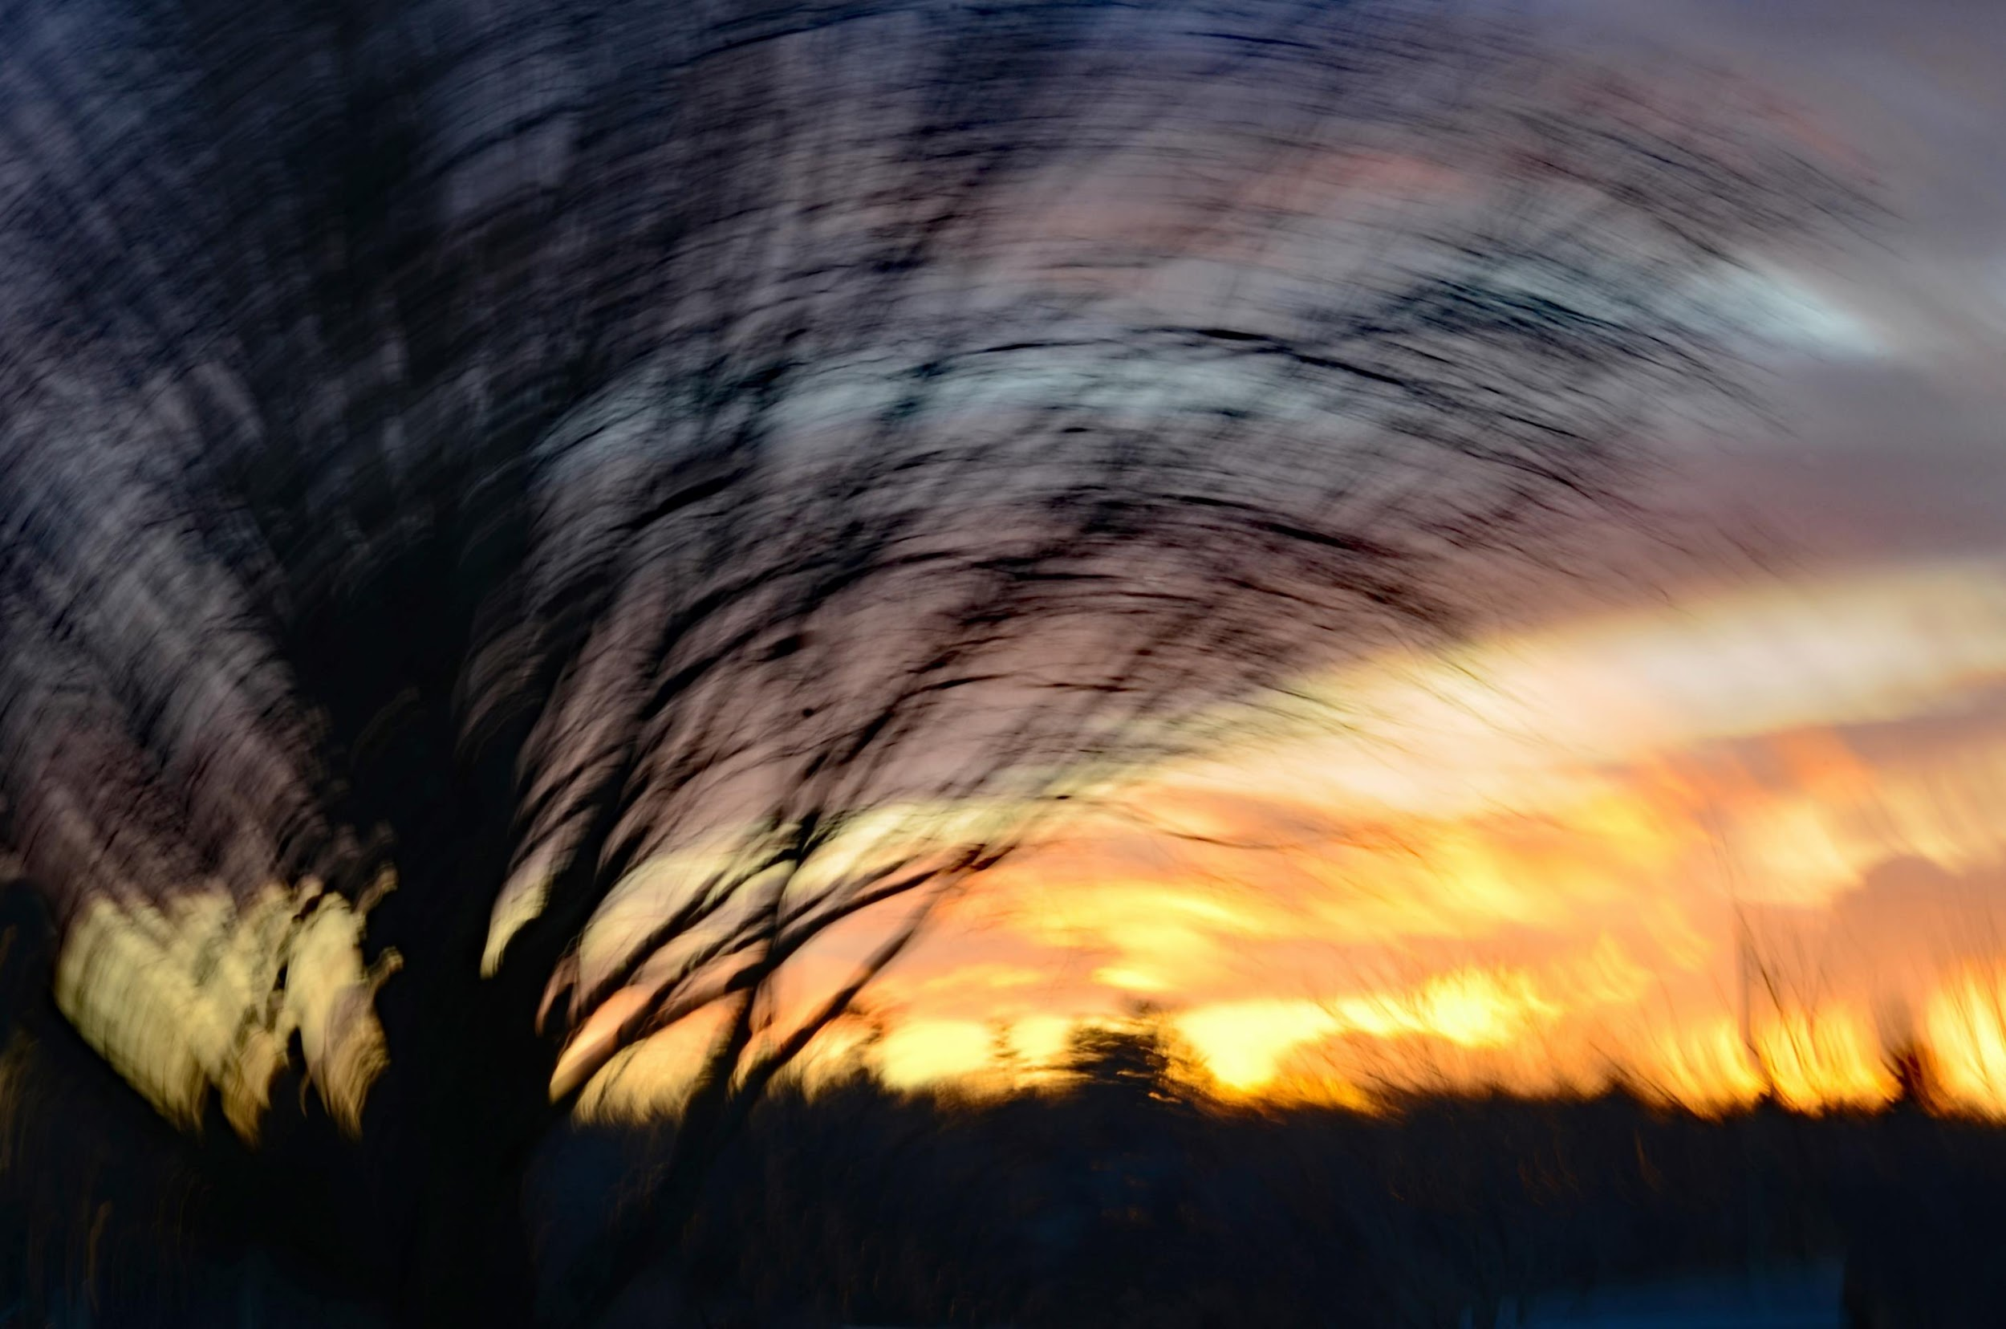
Sharon Fry

Slide 19
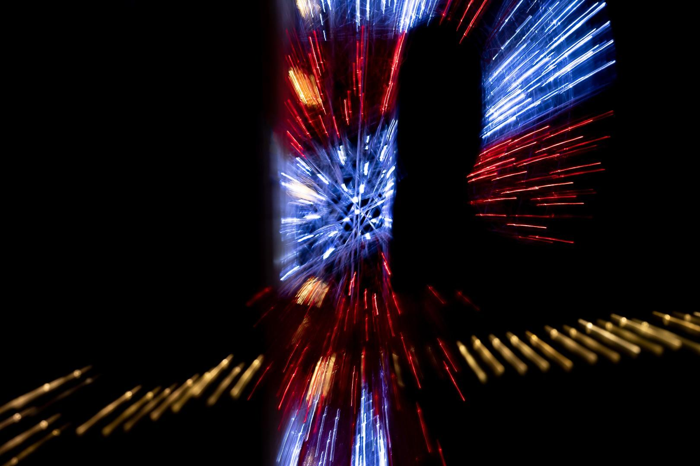
Johan Carignan

Slide 20
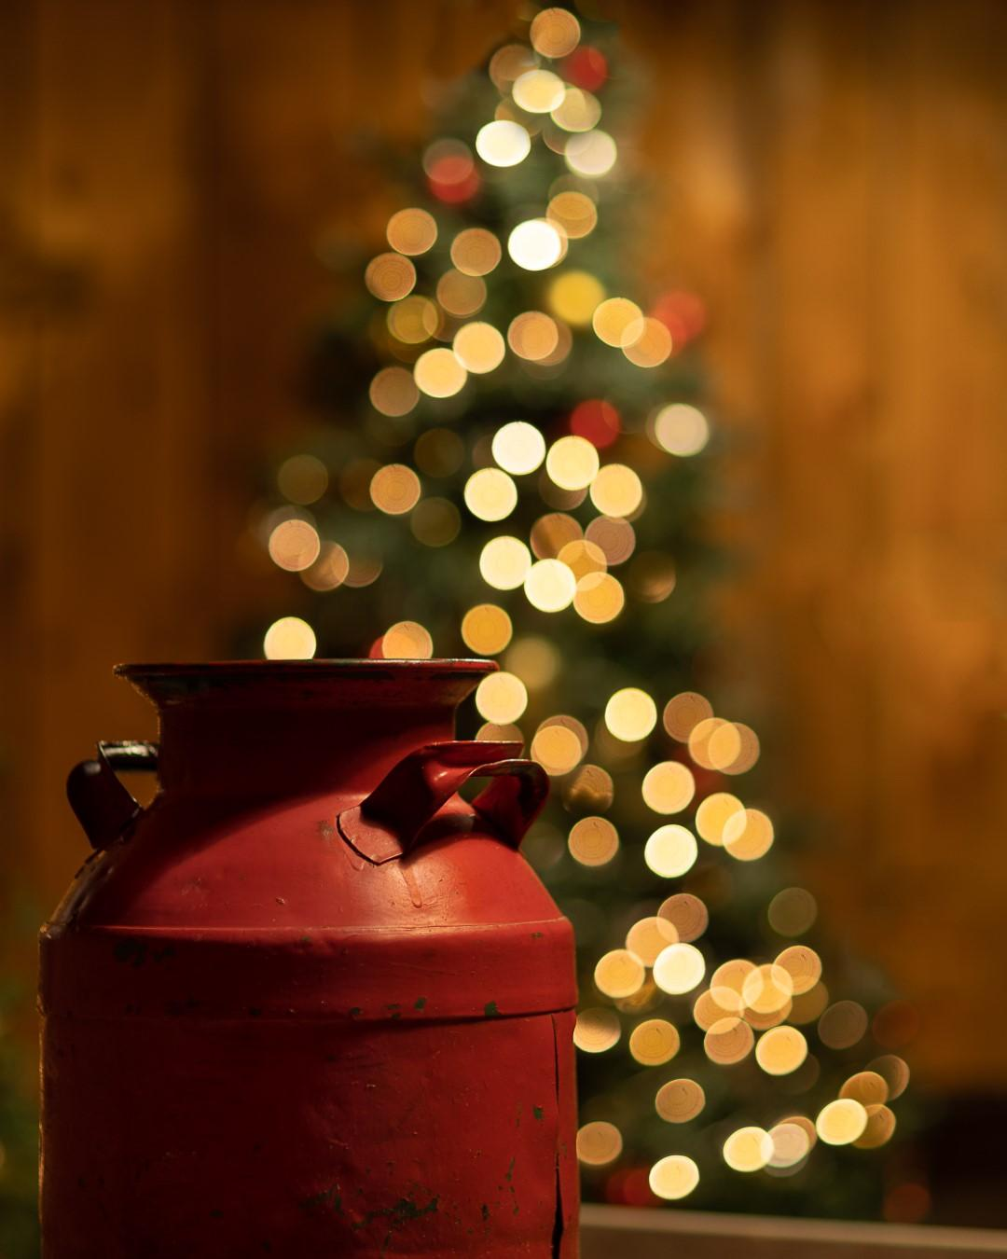
Johan Carignan

Slide 21
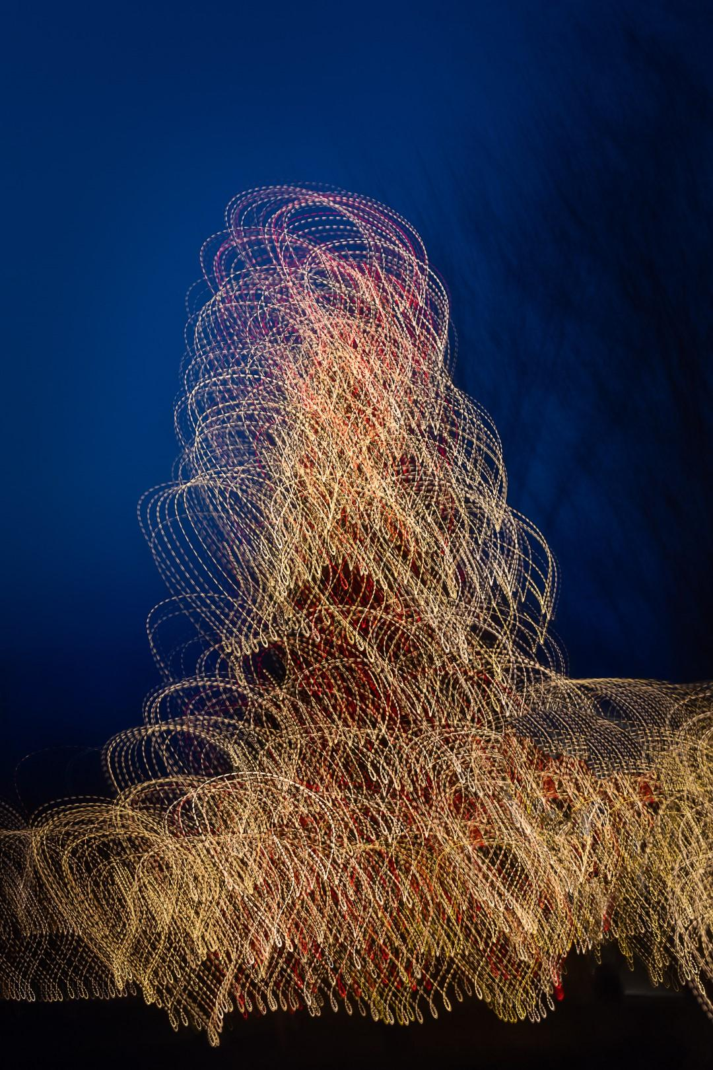
Johan Carignan

Slide 22
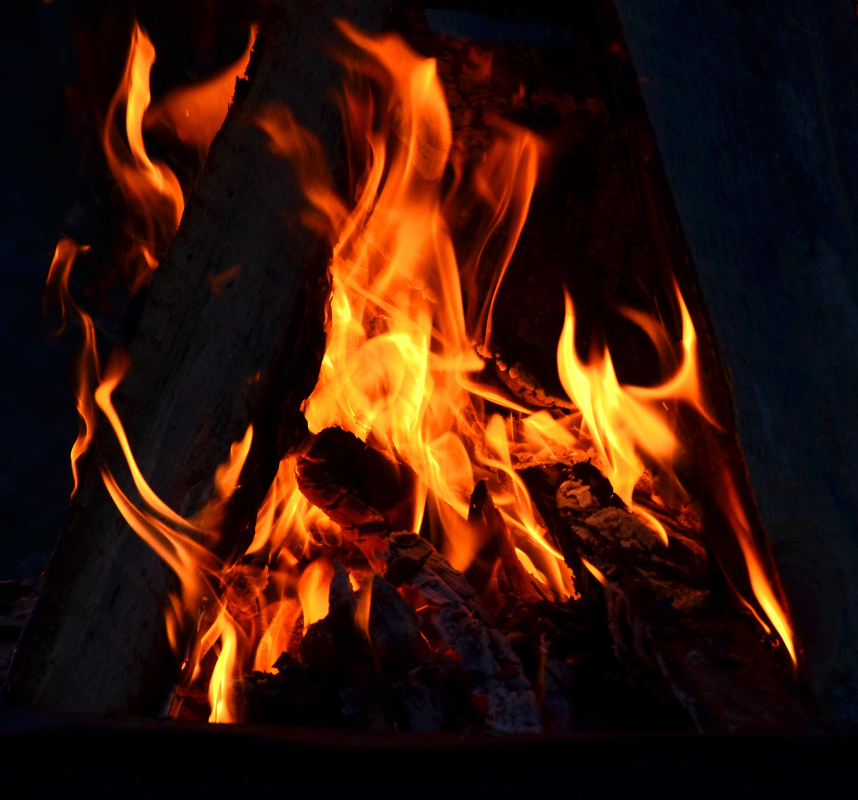
Donald Fry

Slide 23
Donald Fry

Slide 24
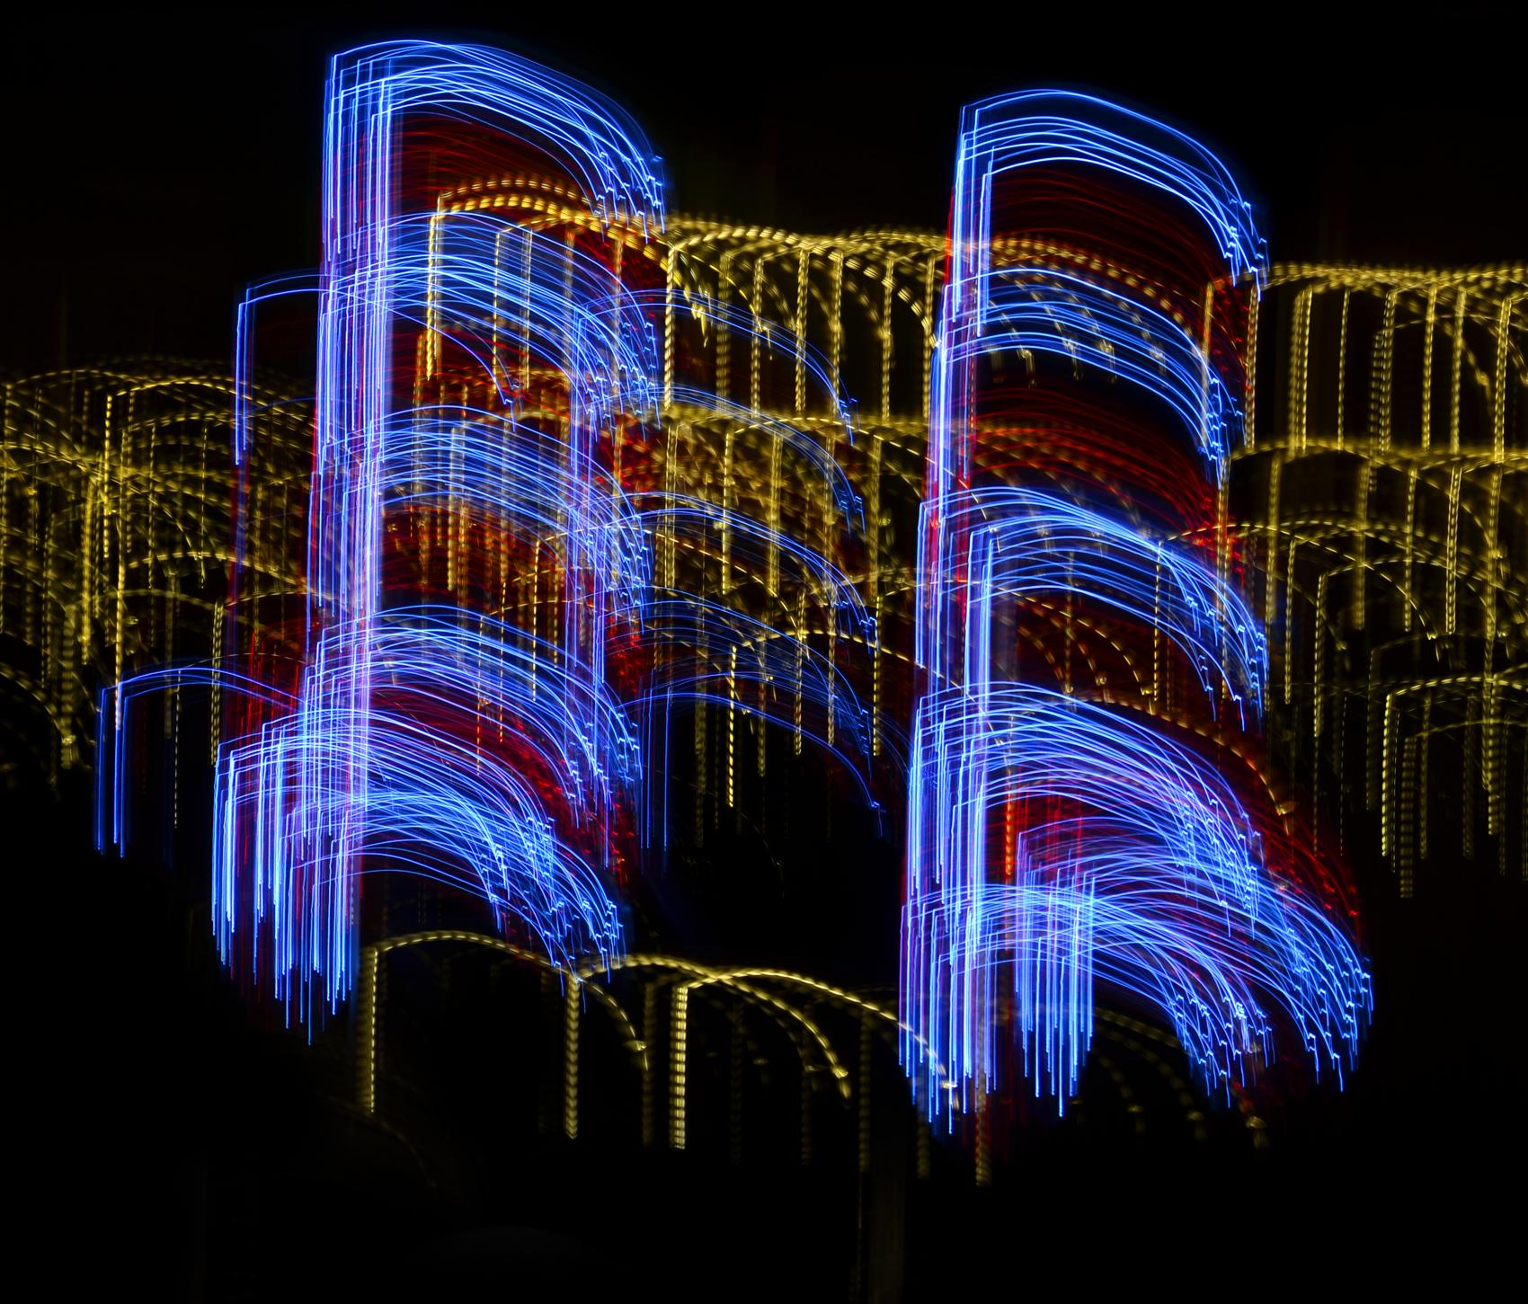
Donald Fry

Slide 25
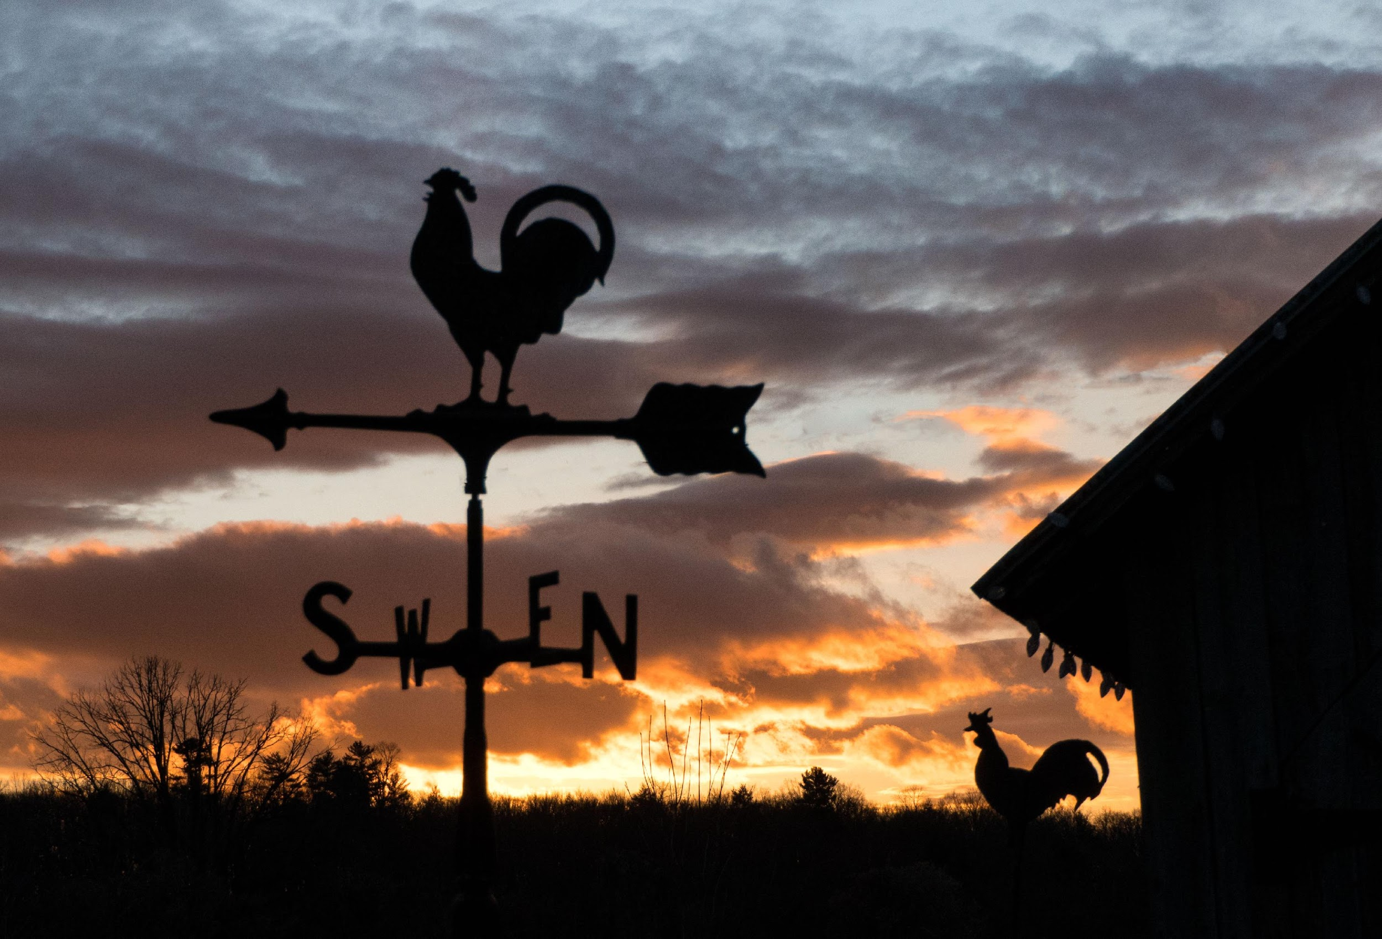
Alan White

Slide 26
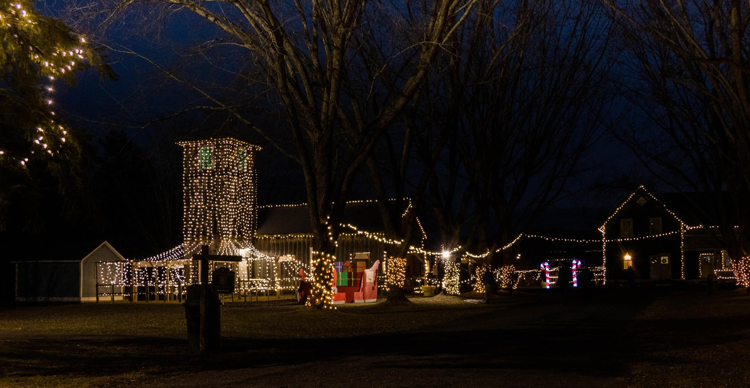
Alan White

Slide 27
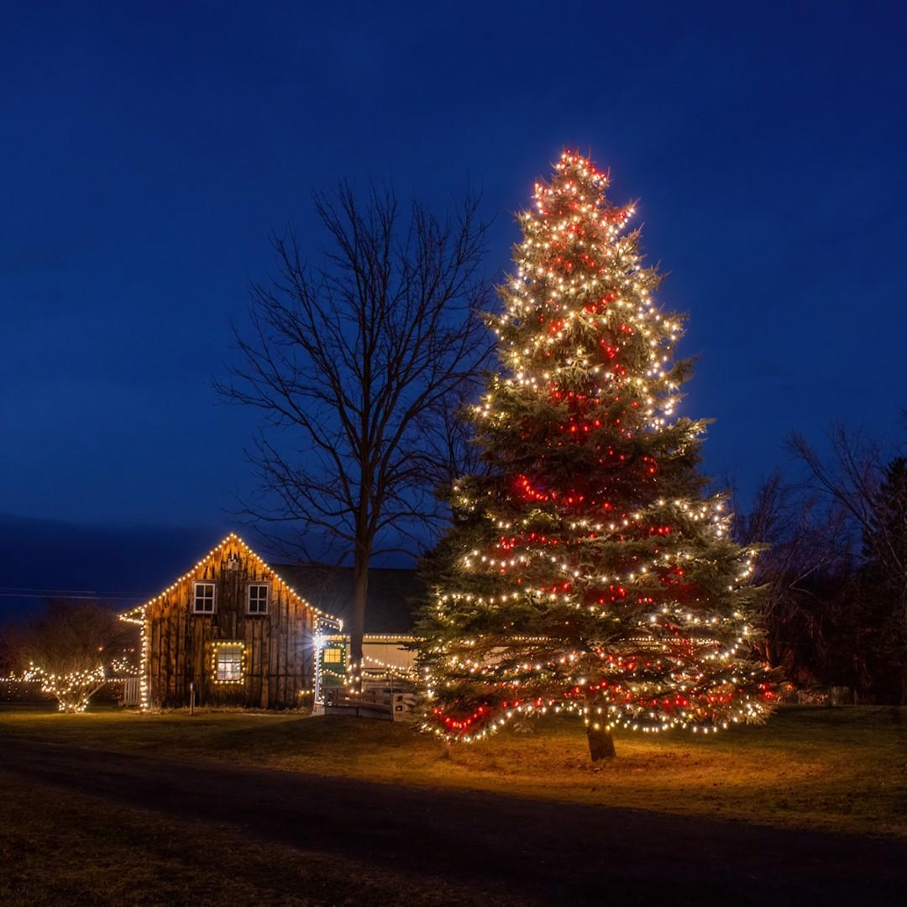
Marianne Pethke

Slide 28
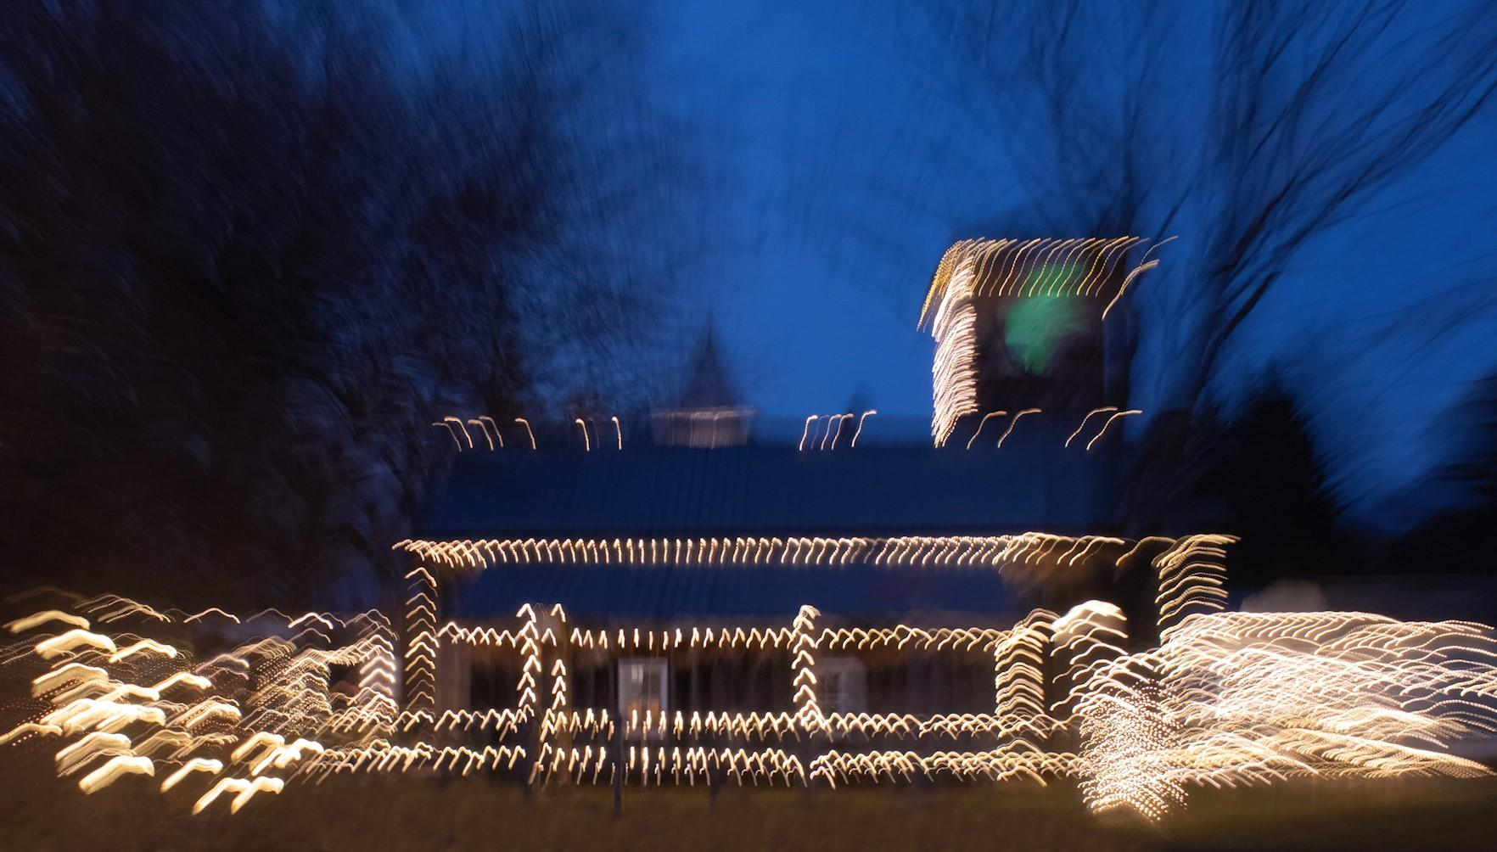
Marianne Pethke

Slide 29
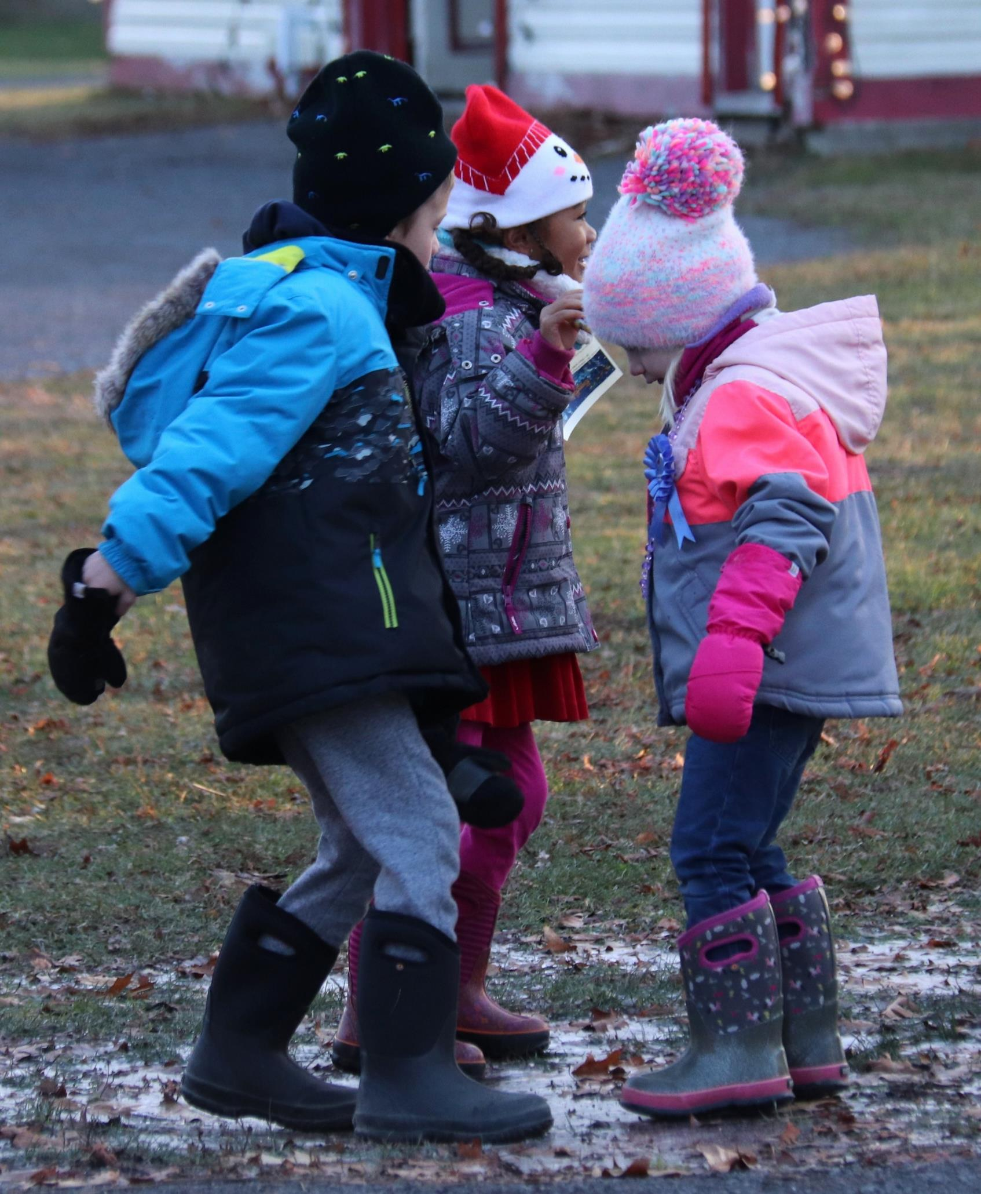
Lynda Buske

Slide 30
Lynda Buske

Slide 31
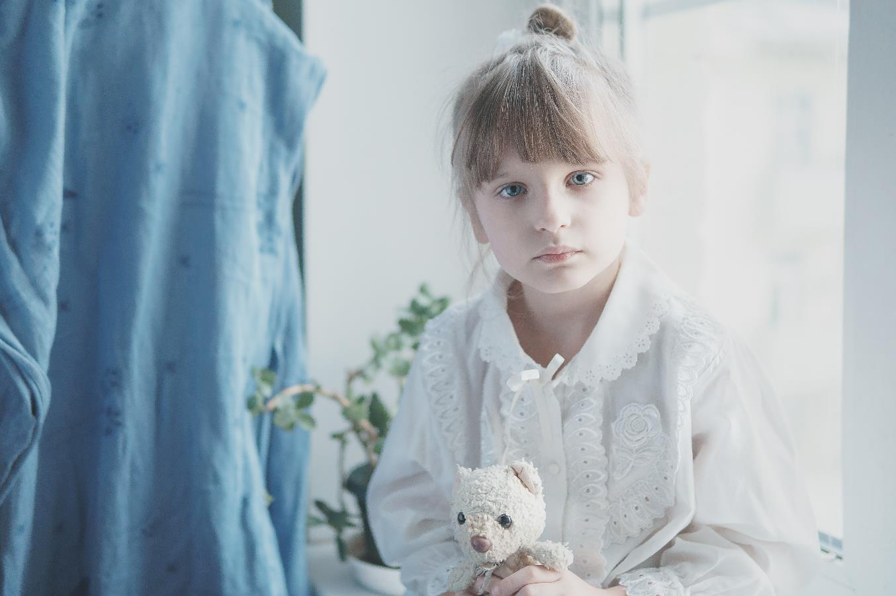
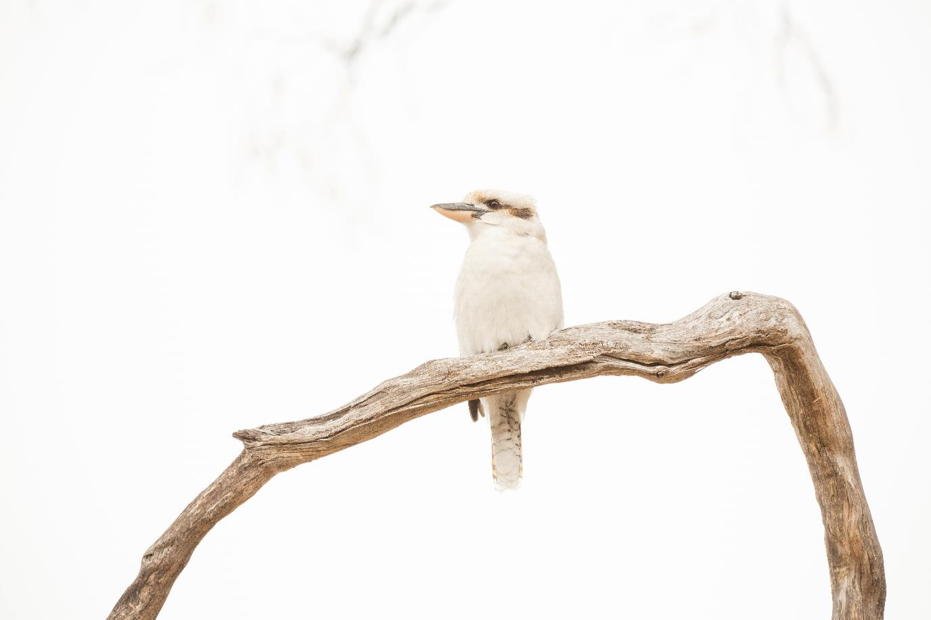
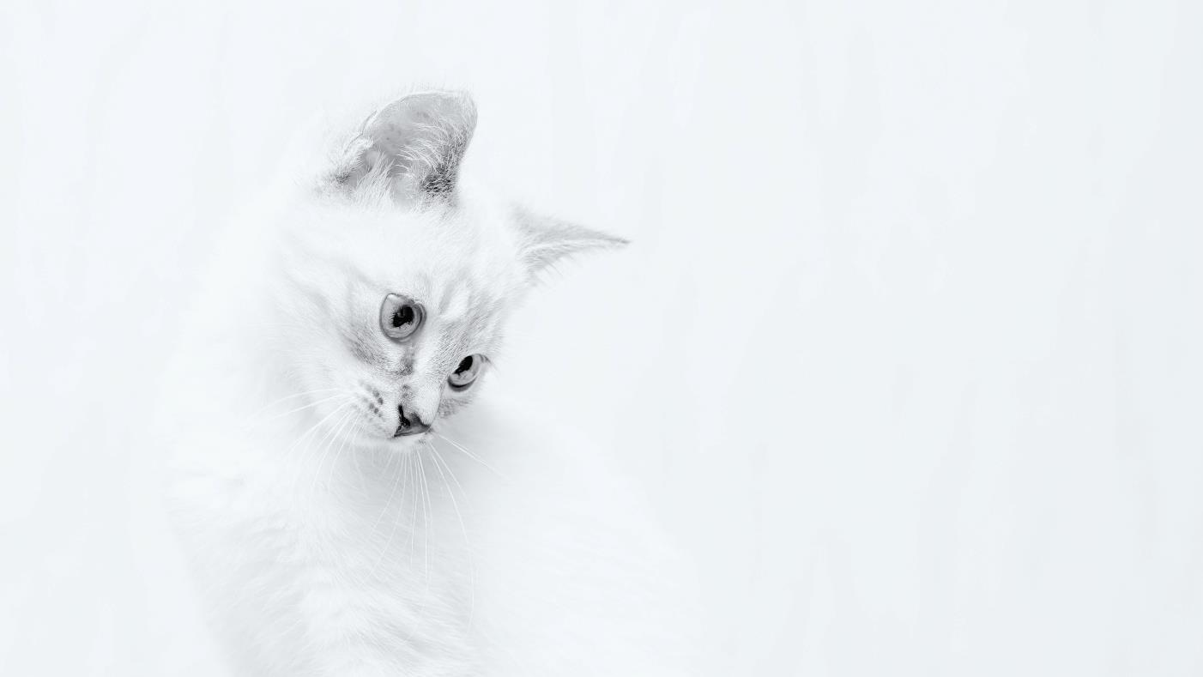
December Technique High key
A high-key image is one that is unusually bright with little or no dark shadows present.
Can create a mood and in particular, a positive or upbeat look.
Vitolda Klein on Unsplash
Lukasz Szmigiel on Unsplash
Matt Palmer on Unsplash

Slide 32
Technique – High key
Johan Carignan

Slide 33
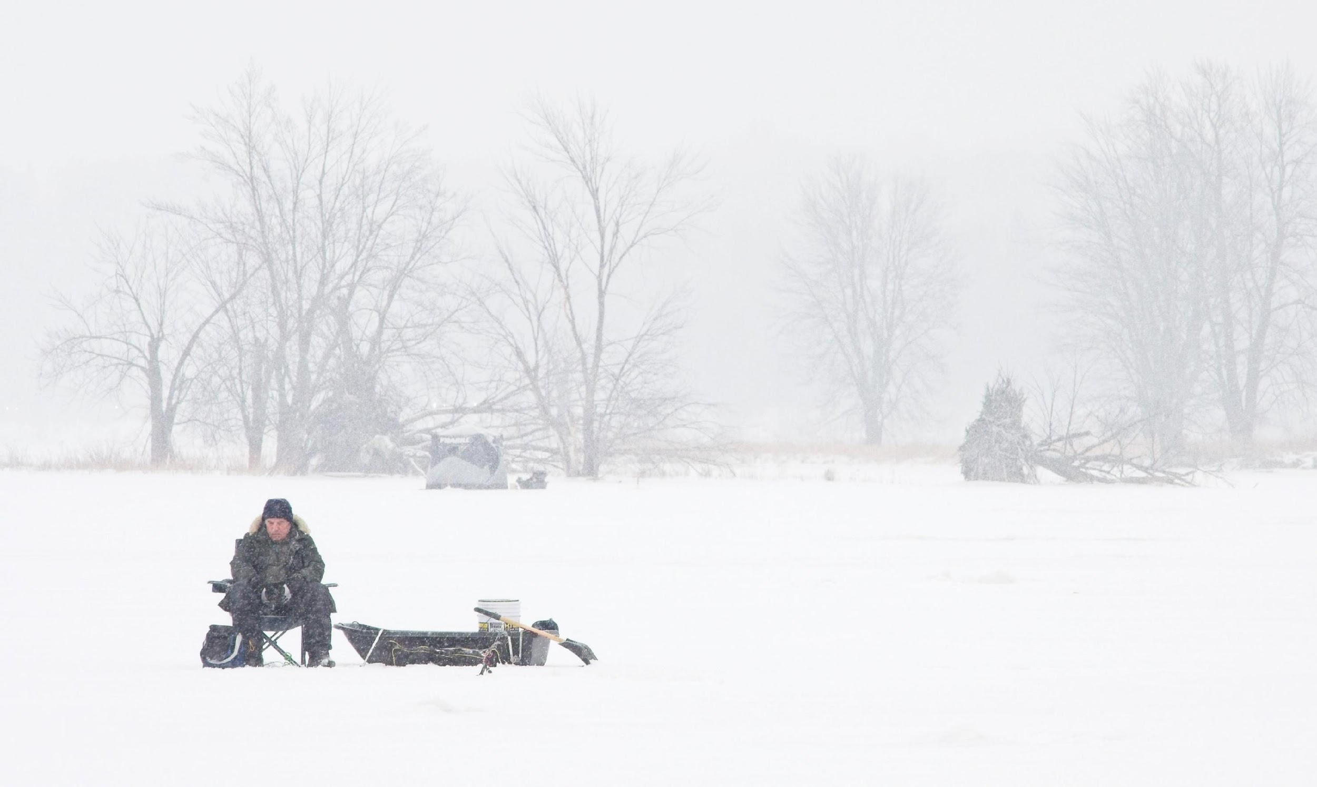
Chris Taylor

Slide 34
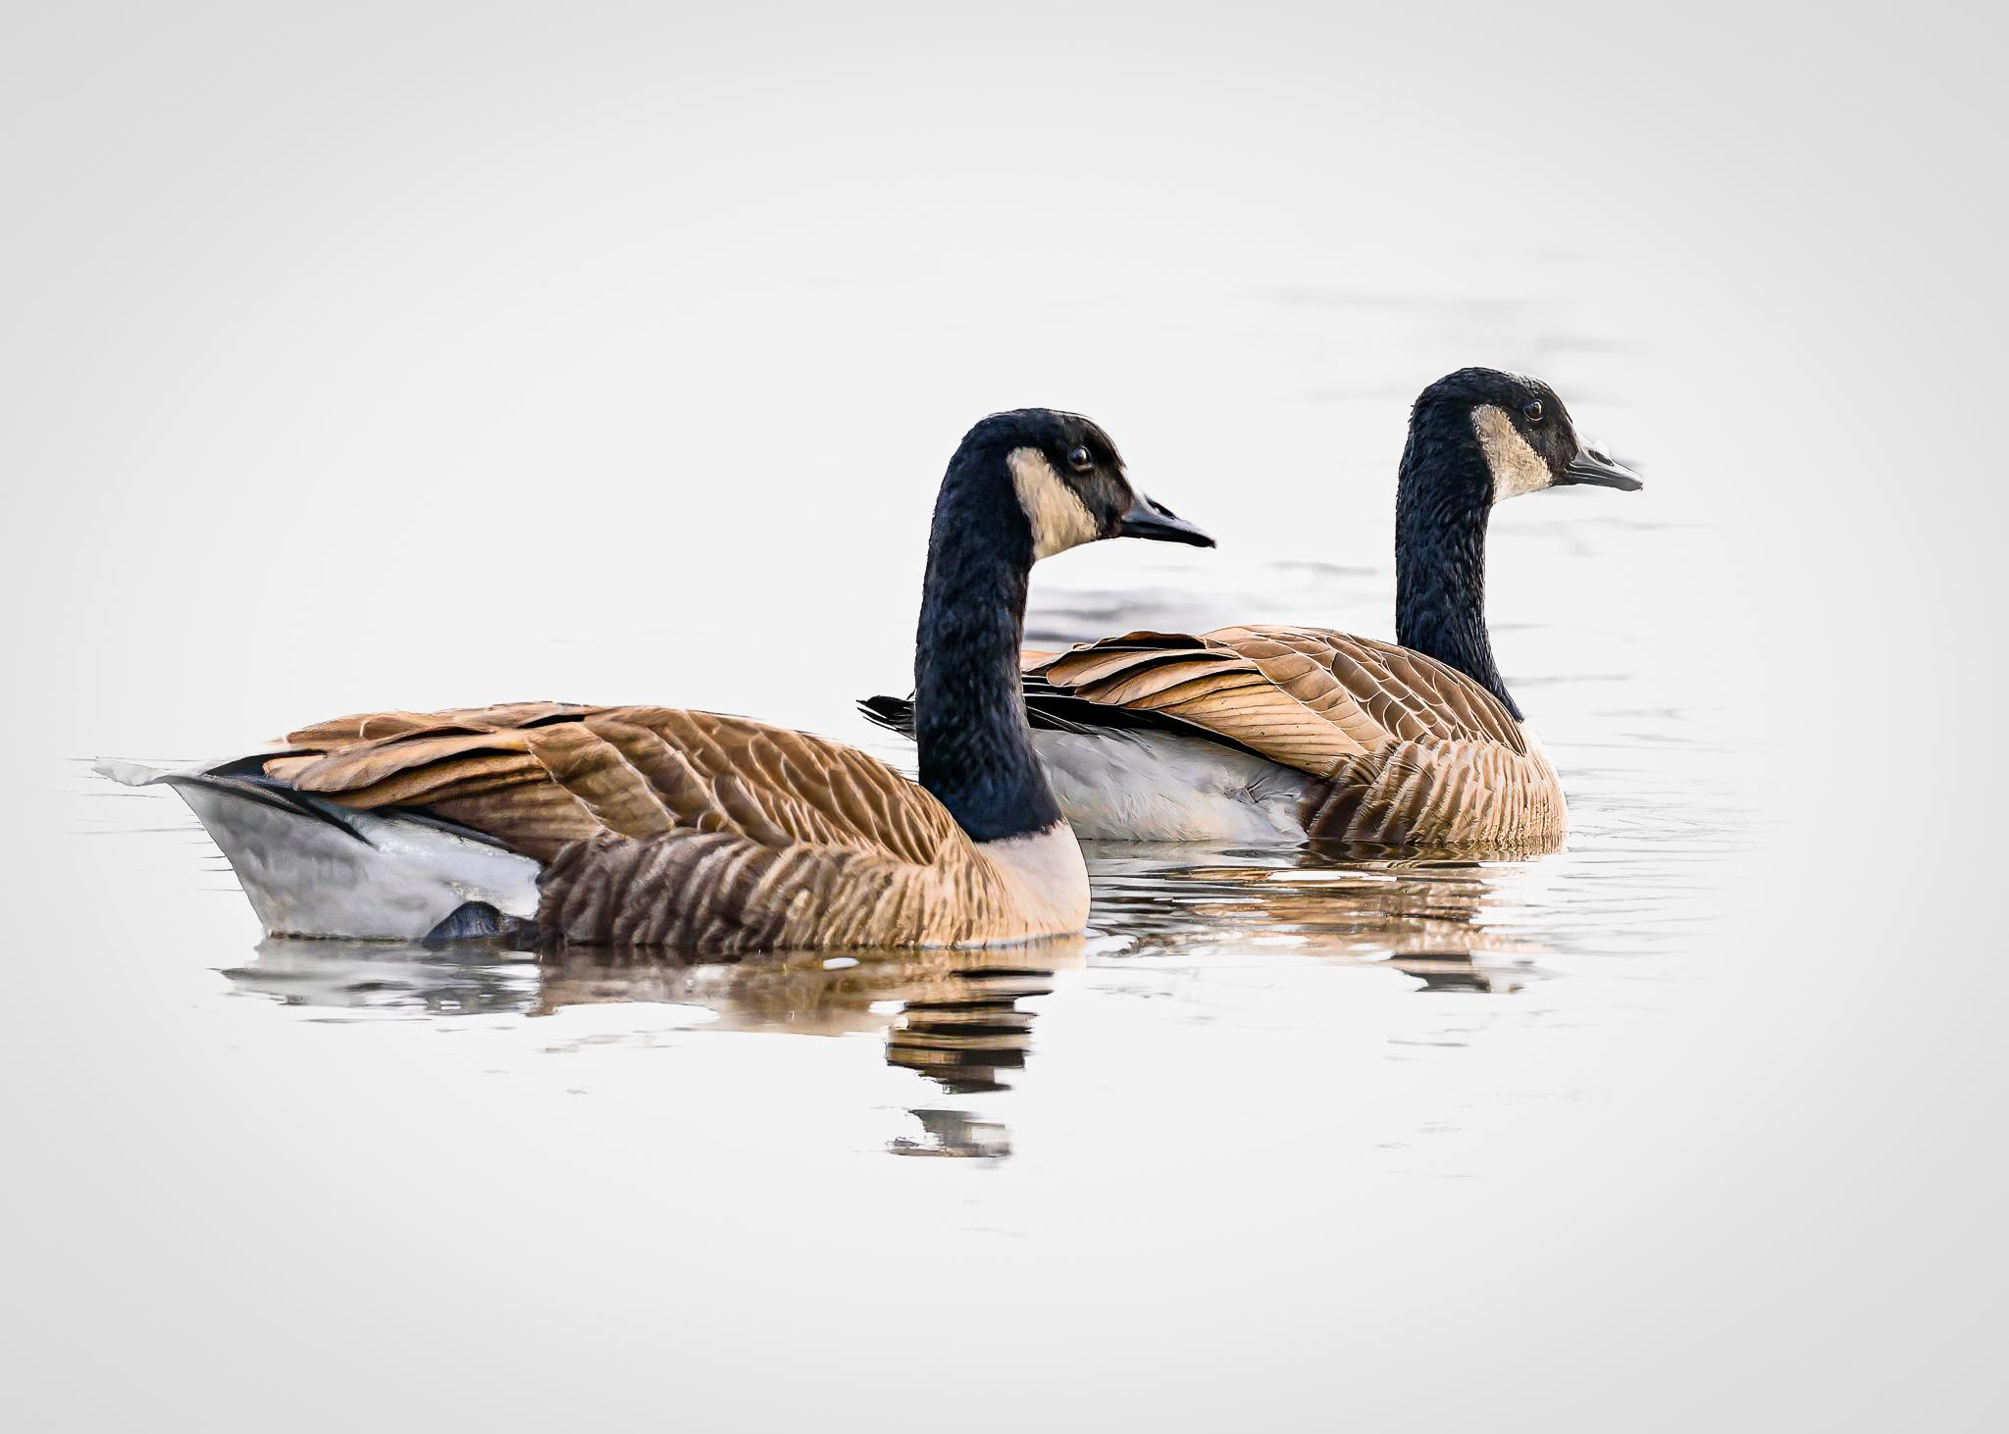
Yoline Joseph-Hoskin

Slide 35
Ramesh Chauhan

Slide 36
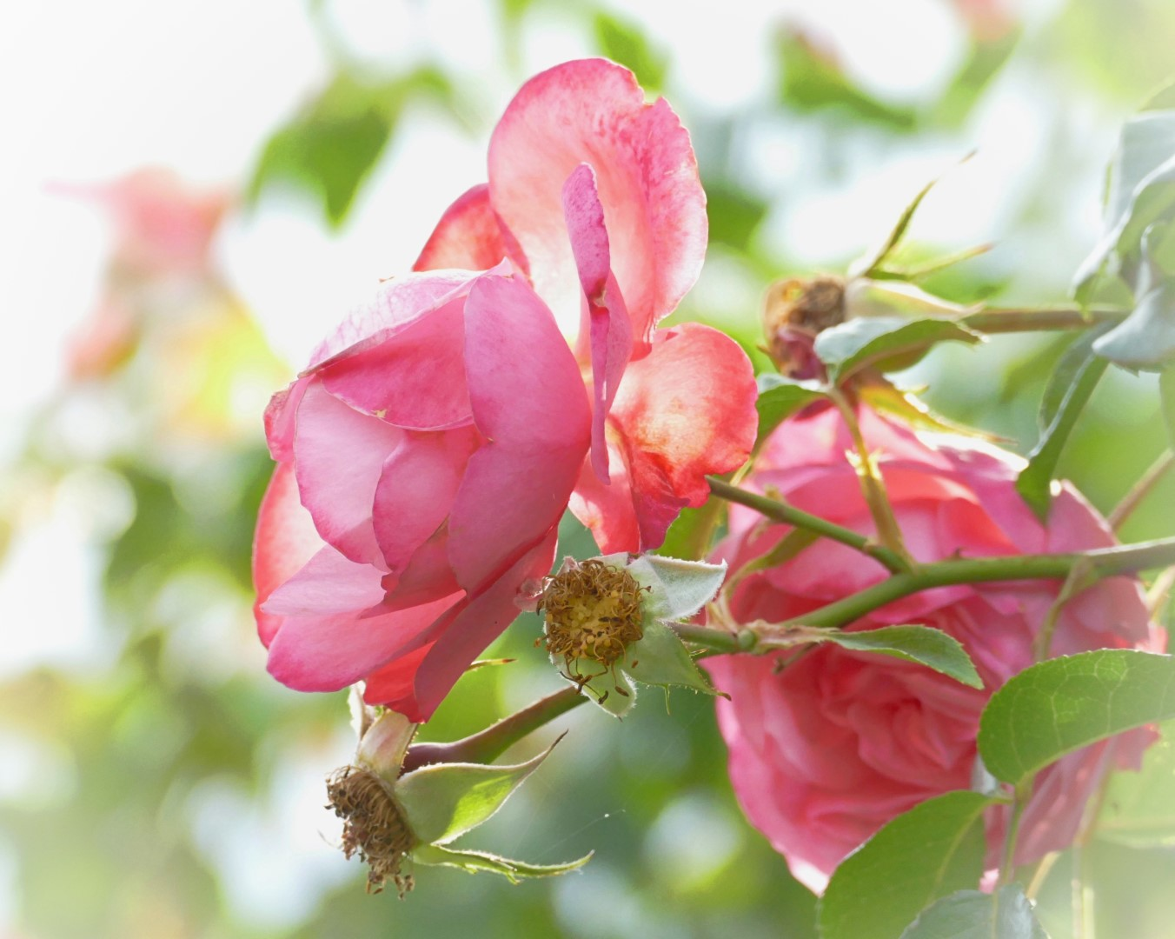
Lynda Buske

Slide 37
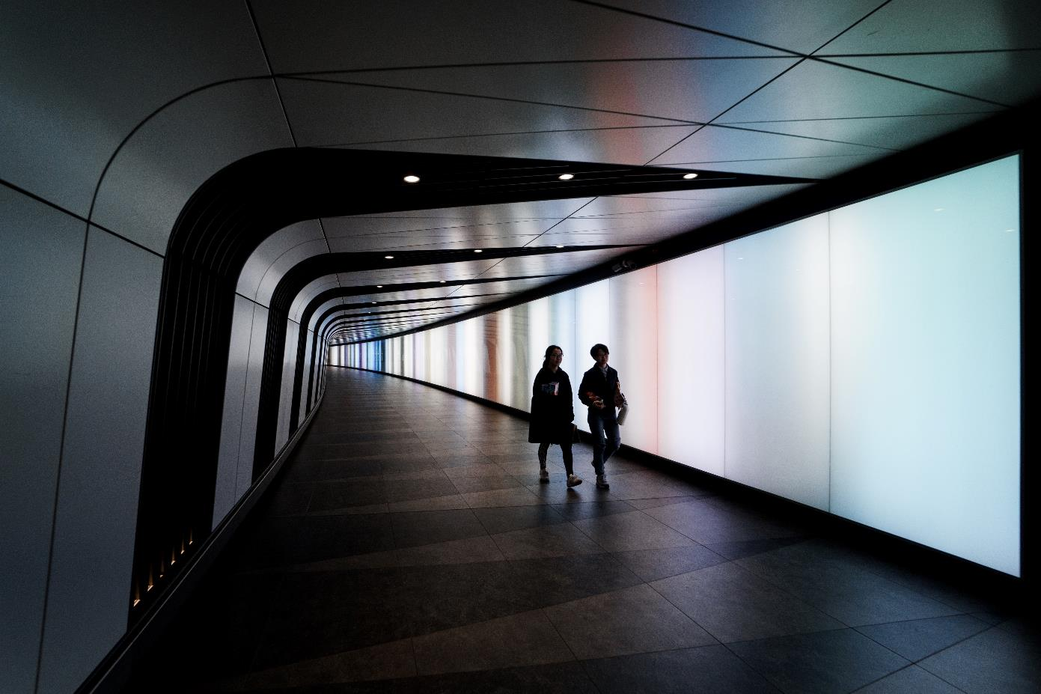
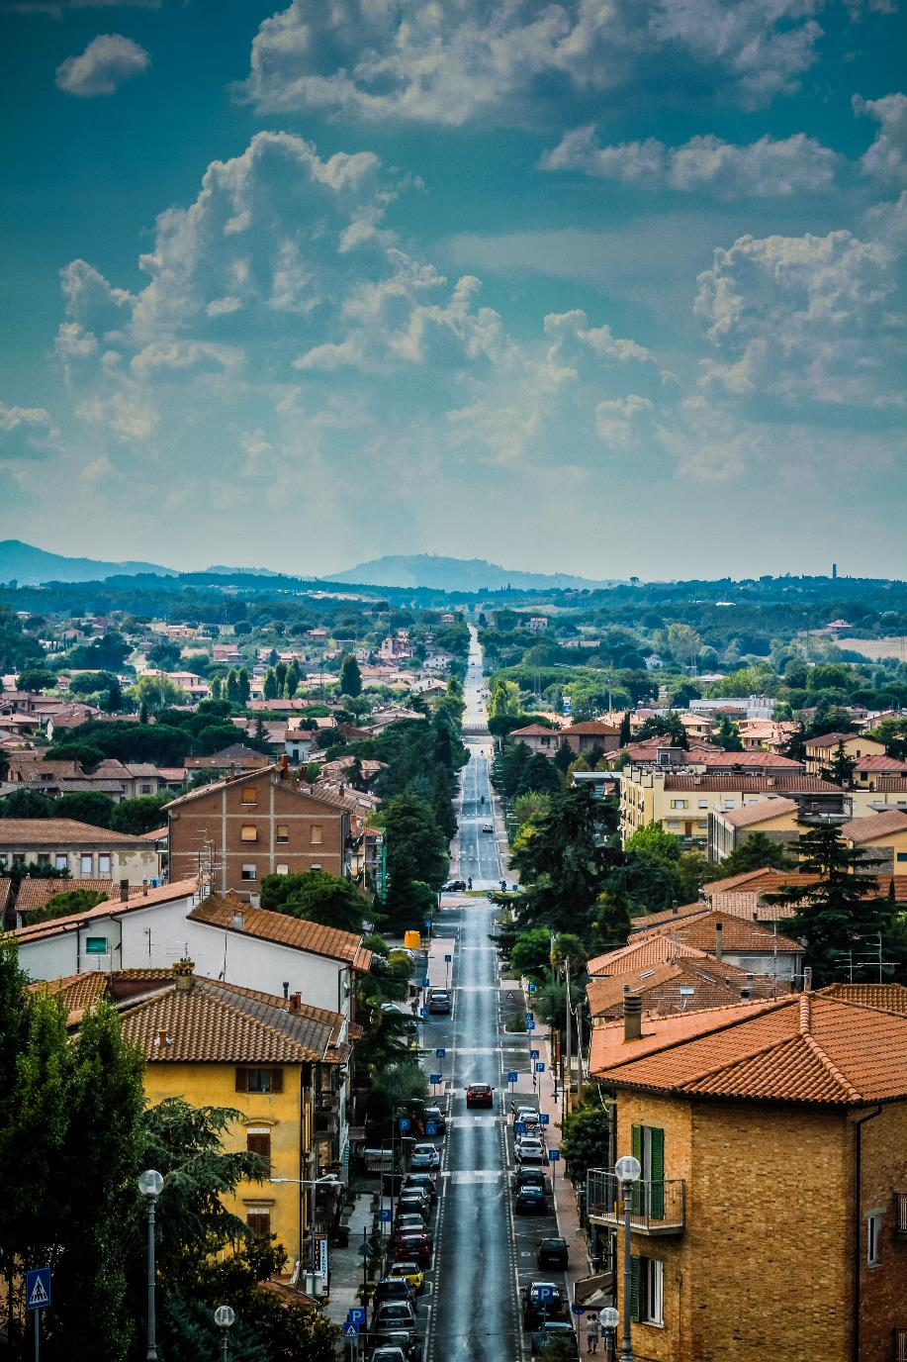
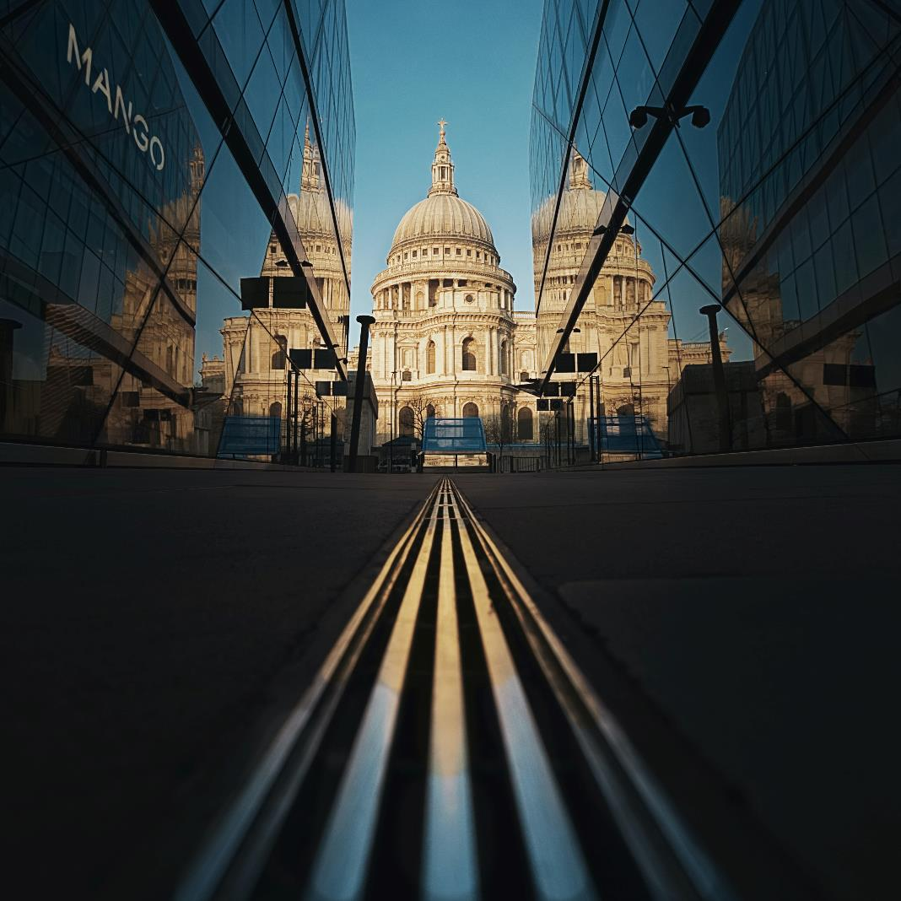
Jan 2023 Technique – Leading lines
Marcos Nieto, Unsplash
Sophie Dale, Unsplash
Leading lines are a compositional technique where human-made or natural lines lead the viewer's eyes through a photograph to the subject or the heart of the image.
Roman Fox, Unsplash

Slide 38
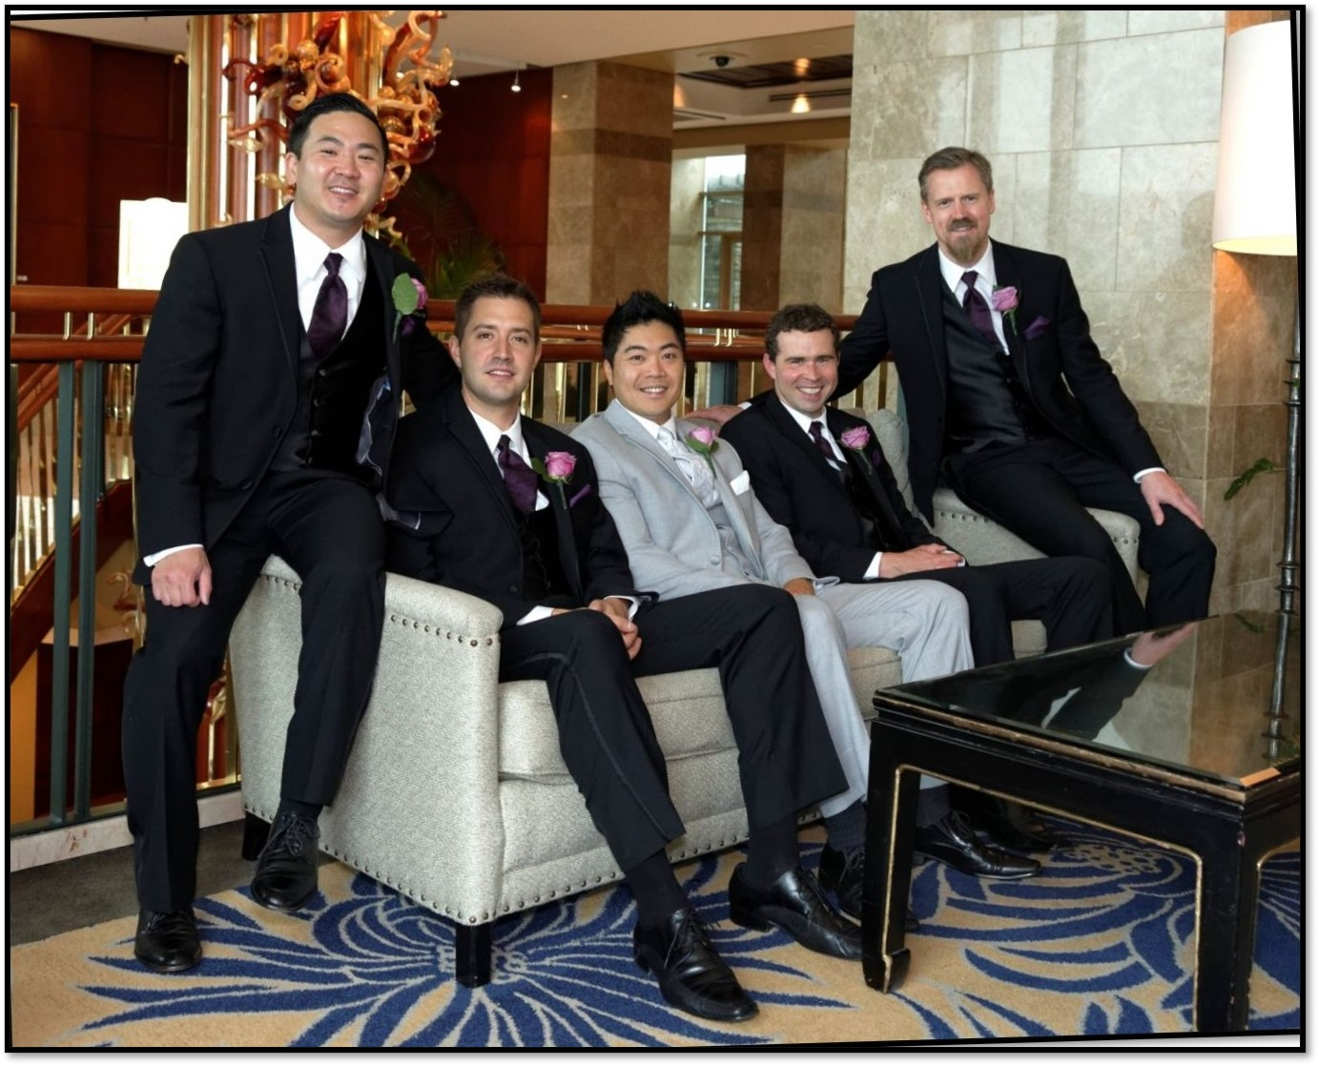
Photo 101; Taking group photos
Shoot from the corner of a couch, not in front.

Slide 39
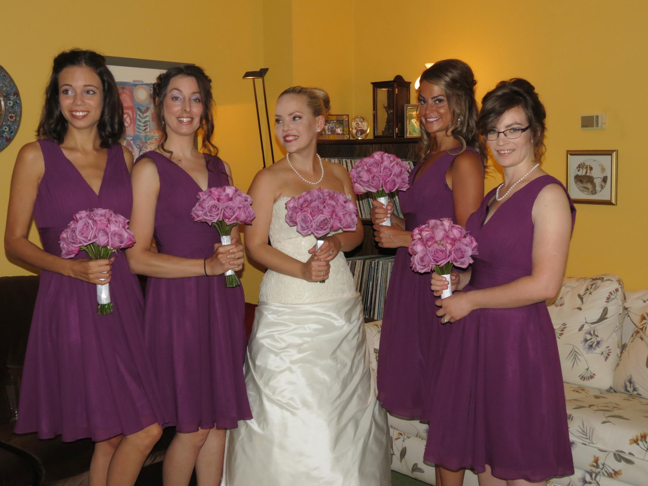
Not a great image
People looking in different directions
Large gaps between ladies
Cluttered background
Neither full length nor good crop.

Slide 40
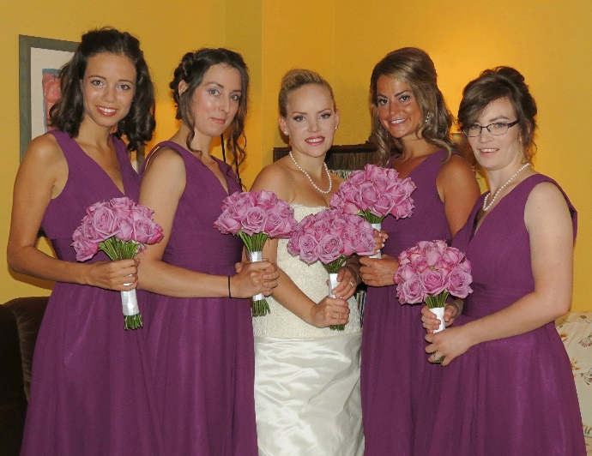
A better image
Have people angle their bodies and overlap a bit.

Slide 41
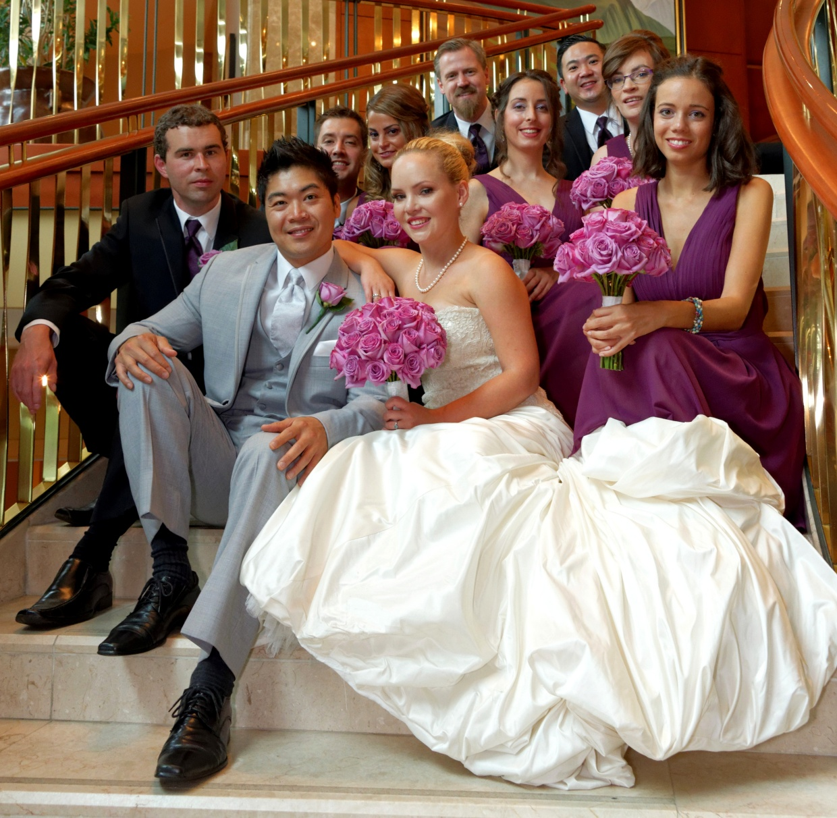
Use stairs if you have them since height differences are mostly in the legs.

Slide 42
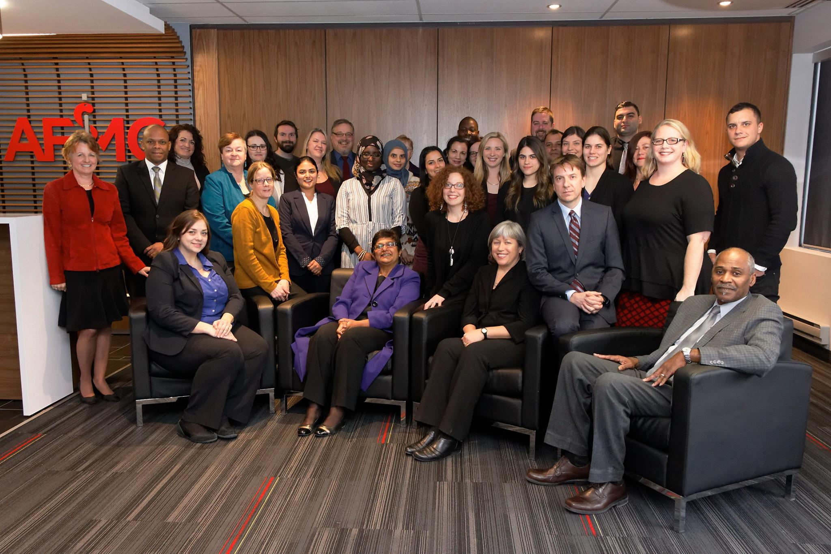
Count down to opening eyes

Slide 43
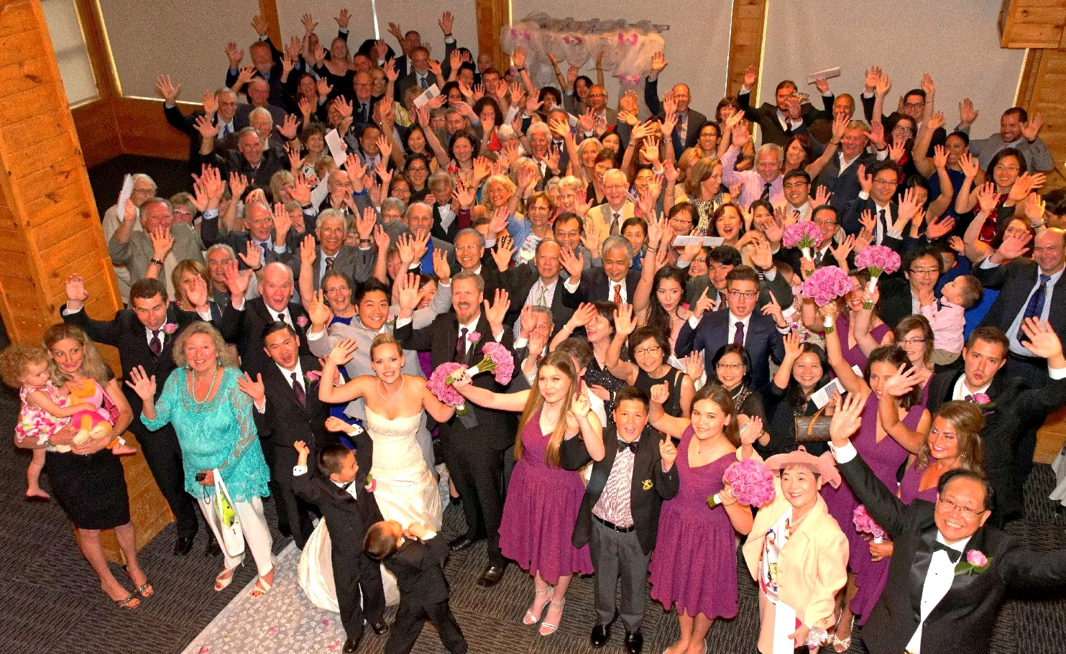

Slide 44
2022-23 Speaker and Topics Schedule Programs Director; Marianne Pethke Competitions Director; Lynda Buske

Slide 45
CPOPC on Twitter Vice President; Chris Taylor
@OrleansPhotoClb
We now have a Twitter account
@CPOPC was taken
We will tweet 3 or 4 times a month
upcoming challenges and competitions
meeting announcements
other items likely to be of interest to members
https://twitter.com/OrleansPhotoClb
NOTES; Newsletters will continue as before
Challenge and Competition winners will be posted on our Facebook page
Twitter wouldn’t let us have a “u”

Slide 46
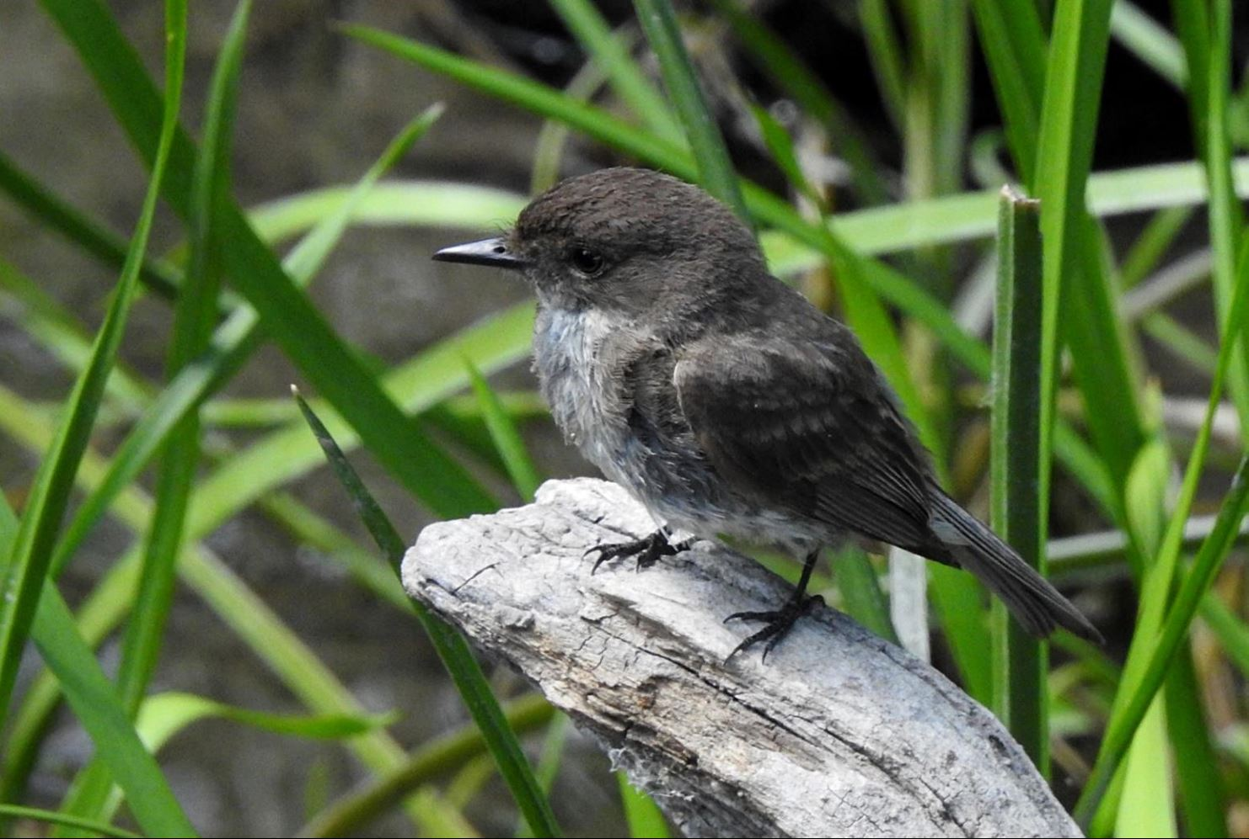
Notices – December 2022
FOR FRANCOPHONES ONLY
Le MIFO lance un appel aux artistes visuels francophones de la région de la capitale nationale et de l'Est ontarien (professionnels et semi-professionnels) pour des soumissions d’expositions pour 2023-2024. Est-ce que des artistes francophones de votre réseau seraient intéressés? Les artistes intéressés peuvent soumettre leur candidature sur le mifo.ca d’ici le 15 janvier 2023. Au plaisir d’exposer vos artistes dans notre galerie! Amélie Lafrance Coordonnatrice artistique 613 830-6436, poste 288 | Cellulaire : 613 808-7387 alafrance@mifo.ca | MIFO.CA
Diane Cummings

Slide 47
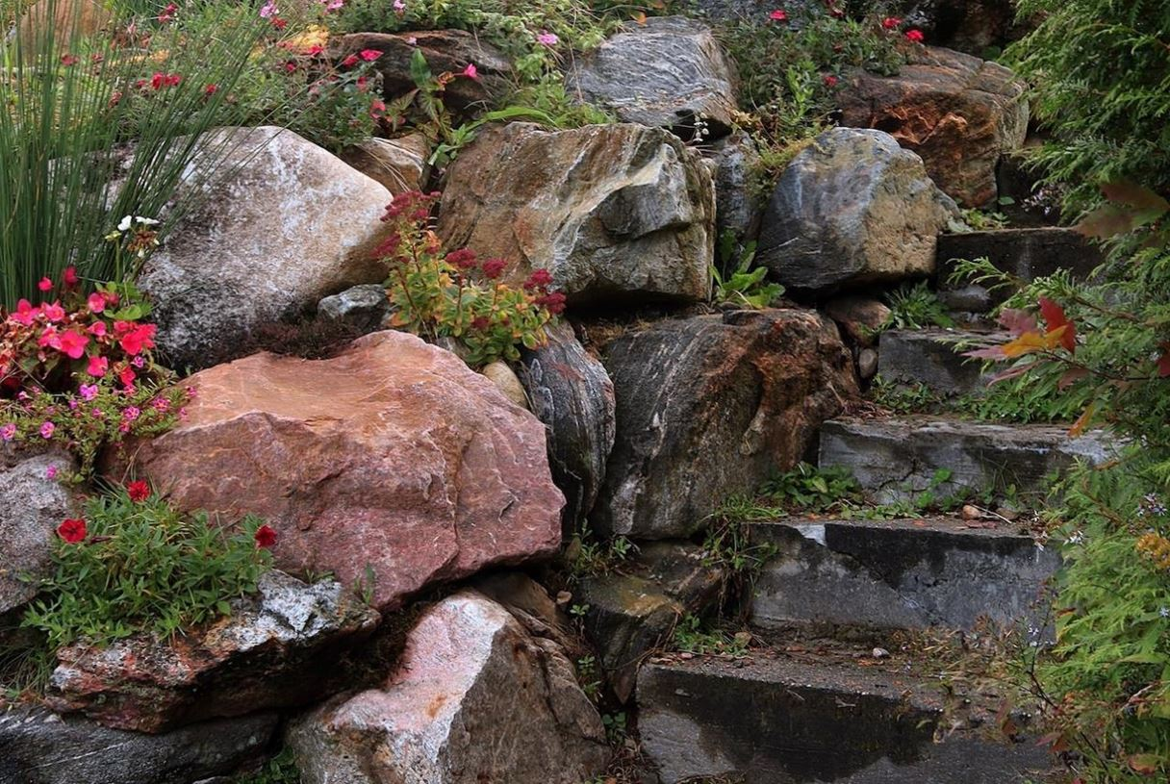
Notices – December 2022
NEW TOPICS ADDED TO OUR RESOURCES PAGES ON THE WEBSITE
Chris Taylor has added the following pages;
5 Recipes for using Curves in post-processing, by Scott Davenport – Editing, general + Tips and Tricks + Tutorials
How to ensure a print has no area with no ink, by Scott Davenport – Editing, general + Tips and Tricks + Tutorials
A lesson In Storytelling for Better Landscape Photography(Podcast) - Editing, general + Tips and Tricks + Tutorials
Landscape Photography for Beginners: A Comprehensive Guide- Editing, general + Tips and Tricks + Tutorials
Christine Martel

Slide 48
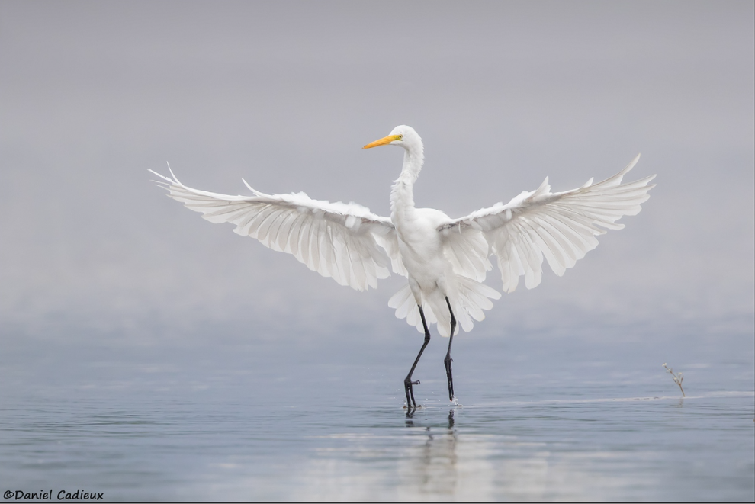
Next Meetings
17 December, Social and Pot Luck Lunch
Queenswood Heights Community Centre, 10.30 to 1pm
14 January, Club Meeting on Zoom, 9.30am to 12 noon
Wildlife photography with Daniel Cadieux
Challenge – Urban Life
Technique – Leading Lines
Photo 101 – Compression (redux)
Daniel Cadieux
https://www.dancadphotography.com/

