Slide 1
CPOPC March 2023
March 11, 2023

Slide 2
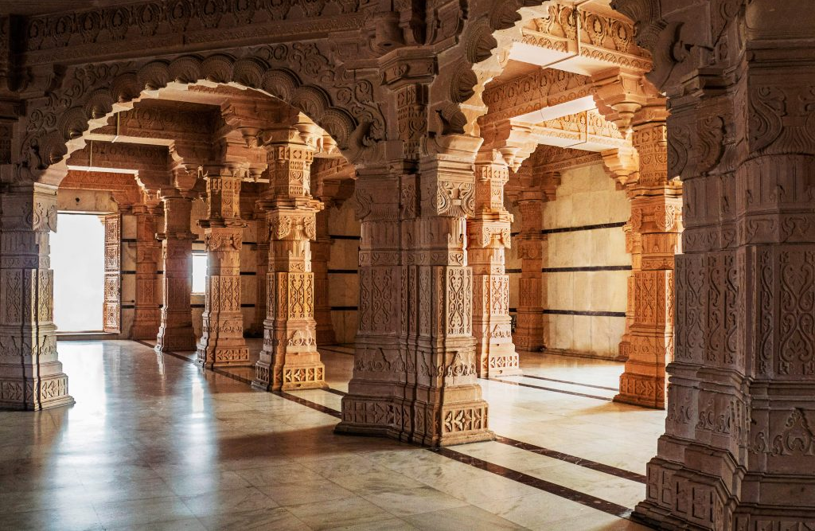
Welcome
Guests and prospective members
Zoom difficulties? email John Miner john@miner.ca
10 min break between 10:30 and 11am
Ramesh Chauhan

Slide 3
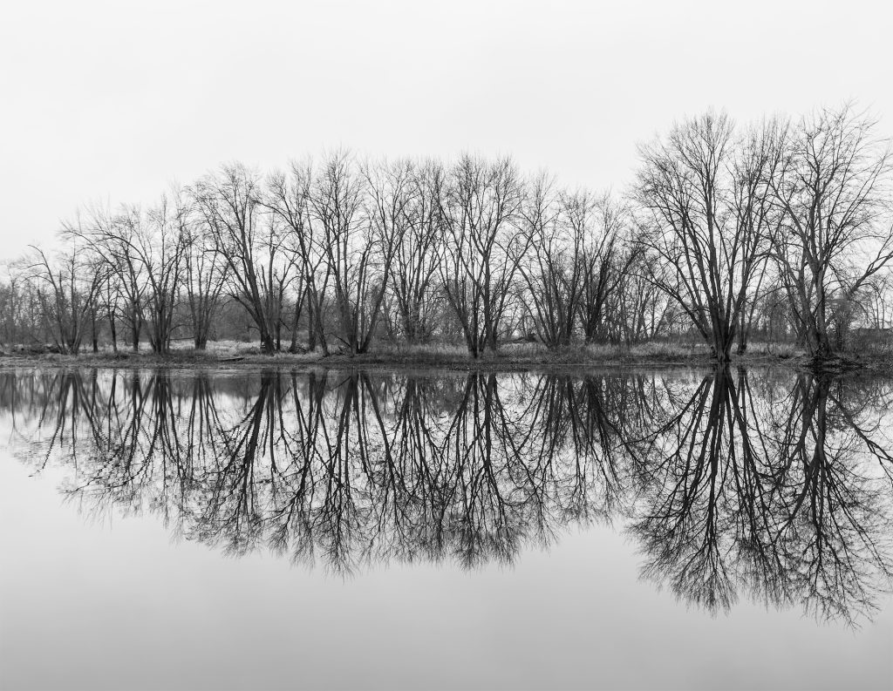
March 2023
Agenda
Featured speaker: Manfred Mueller - Still Life
February Workshop showing: Still Life (Botanicals)
March Challenge: Places of Worship
March technique: Low Angle
Upcoming events Workshops: March 18; Composition and Lighting
April 22; Lenses April challenge: Diagonals
April technique: Fill the Frame Spring competition: Water Interclub competition: Urban life
Photography 101: RAW vs. JPEG
Notices
Next Meeting
Kathy Burke

Slide 4
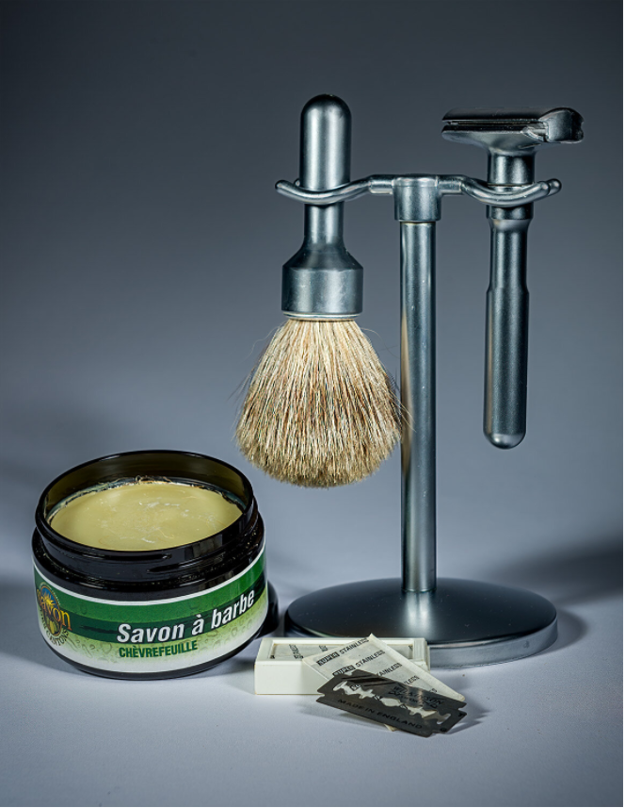
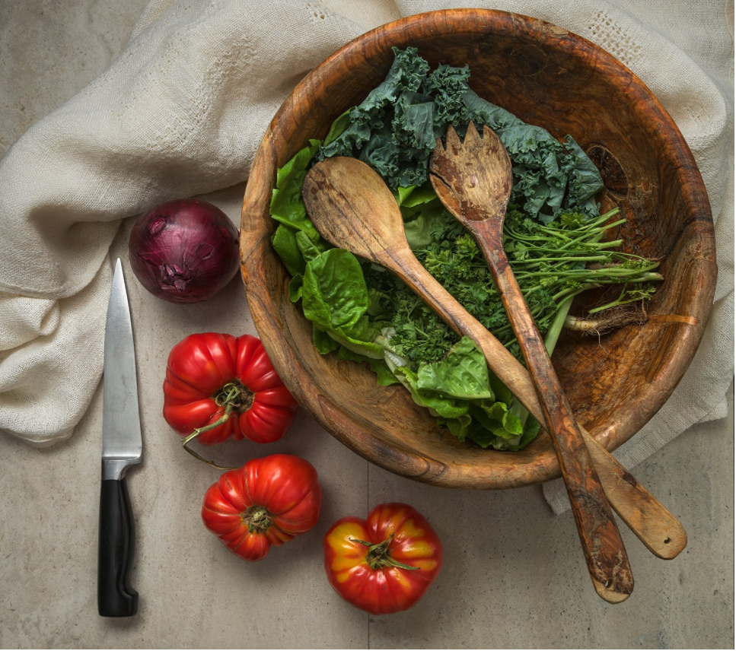
Featured Speaker
Manfred Mueller
Still Life Photography

Slide 5
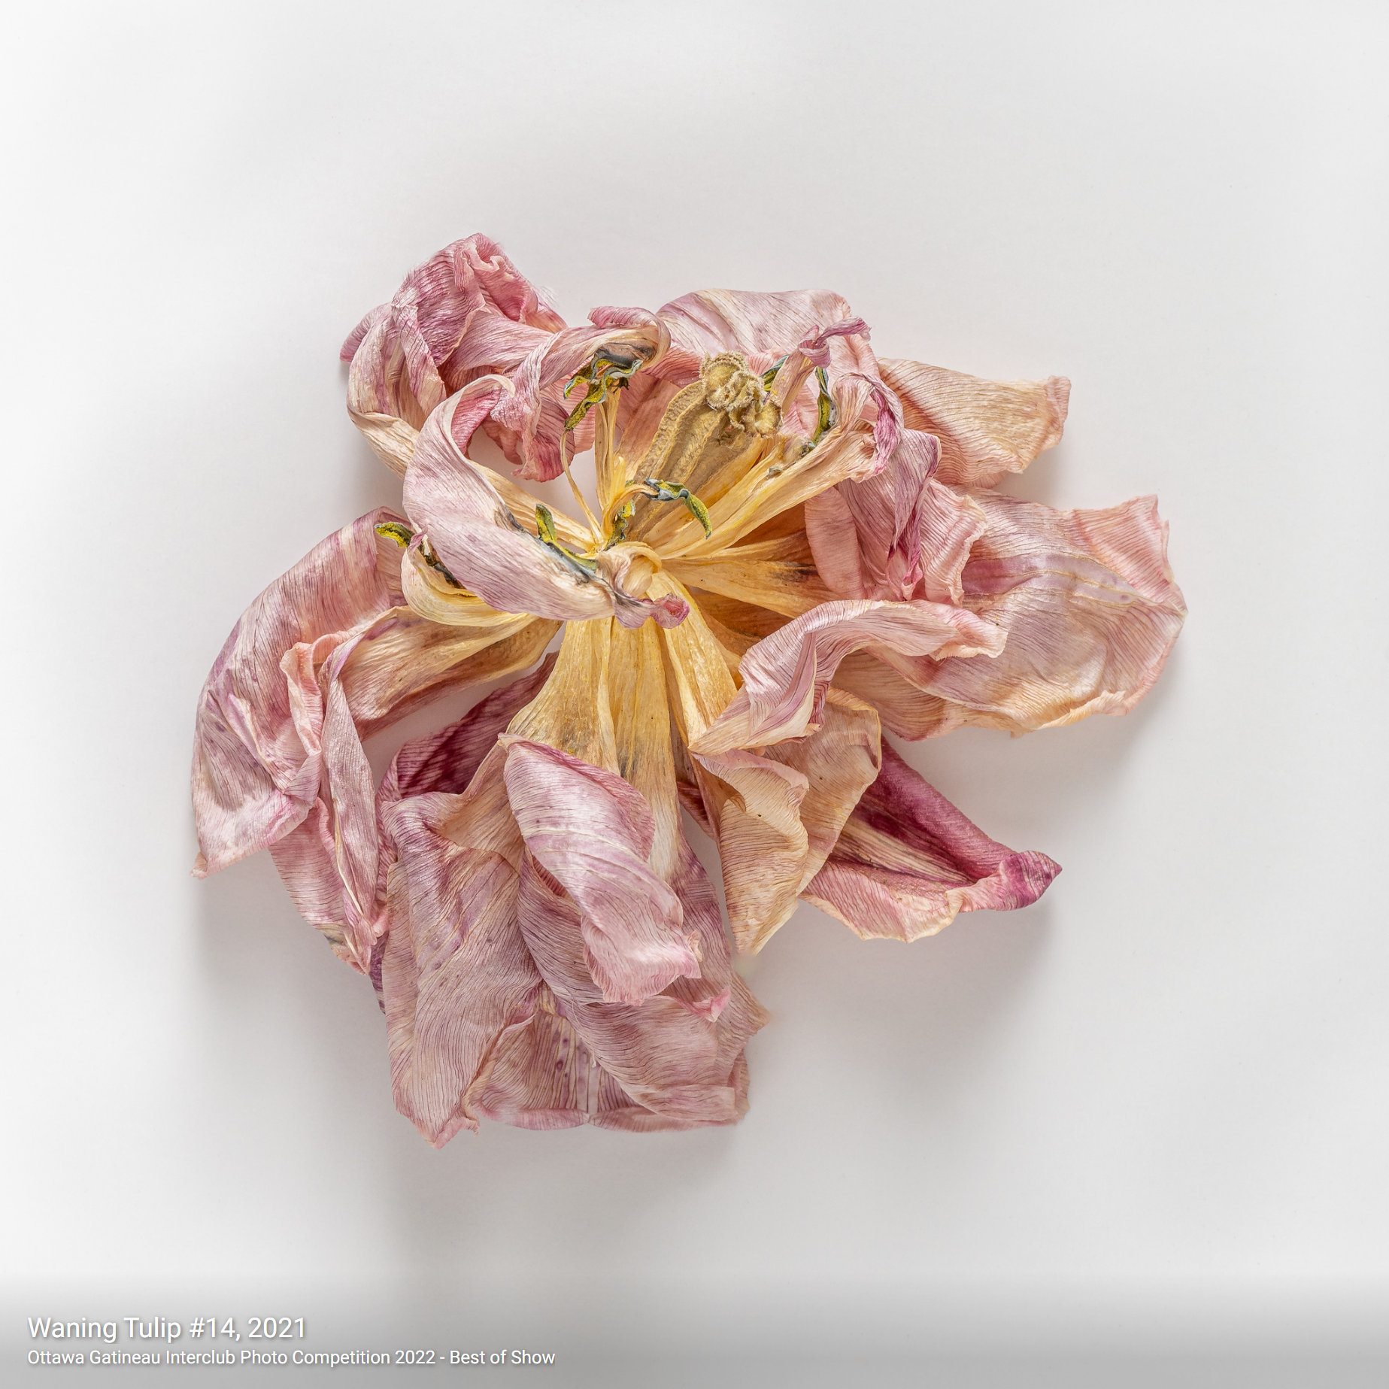
February Workshop Still Life - Botanicals on White
Instructor: Allan Cameron
Location: RA Center, Photo Studio (East Wing)
Date: Saturday, February 18
Waning Tulip #14, 2021 – Allan Cameron
Ottawa Gatineau Interclub Photo Competition 2022
Best of Show
Allan’s images https://abc-photo-album.smugmug.com/Home
Notes:
Allan Cameron is an Ottawa based digital photographer. His practice is centered on Still Life photography. Allan also photographs small landscapes and occasionally people if they are doing something interesting.
He is a member of the RA Photo Club and a long-time, part-time student at the School of The Photographic Arts, Ottawa (SPAO).
Examples of his work can be found at: https://abc-photo-album.smugmug.com/Home

Slide 6
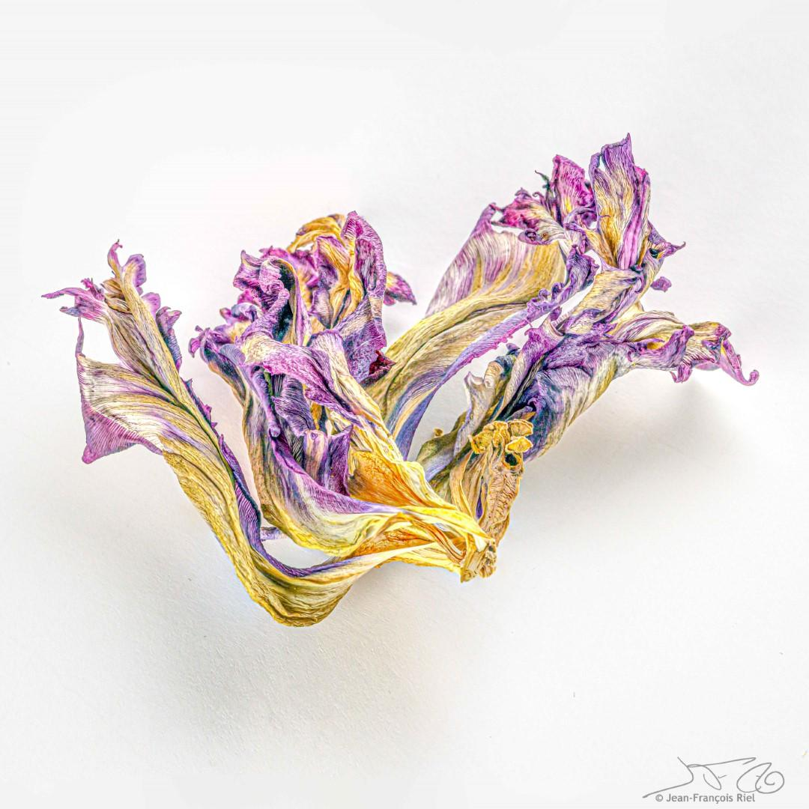
Dried Flower Workshop
Jean-Francois Riel

Slide 7
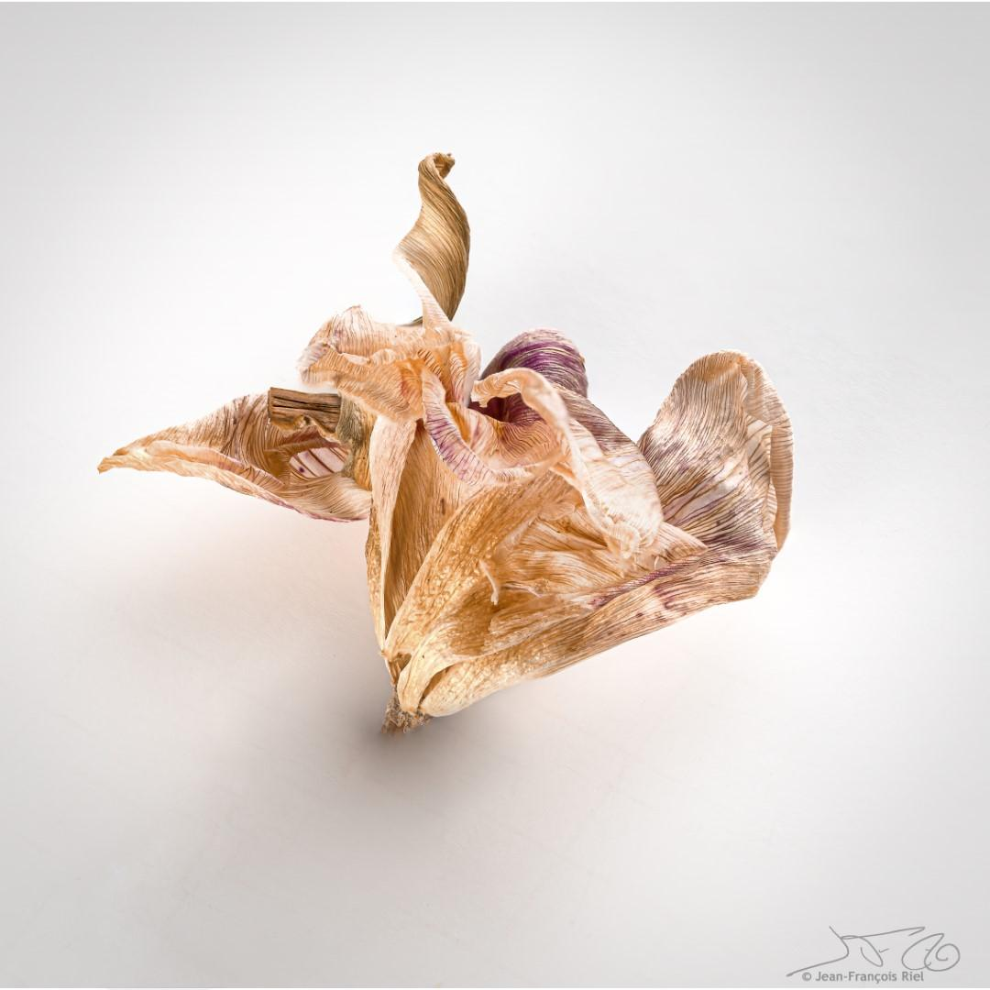
Jean-Francois Riel

Slide 8
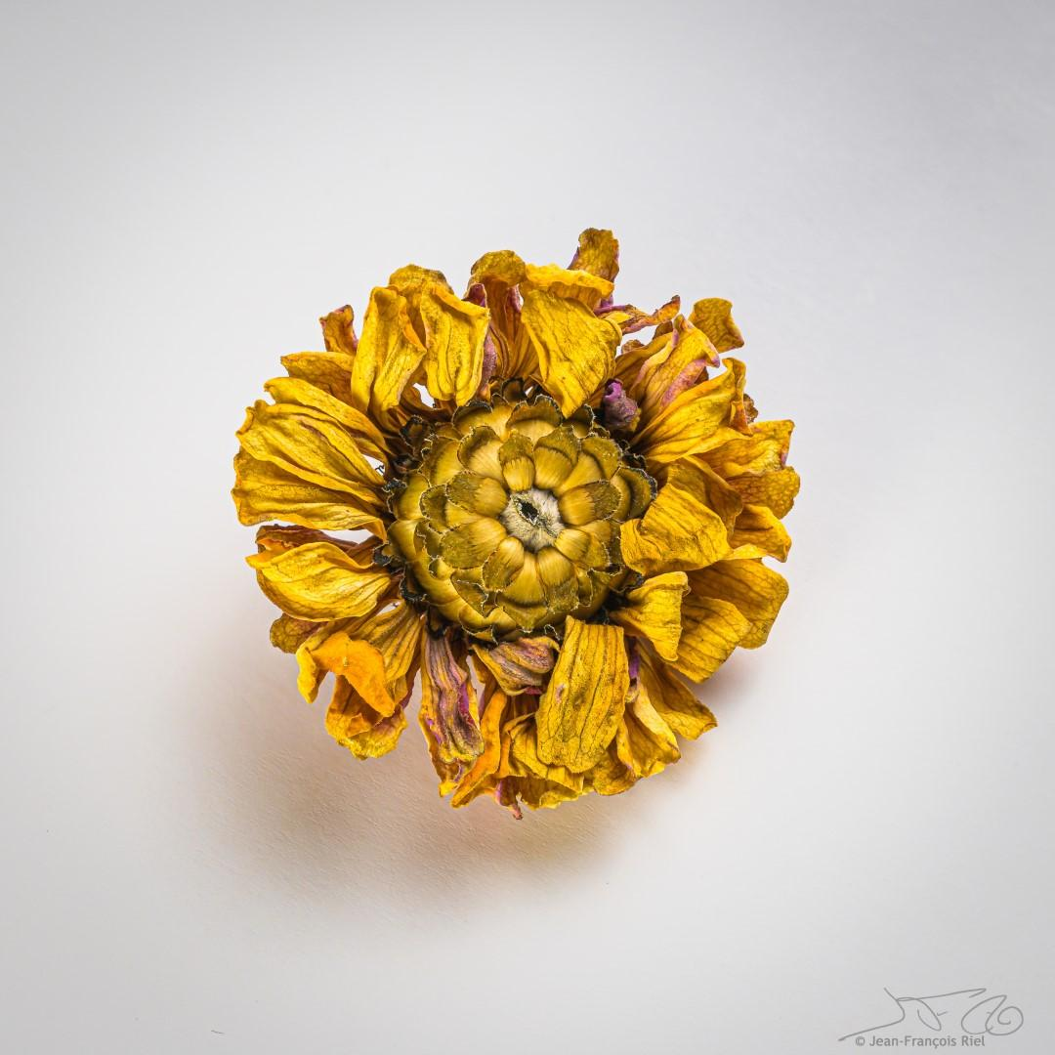
Jean-Francois Riel

Slide 9
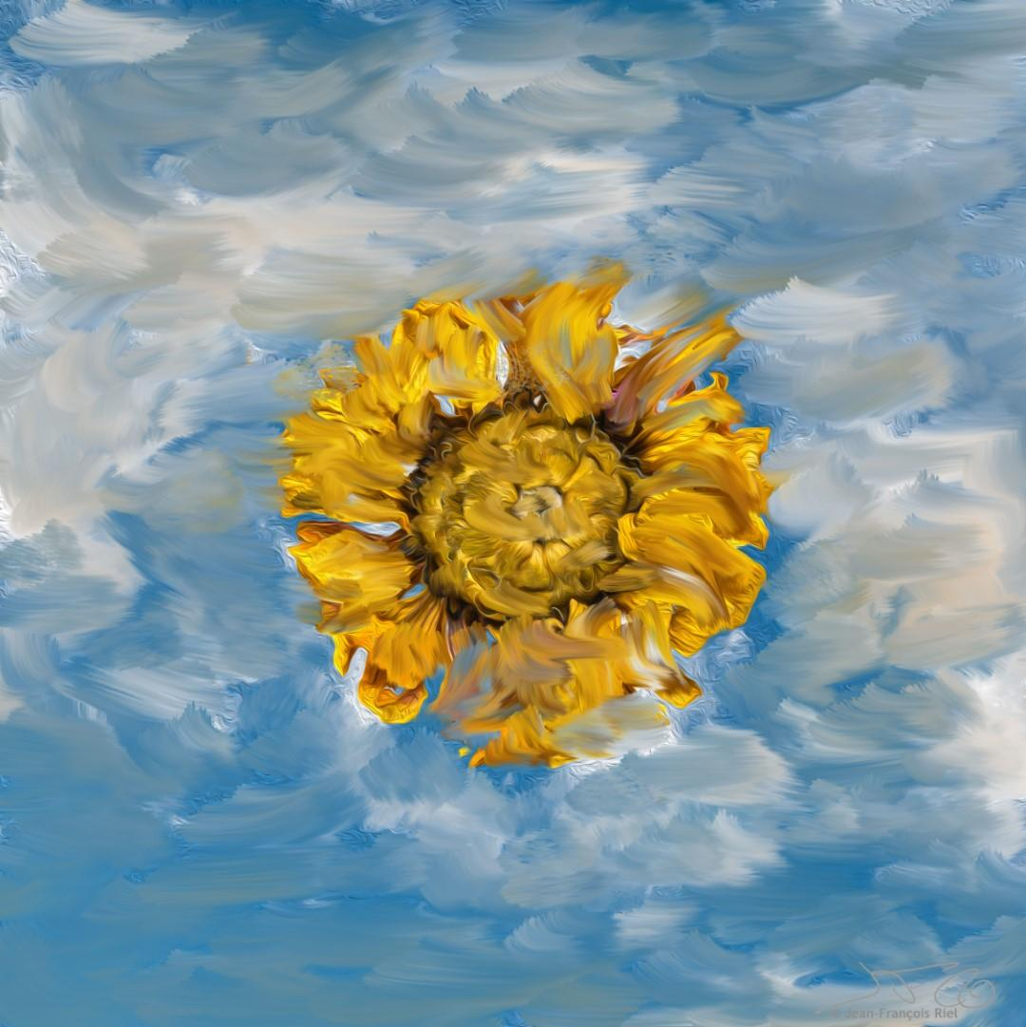
Jean-Francois Riel

Slide 10
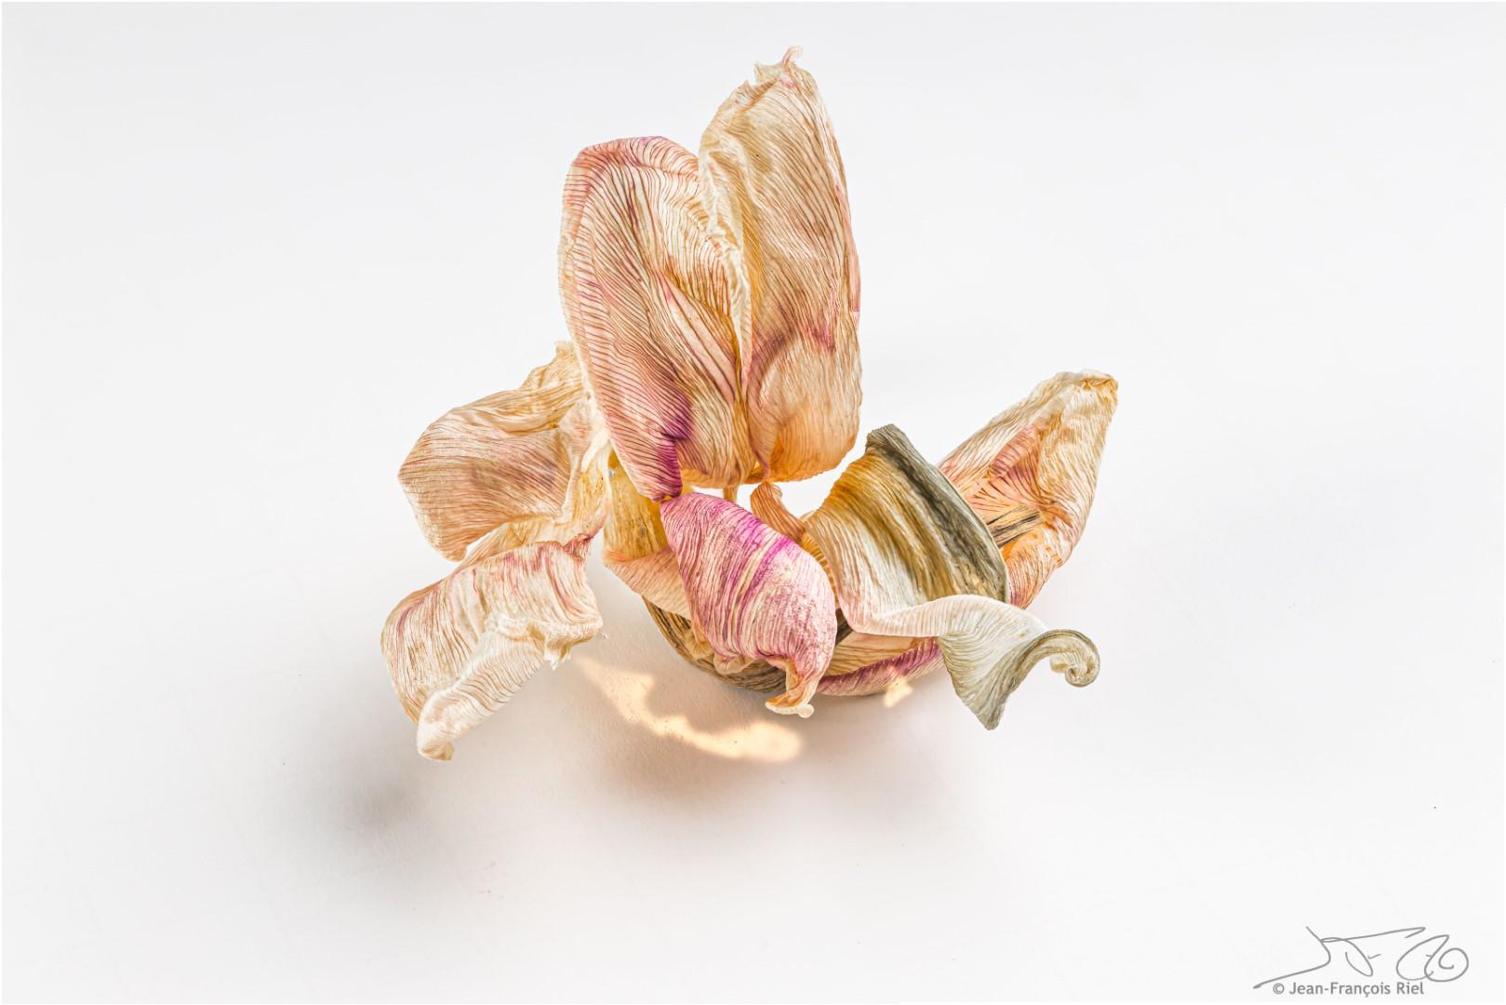
Jean-Francois Riel

Slide 11
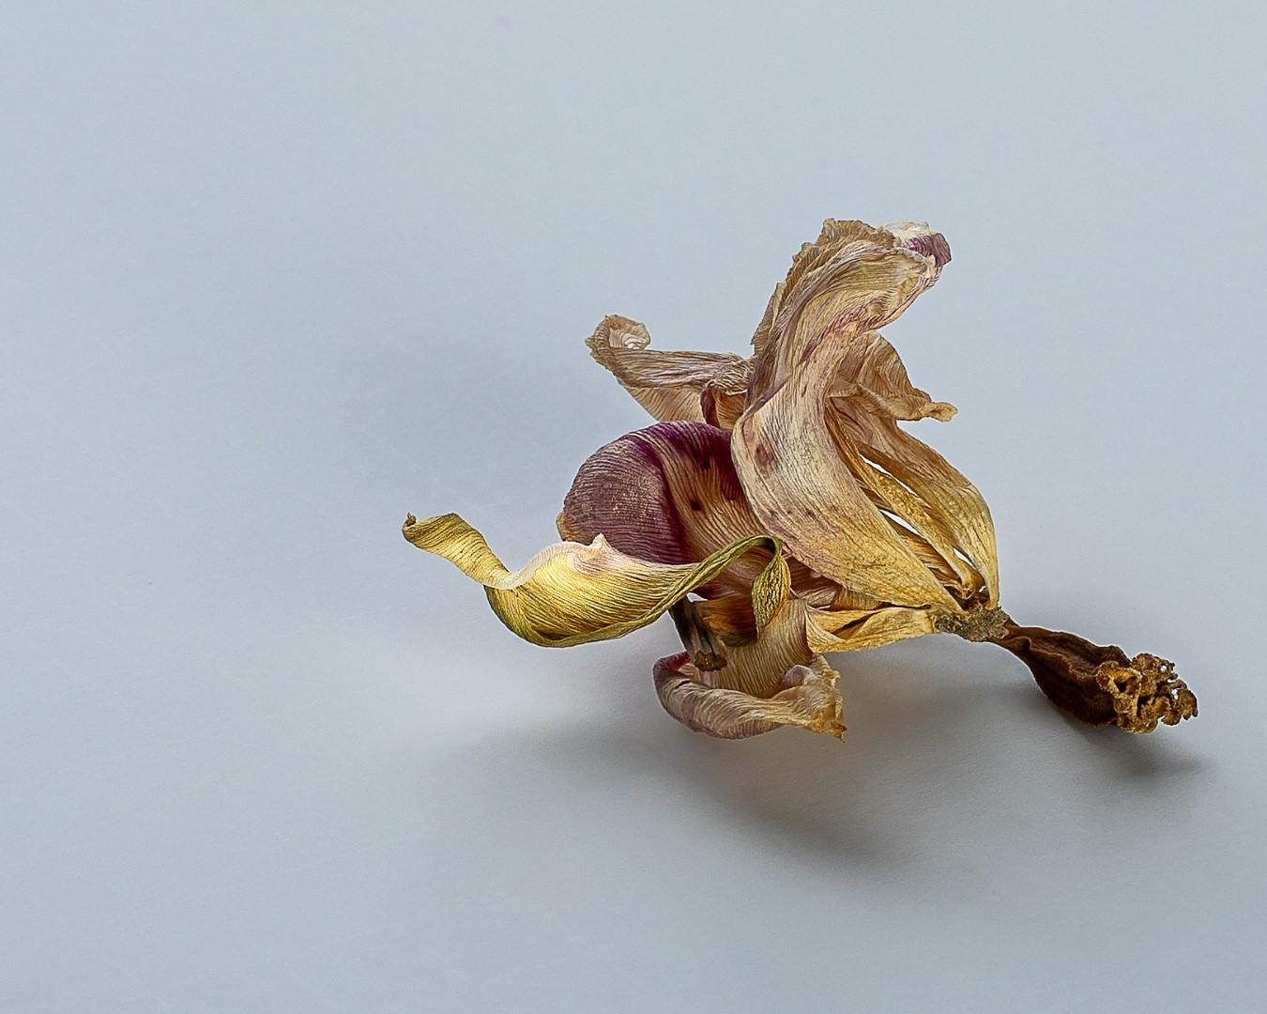
Johan Carignan

Slide 12
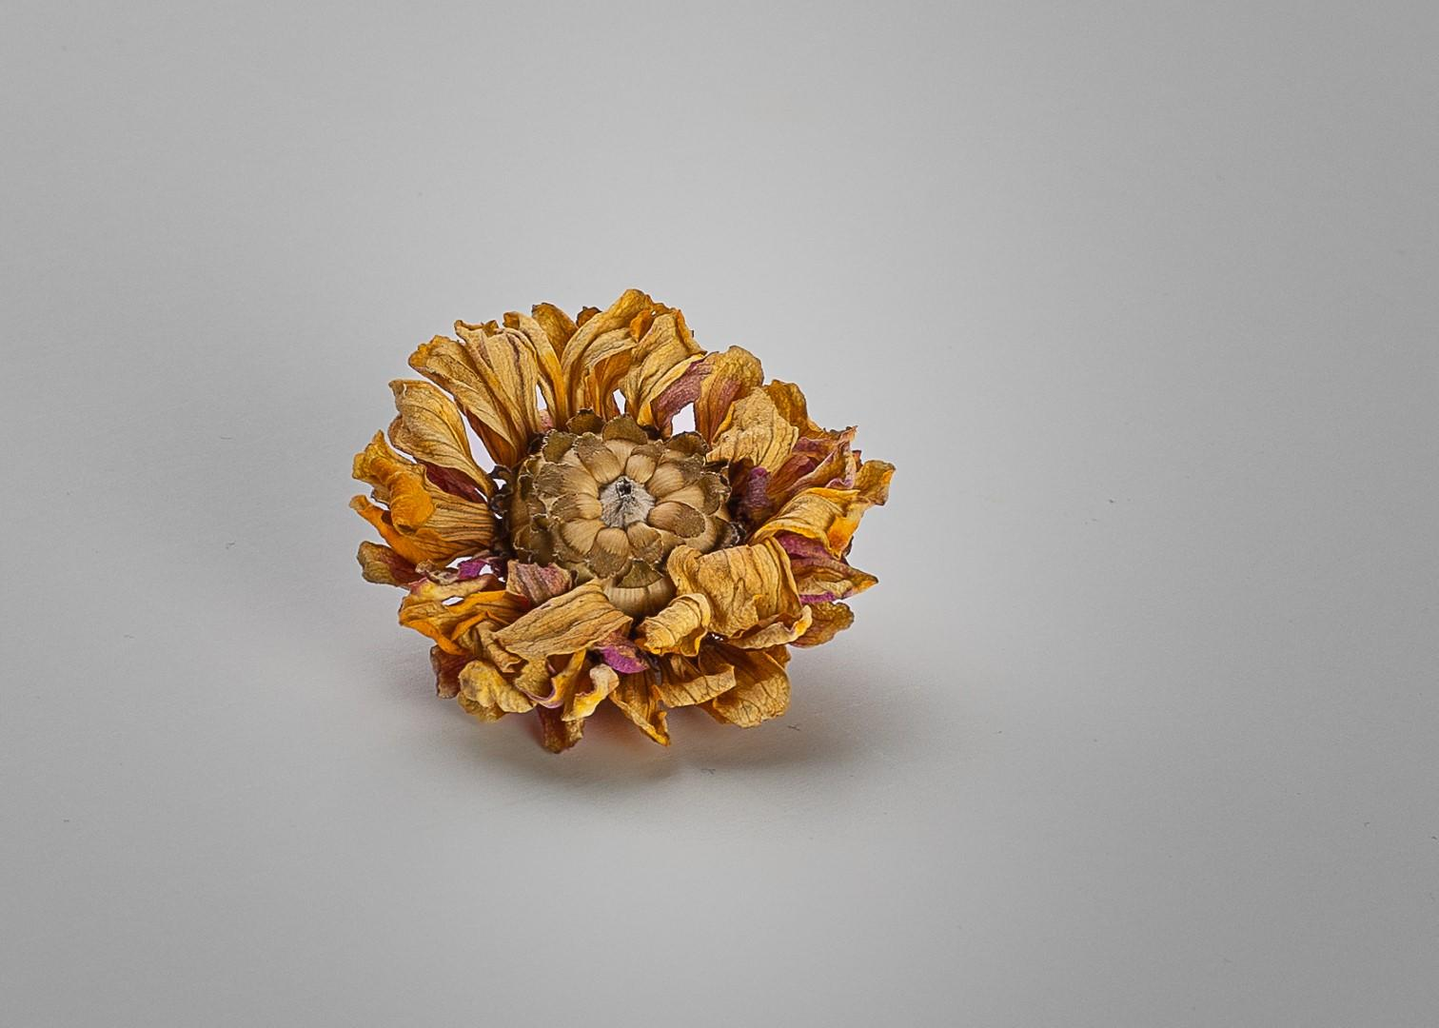
Johan Carignan

Slide 13
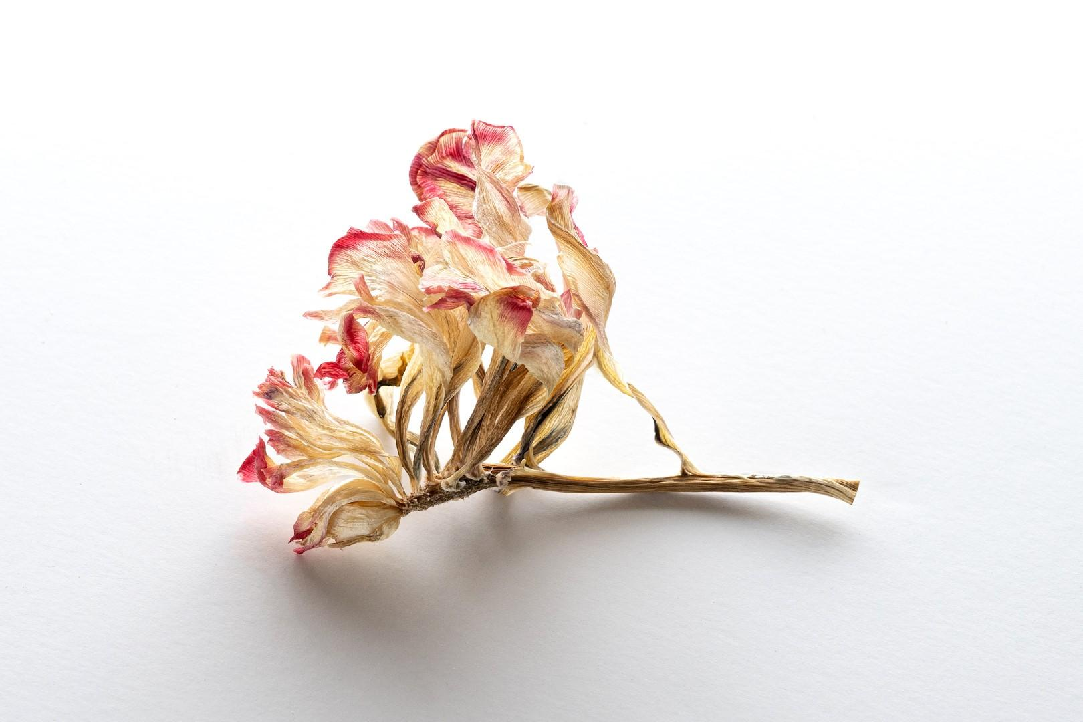
Marianne Pethke

Slide 14
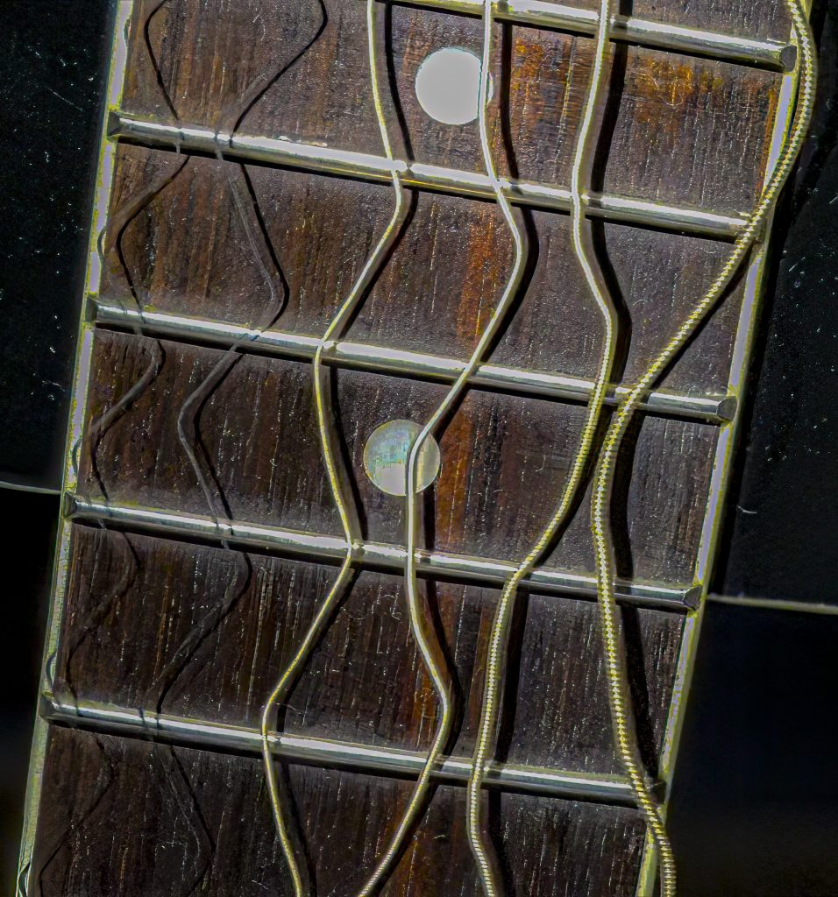
Upcoming: Workshops & Outings
Workshops
Composition & Lighting with Michael Willems March 18, 10AM to 12Noon at Queenswood Heights
Lenses with Michael Willems
April 22, 10AM to 12Noon at Queenswood Heights
Outings
Tentative: Cobblestone bus tour
Tentative: Nature & Wildlife in May
John Ingold
Notes:
Allan Cameron is an Ottawa based digital photographer. His practice is centered on Still Life photography. Allan also photographs small landscapes and occasionally people if they are doing something interesting.
He is a member of the RA Photo Club and a long-time, part-time student at the School of The Photographic Arts, Ottawa (SPAO).
Examples of his work can be found at: https://abc-photo-album.smugmug.com/Home

Slide 15
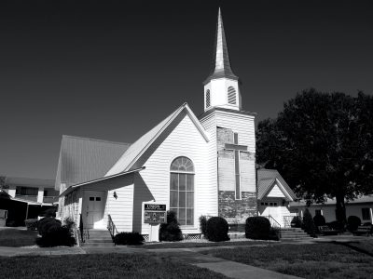
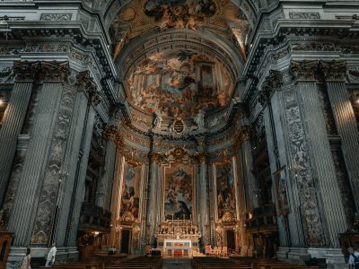
March challenge – Places of worship
Interior or exterior images of a church or other place of worship from any religion. The emphasis must be on the architecture or structural design.
Off topic: Since the focus of this challenge is architecture, images of small objects (e.g., cross, candle) representative of a particular religion will be considered to be off-topic
On topic: Spires or minarets are on-topic because they are part of the building structure
Submission deadline: Saturday, March 4 (midnight)
Archived images allowed
Andrew Mcquaid on Unsplash
Clay Banks on Unsplash

Slide 16
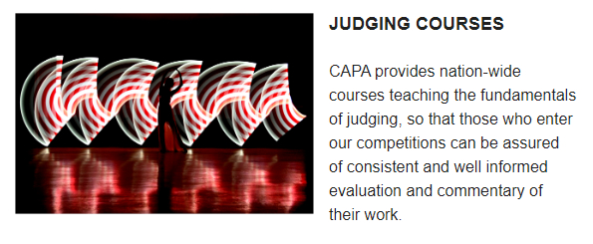
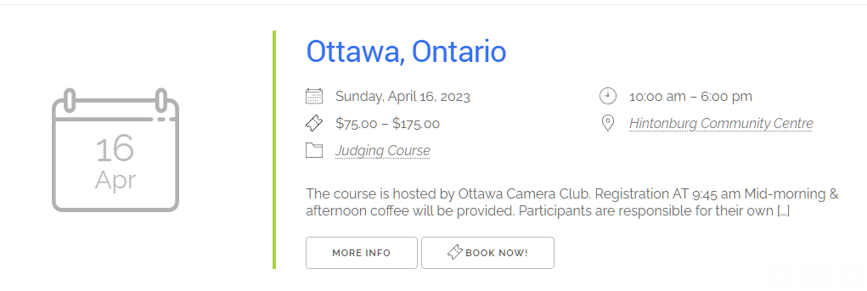
Notices:
CAPA JUDGING COURSE

Slide 17
New Voting Guidelines for Challenges
Assistance for members.
Standardization of voting amongst all members.
No change to categories or scale.
Expanded description on what each value of the 5 point scale means.
For Wow, Technique and Composition, an “average” image should receive a score of around 3.
Please review website before voting on a challenge.
Link will appear on every voting page.
Go to cpopc.ca — Home page Members only Challenges Voting information

Slide 18
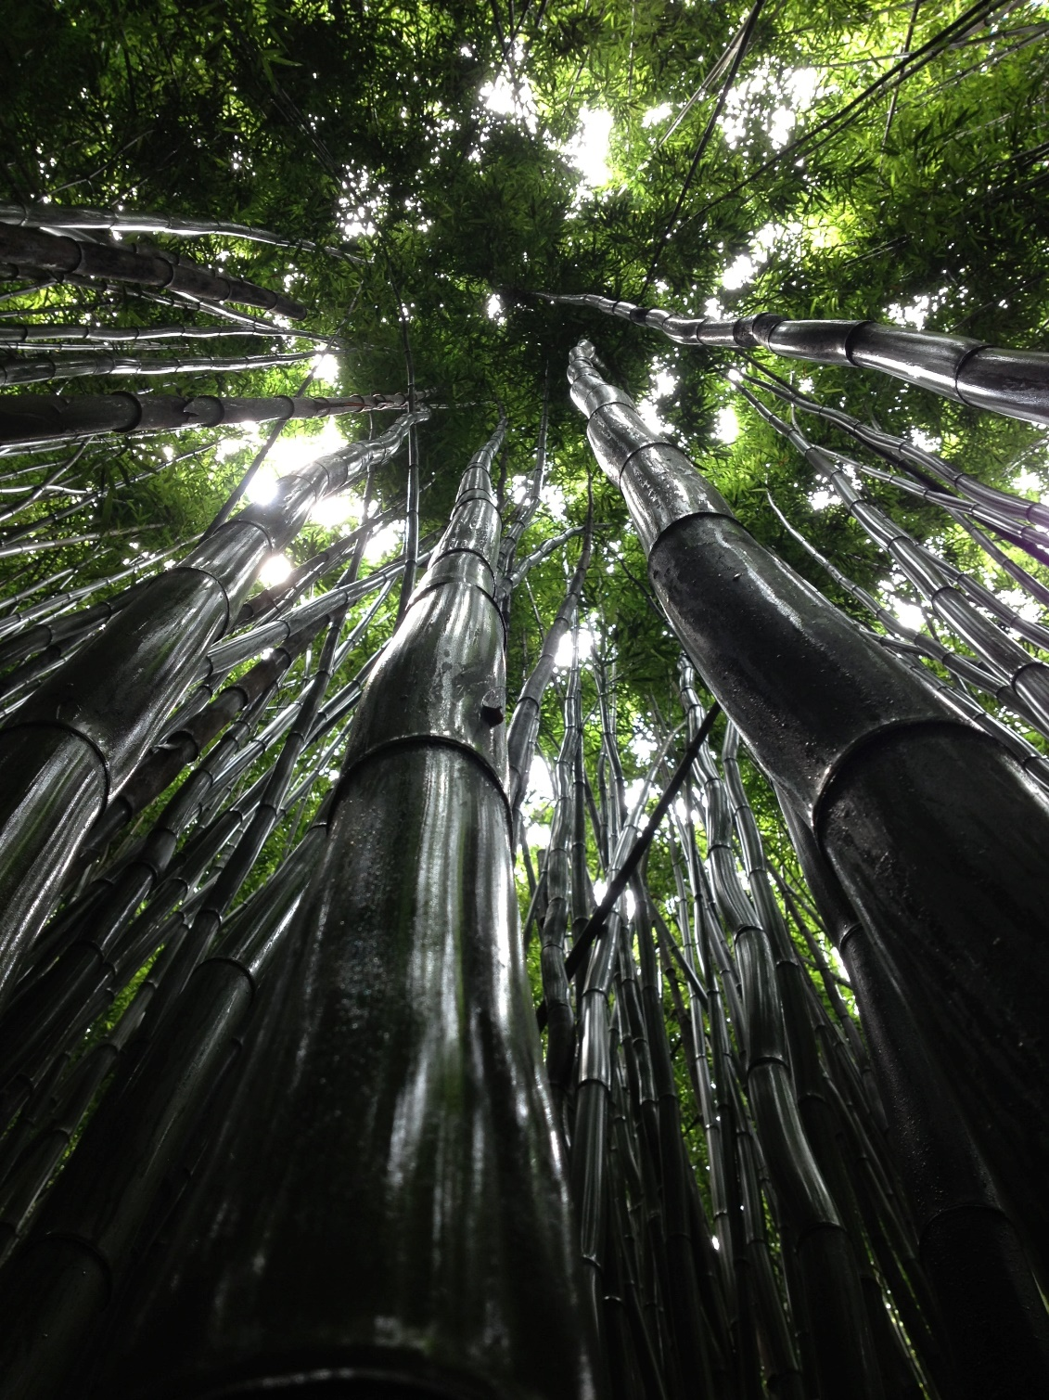
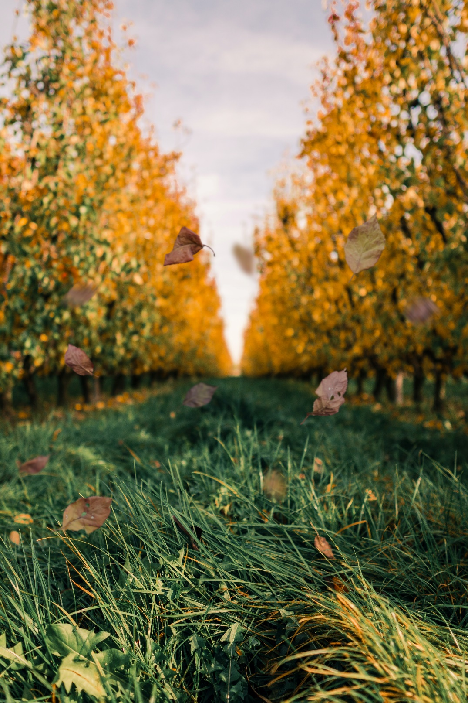
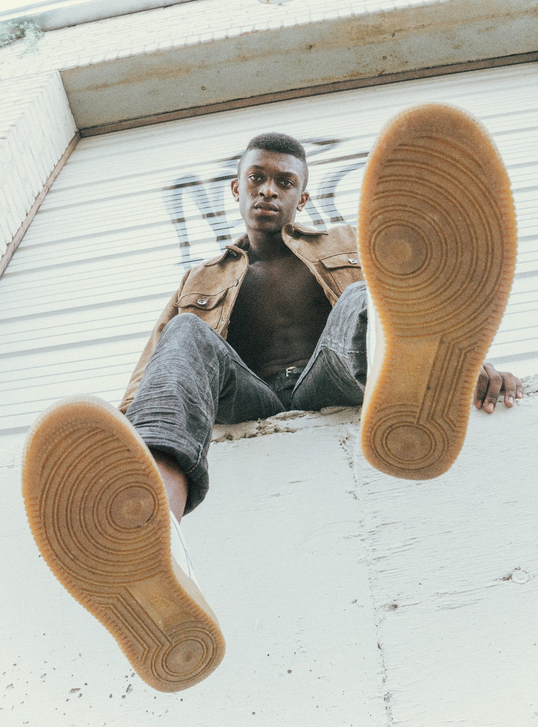
March Technique – Low angle
Taken from a camera angle positioned below the average eye line & pointing up
Often near the ground and can add attractive details to the setting
Subject appears larger, wider, taller, & closer
Kaitlyn Jameson, Unsplash
Bram Laenen, Unsplash
Haley Lawrence, Unsplash

Slide 19
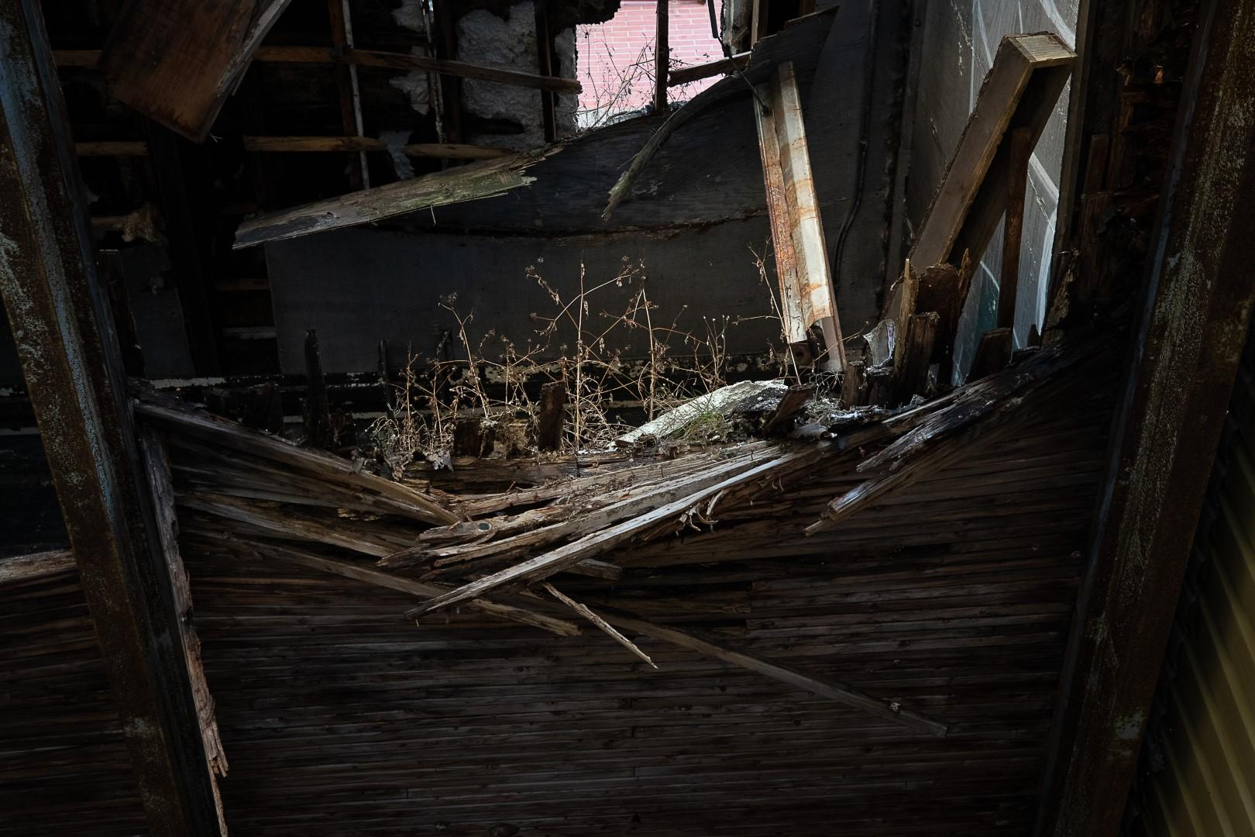
Johan Carignan

Slide 20
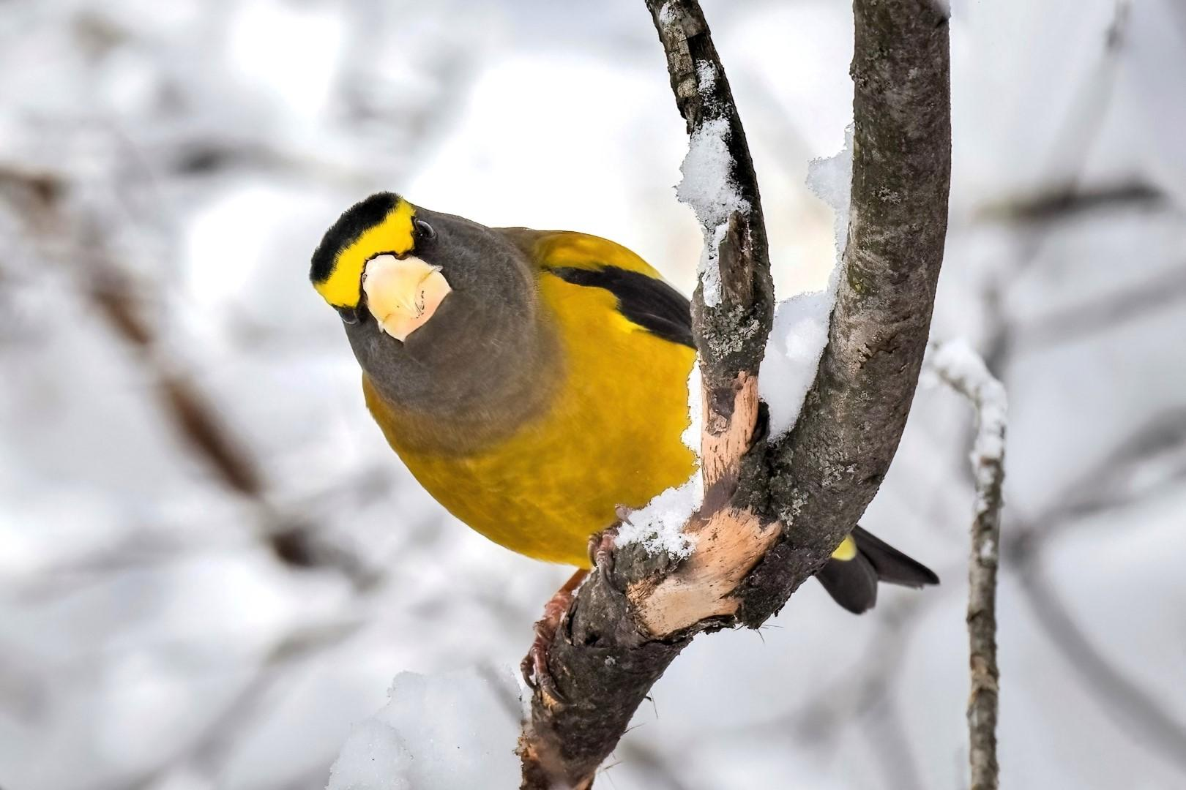
Marianne Pethke

Slide 21
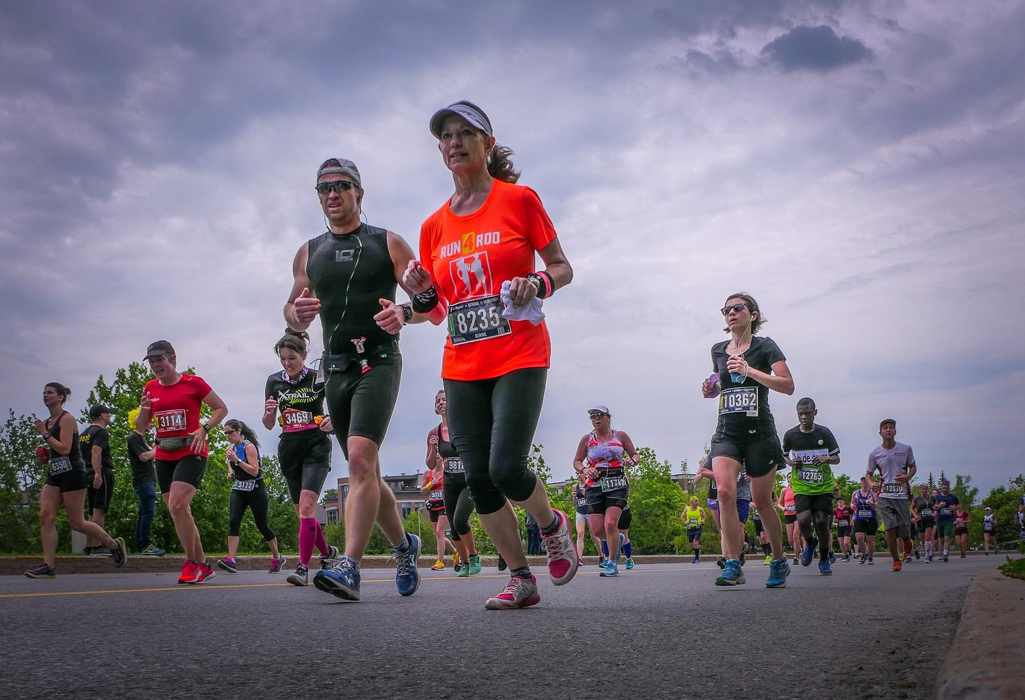
Alan White

Slide 22
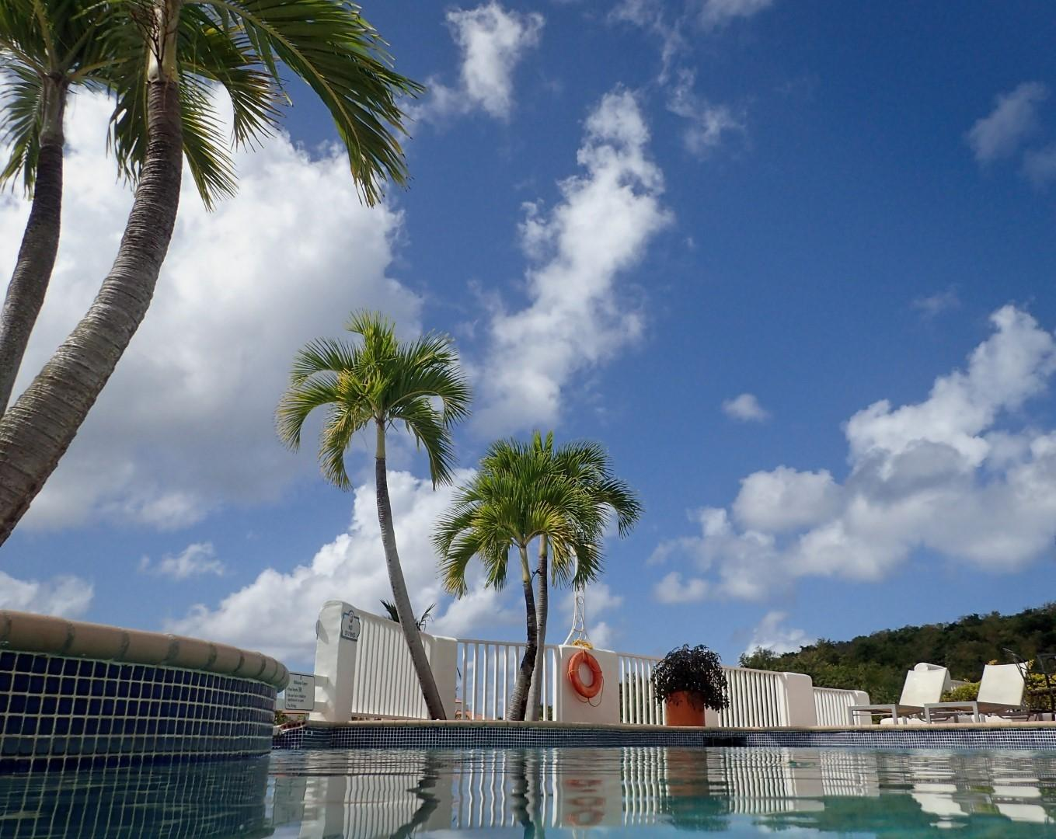
Chris Taylor

Slide 23
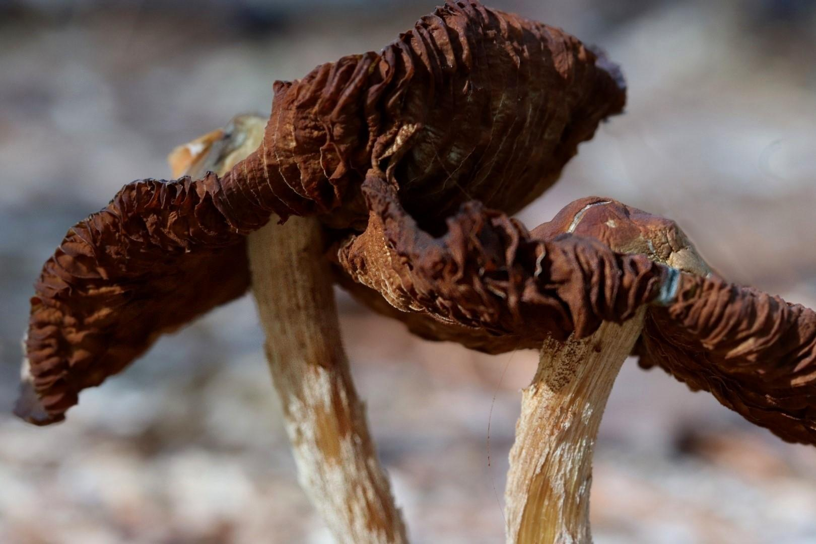
Lynda Buske

Slide 24
Spring competition – Water
Photos can be bodies of water, droplets, ice, snow, waves, reflections, fog, etc. Other objects can be present (even dominant) as long as water plays a key role in the image
Images must have been taken since June 2022
Submit up to three images
Submission deadline: Saturday, May 20 (midnight)

Slide 25
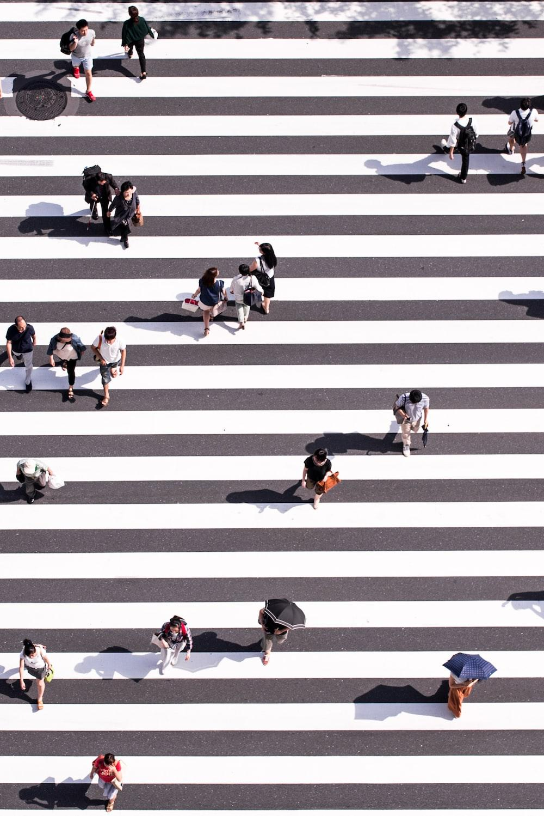
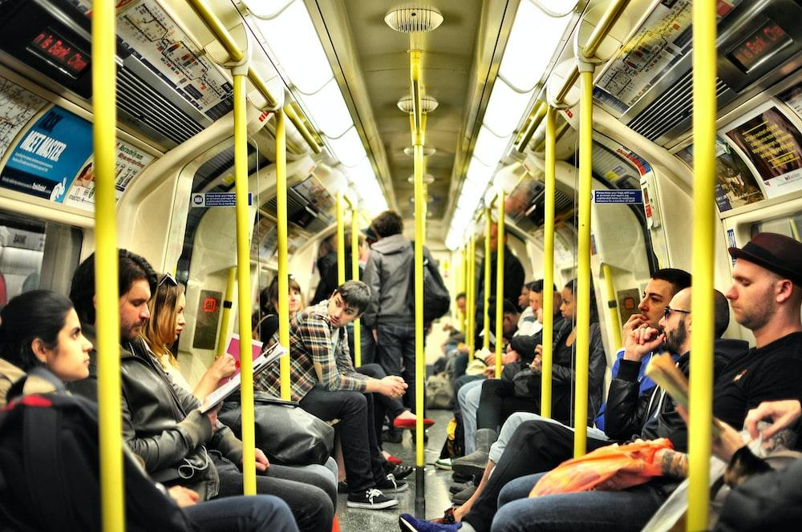
Interclub competition – Urban life
Capturing the spontaneous encounters of life in cities or towns.
To be on topic, your image must include a live person, animal or plant that contributes a significant compositional element. Any image that does not include a clear indicator of an urban environment (e.g. buildings, street, etc) will be considered to be off topic.
Note: Up to three images are allowed; at least one must be on topic of urban life.
136 Entries, 15 from CPOPC
Presentation date: Tuesday, April, 4, 2023 (Online)
Ryoji Iwata
Unsplash
https://youtube.com/live/nDV3RuWAzjg?feature=share
Viktor Forgacs
Unsplash

Slide 26
Photo 101 – RAW vs JPEG
What is RAW
What is JPEG
Unmodified data from sensor
Captures all the data
Camera processes the raw data and applies certain changes (e.g. temperature, sharpening, saturation)
You can influence JPEG creation with camera settings such as cloudy, landscape, portrait, vivid, etc.

Slide 27
Pros of RAW
Cons of RAW
Can rescue dark or bright areas more easily…maybe?
Can modify colour temperature more easily
Retains the colour information even when shooting in B&W
You have full control of sharpening, saturation, etc.
Dozens of RAW formats so new formats may cause delays in photo editing software updates
All cameras that can produce RAW files will include processing software
Have to process in order to post to web, print or email
Files are large 20-30MB or more

Slide 28
Pros of JPEG
Cons of JPEG
May have aberrations when adjusting light, e.g. unnatural look
Temperature adjustment more difficult
Hard to undo baked in JPEG decisions, e.g. sharpening, temperature, saturation
Modern sensors tend to create a good image and preserve shadow and highlight details well
Files are more manageable size, much smaller than RAW
Can immediately post to web, print or email

Slide 29
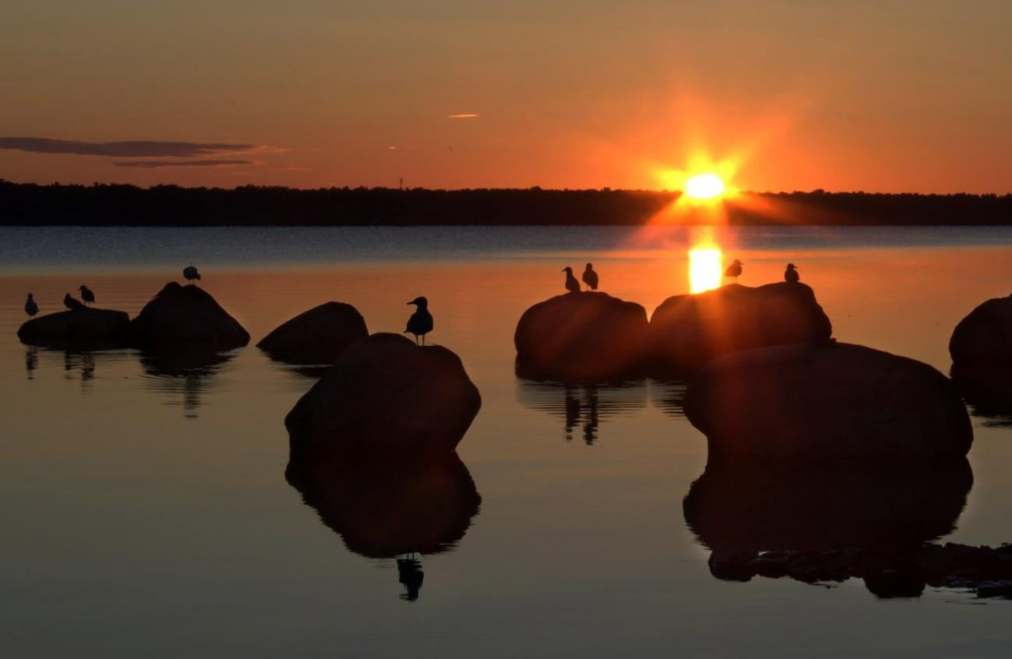
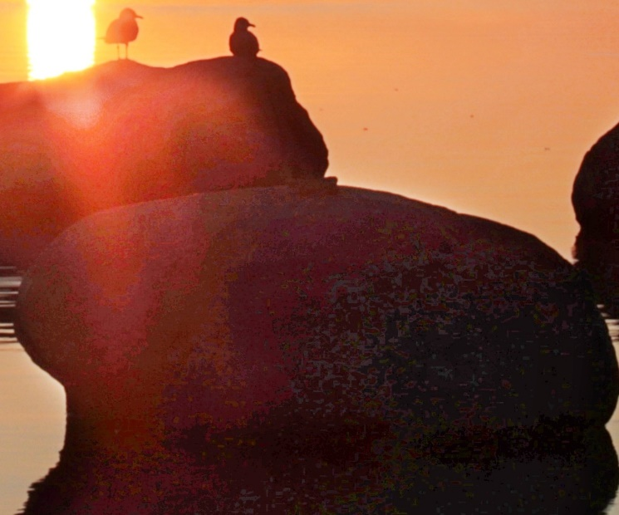
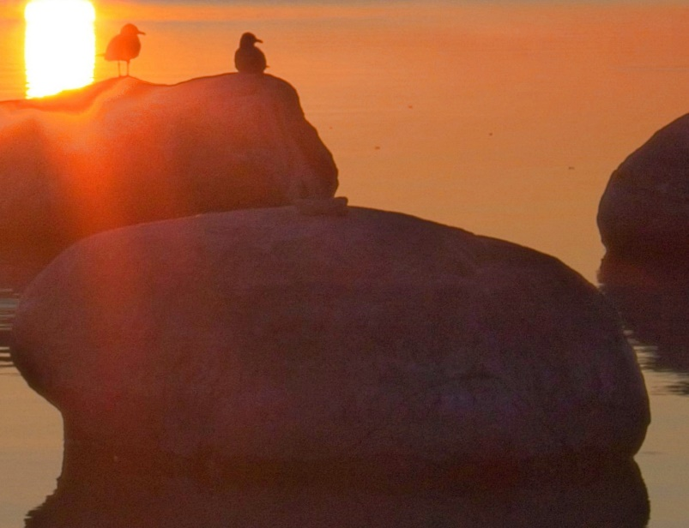
Colour/tonal banding is unnatural looking with JPEG
Smoother gradations in colour/tones with RAW

Slide 30
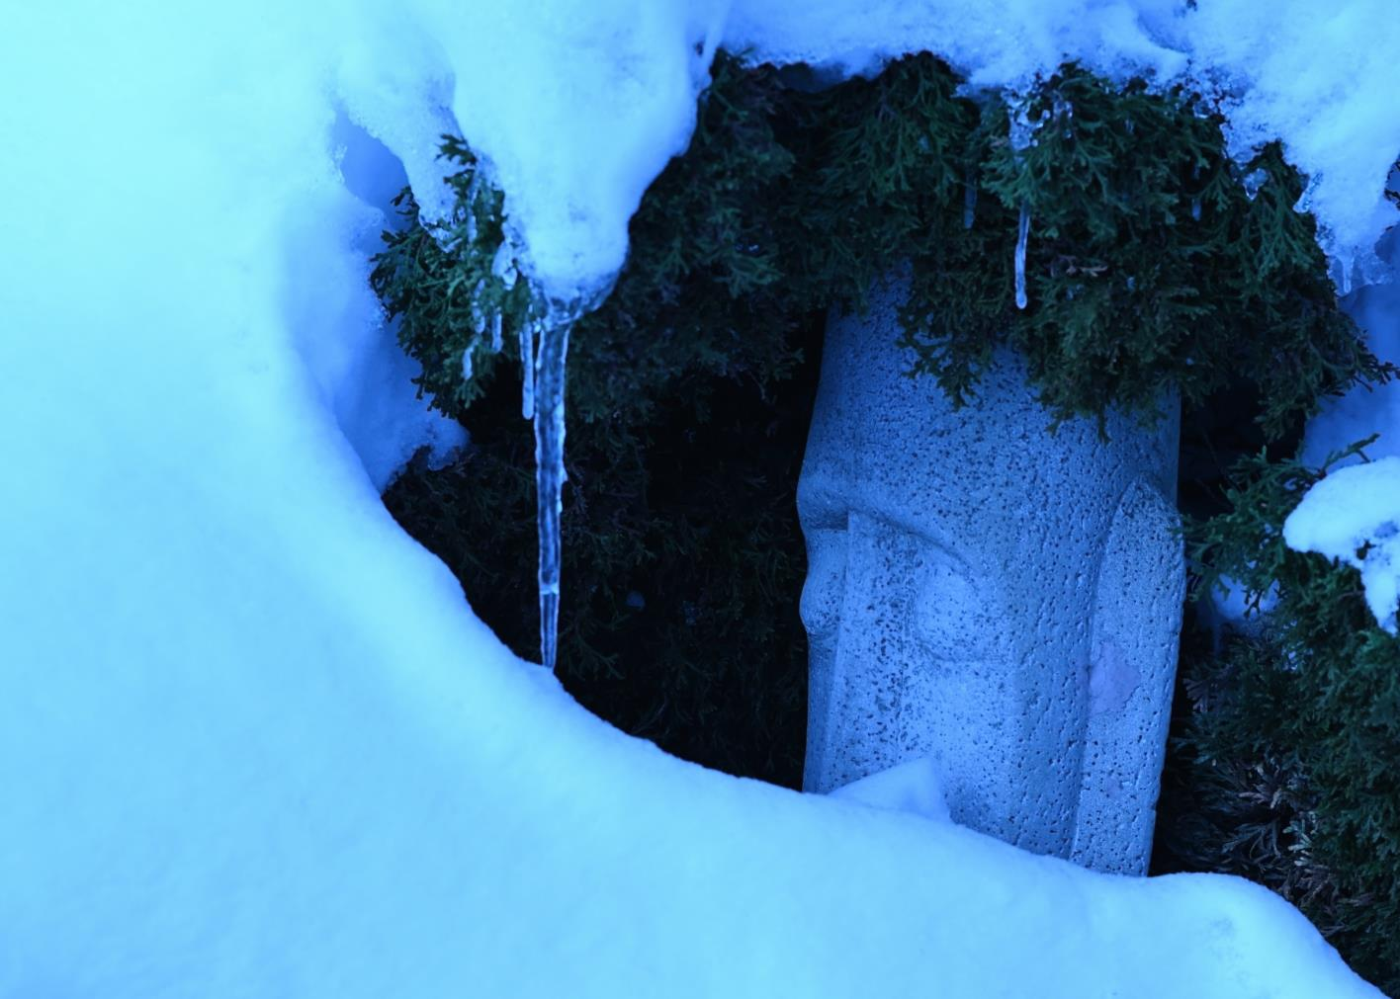
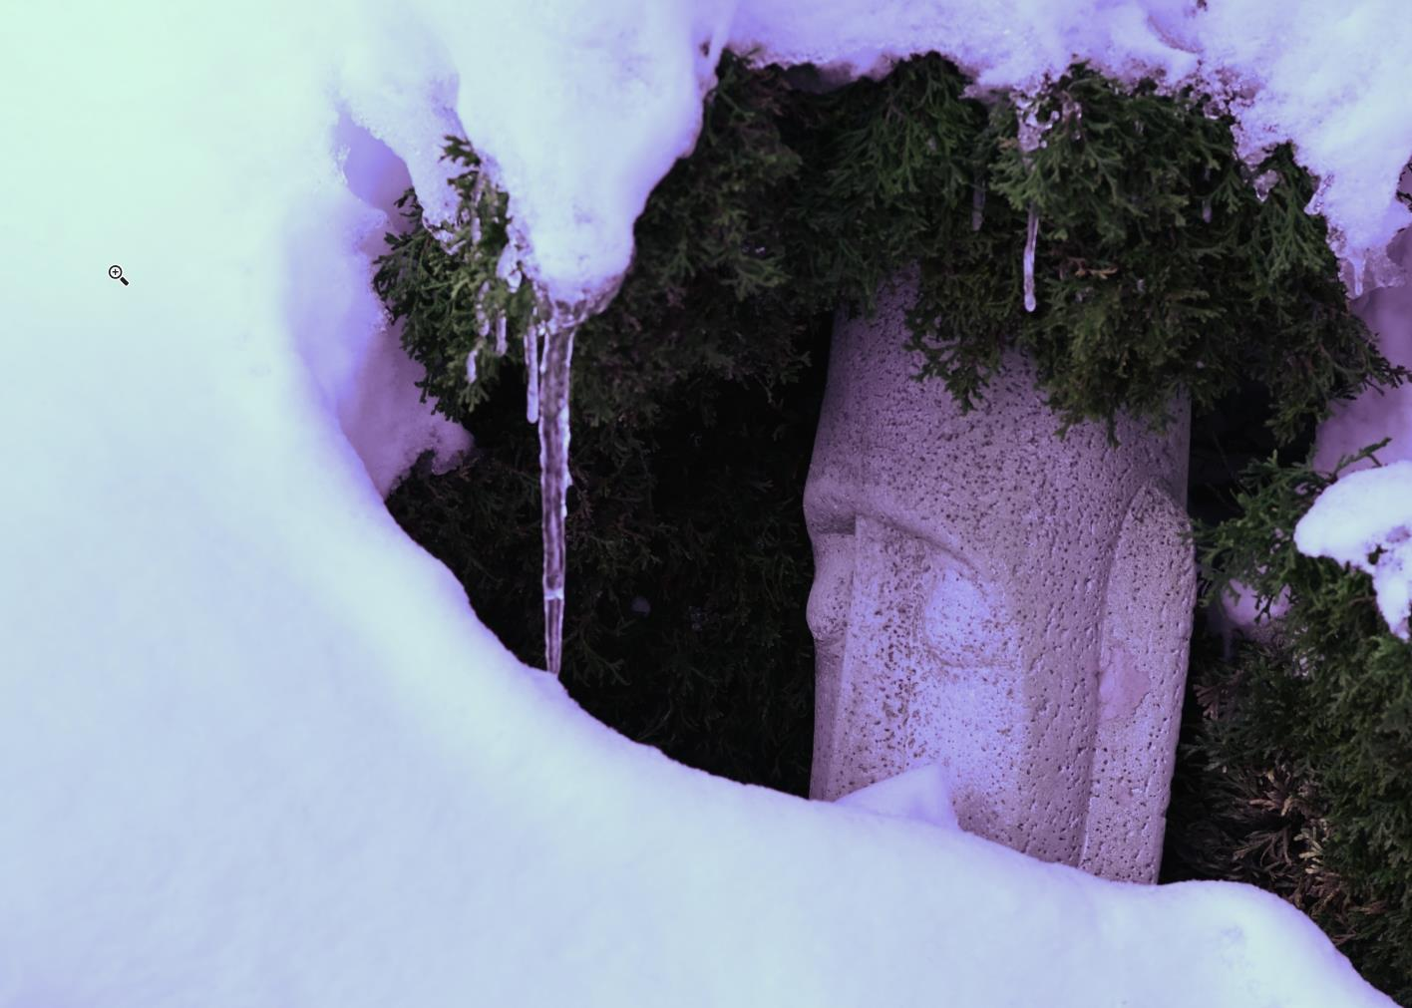
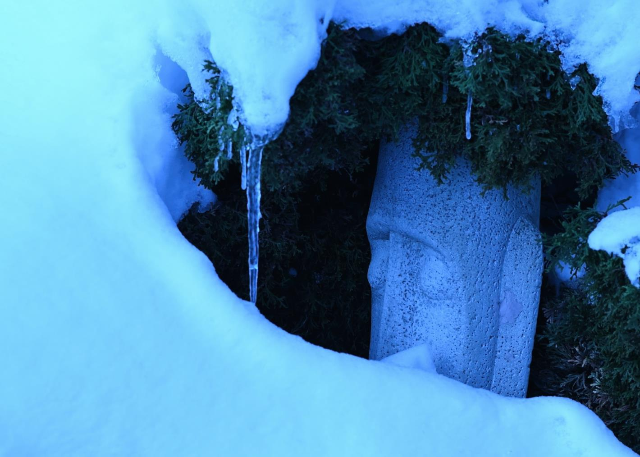
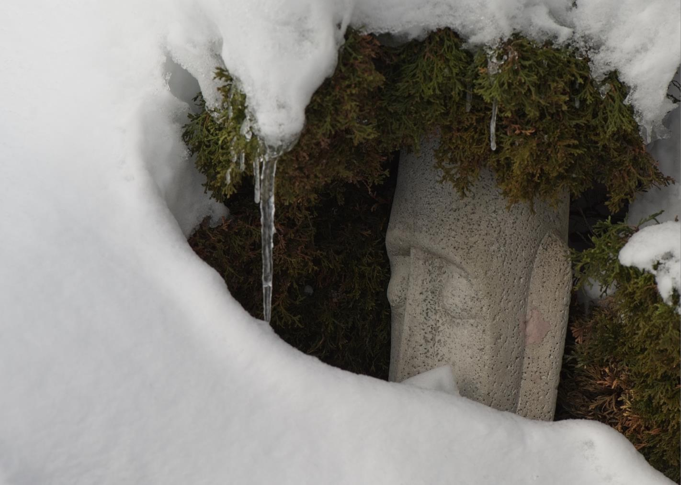
May have to play with colour temp and tint
Jpeg – shot at colour temp 2500K
Jpeg adjusted colour temp in post
Easier to adjust RAW colour temp in post
RAW – shot at colour temp 2500K
RAW adjusted colour temp in post

Slide 31
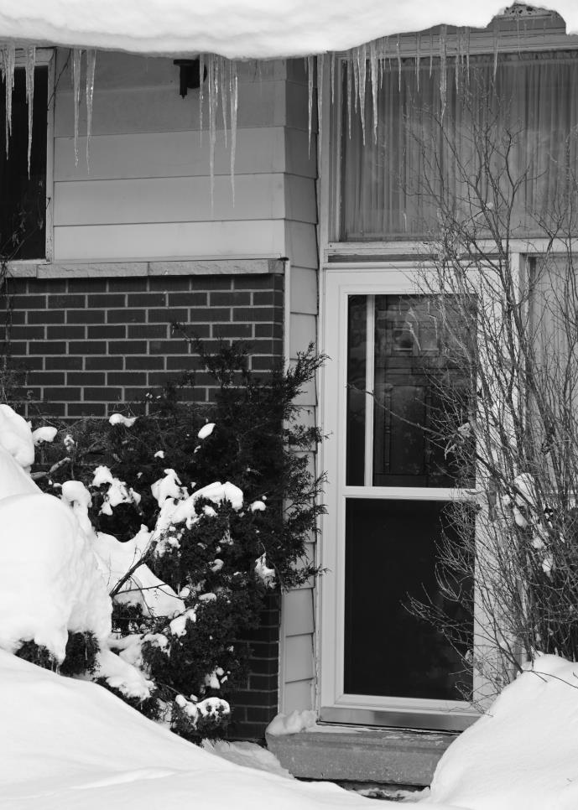
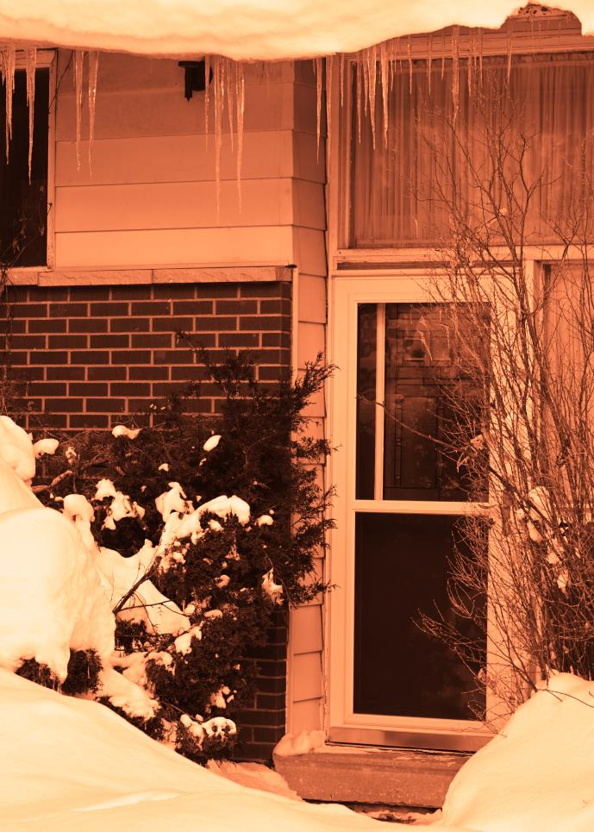
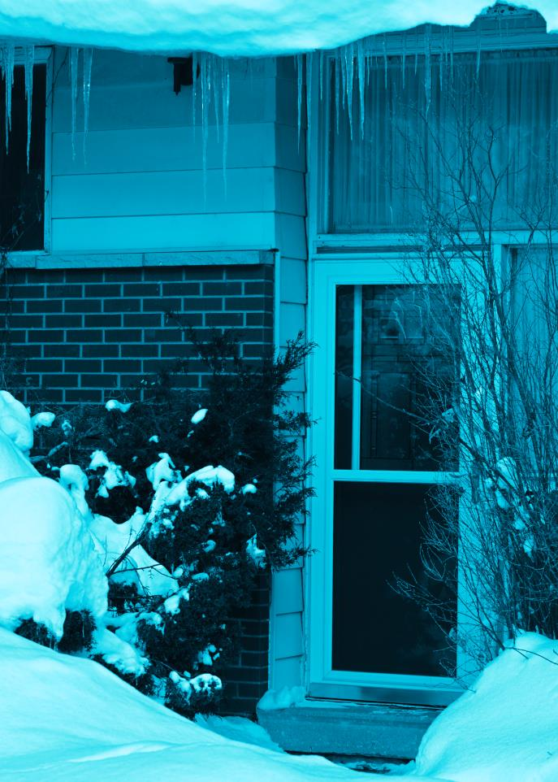
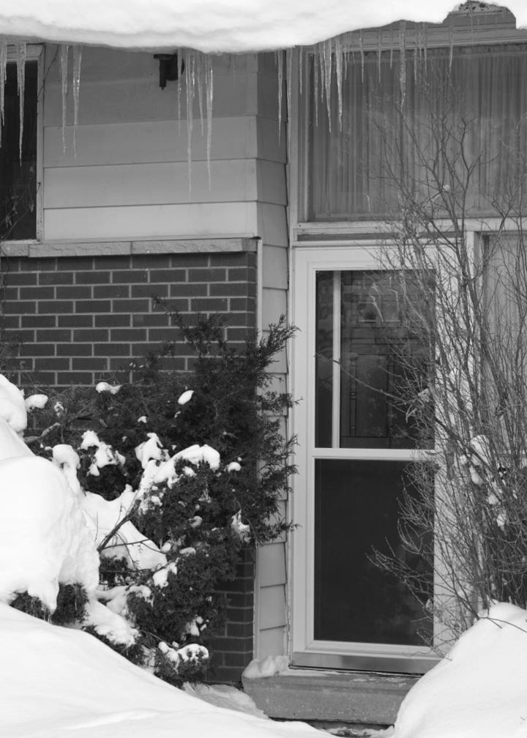
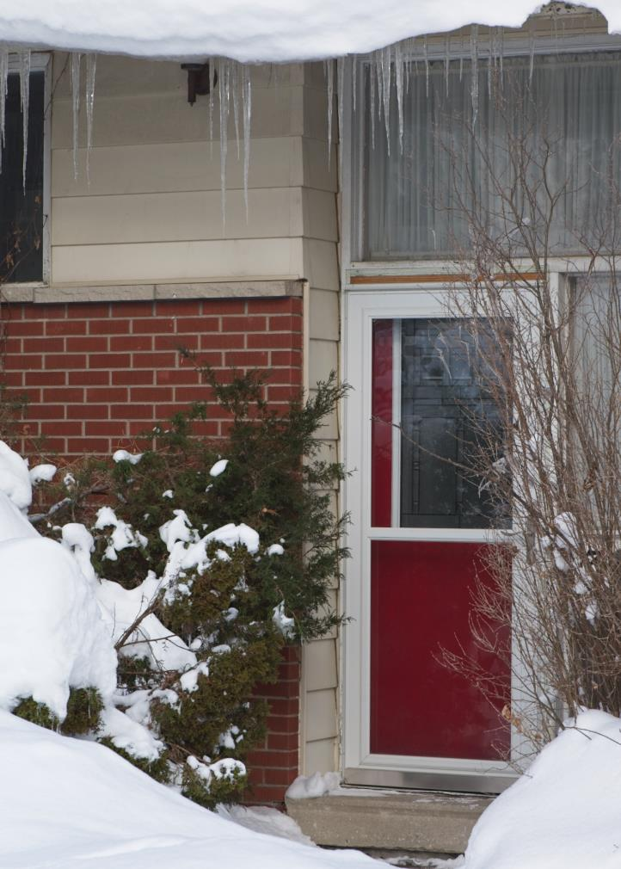
JPEG
shot in monochrome mode
Warmed in post
Cooled in post
RAW
shot in monochrome mode
RAW set to “as shot” colour temp in post (5,132K)
Out of camera

Slide 32
My happy medium
I shoot both RAW + JPEG
I download only JPEG onto my computer
If extensive editing is required, I download the RAW versions
Keeps more disc space available
Months later, I delete both off 128 GB SD card

Slide 33
Notices: Communications Director
Ehsan Roshani is stepping down
John Ingold will be taking over the Newsletters, Social Media and Event Calendar
Please show your thanks to Ehsan for some great work over the past few years and welcome John in his new role!

Slide 34
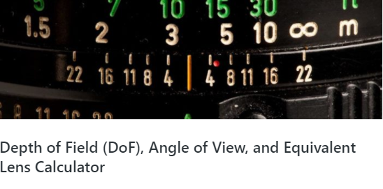
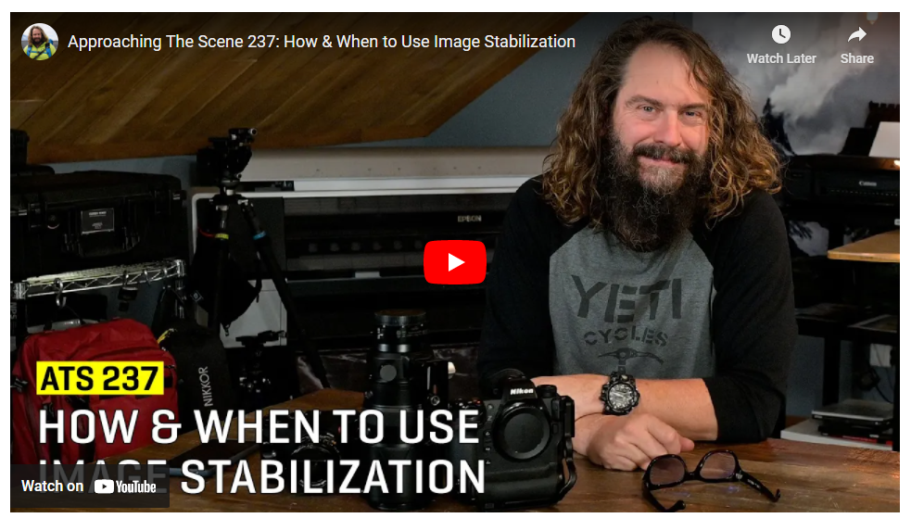
Notices: Additions to Resources pages
Chris Taylor has added two more
Depth of field calculator
Are there times when you should turn off image stabilization?
http://cpopc.ca Home > Members Only > Member Resources

Slide 35
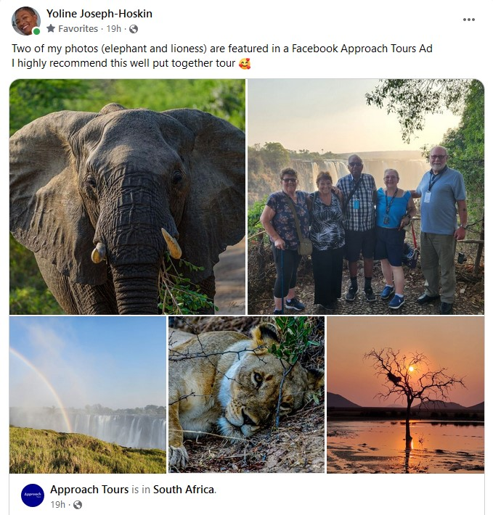
Notices:
Congratulations Yoline!
(When do we get to see more?)

Slide 36
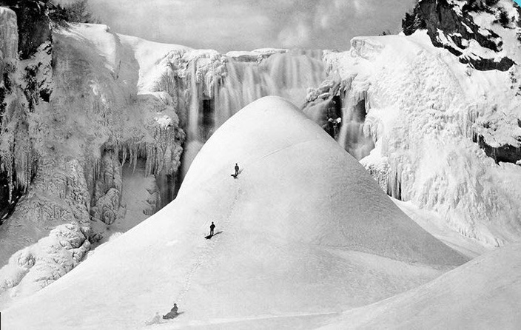
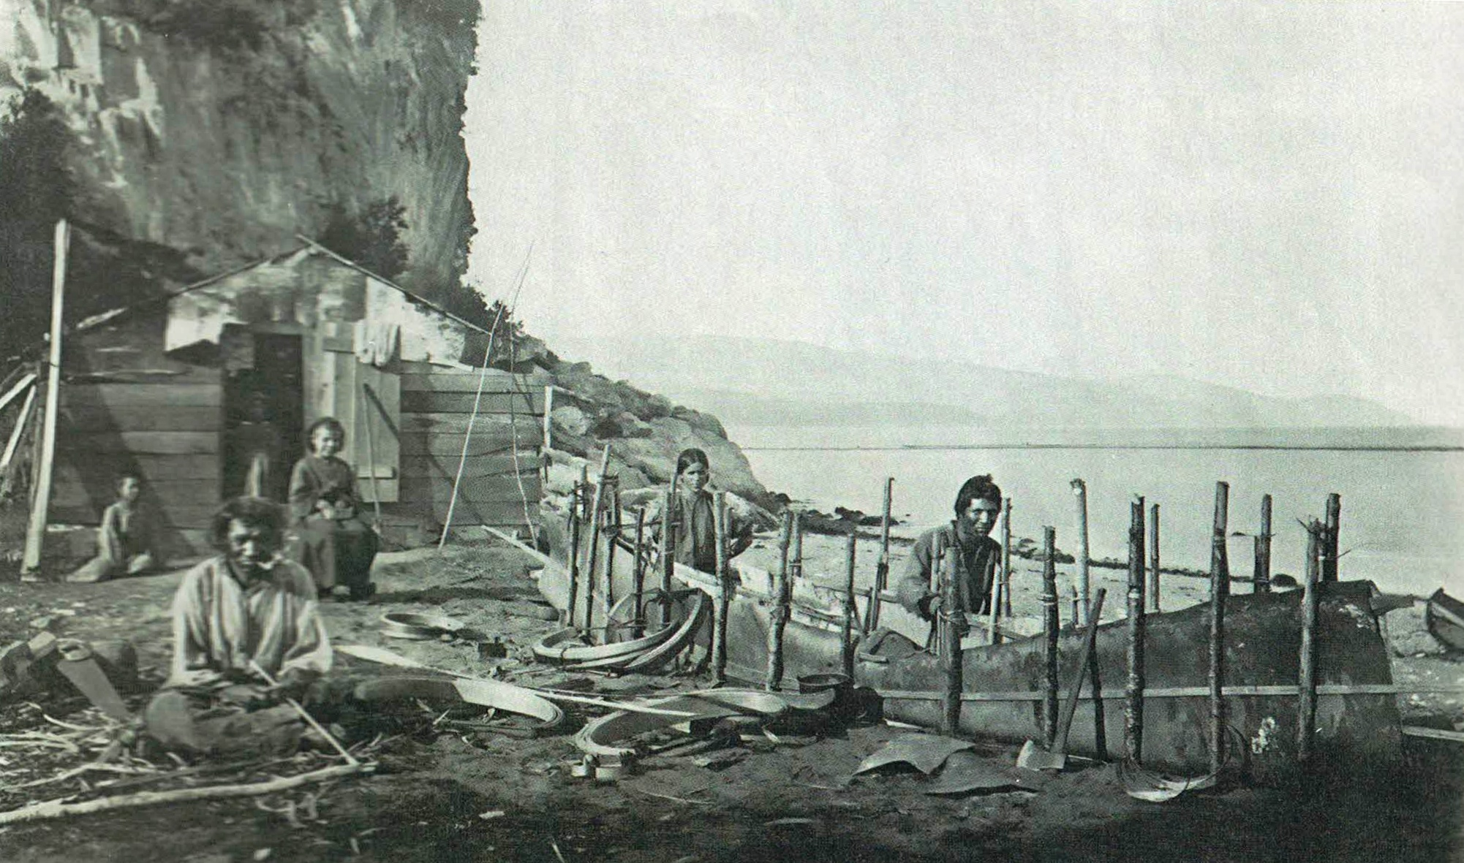
Notices: Alexander Henderson exhibit
250 images of 19th century Quebec
McCord Stewart Museum, 690 Sherbrooke Street West, Montreal
Until April 16th
Adult $19, Senior $17 for all exhibits

Slide 37
2022-23 Speaker and Topics Schedule Programs Director: Marianne Pethke Competitions Director: Lynda Buske

Slide 38
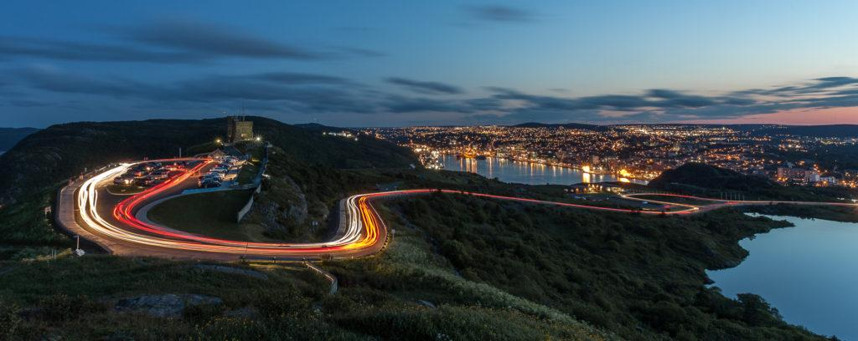
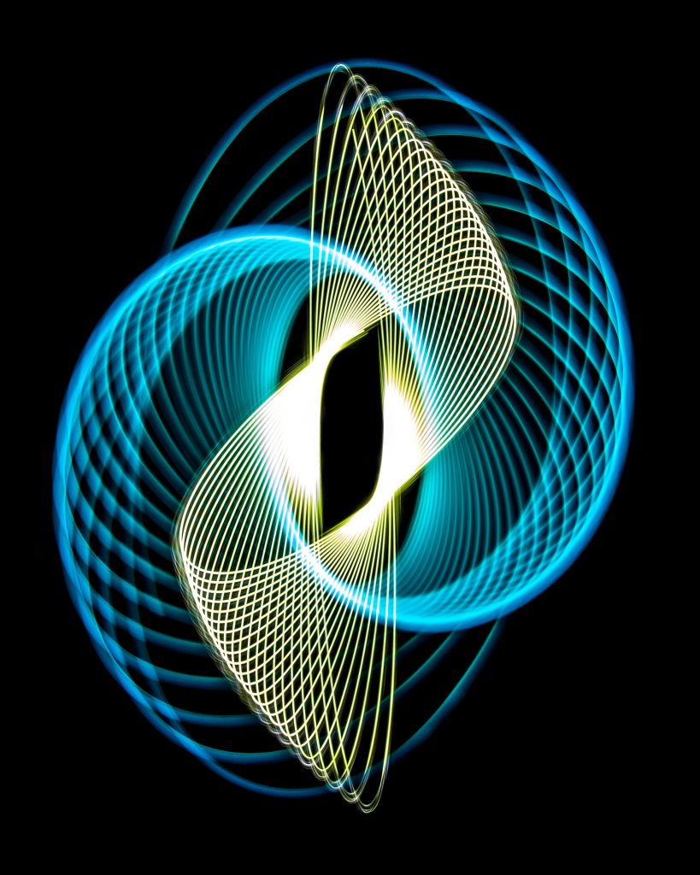
April Meeting
Saturday April 8, Club Meeting on Zoom, 9.30am to 12 noon
Featured speaker: Scott Udle: My Approach to a Shot
Challenge: Diagonal Lines (submission deadline Sat April 1, voting deadline Thurs April 6)
Technique: Fill the Frame (submission deadline Wed April 5)
Photo 101: TBA
Scott Udle

