Slide 1
CPOPC November 2022
Alan White – November 12, 2022

Slide 2
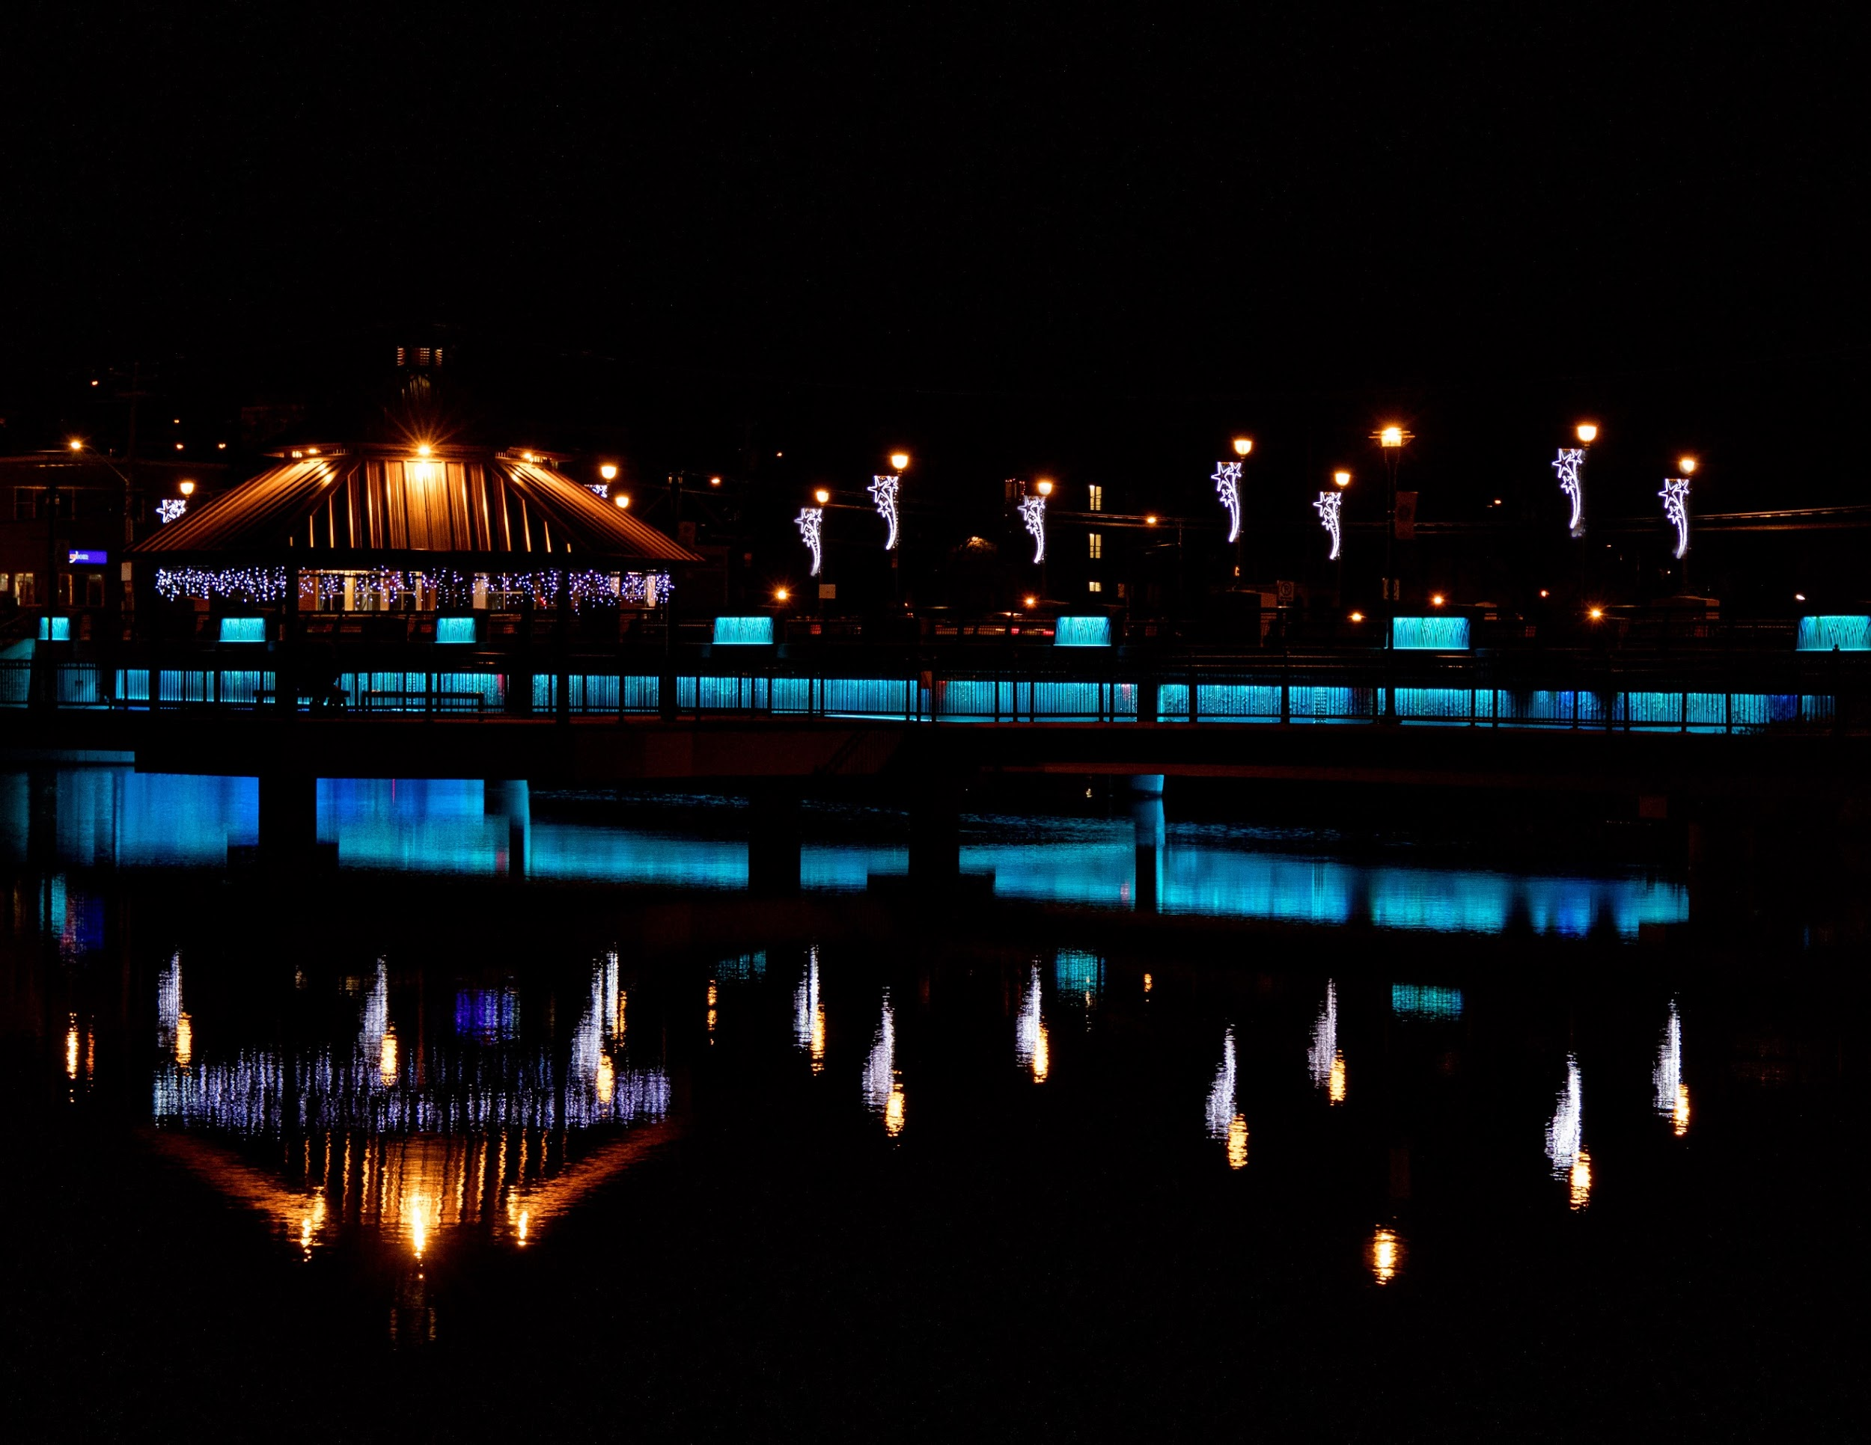
Welcome
Acknowledgement of guests and prospective members
Membership dues reminder
Zoom difficulties? - Email John Miner john@miner.ca
10 min break between 10:30 and 11am
Our agenda
Johan Carignan
“Beauty”- 2021 Scavenger Hunt

Slide 3
October 2022
Agenda topics
Featured Speaker – Stephen DesRoches
Upcoming Outing and Social Event
Scavenger Hunt announcement
Member Contributions - Gatineau park outing
October Technique Review - ICM
October Challenge - Rocks
November Challenge and Competition reminders
Photography 101- Compression explained
Notices
Next Meeting
Marianne Pethke
“Artistic”- 2020 Scavenger Hunt

Slide 4
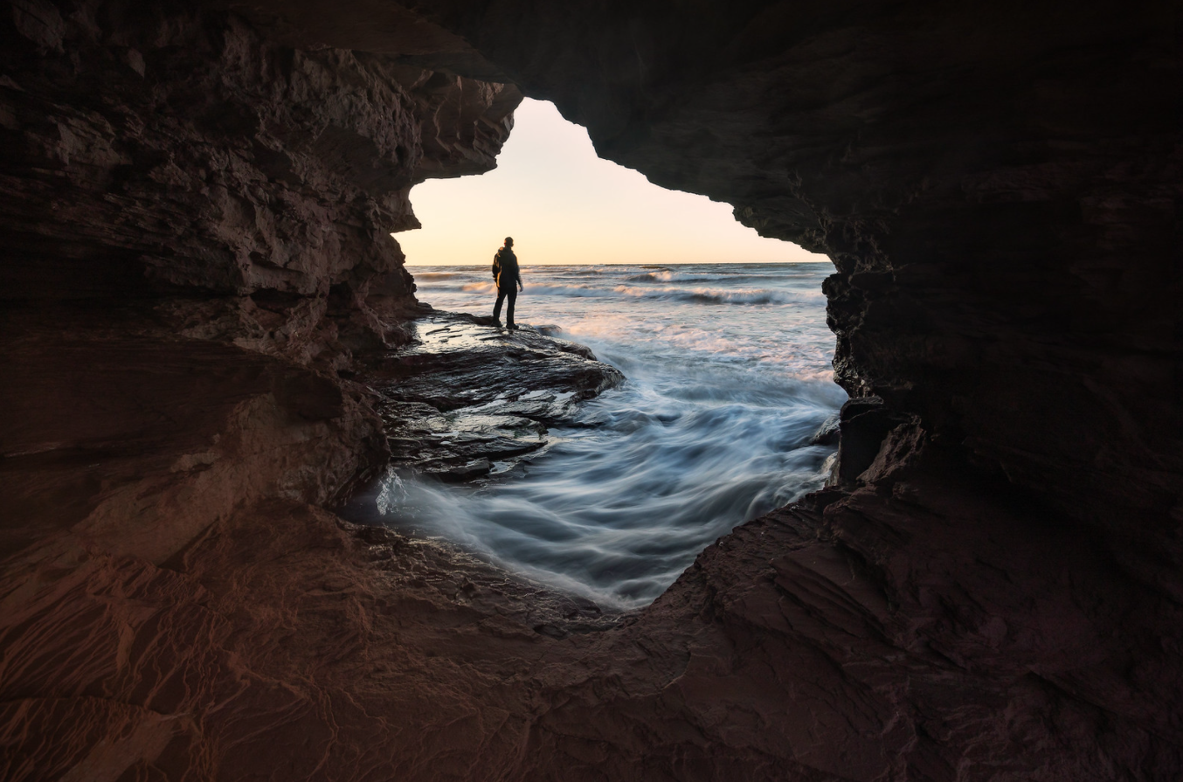
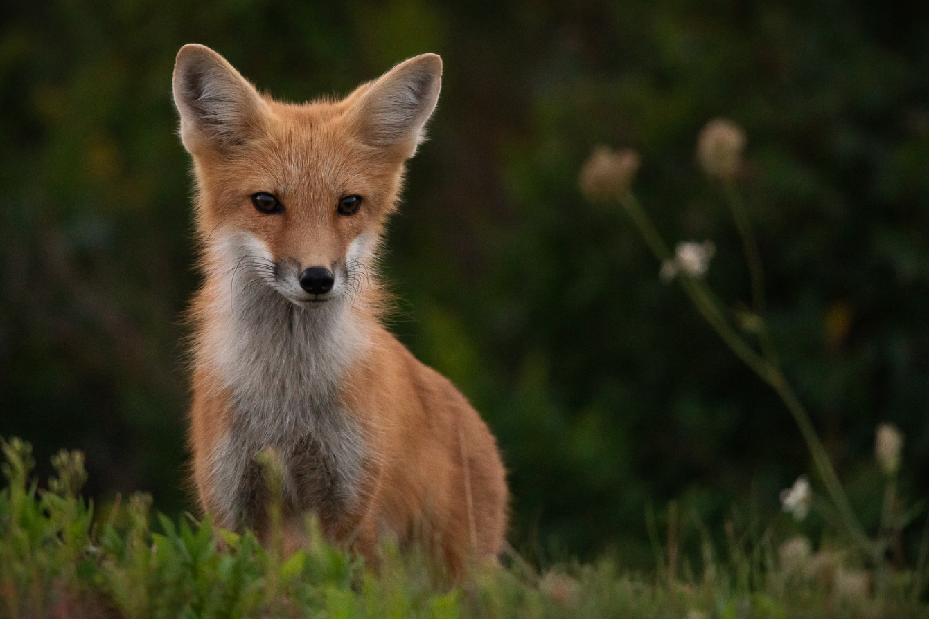
Featured Presenter
Featured Presenter:
Stephen DesRoches
Landscape and Nature
Photography
https://www.stephendesroches.com/

Slide 5
Upcoming Outing and Social Event Programs Director; Marianne Pethke
Cumberland Museum Christmas Lights
Sunday December 4 at 3.30pm
This is an opportunity to practice low light shooting and maybe get creative with ICM after dark.
Registration opens November 17
Christmas POT LUCK social event and equipment swap
Saturday, December 17 at Queenswood Heights Community Centre, 10.30am to 1pm
Not a replacement for the regular meeting but a chance to meet old friends and share in the holiday spirit. Bring along any equipment for sale or give away. Guests are welcome!
Registration opens December 1
Both are free with your membership.
Solange Boulet-Bélanger
“Magic”- 2020 Scavenger Hunt

Slide 6
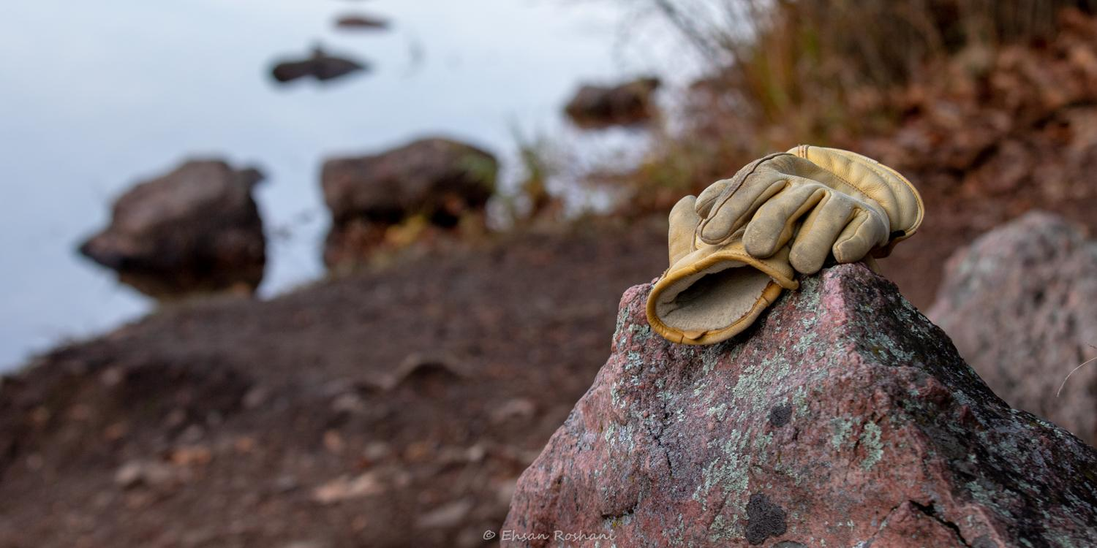
Outing: Gatineau Park, October 29 Leader; Ehsan Roshani
Ehsan Roshani

Slide 7
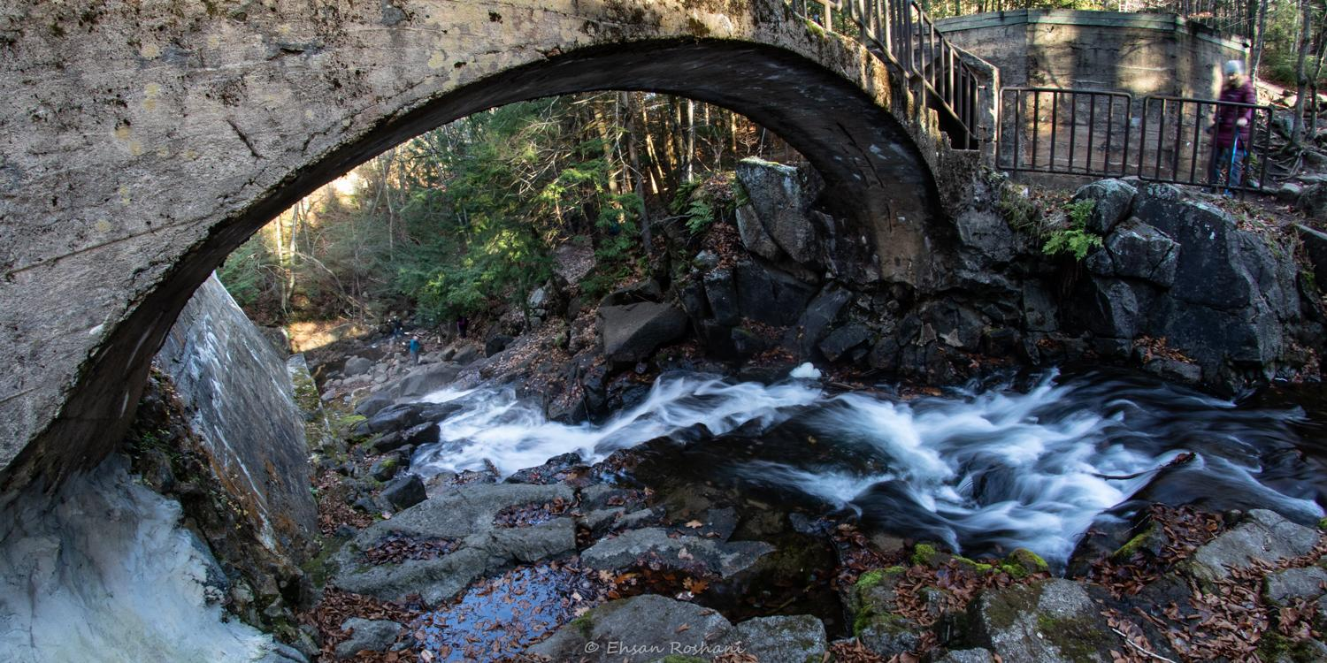
Outing: Gatineau Park, October 29
Ehsan Roshani

Slide 8
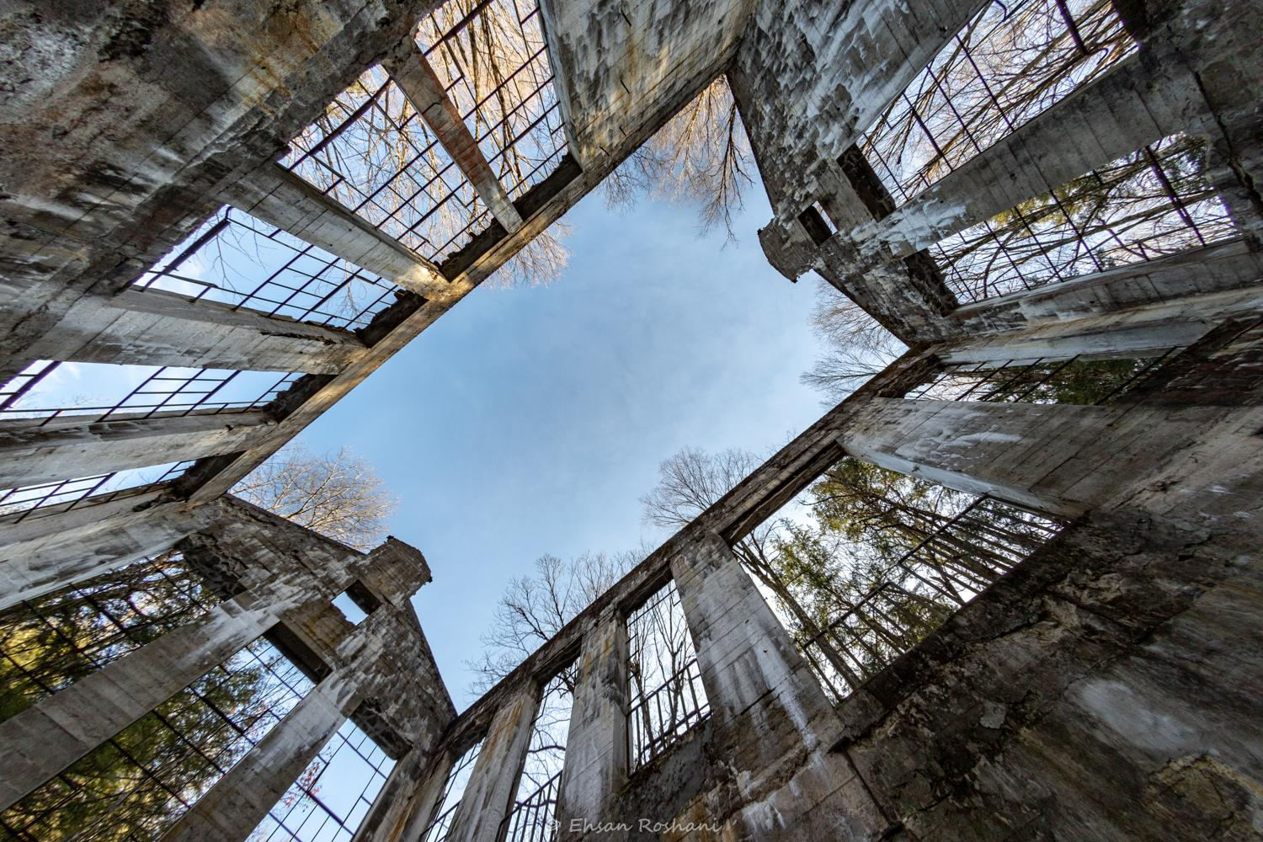
Outing: Gatineau Park, October 29
Ehsan Roshani

Slide 9
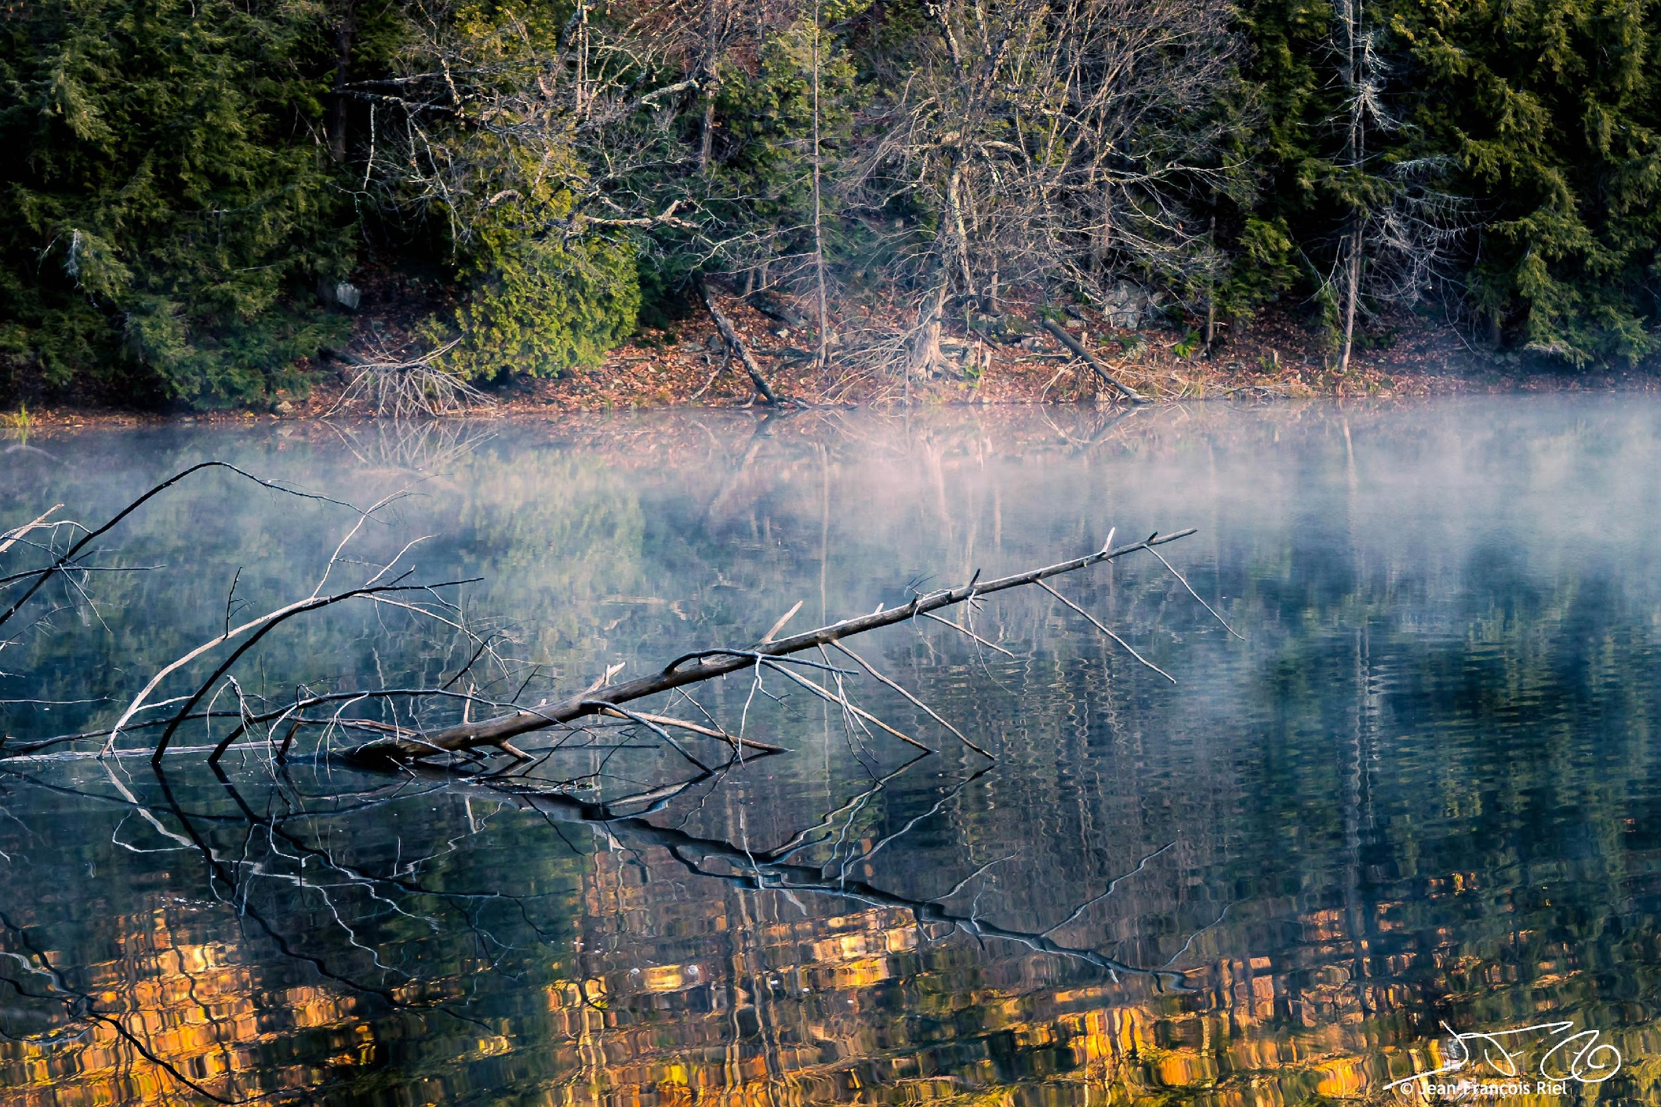
Outing: Gatineau Park, October 29
Jean-Francois Riel

Slide 10
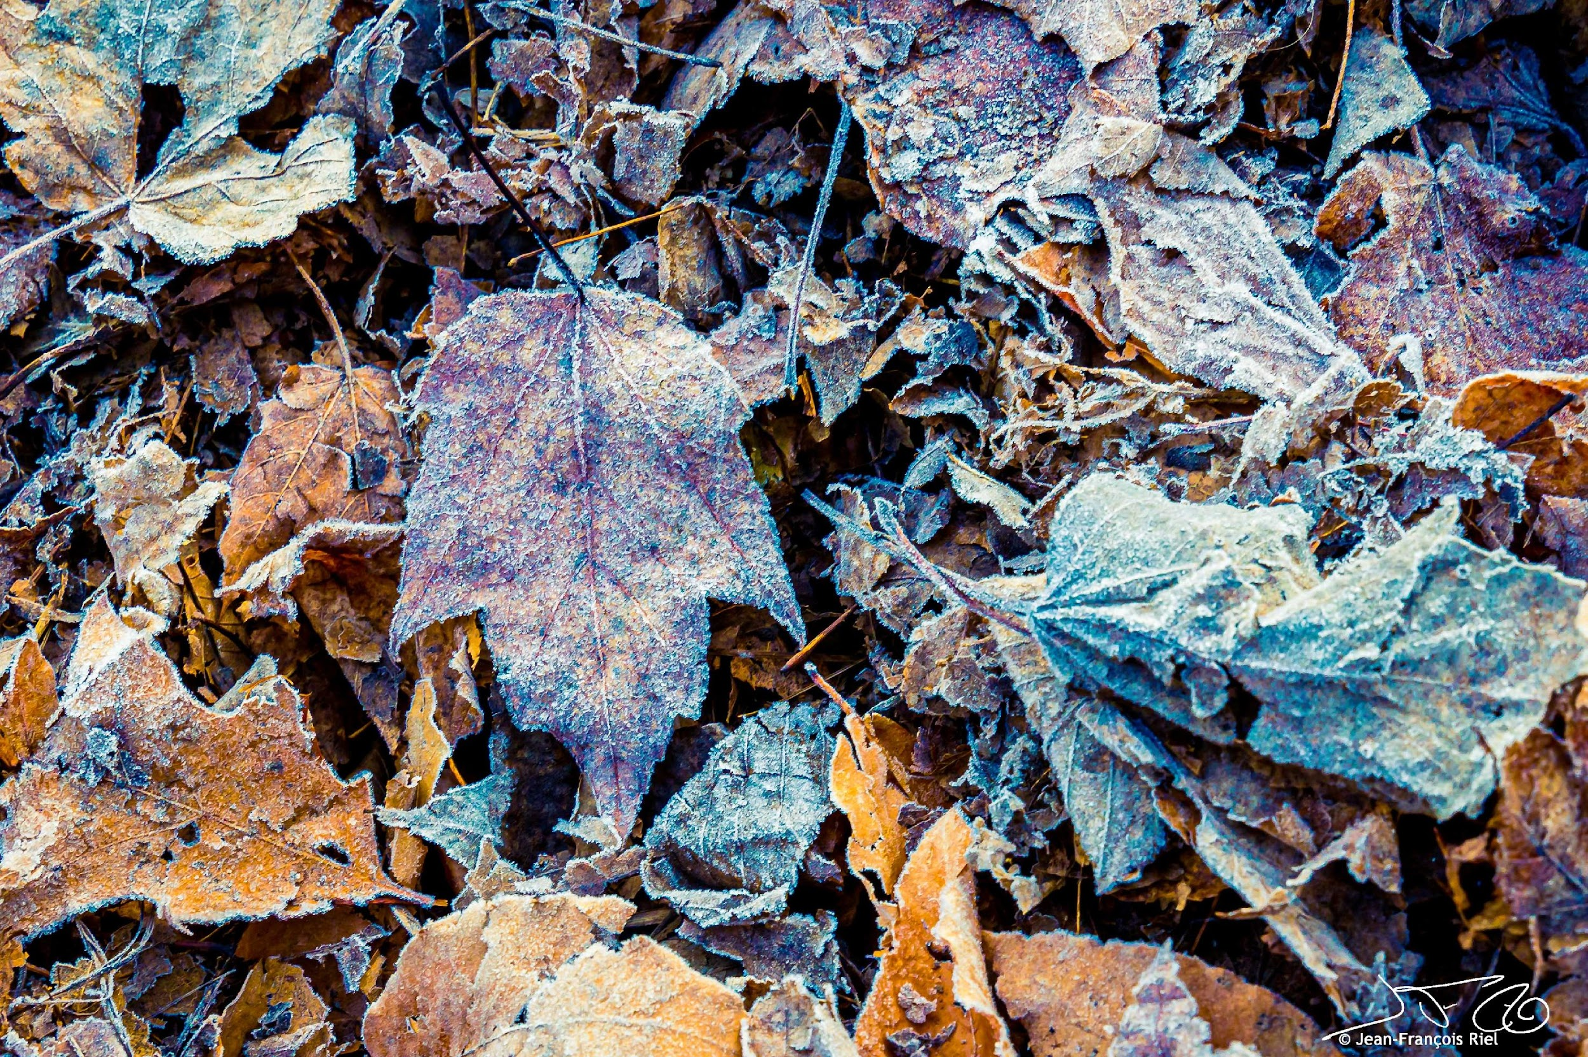
Outing: Gatineau Park, October 29
Jean-Francois Riel

Slide 11
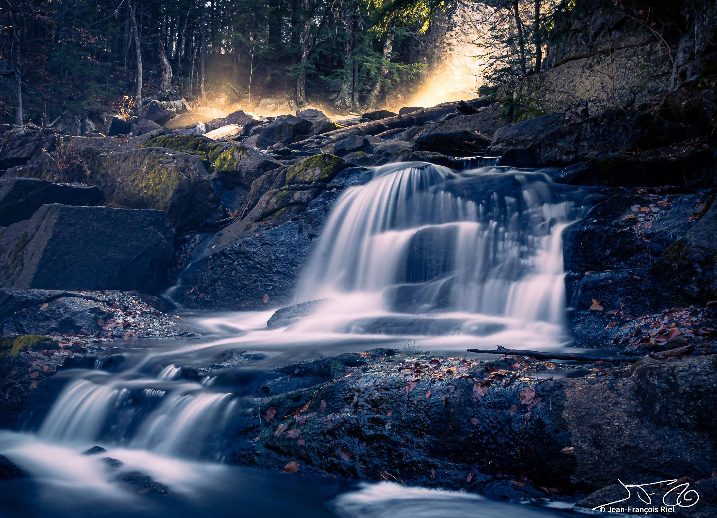
Outing: Gatineau Park, October 29
Jean-Francois Riel

Slide 12
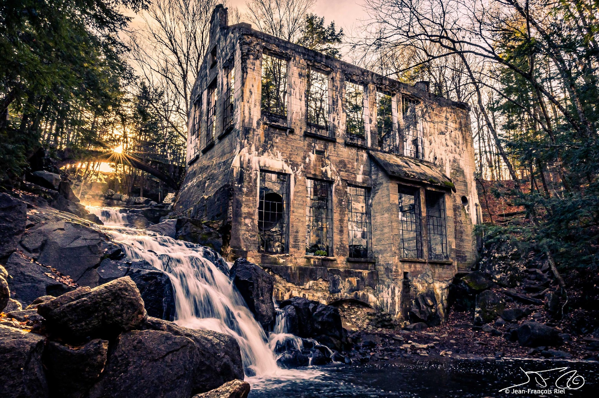
Outing: Gatineau Park, October 29
Jean-Francois Riel

Slide 13
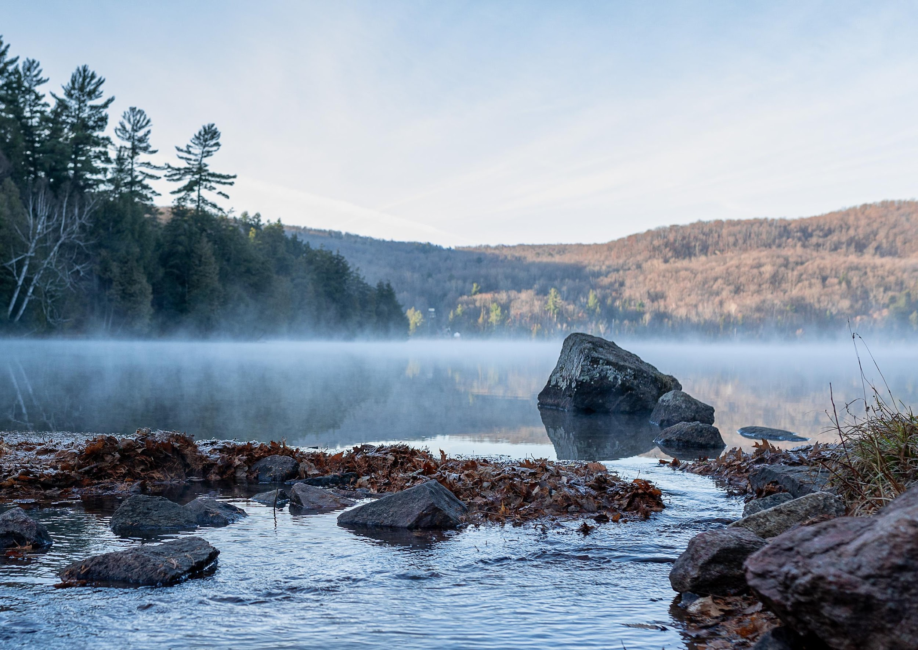
Outing: Gatineau Park, October 29
Johan Carignan

Slide 14
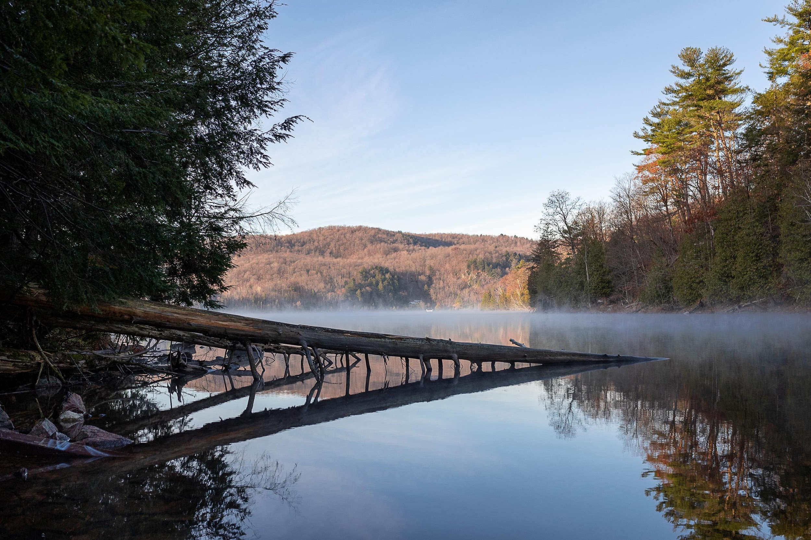
Outing: Gatineau Park, October 29
Johan Carignan

Slide 15
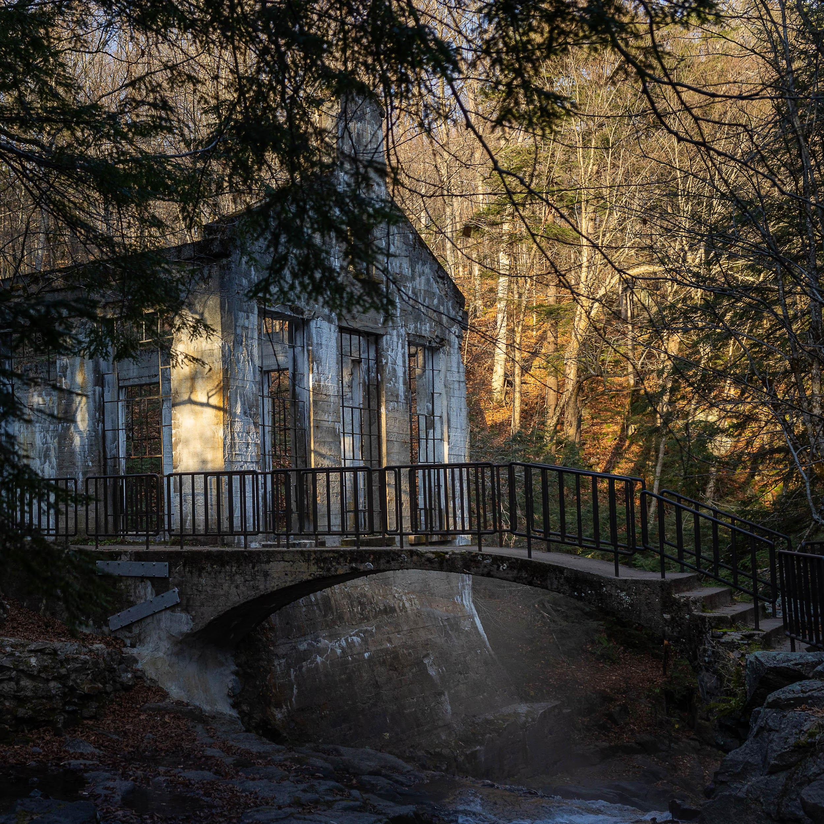
Outing: Gatineau Park, October 29
Johan Carignan

Slide 16
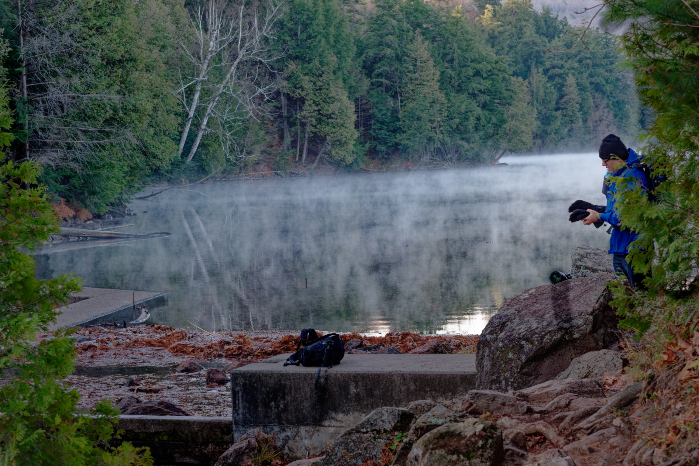
Outing: Gatineau Park, October 29
Ken Udle

Slide 17
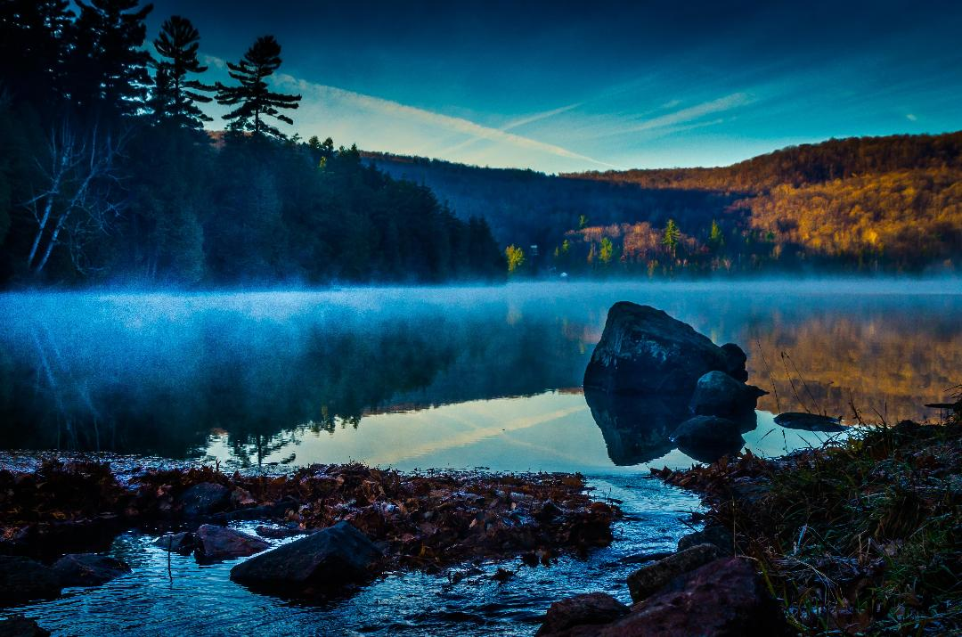
Outing: Gatineau Park , October 29
Pierre

Slide 18
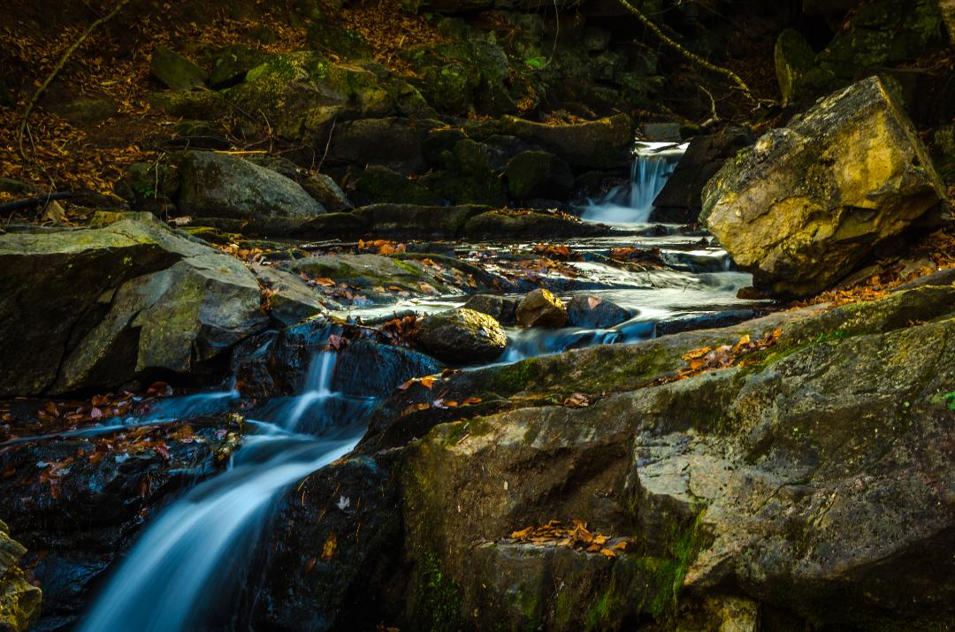
Outing: Gatineau Park, October 29
Pierre

Slide 19
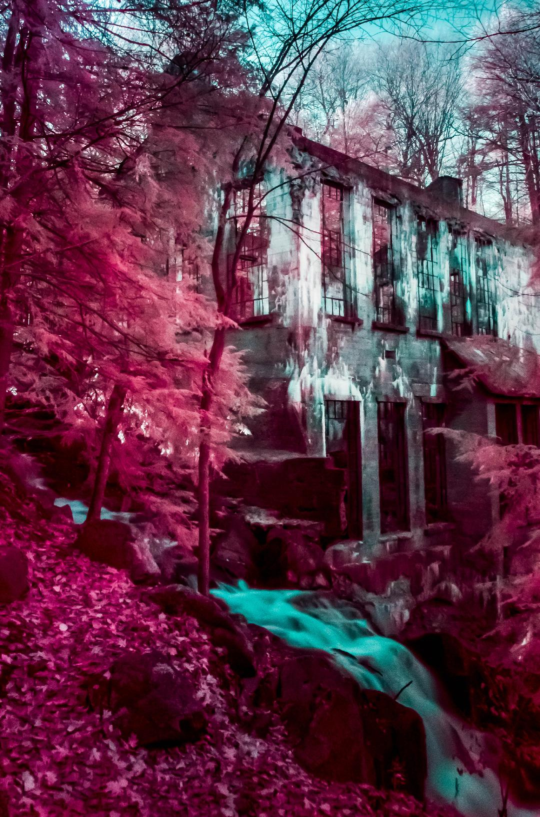
Outing: Gatineau Park, October 29
Pierre

Slide 20
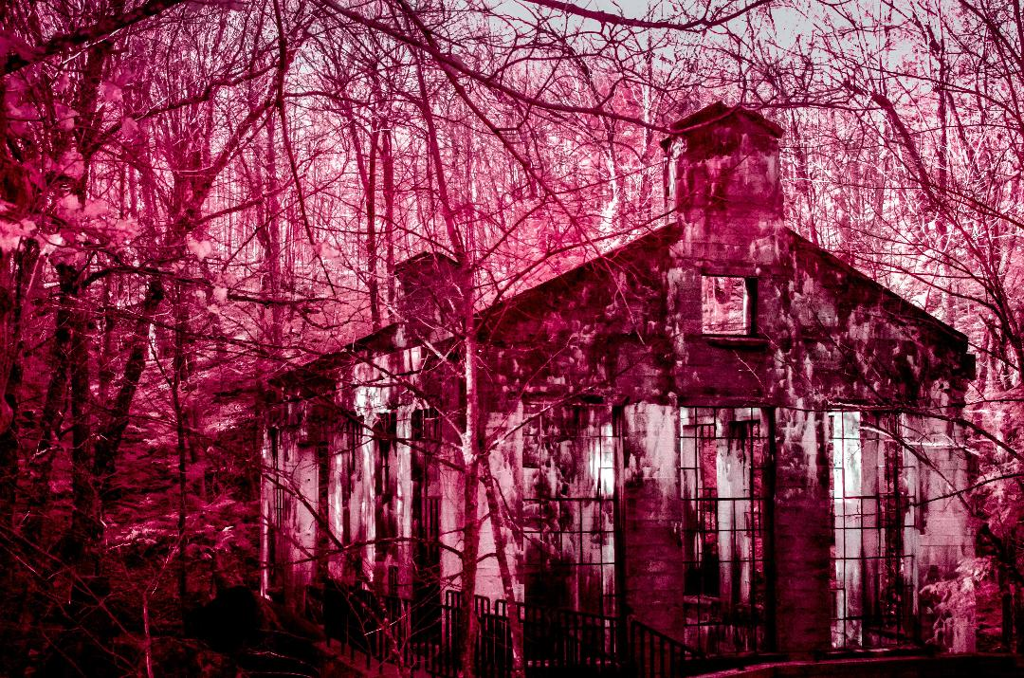
Outing: Gatineau Park, October 29
Pierre

Slide 21
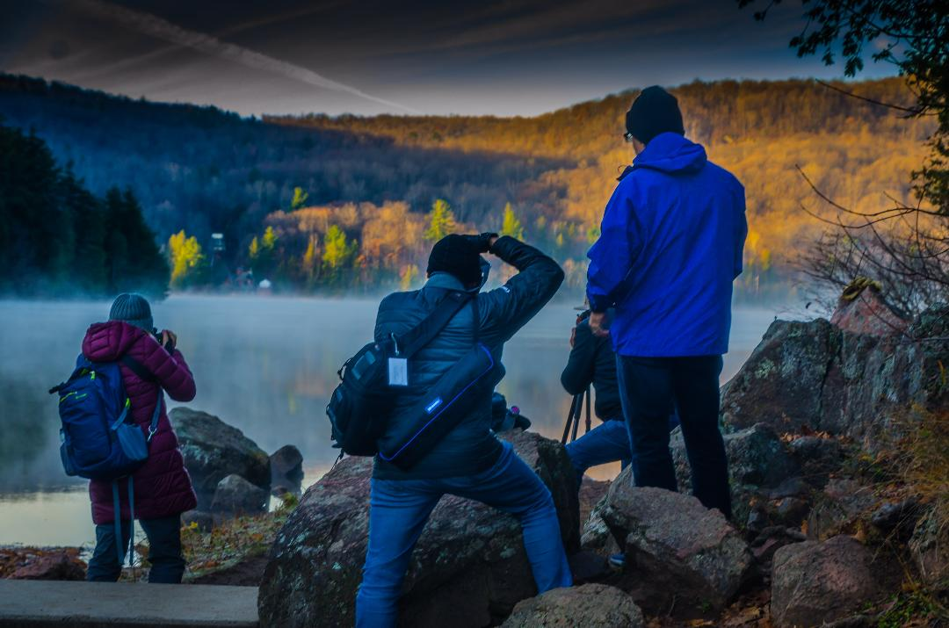
Outing: Gatineau Park, October 29
Pierre

Slide 22
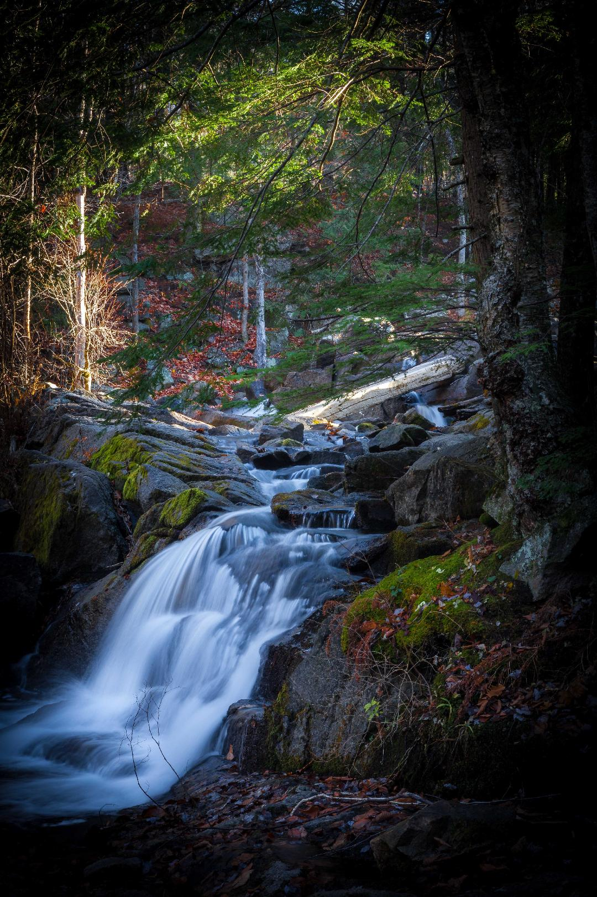
Outing: Gatineau Park, October 29
Scott Udle

Slide 23
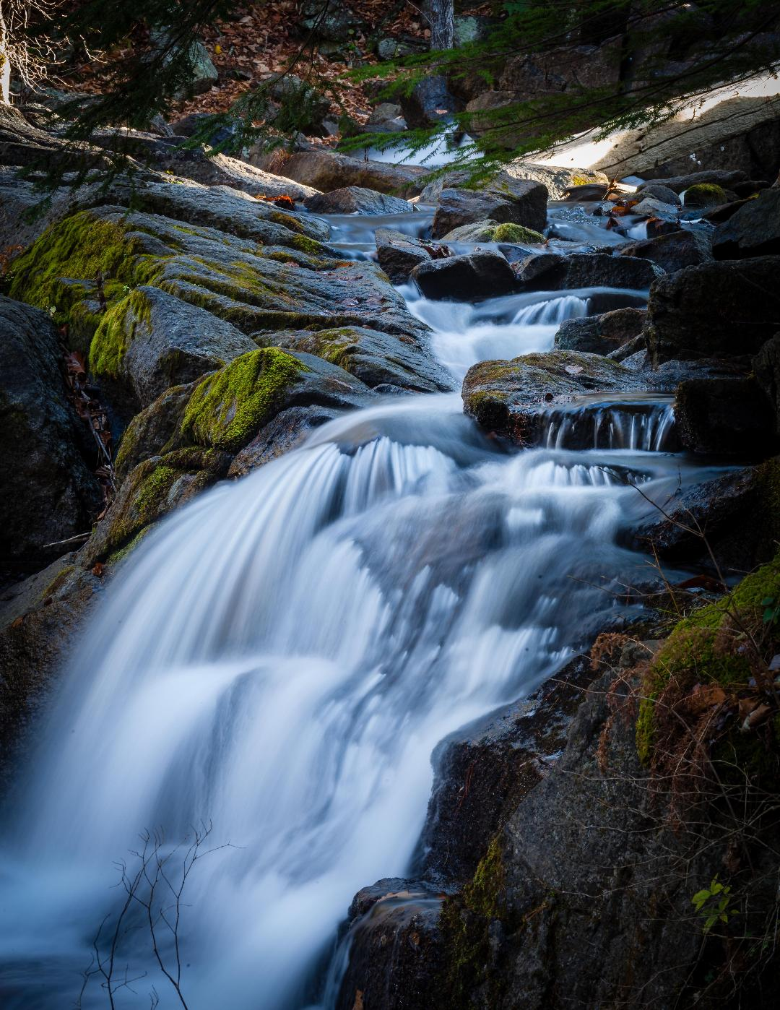
Outing: Gatineau Park, October 29
Scott Udle

Slide 24
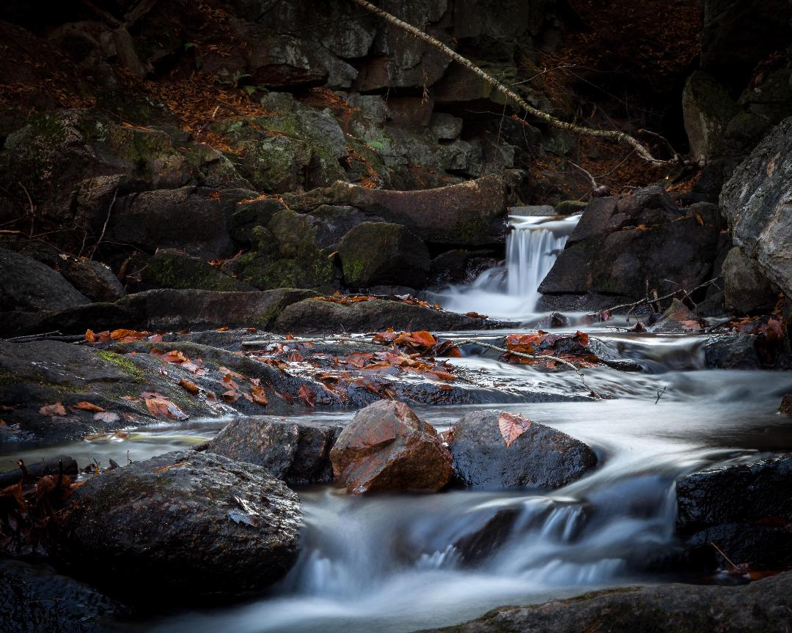
Outing: Gatineau Park, October 29
Scott Udle

Slide 25
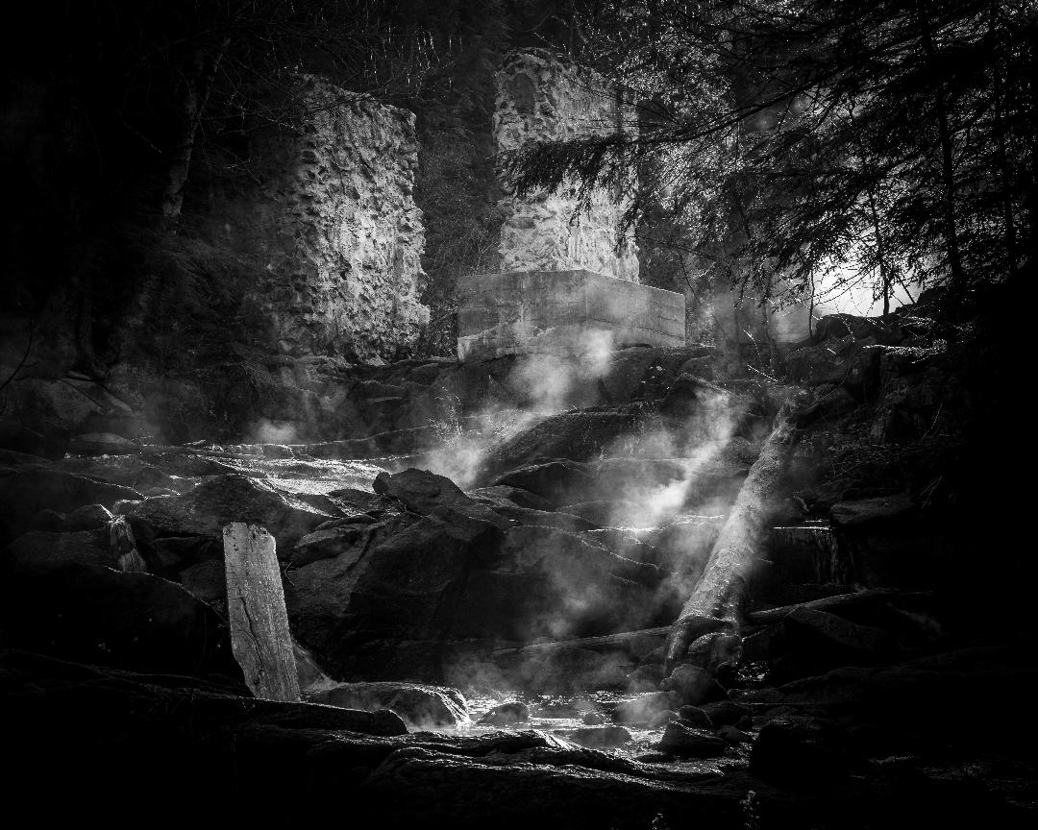
Outing: Gatineau Park, October 29
Scott Udle

Slide 26
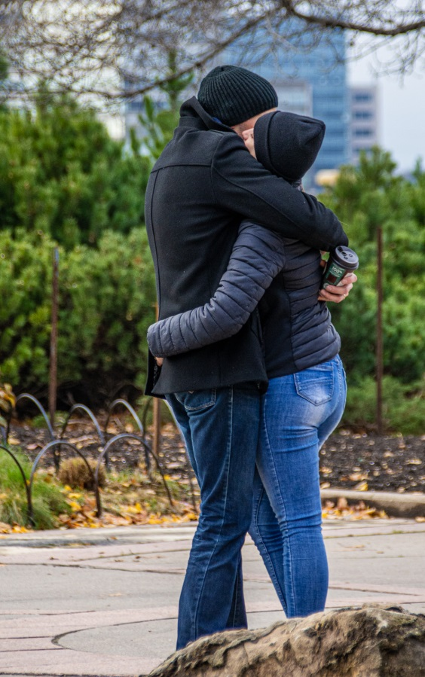
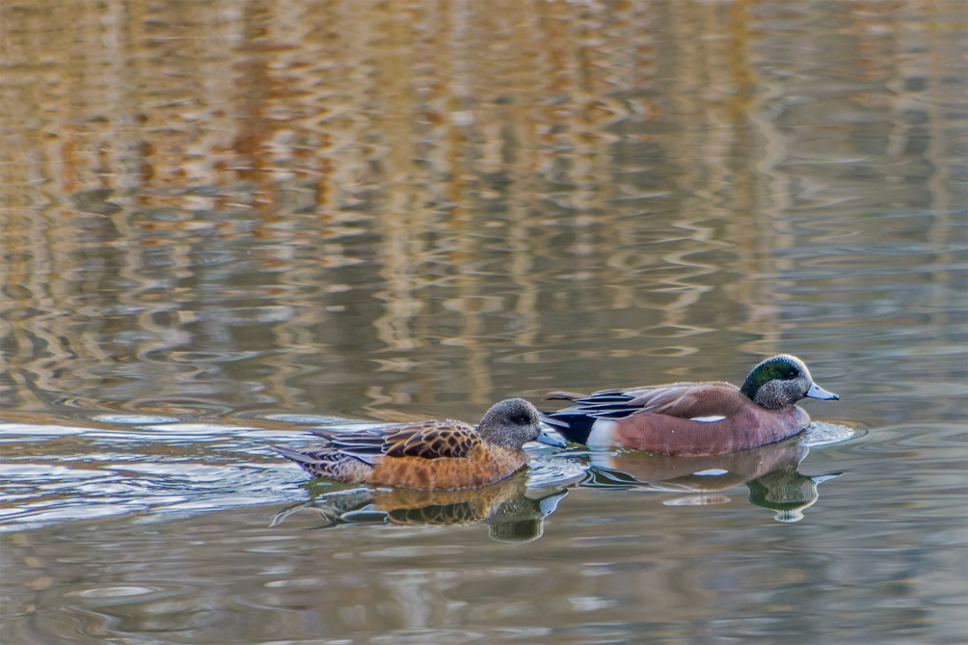
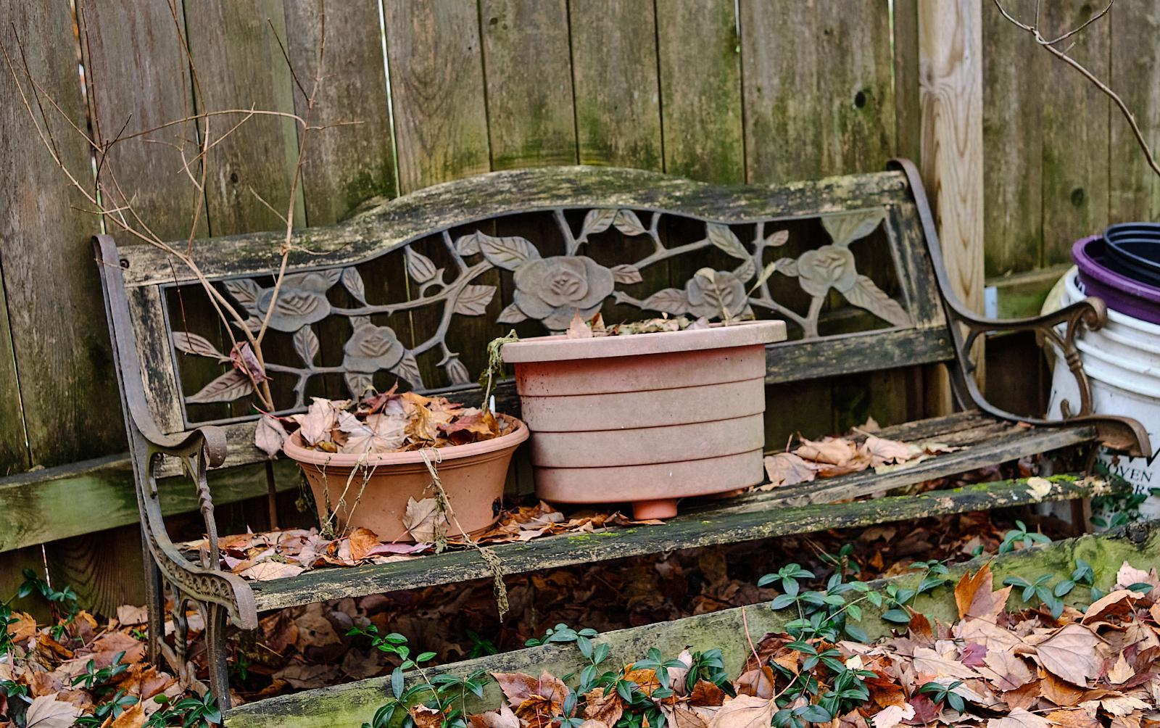
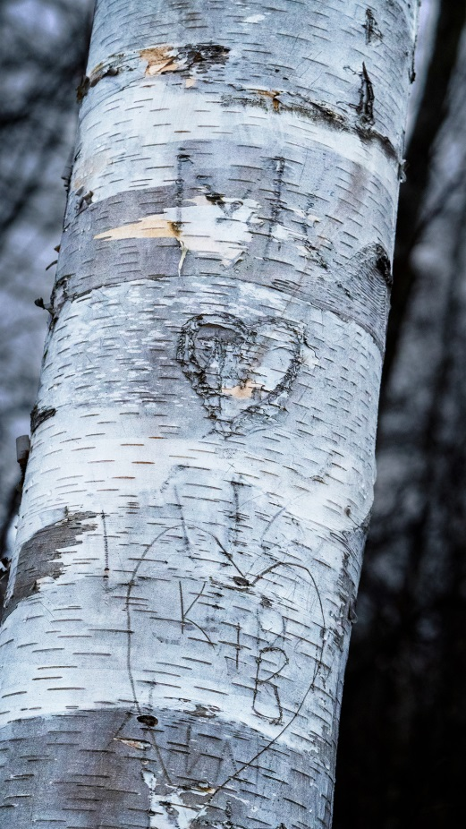
Presentations and Workshops
Scavenger Hunt 2022
Looking Up
Beverly Dawson
Love & friendship
No need to register
24 Topics to be released by email at 6pm on Friday 18 November
Your shooting to be completed over the weekend of 19,20 November
Post processing is allowed
Choose your best 6 pictures (one per topic)
Submit on website page by midnight November 30
All submissions will be shown during the December meeting
No judging, no prizes, just for fun!
Images are from 2021 Scavenger Hunt
Beverly Dawson
Kathy Burke
Ramesh Chauhan
Abandonment
Ken Udle

Slide 27
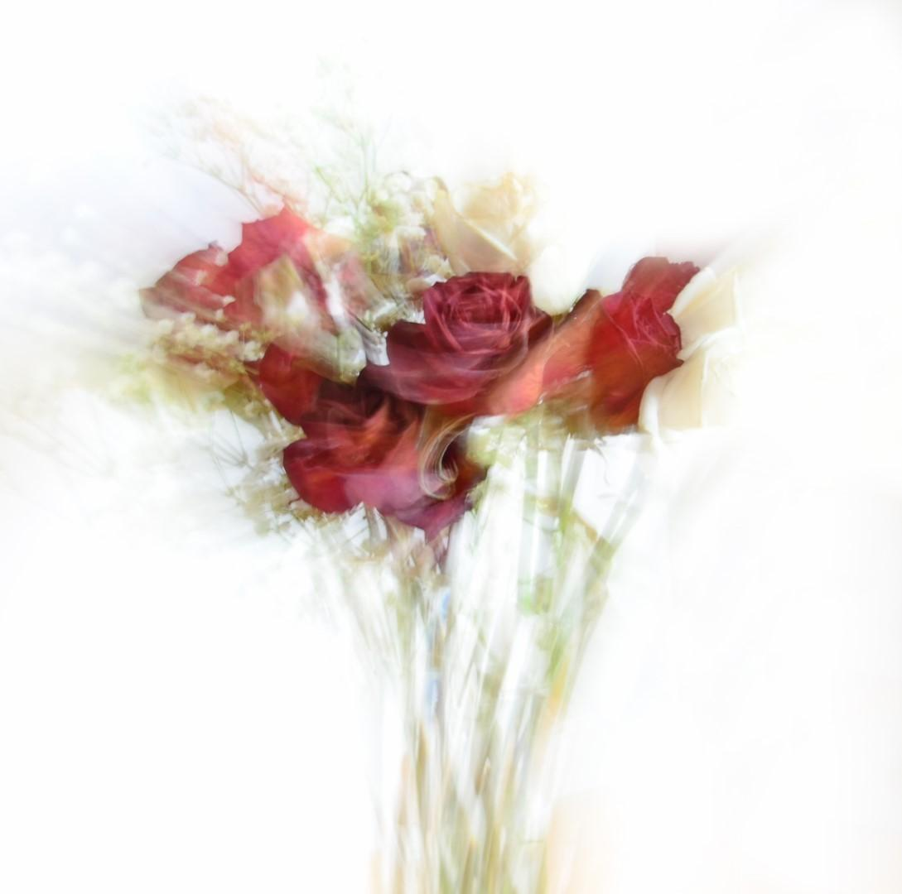
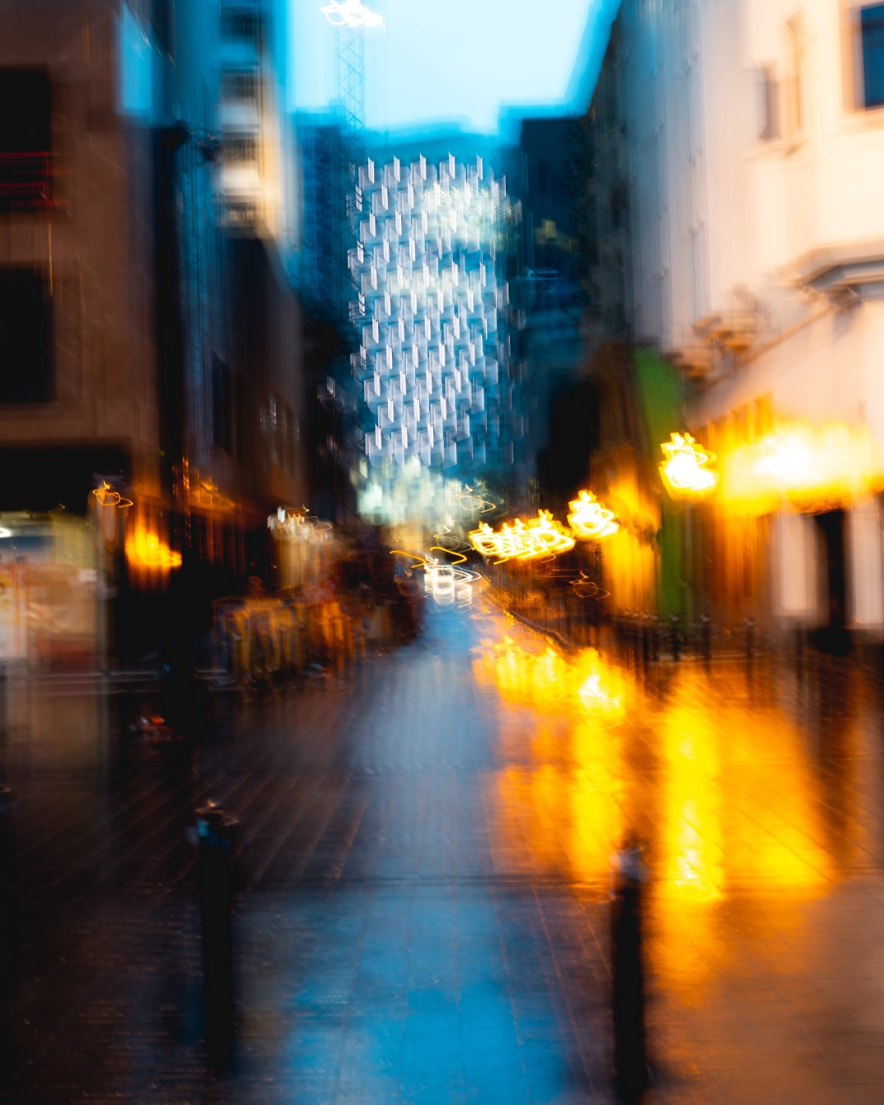
Novenber Technique – ICM (Intentional Camera Movement)
Purposely moving the camera while the shutter is activated.
May physically move the camera body in a specific way (up/down, circle) or zoom in and out while the shutter is released.
Create a stylized recognizable image or pure abstract
Sharon Fry
Maksym
Tymchyk
Frédéric Paulussen

Slide 28
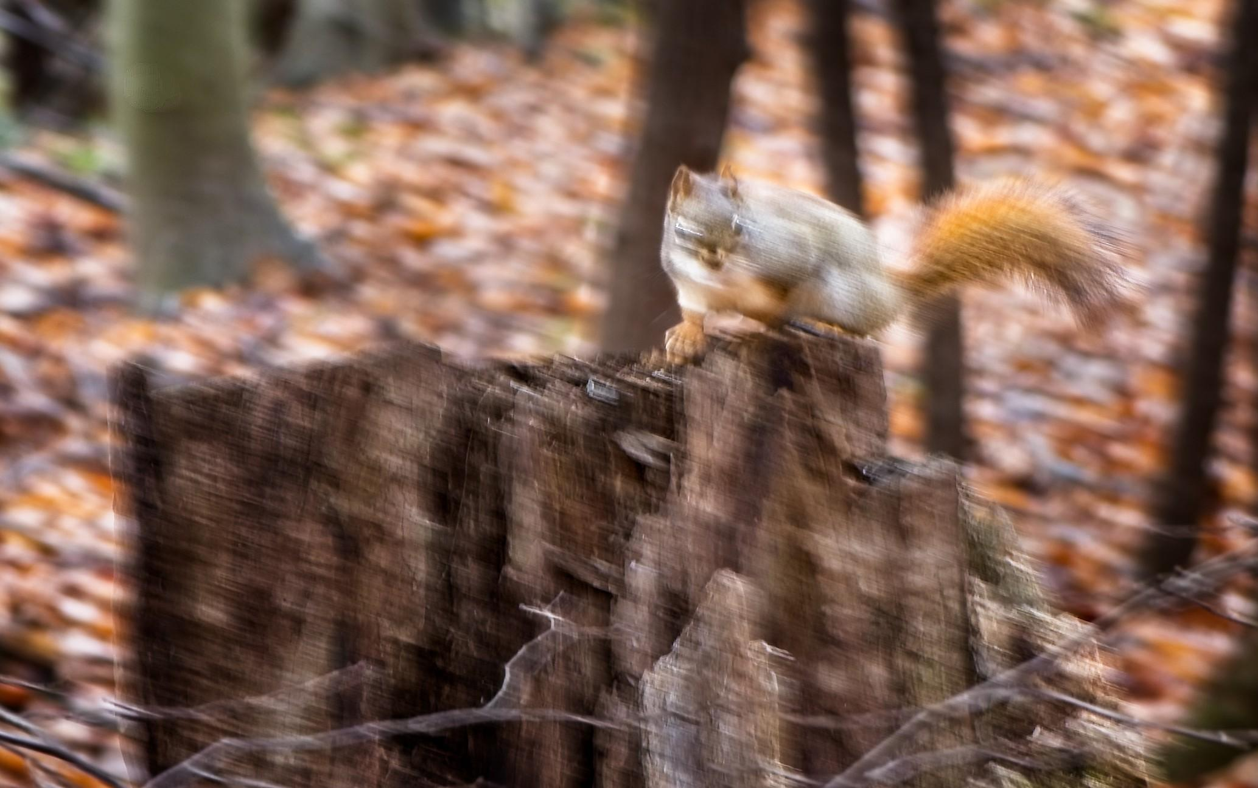
Technique – ICM (intentional camera movement)
Chris Taylor

Slide 29
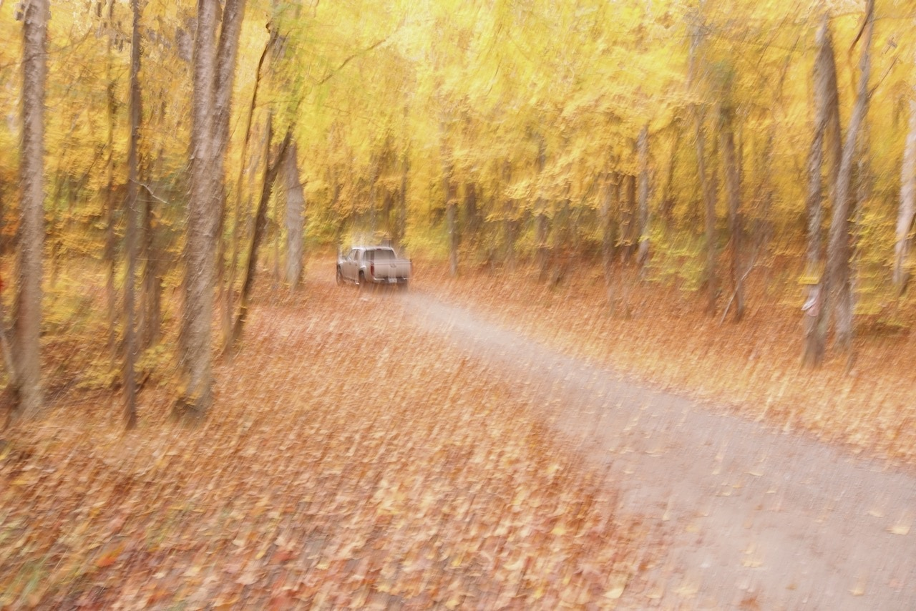
Christine Martel

Slide 30
Sharon Fry

Slide 31
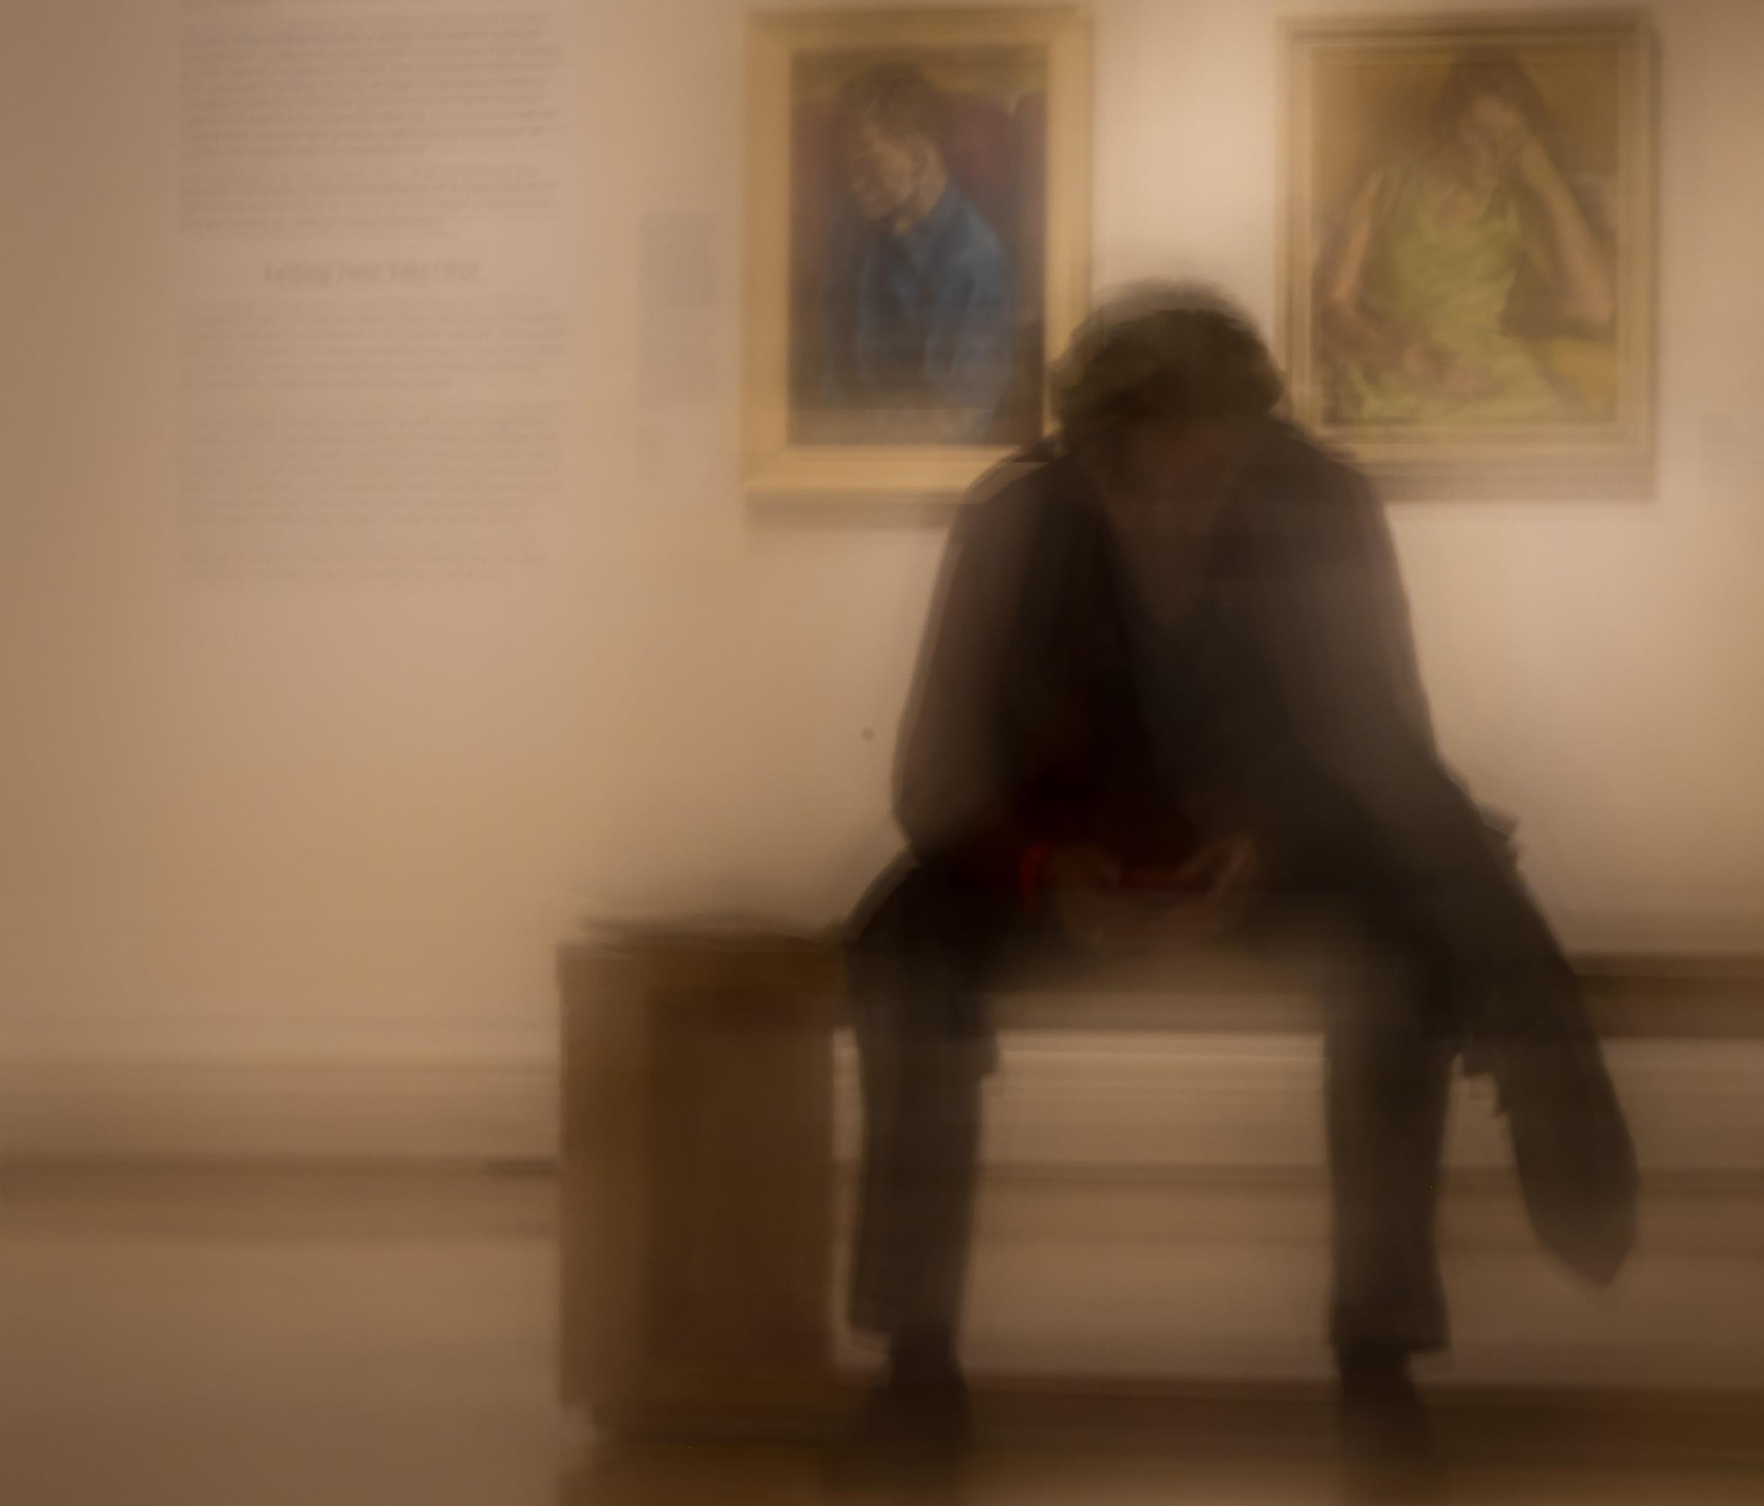
Jean-François Riel

Slide 32
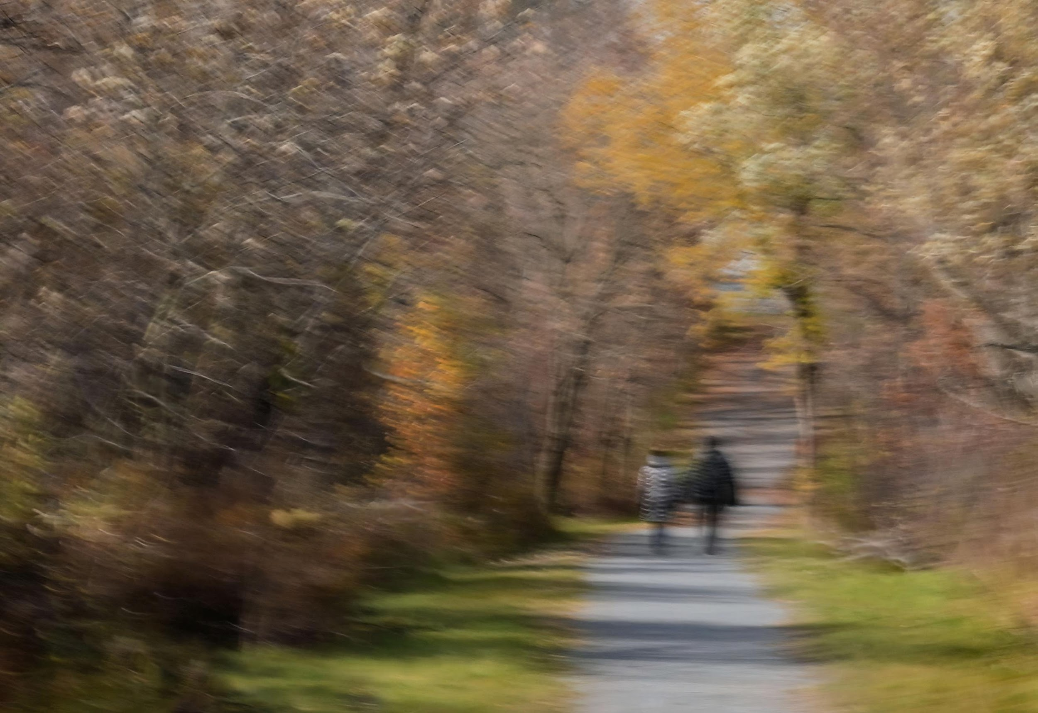
Marianne Pethke

Slide 33
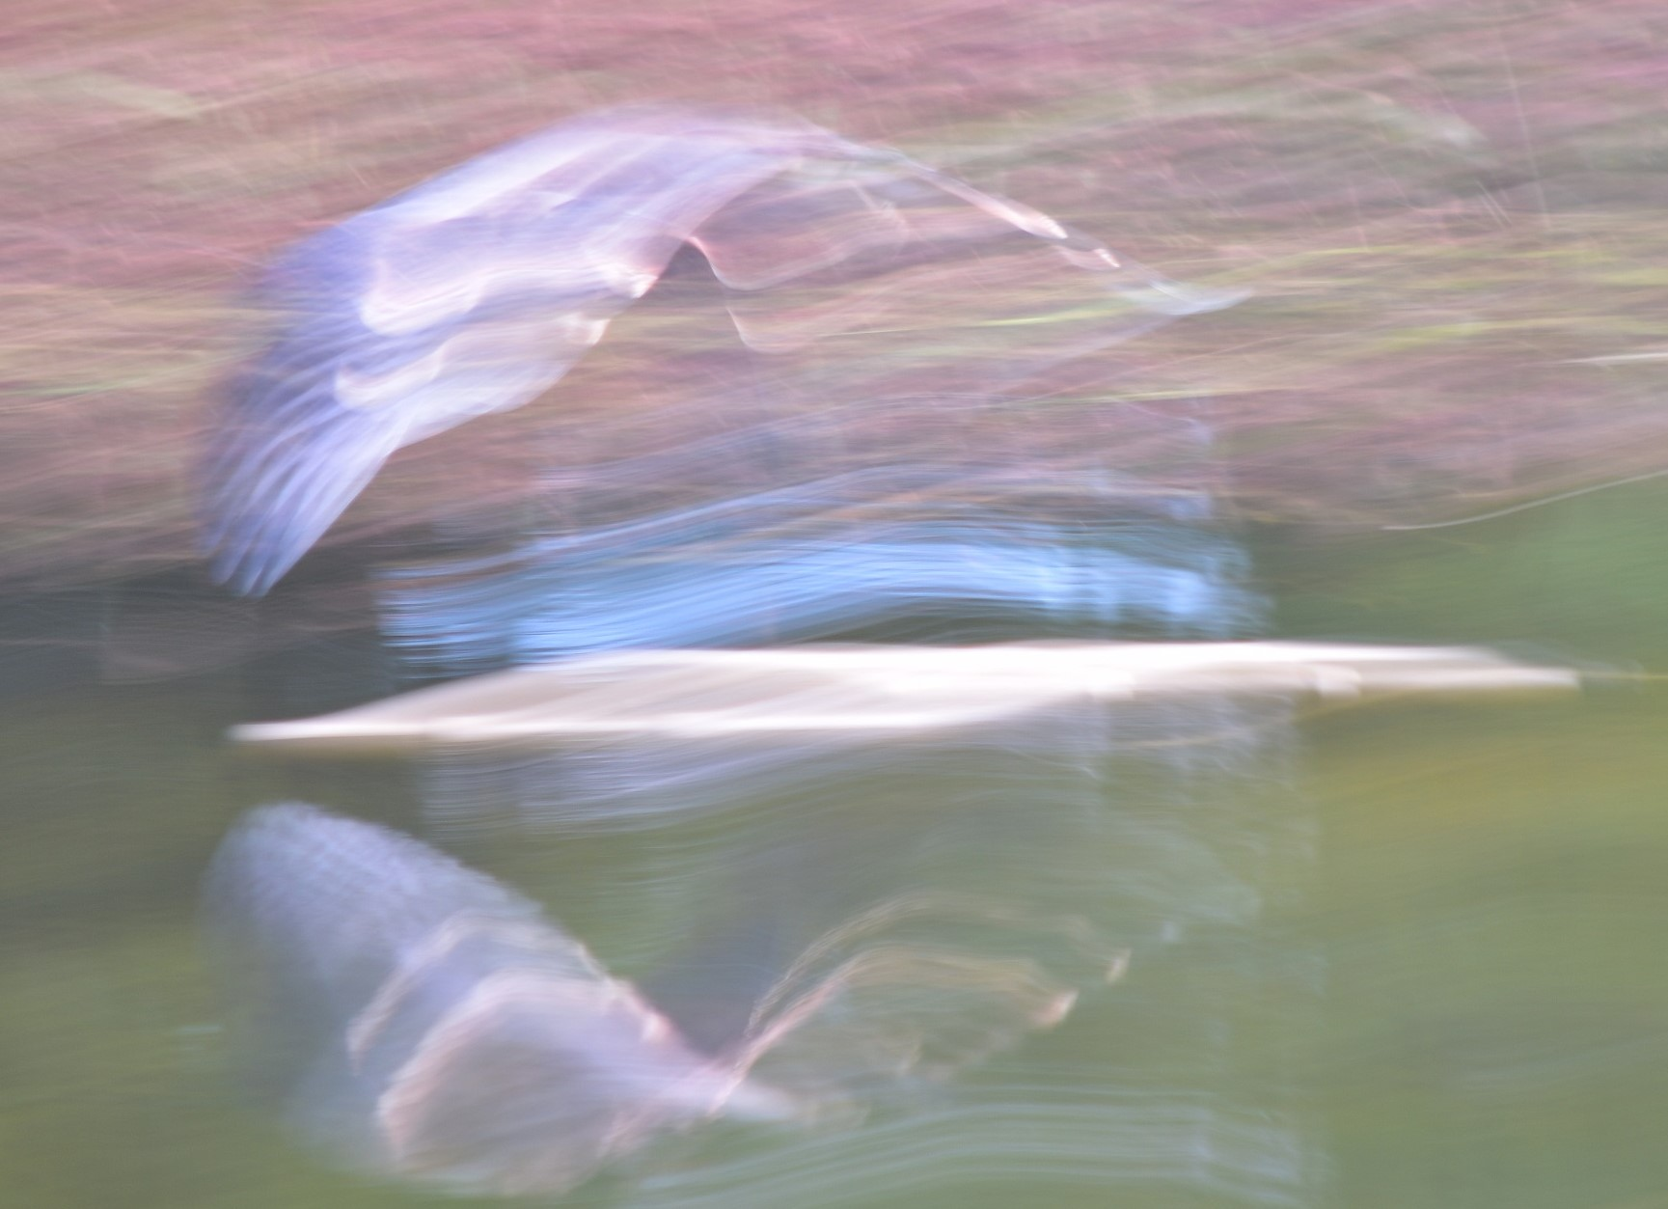
Wendy Noble

Slide 34
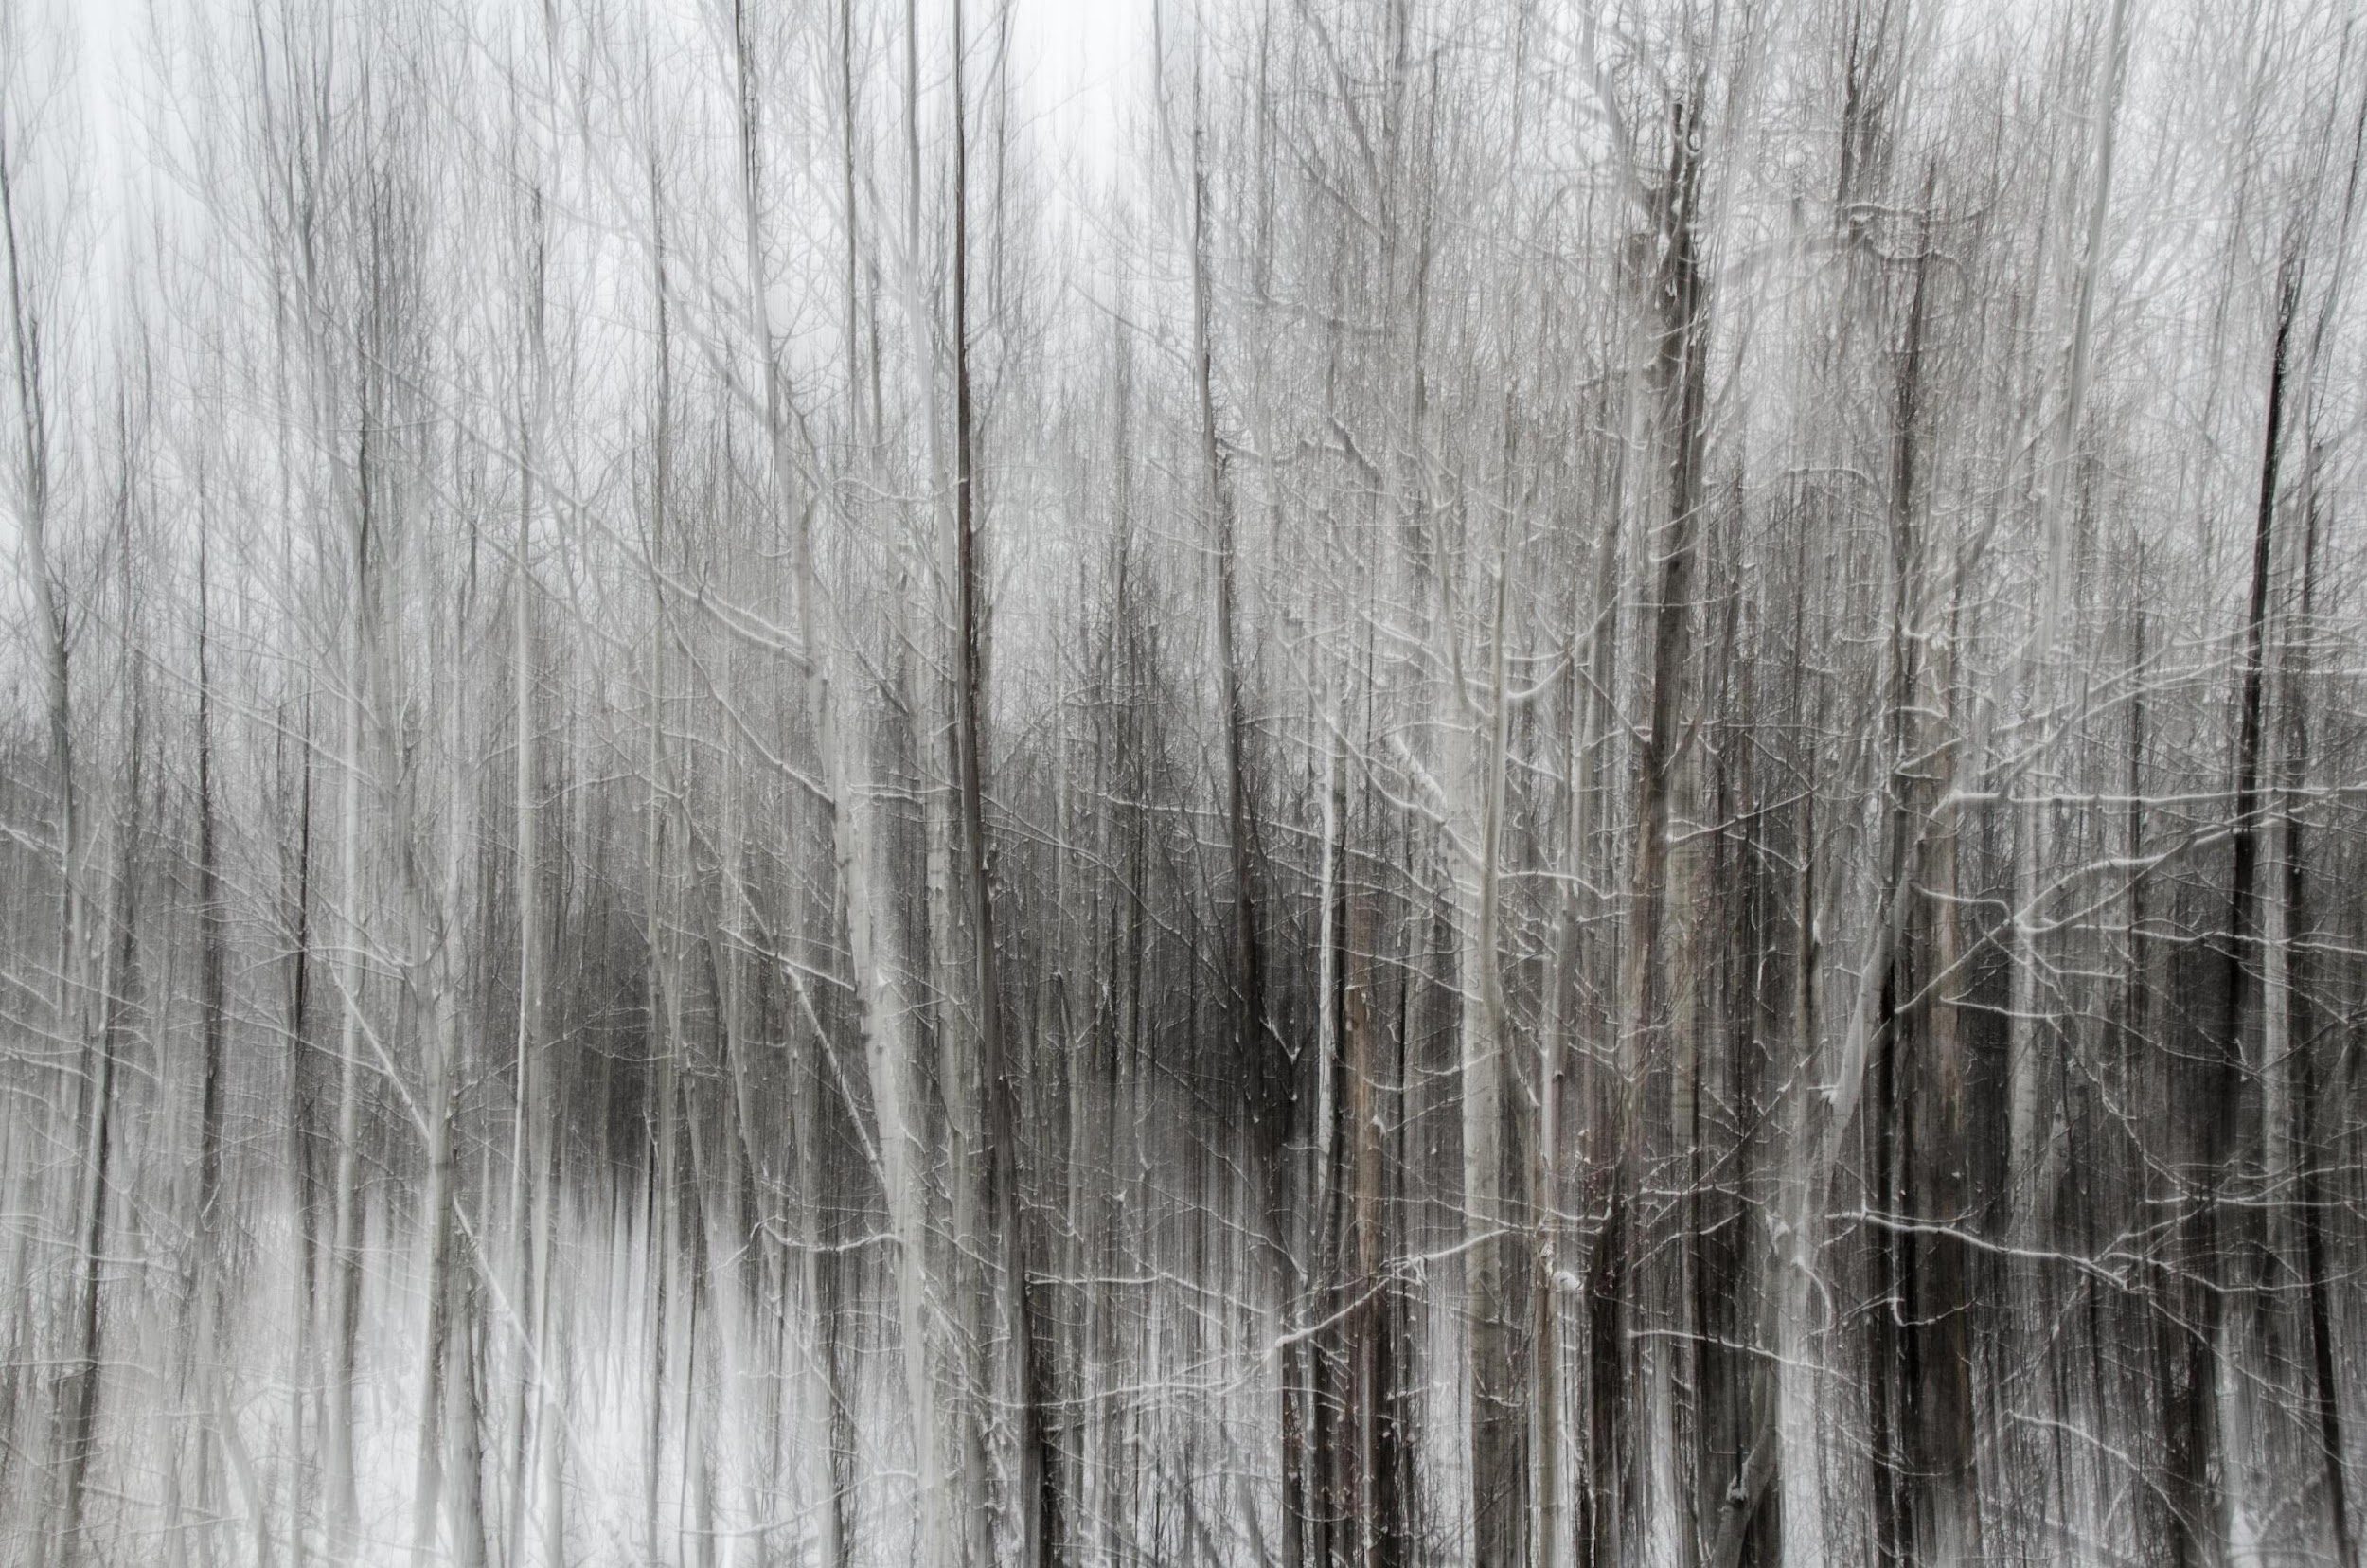
Pierre Roy

Slide 35
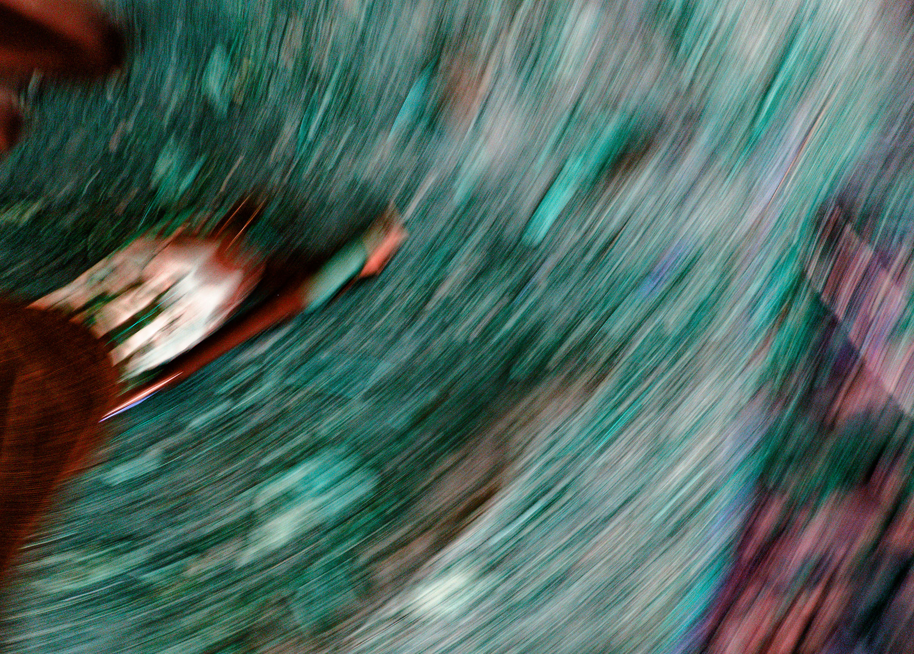
Ken Udle

Slide 36
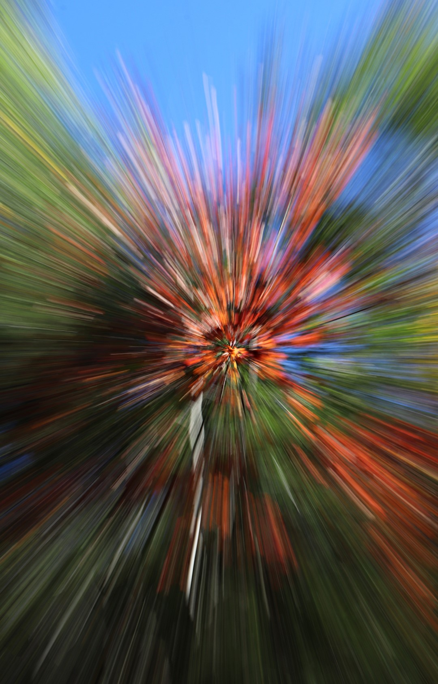
Lynda Buske

Slide 37
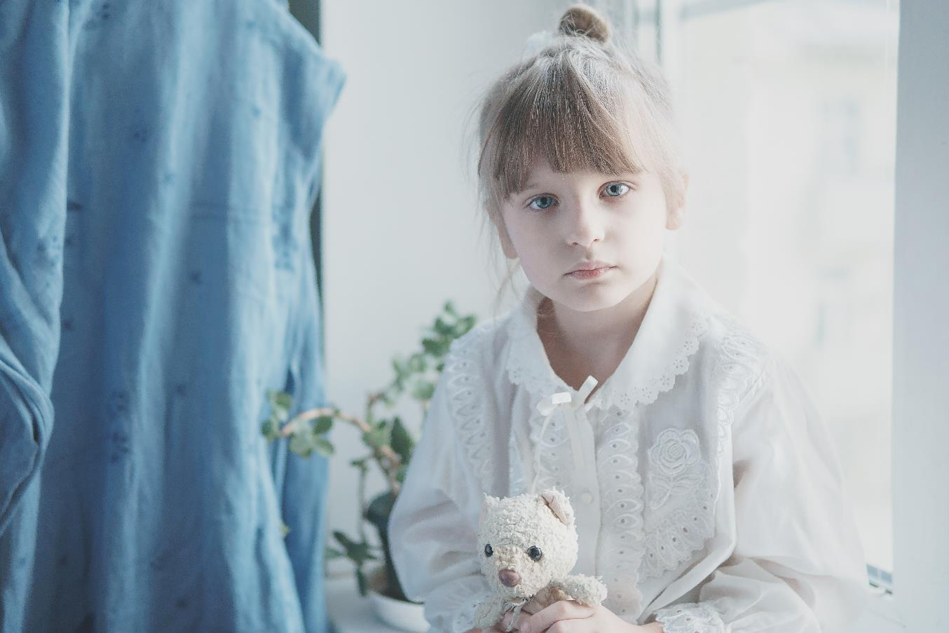
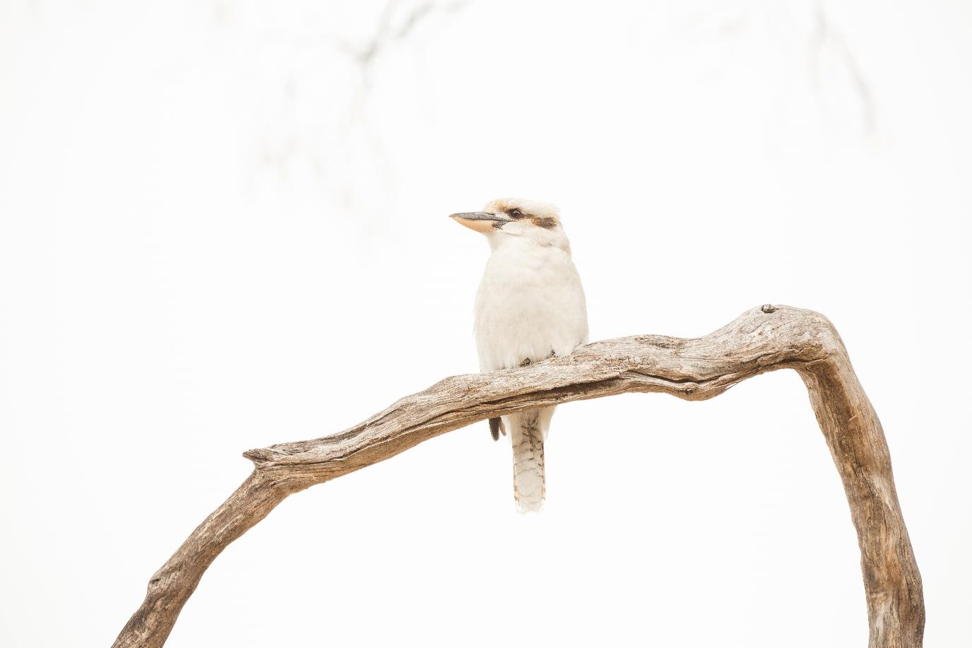
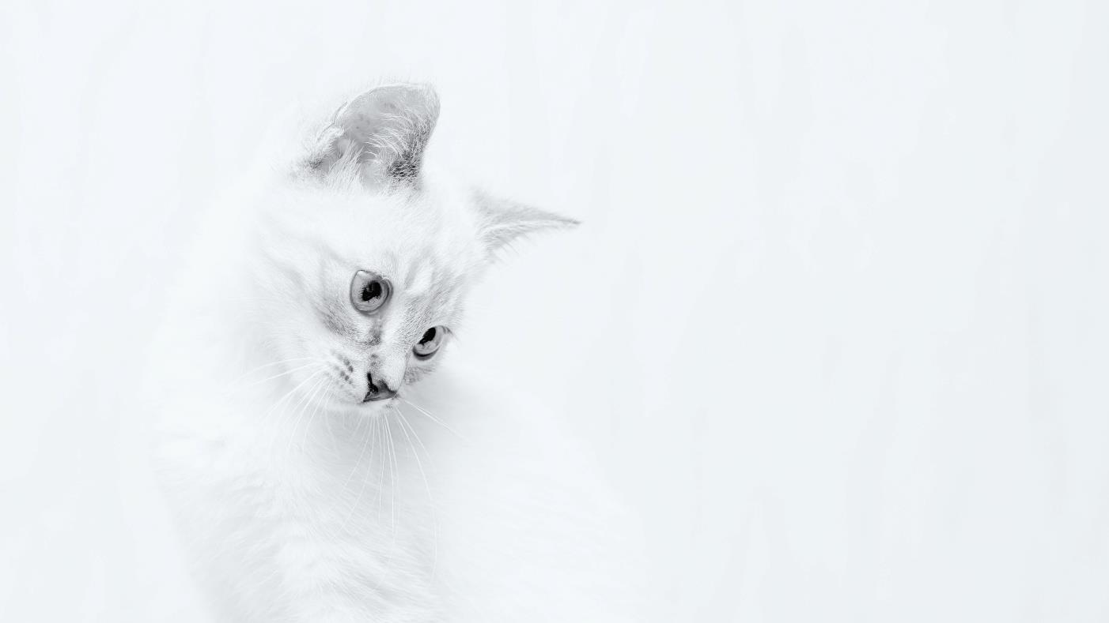
December Technique High key
A high-key image is one that is unusually bright with little or no dark shadows present.
Can create a mood and in particular, a positive or upbeat look.
Vitolda Klein on Unsplash
Lukasz Szmigiel on Unsplash
Matt Palmer on Unsplash

Slide 38
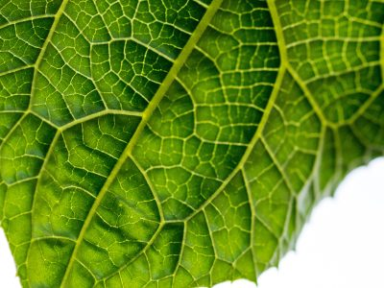
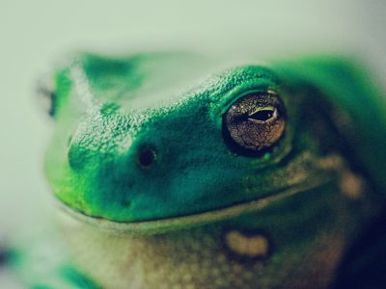
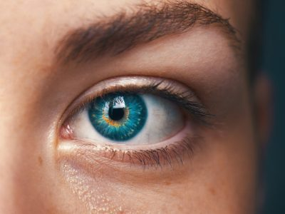
Fall Competition – Close Up
Jason Leung on Unsplash
A tightly cropped shot that shows a subject (or object) up close and with perhaps more detail than the human eye usually perceives
Images must have been taken since June 2022 AGM
Submit up to three images
Submission deadline: Saturday Nov 19, 2022 (midnight)
Paul Kapischka on Unsplash
Amanda Dalbjorn on Unsplash
NOTE THE SUBMISSION DEADLINE IS JUST ONE WEEK AWAY!

Slide 39
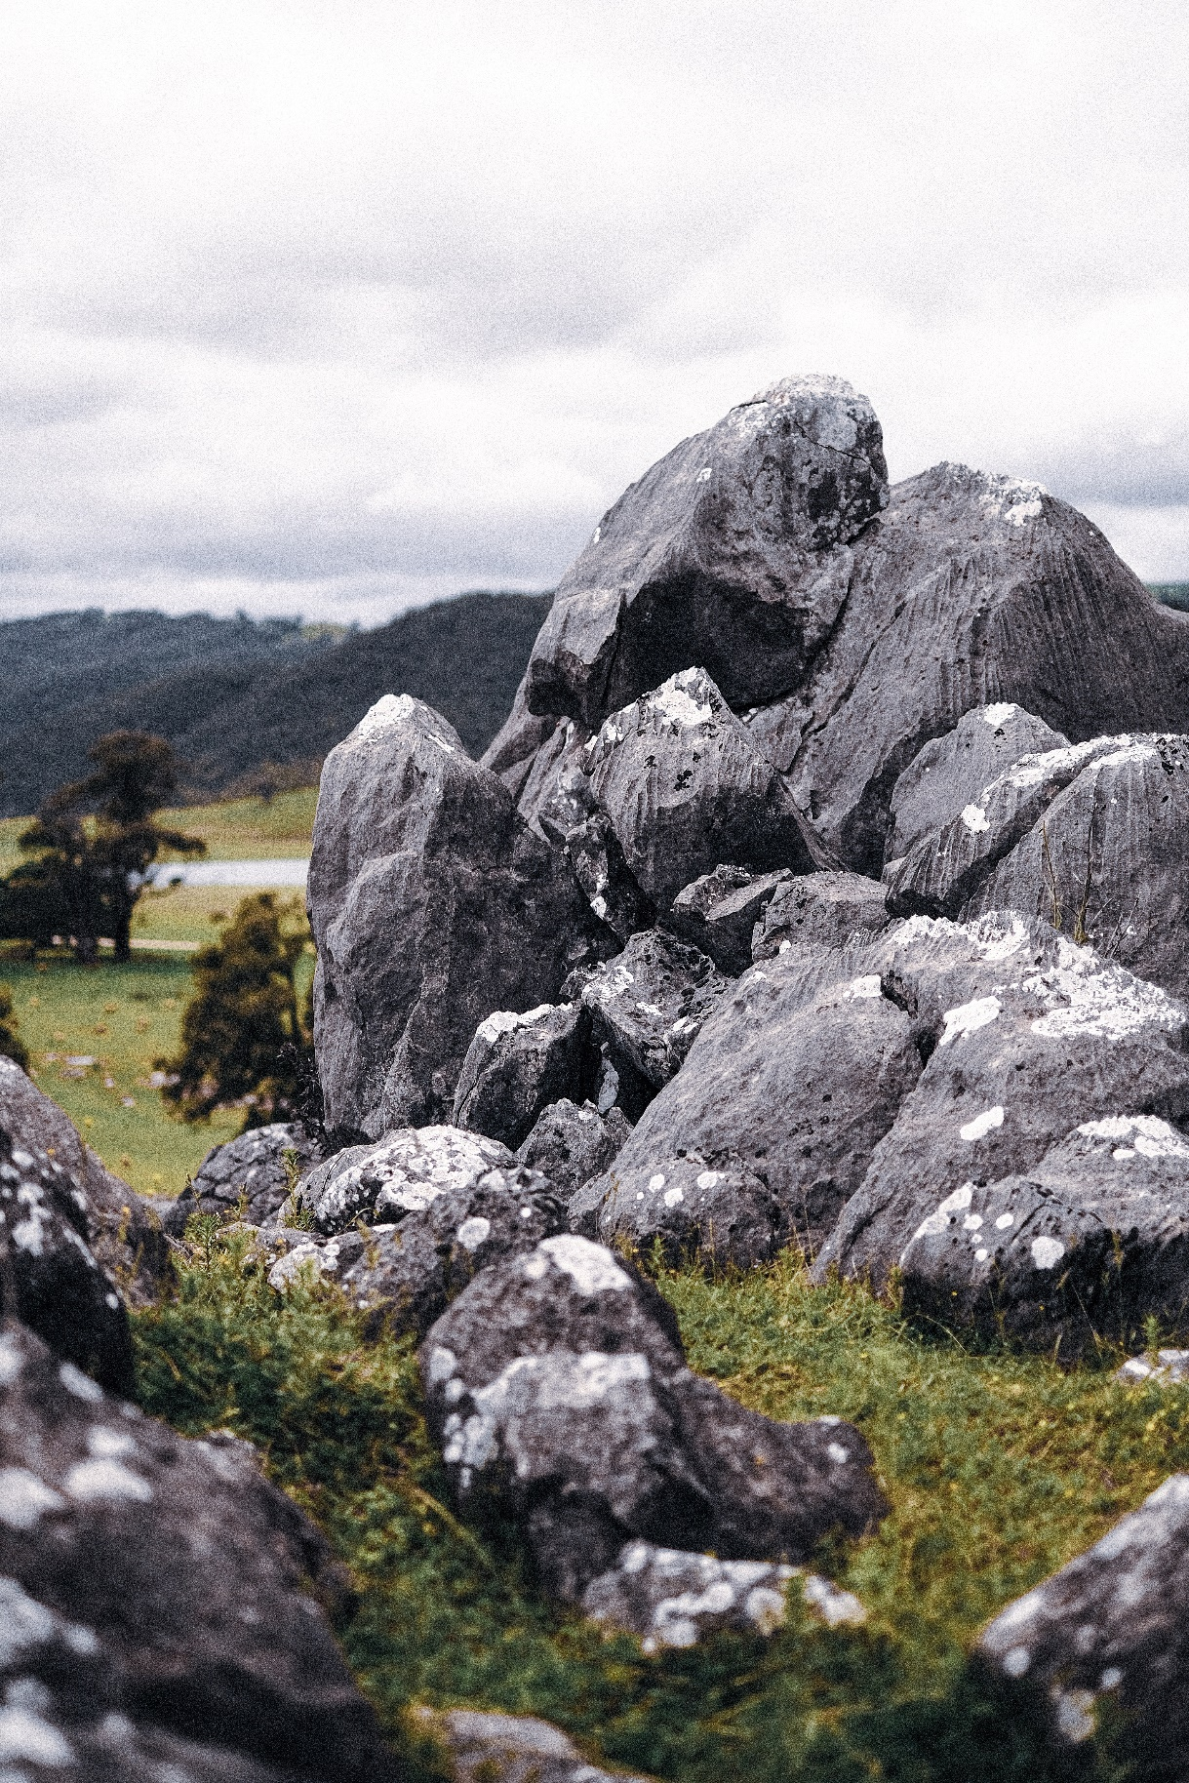
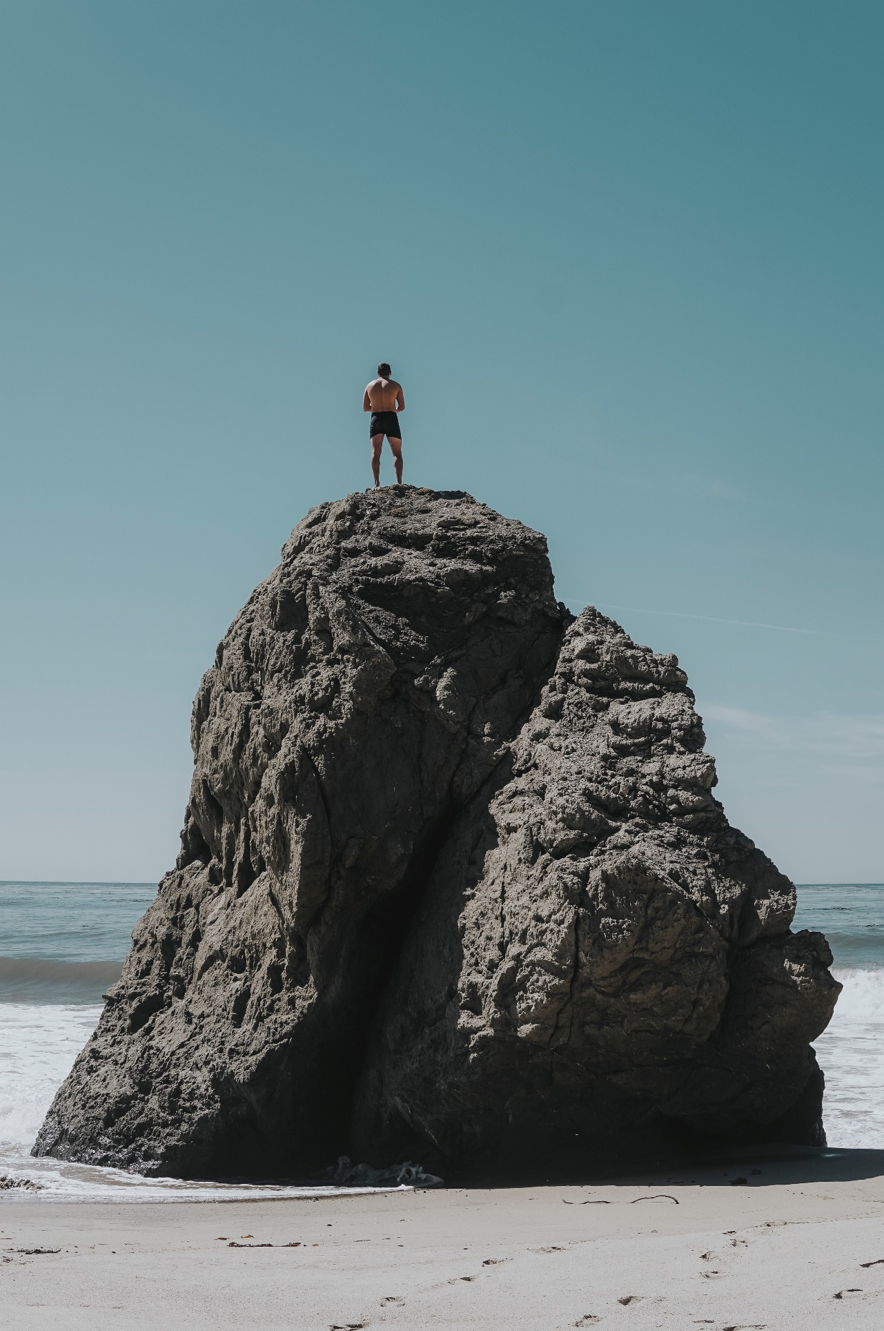
November challenge – Rocks
Maxwell Ingham
Any pebble, stone, rock, boulder
Off topic: Rock faces, mountains, sand.
Submission deadline: Saturday, Nov 5, 2022 (midnight)
Voting deadline: Thursday, Nov 10, 2022 (midnight)
All archived images are allowed.
Andrew Charney
Oliver Paaske

Slide 40
2022-23 Speaker and Topics Schedule Programs Director; Marianne Pethke Competitions Director; Lynda Buske

Slide 41
CPOPC on Twitter Vice President; Chris Taylor
@OrleansPhotoClb
We now have a Twitter account
@CPOPC was taken
We will tweet 3 or 4 times a month
upcoming challenges and competitions
meeting announcements
other items likely to be of interest to members
https://twitter.com/OrleansPhotoClb
NOTES; Newsletters will continue as before
Challenge and Competition winners will be posted on our Facebook page
Twitter wouldn’t let us have a “u”

Slide 42
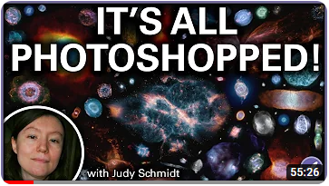
Notices – November 2022
NEW TOPICS ADDED TO OUR RESOURCES PAGES ON THE WEBSITE
Chris Taylor has been busy and added the following pages;
A good explanation of compression in images – Cameras and equipment + Tips and Tricks
25 common photography abbreviations, explained – Cameras and equipment
Free, open-source alternatives to Adobe Lightroom – Photo editing, Lightroom
How astronomical images get processed – Photo editing, General

Slide 43
Next Meetings
10 December at 09.30 on Zoom
Fall Competition Judging and Critique
Scavenger Hunt showing
December Technique - High Key
Member Contributions
17 December, Social and Pot Luck Lunch
Queenswood Heights Community Centre, 10.30 to 1pm
Sharon Fry
“Artistic”- 2020 Scavenger Hunt

