Slide 1
CPOPC October 2022
Alan White – October 8, 2022

Slide 2
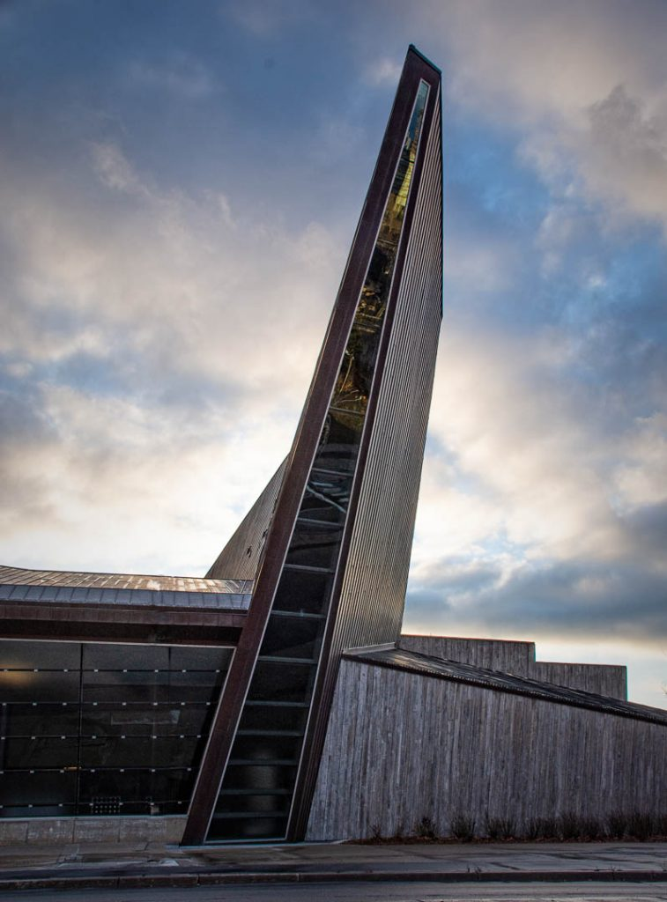
Welcome
Acknowledgement of guests and prospective members
Membership dues reminder
Zoom difficulties? - Email John Miner john@miner.ca
10 min break between 10:30 and 11am
Our agenda
Beverly Dawson

Slide 3
October 2022
Agenda topics
Featured Speaker – Robert Scott
Upcoming Workshop and Outing
Scavenger Hunt announcement
Member Contributions & Member Recognition
October Technique Review - Silhouette
October Challenge - Weathered Surfaces
November Challenge and Competition reminders
Photography 101- Travel Photography Tips (part one)
Notices
Next Meeting
Donald Fry

Slide 4
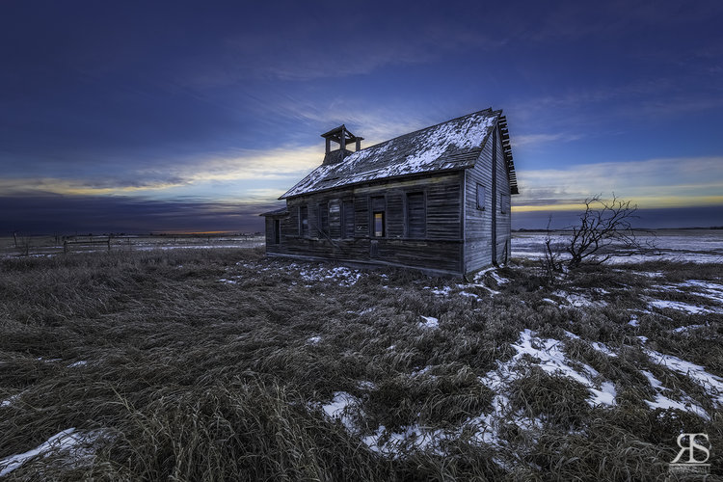
Featured Presenter
Robert Scott
Abandoned Photography
https://www.robertscott.ca

Slide 5
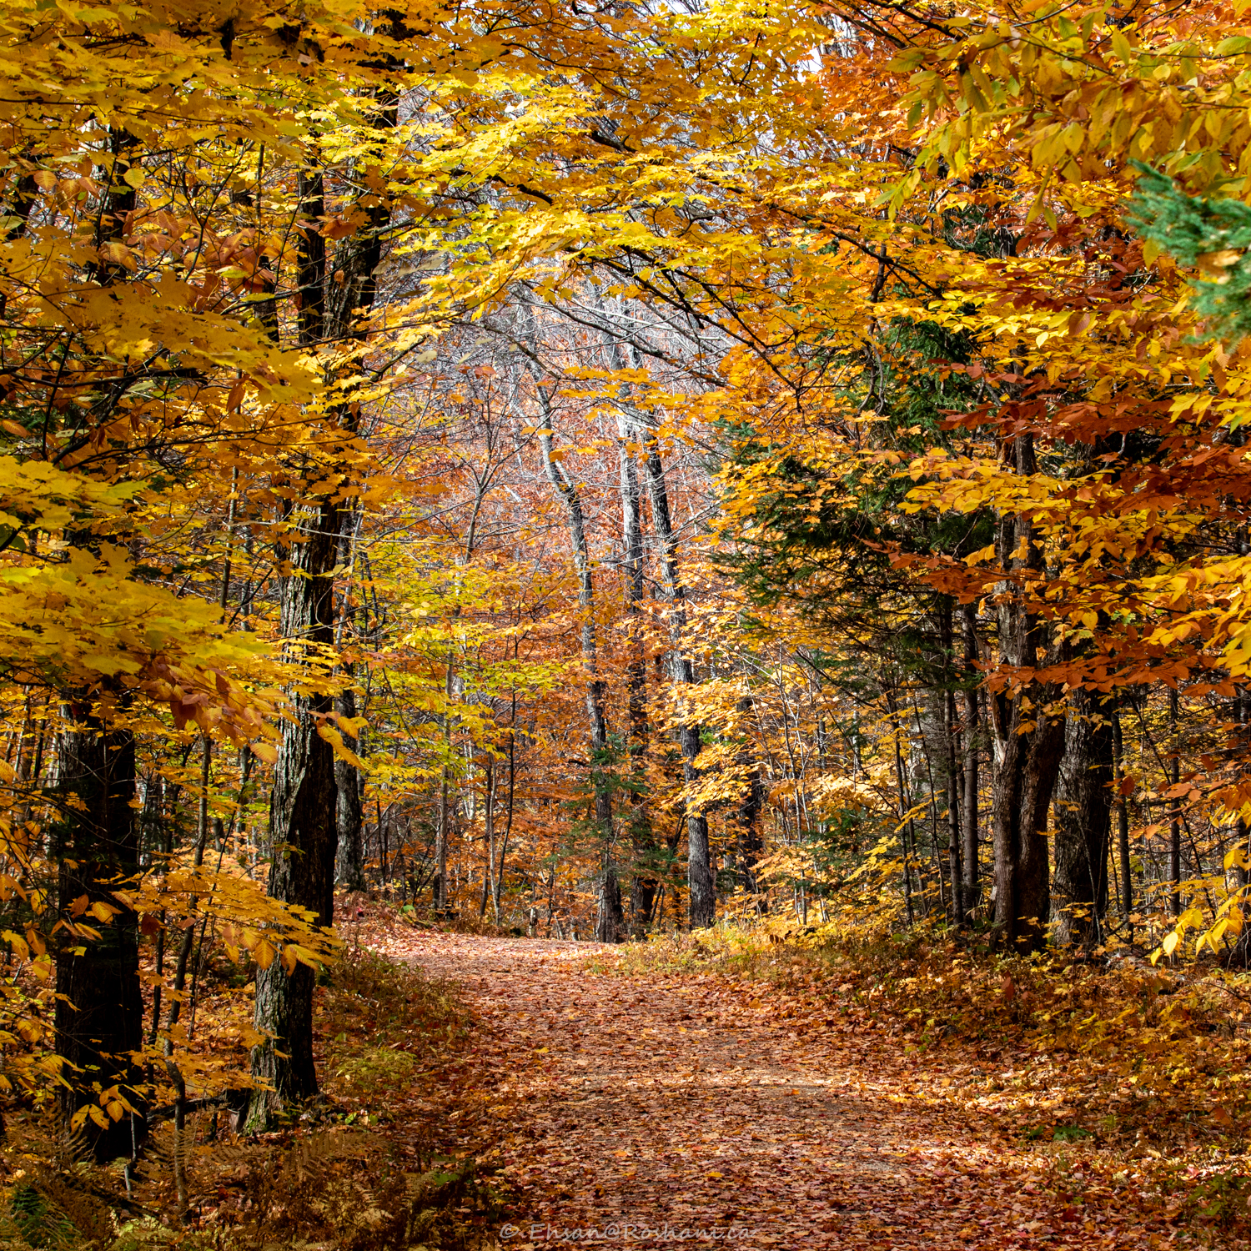
Upcoming Workshop and Outing Programs Director; Marianne Pethke
Workshop; Saturday October 22
Flash Photography with Michael Willems
Outing; Saturday October 29
Ehsan Roshani will lead a group in the Gatineau Park to capture the colours and some of his favourite views
Both workshops are free with your membership.
The registration pages for these activities have been opened on the website – members only section
Ehsan Roshani

Slide 6
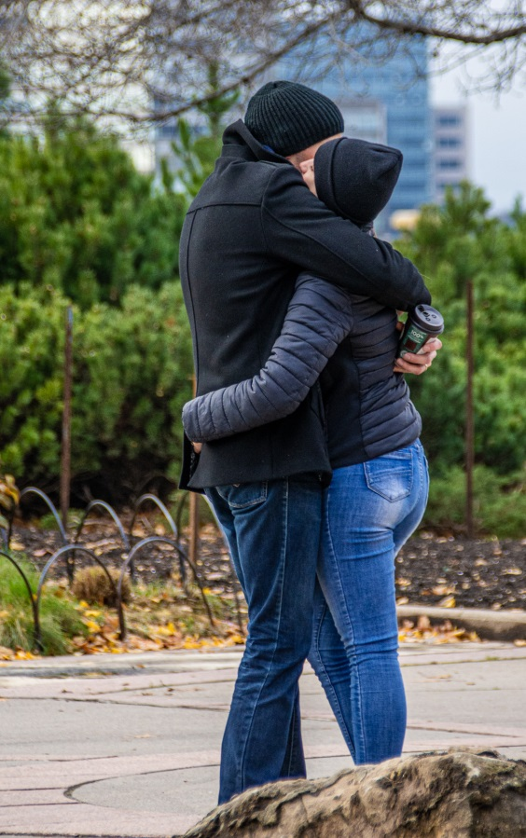
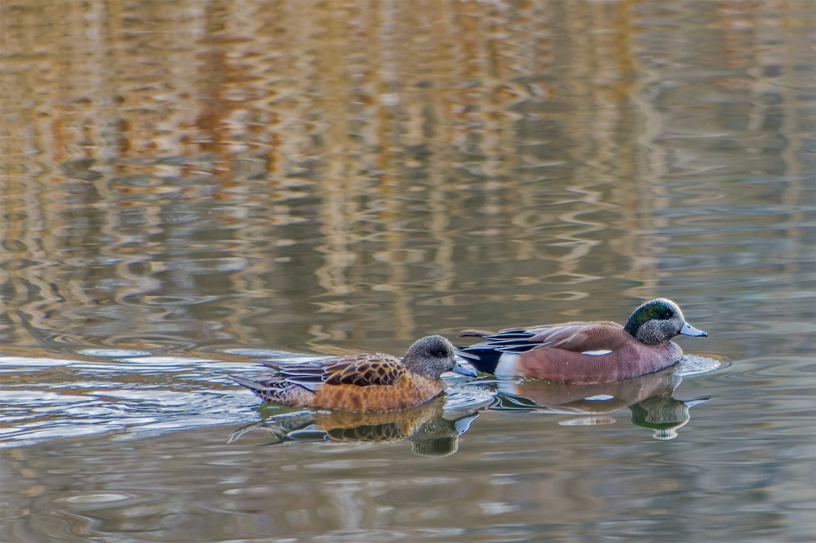
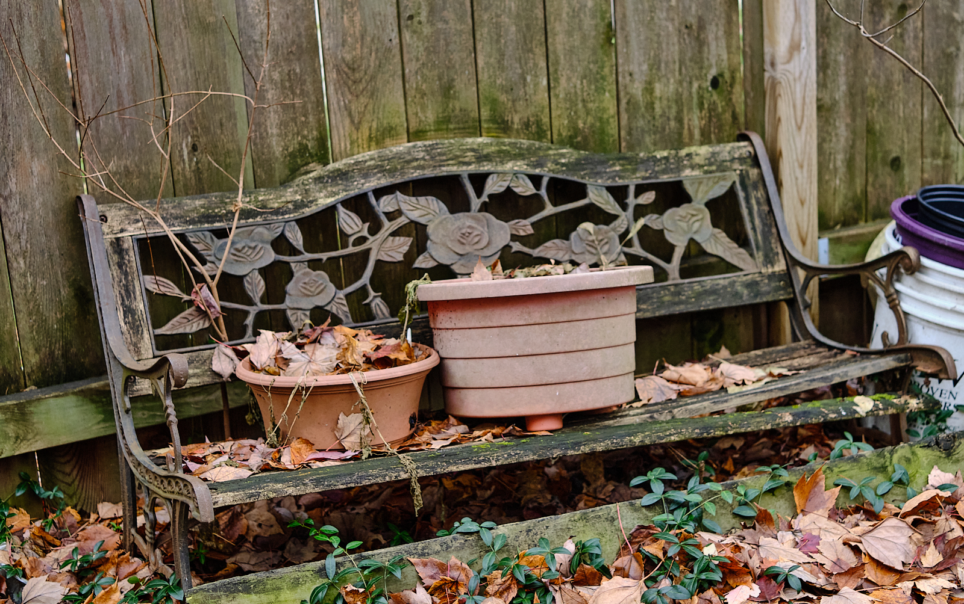
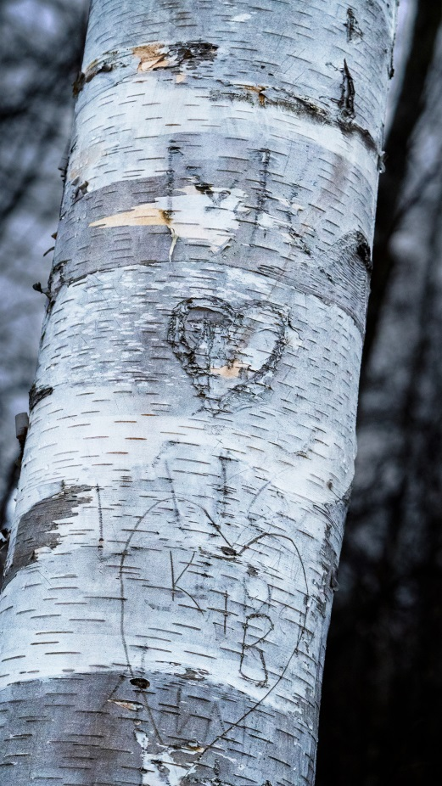
Presentations and Workshops
Scavenger Hunt 2022
Looking Up
Beverly Dawson
Love & friendship
No need to register
24 Topics to be released by email at 6pm on Friday 18 November
Your shooting to be completed over the weekend of 19,20 November
Post processing is allowed
Choose your best 6 pictures (one per topic)
Submit on website page by midnight November 30
All submissions will be shown during the December meeting
No judging, no prizes, just for fun!
Images are from 2021 Scavenger Hunt
Beverly Dawson
Kathy Burke
Ramesh Chauhan
Abandonment
Ken Udle

Slide 7
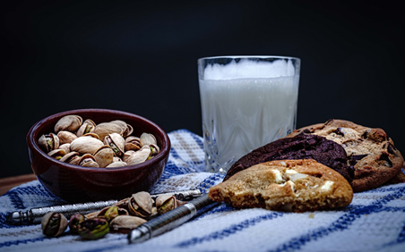
Resumption of In-Person meetings? President; Alan White
Continuing for now with online monthly meetings via Zoom
Planning in-person workshops
Social event to “test the waters”
Saturday 17th September, 9.30am to 11.00am (+)
Hybrid meetings are now considered unworkable
We require Internet Access for access to speakers
QHCC has no Wi-Fi but many other advantages
We are working on getting Internet at QHCC
Probably not happening before New Year
Please give your opinion/preference to any executive member
Image by Dennison Moore

Slide 8
October Technique - Silhouette
Place your subject in front of a light source or ensure that the background is significantly brighter than the subject.
Typically, a camera will automatically create a silhouette but if your subject makes up a large portion of the photo, you may have to manually underexpose your shot.
Rather than tonalities and colour, pay attention to the shape and outline of your object.
Jonathan Mabey
William Farlow

Slide 9
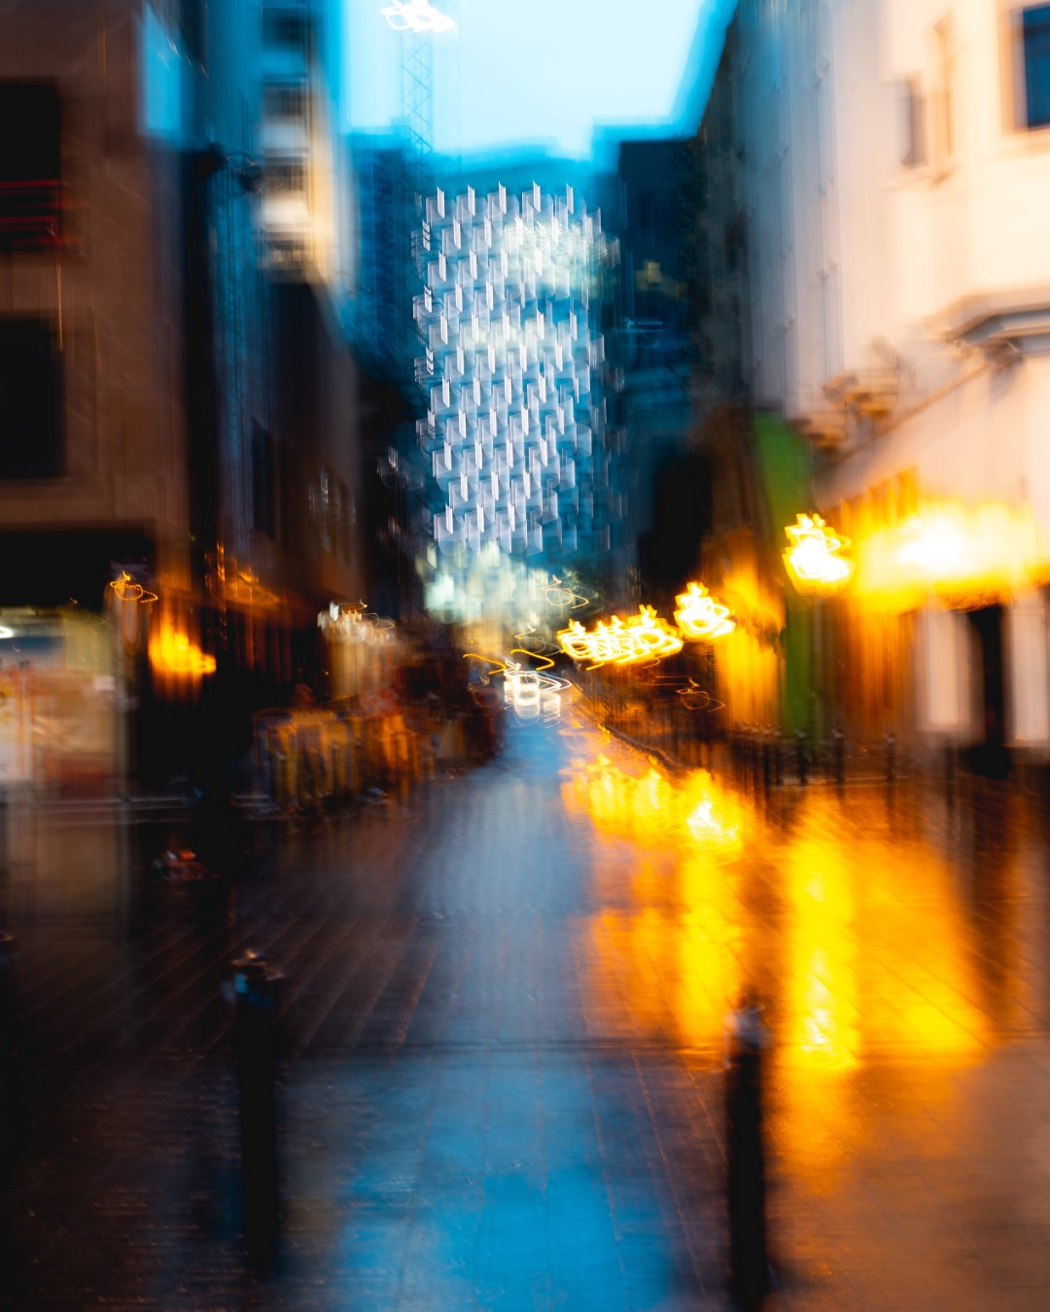
Novenber Technique – ICM (Intentional Camera Movement)
Purposely moving the camera while the shutter is activated.
May physically move the camera body in a specific way (up/down, circle) or zoom in and out while the shutter is released.
Create a stylized recognizable image or pure abstract
Sharon Fry
Maksym
Tymchyk
Frédéric Paulussen

Slide 10
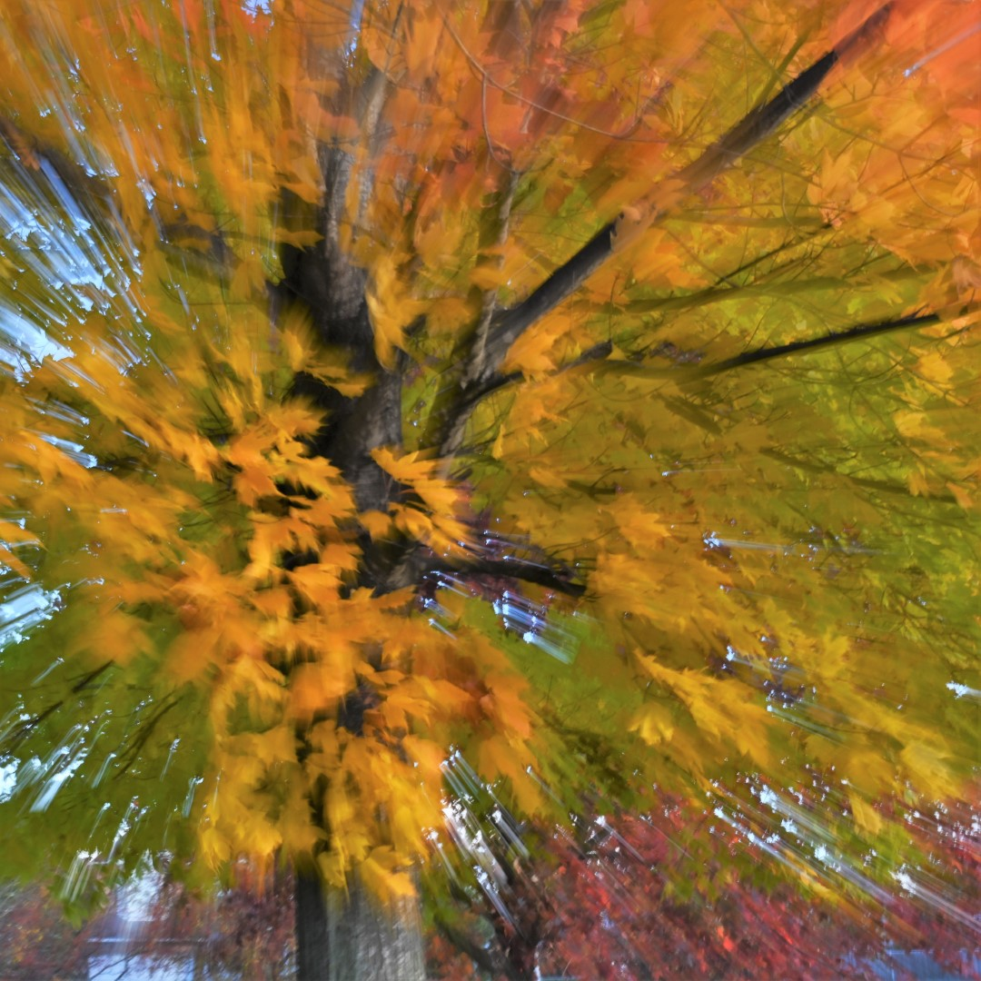
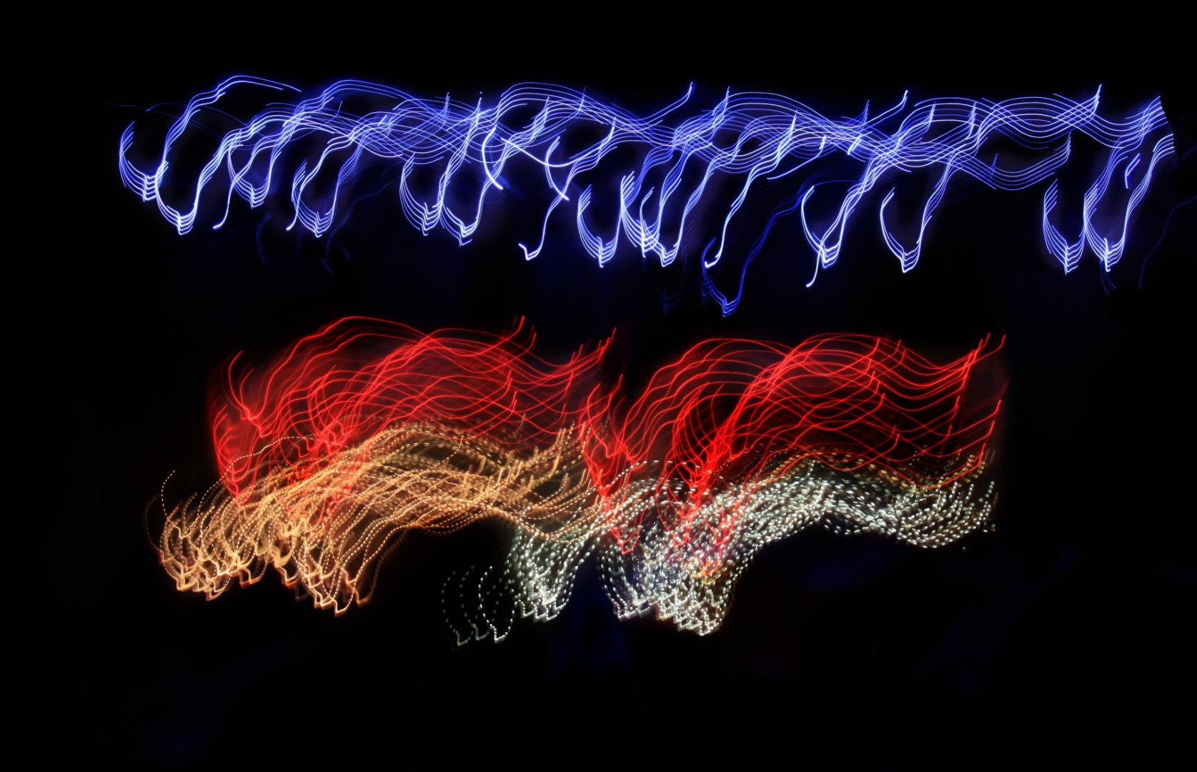
Lynda Buske
1 second, f22
1 sec, f11
Marianne Pethke
Zoomed 1/5 second, f22
Easy to get long exposures at night!

Slide 11
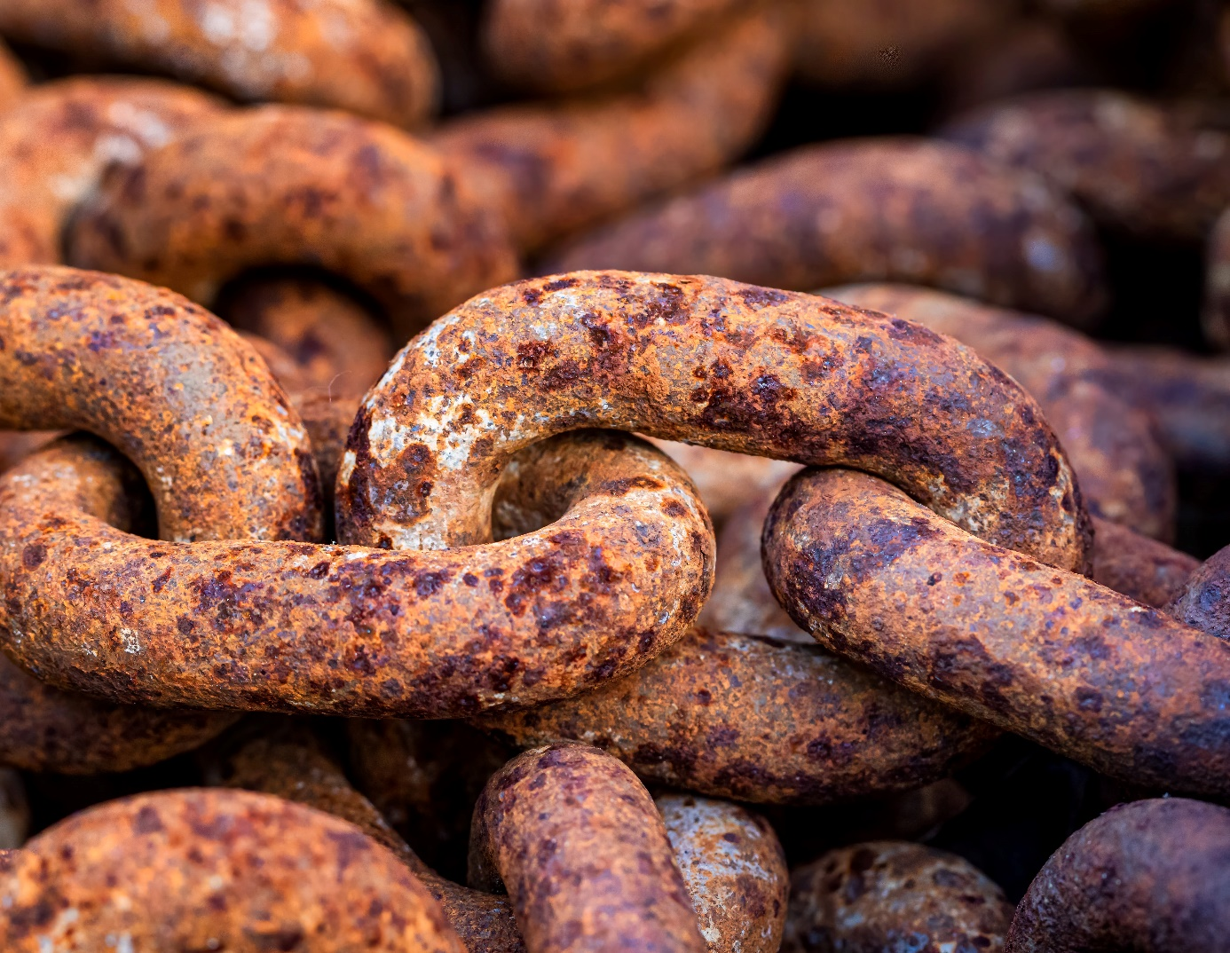
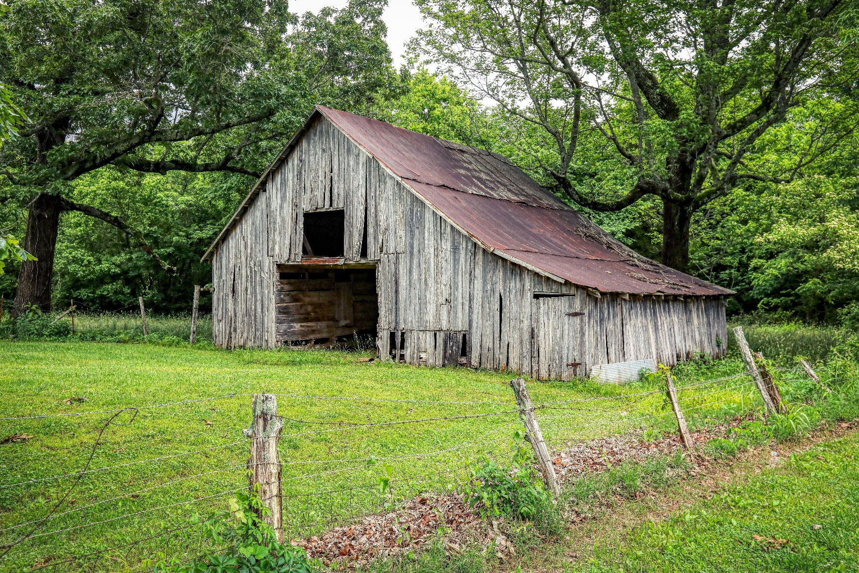
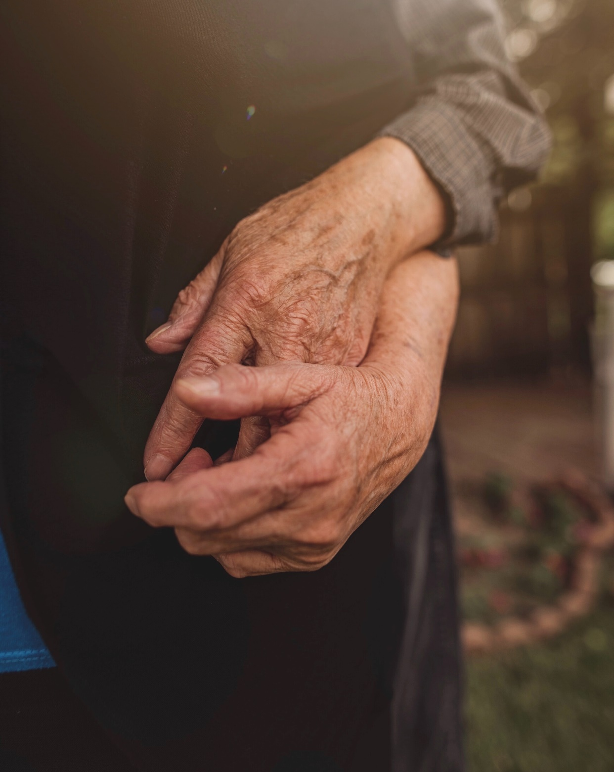
October challenge – Aged or weathered surfaces
Zdenek Machacek
Any object(s) that emphasizes texture caused by age, weather, use, etc. This could include animate or inanimate objects.
Submission deadline: Saturday, October 1, 2022 (midnight)
Voting deadline: Thursday, October 6, 2022 (midnight)
All archived images are allowed.
Mick Haupt
Nina Hill

Slide 12
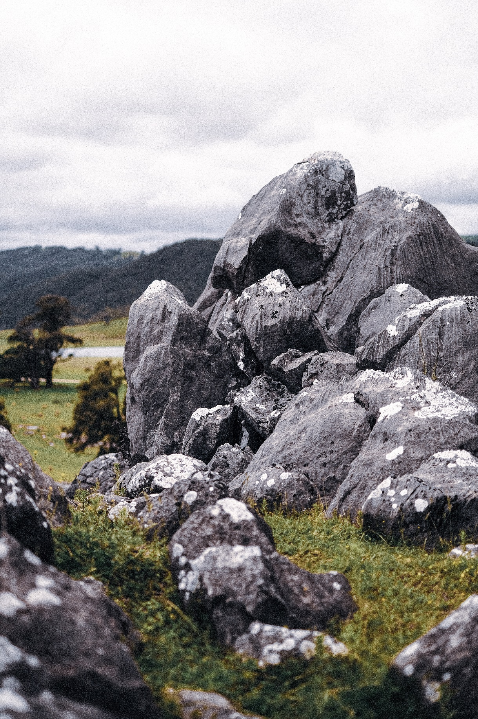
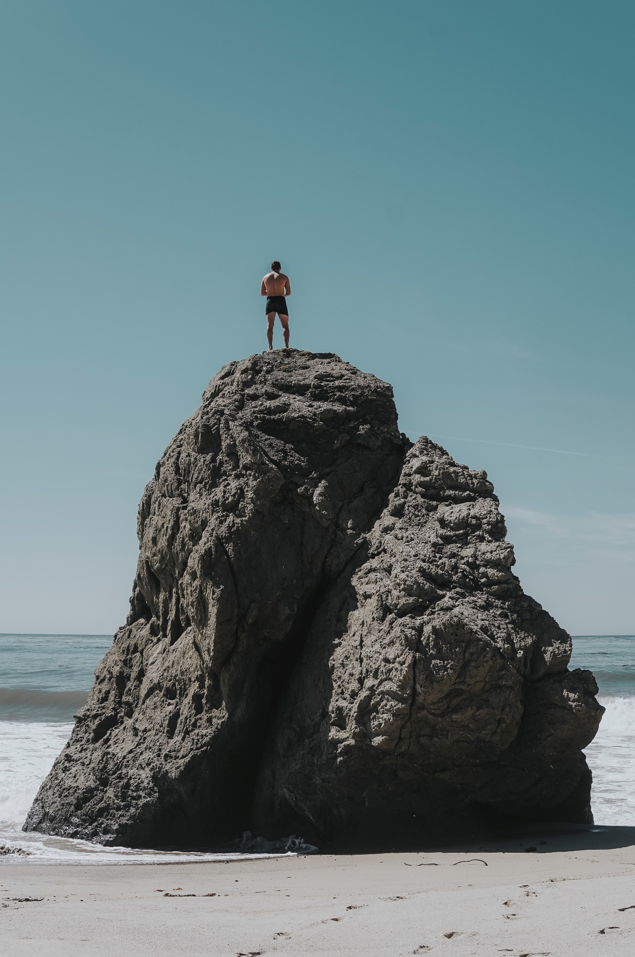
November challenge – Rocks
Maxwell Ingham
Any pebble, stone, rock, boulder
Off topic: Rock faces, mountains, sand.
Submission deadline: Saturday, Nov 5, 2022 (midnight)
Voting deadline: Thursday, Nov 10, 2022 (midnight)
All archived images are allowed.
Andrew Charney
Oliver Paaske

Slide 13
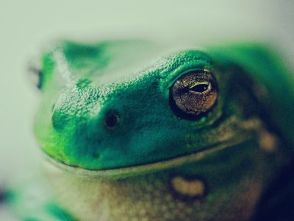
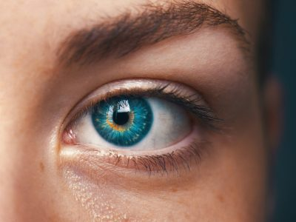
Fall Competition – Close Up
Jason Leung on Unsplash
A tightly cropped shot that shows a subject (or object) up close and with perhaps more detail than the human eye usually perceives
Images must have been taken since June 2022
Submit up to three images
Submission deadline: Saturday Nov 19, 2022 (midnight)
Paul Kapischka on Unsplash
Amanda Dalbjorn on Unsplash

Slide 14
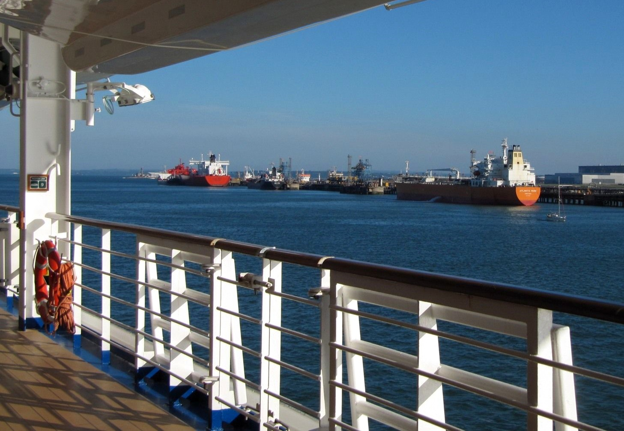
Travel photography tips #1
Use foreground to help tell your story
Can provide context
Adds 3D effect
Can set the mood
Can frame the main subject

Slide 15
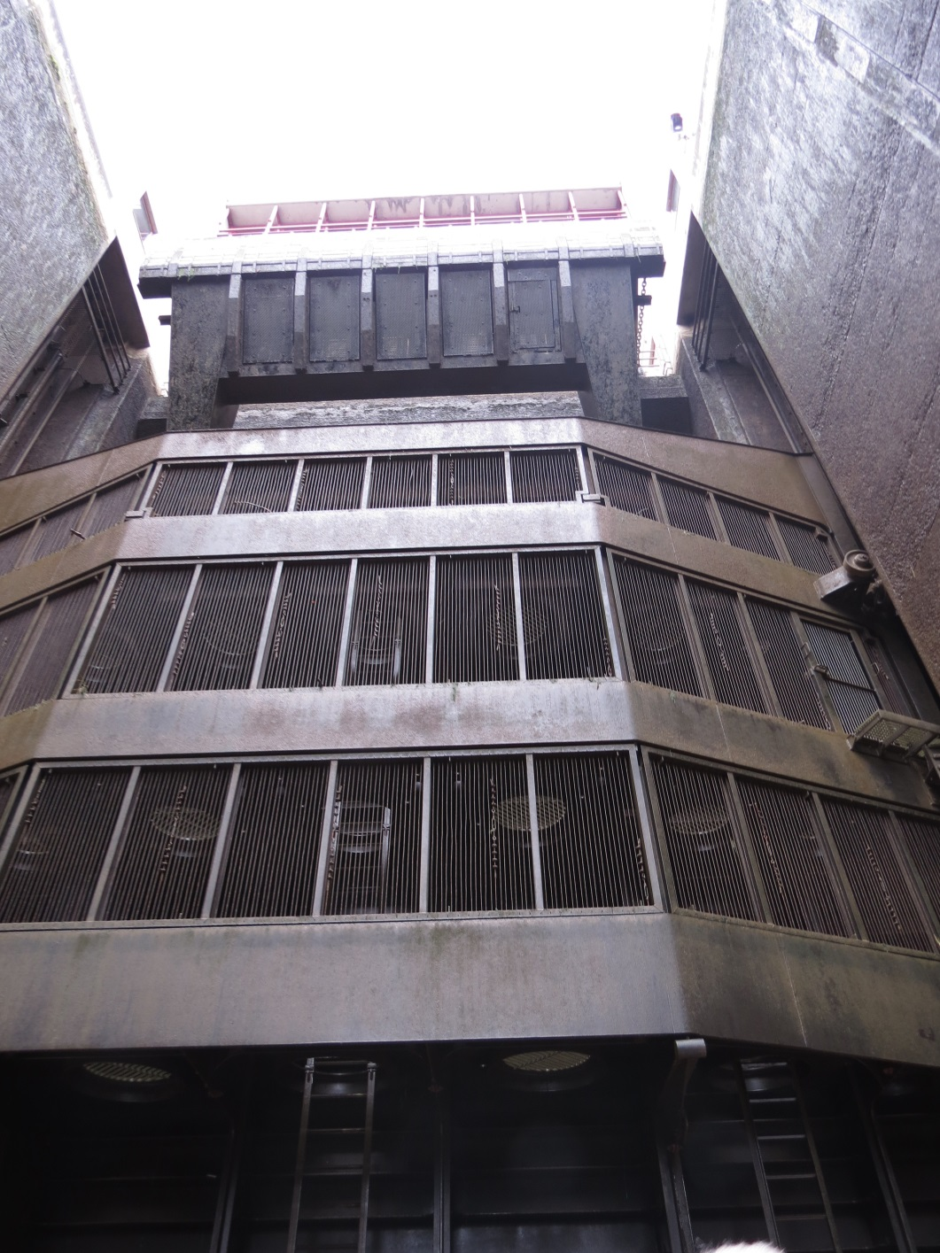
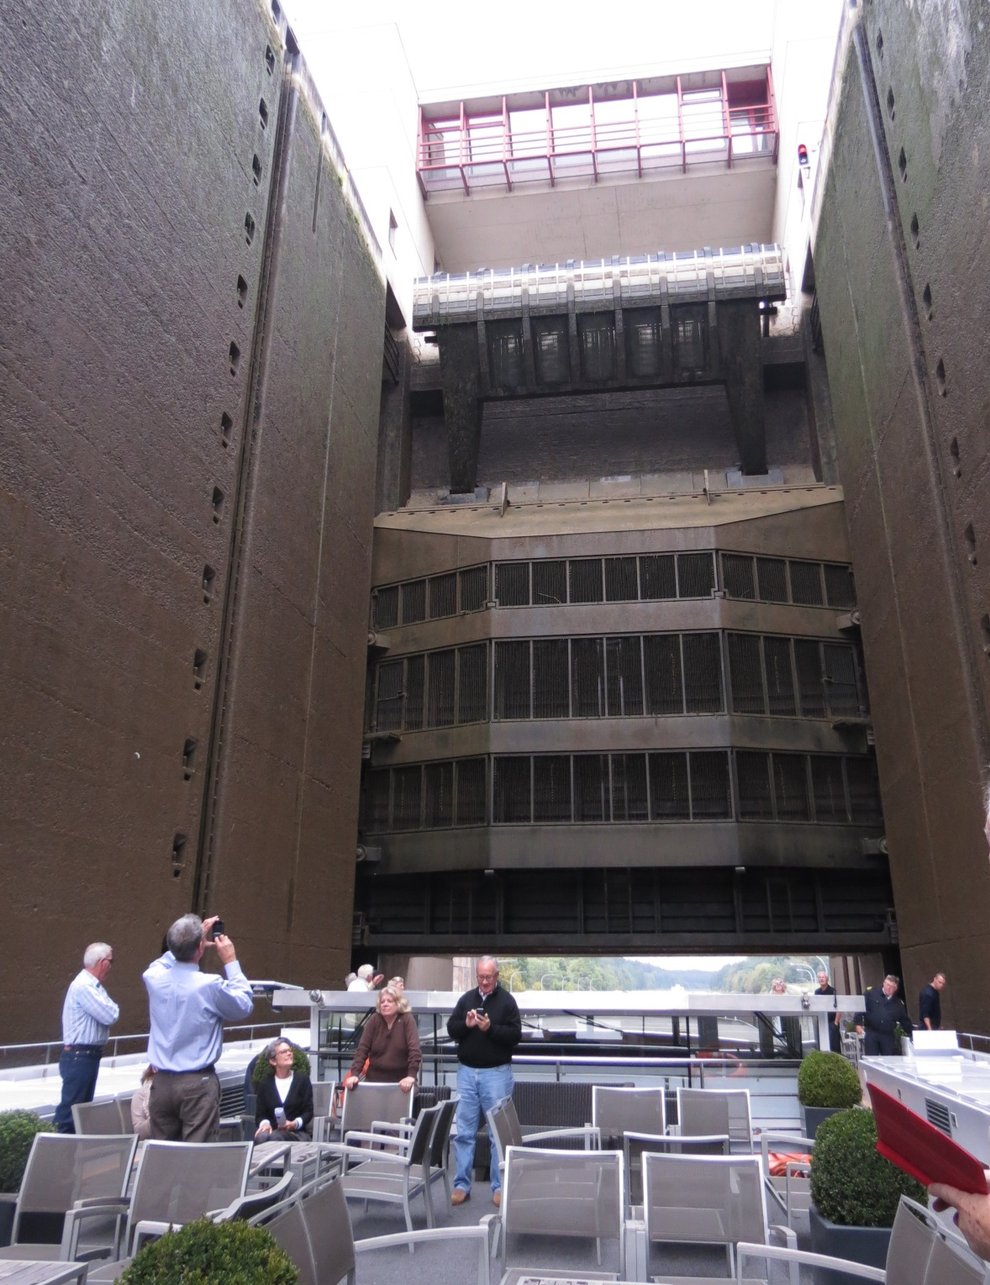
Use foreground to show context

Slide 16
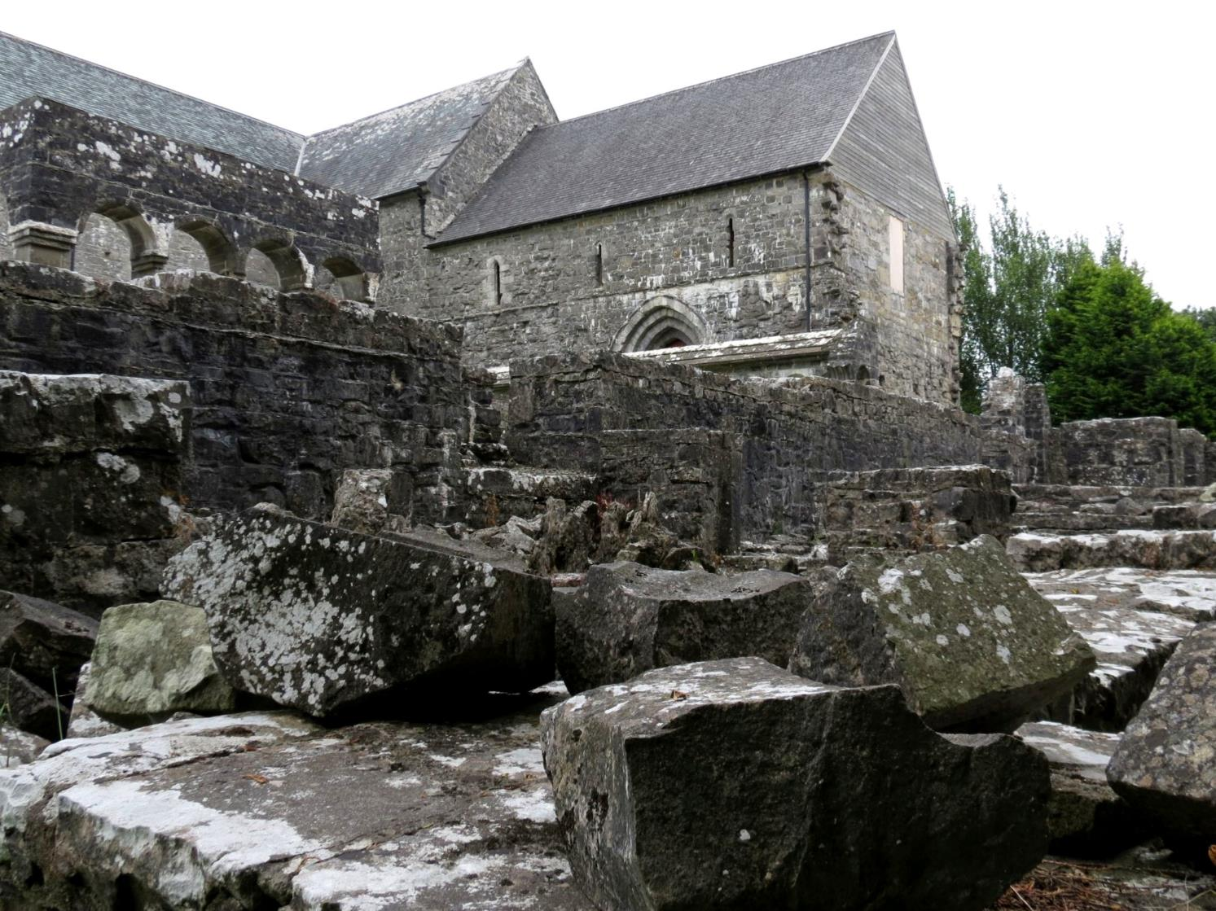
Invite people to step into your story

Slide 17
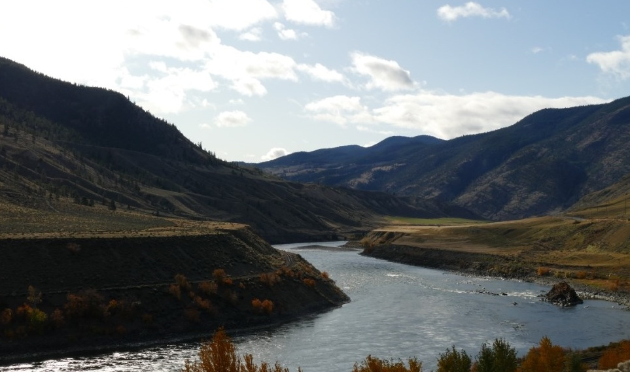
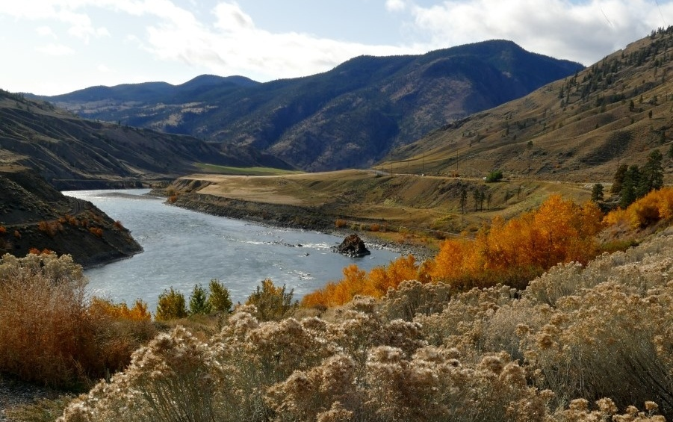
View from the lookout
Foreground adds depth

Slide 18
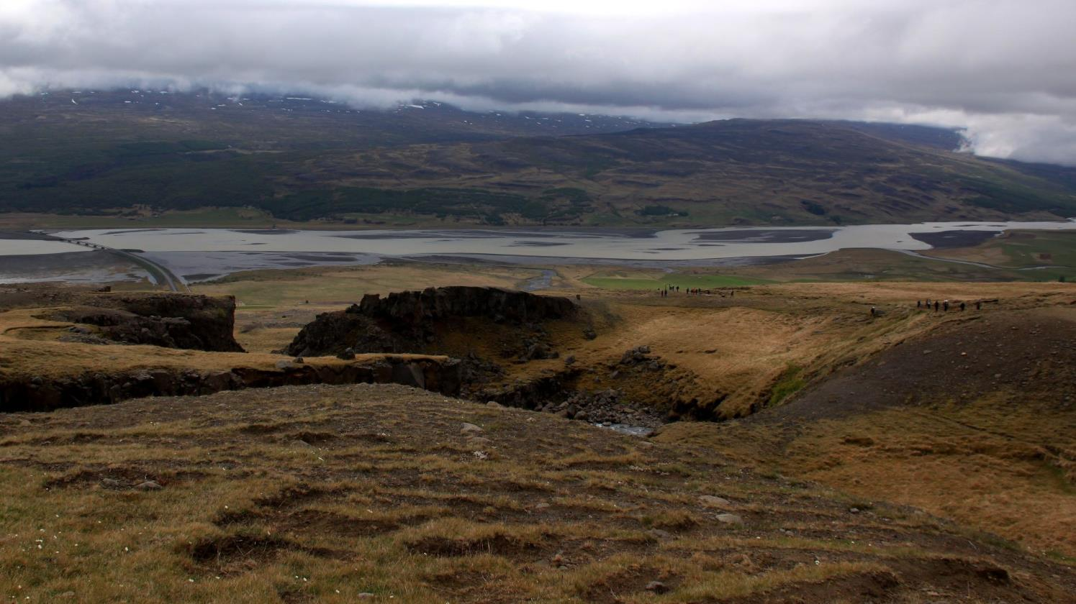
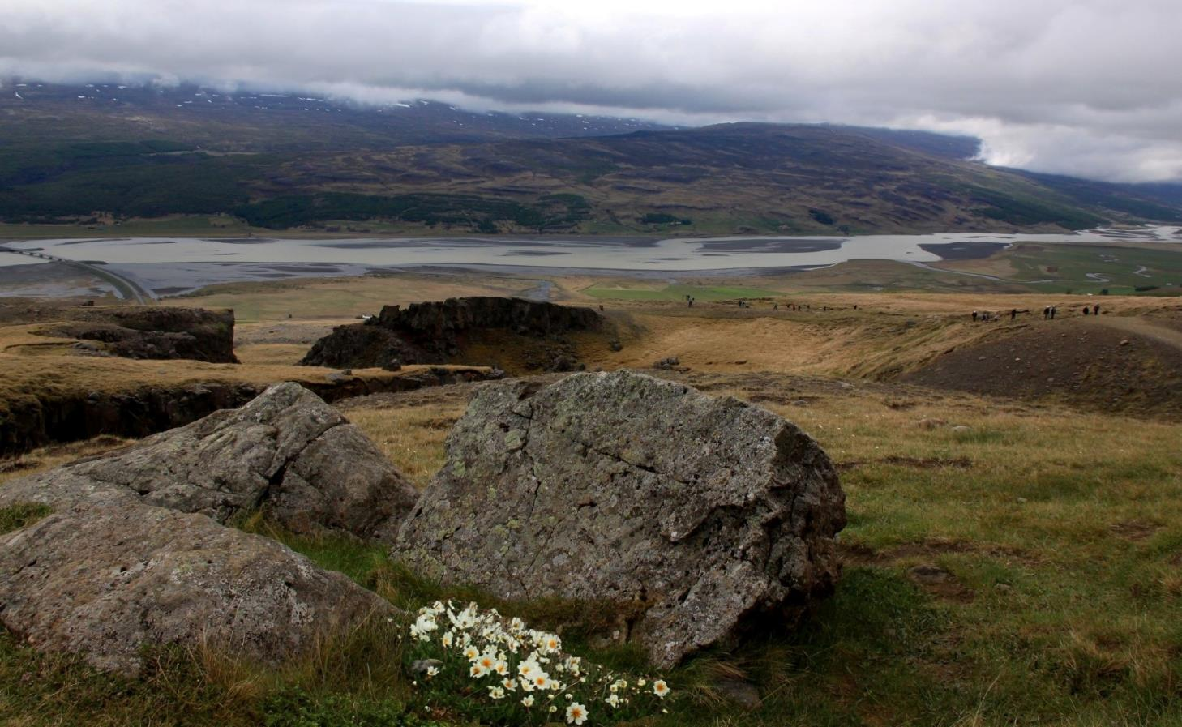
Use long depth of field if you want everything in focus

Slide 19
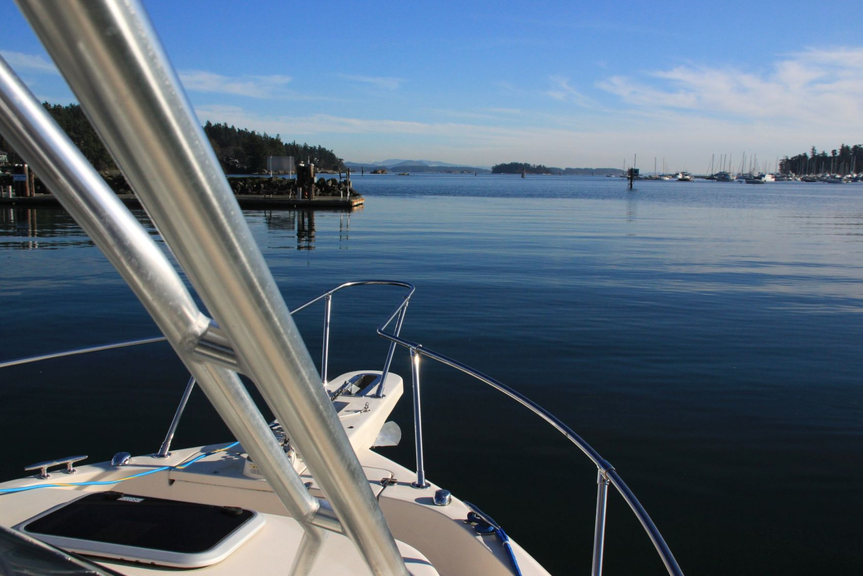
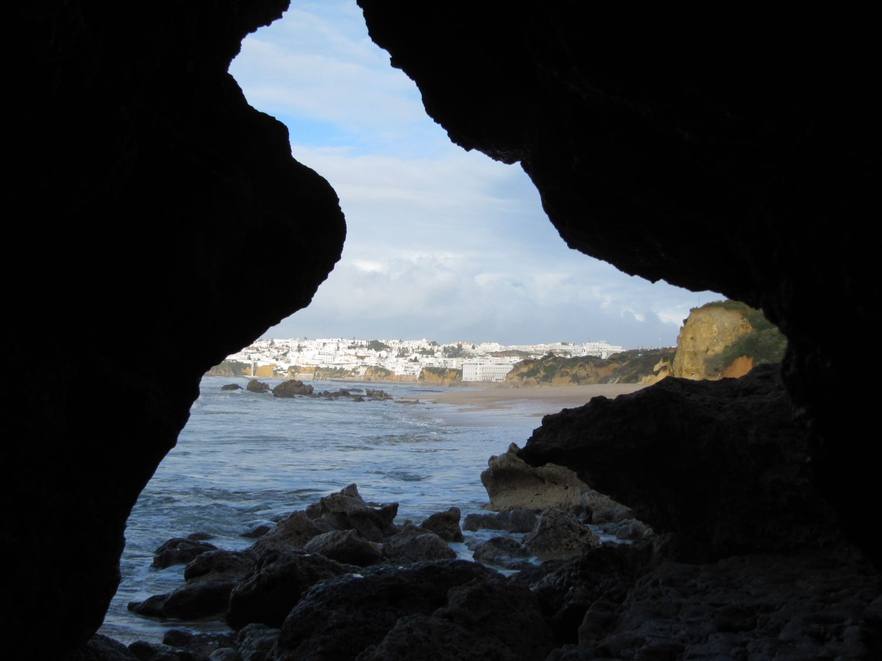
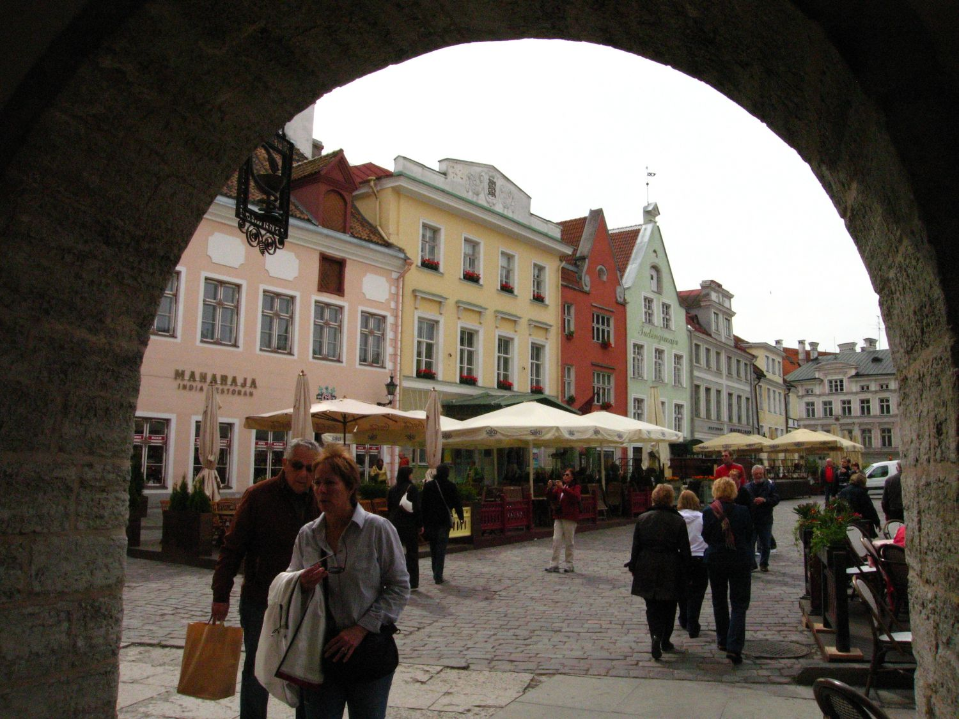
Set the scene and add a mood

Slide 20
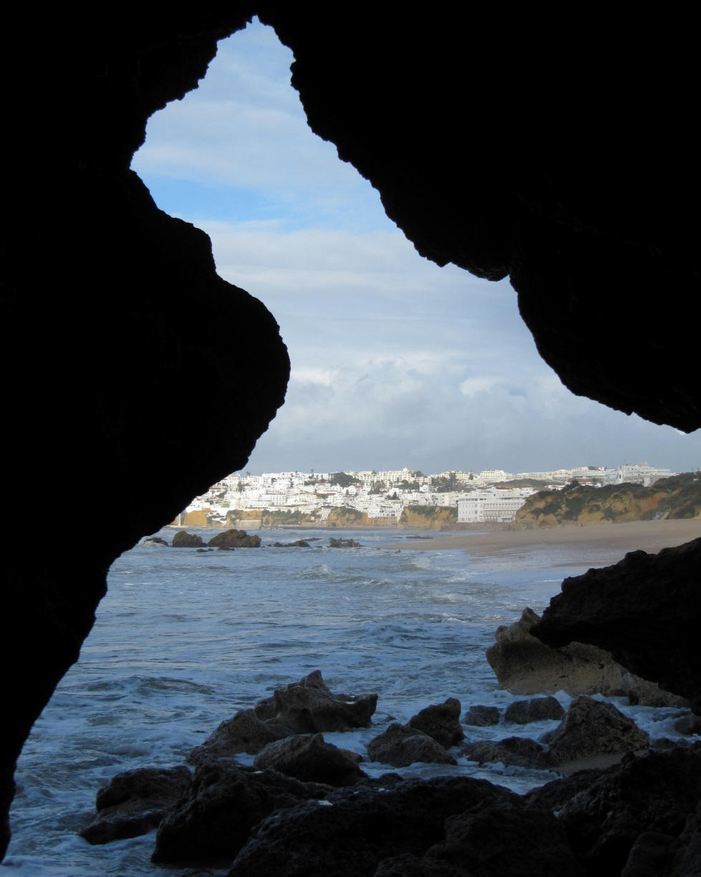
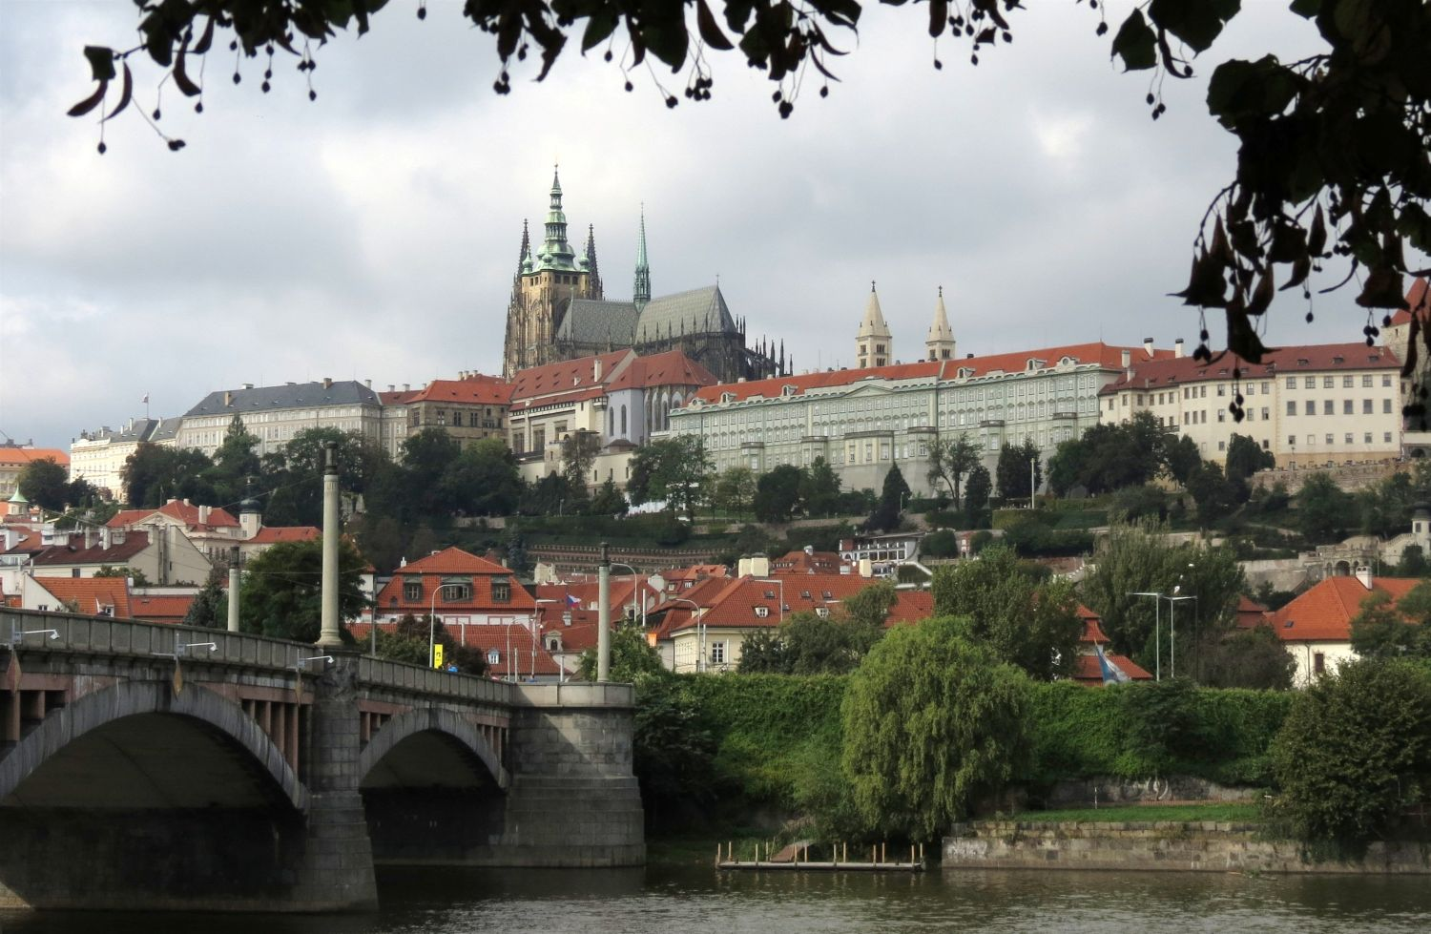
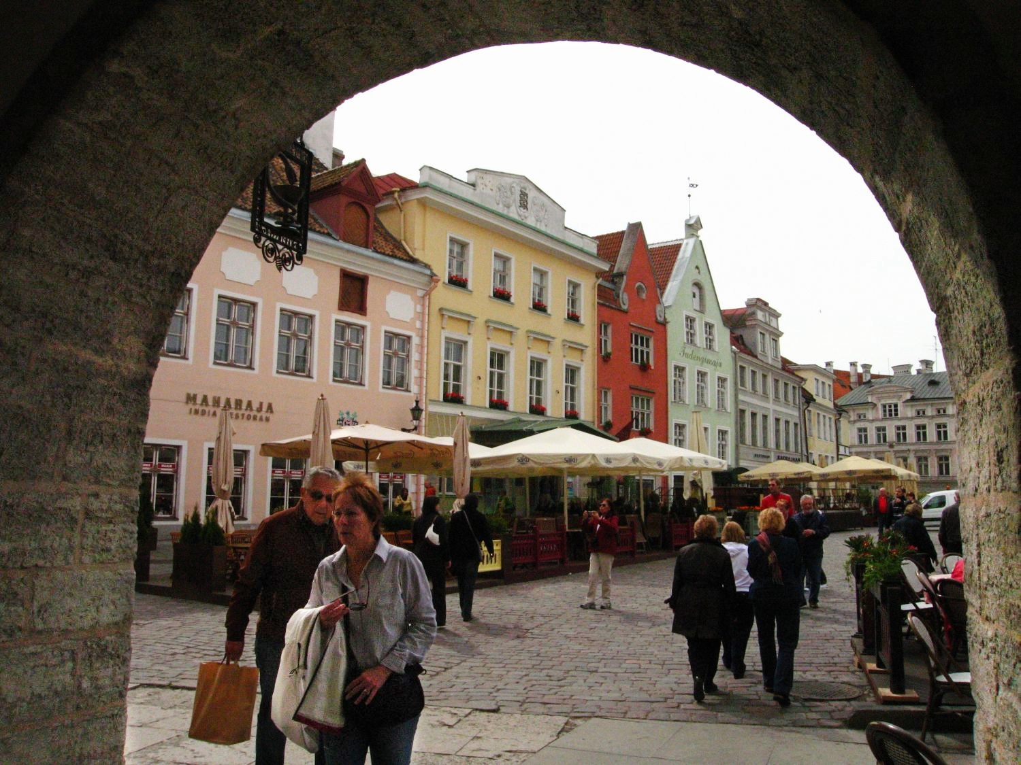
Frame it!

Slide 21
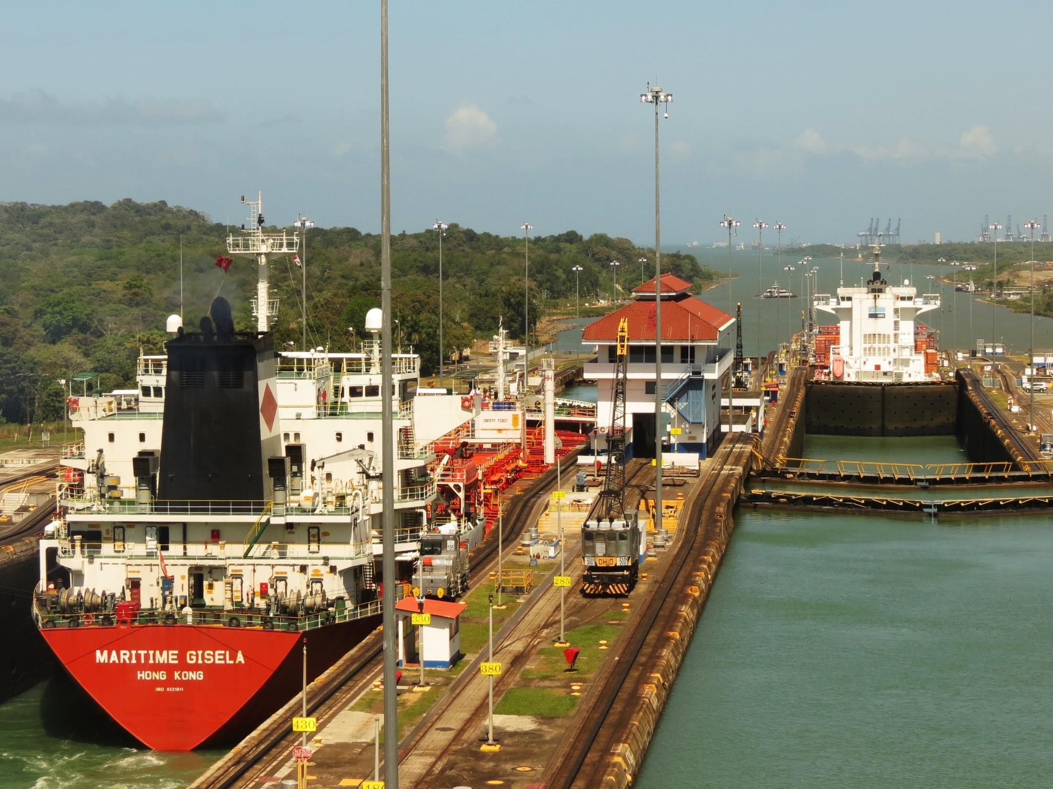
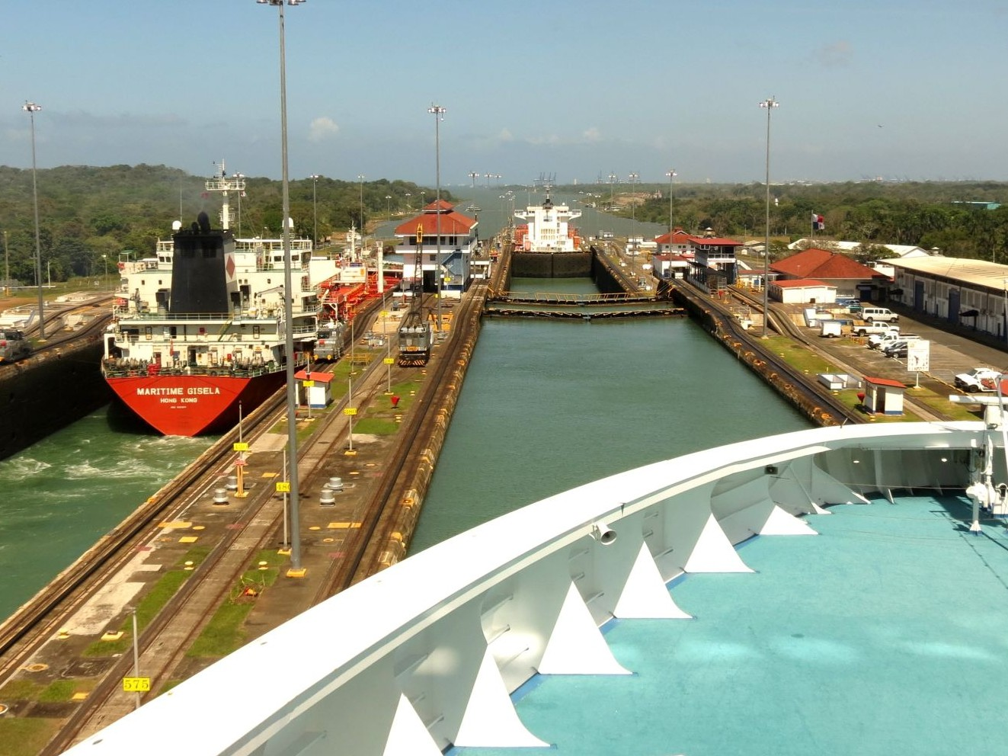
Foreground can even show motion

Slide 22
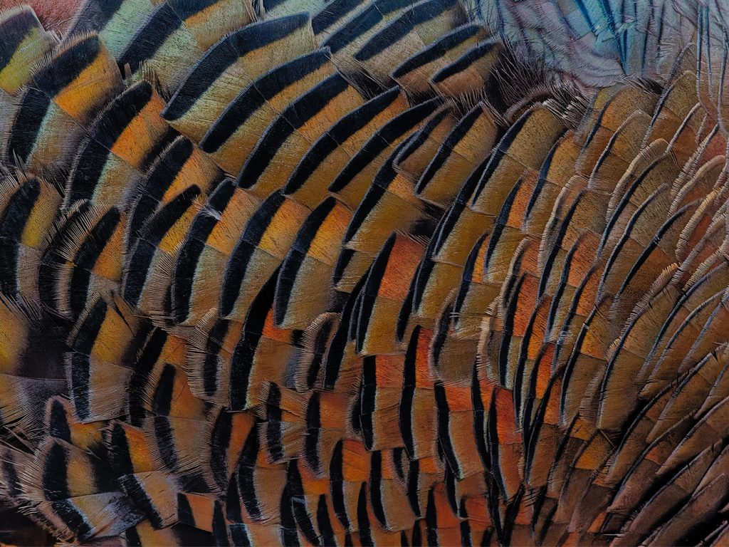
Feedback Group
Ken Udle is not able to continue leading the group this year
The group allowed more in-depth discussion and suggestions for improvement of images than the challenge critiques
Alternative formats are being considered
We need members to demonstrate interest in continuing this club activity
Please contact President@CPOPC.ca if you wish the activity to continue
Paul Downing

Slide 23
2022-23 Speaker and Topics Schedule Programs Director; Marianne Pethke Competitions Director; Lynda Buske

Slide 24
CPOPC on Twitter Vice President; Chris Taylor
@OrleansPhotoClb
We now have a Twitter account
@CPOPC was taken
We will tweet 3 or 4 times a month
upcoming challenges and competitions
meeting announcements
other items likely to be of interest to members
https://twitter.com/OrleansPhotoClb
NOTES; Newsletters will continue as before
Challenge and Competition winners will be posted on our Facebook page
Twitter wouldn’t let us have a “u”

Slide 25
Notices – October 2022
https://www.naturephotographyclasses.com/speaker-series
Nic Stover is presenting this series of speaker presentations
Available online for $10 US each.

Slide 26
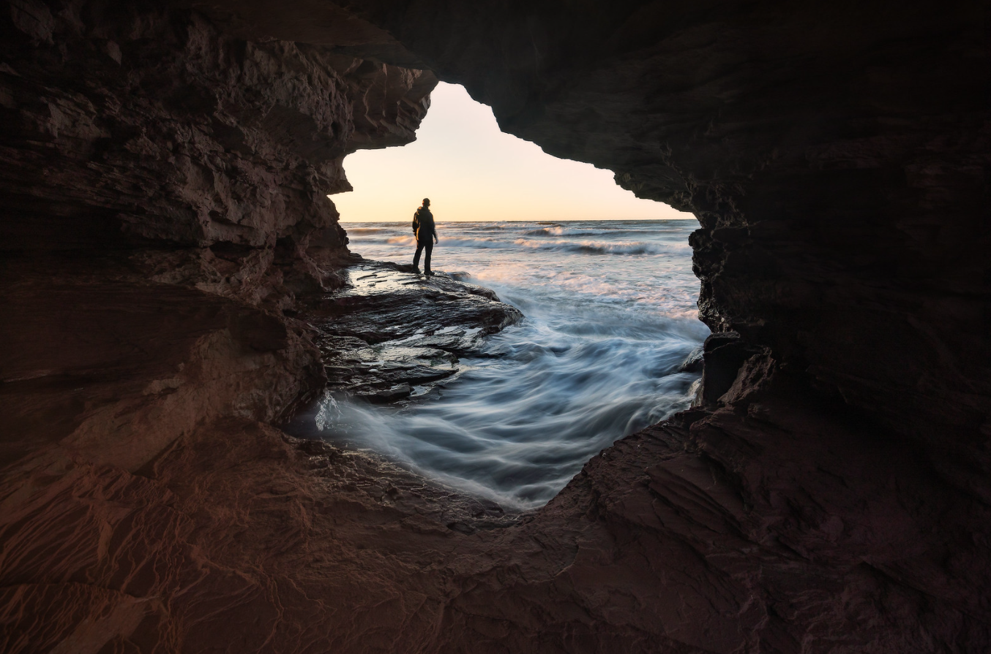
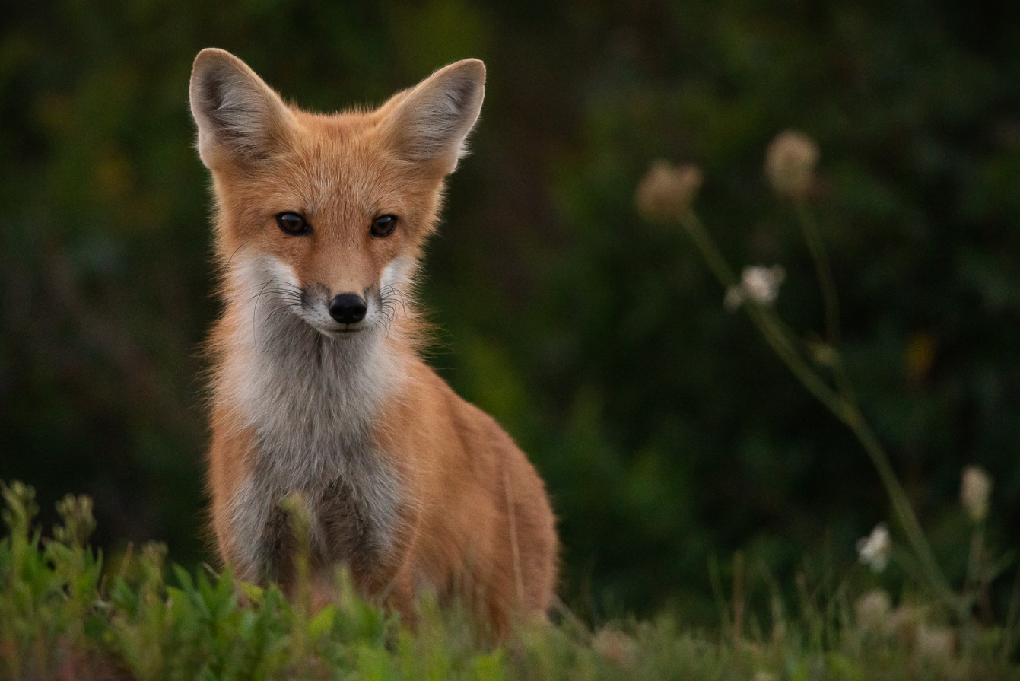
Next Meeting
12 November at 09.30 on Zoom
Featured Presenter:
Stephen DesRoches
Landscape and Nature
Photography
November Challenge
Rocks
November Technique
Intentional Camera Movement
https://www.stephendesroches.com/

