Slide 1
CPOPC September 2022
Welcome back! How was your summer?
Alan White - September 10, 2022

Slide 2
Welcome
First meeting of new year
Acknowledgement of guests and prospective members
Zoom difficulties? - Email John Miner john@miner.ca
10 min break between 10:30 and 11am
Our agenda
Image by Sandy Menard

Slide 3
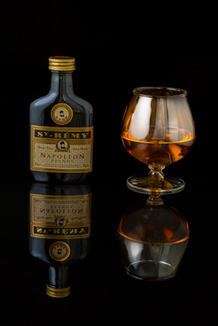
September 2022
Agenda topics
Welcome
Summer photo share – part one
The Year Ahead
In-person resumption?
Speakers scheduled
Workshops and other activities
Challenges and competitions
Feedback Group?
Social media presence
Finances and membership fees for 2022-2023
Member Contributions
Member Recognition
Technique Review - October topic
Summer photo share – part two
Photography 101- What to do with your travel photos
Notices
Image by Paul Downing

Slide 4
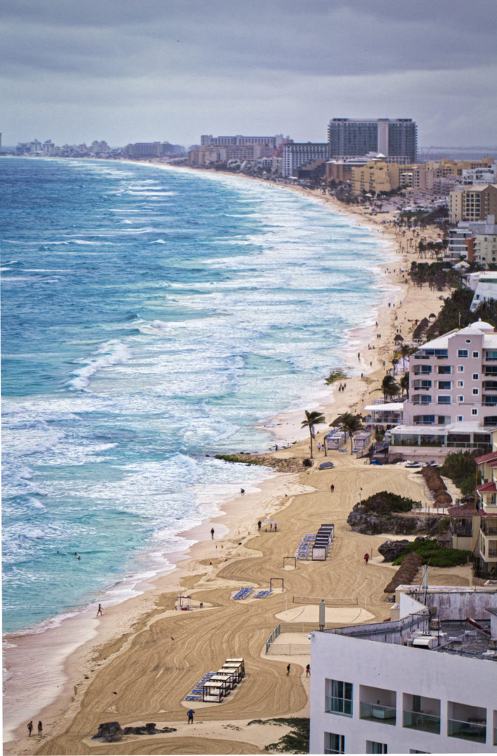
Summer Photo Share
Trish Parsons

Slide 5
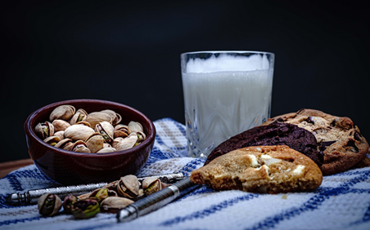
Resumption of In-Person meetings? President; Alan White
Continuing for now with online monthly meetings via Zoom
Planning in-person workshops
Social event to “test the waters”
Saturday 17th September, 9.30am to 11.00am (+)
Hybrid meetings are now considered unworkable
We require Internet Access for access to speakers
QHCC has no Wi-Fi but many other advantages
We are working on getting Internet at QHCC
Probably not happening before New Year
Please give your opinion/preference to any executive member
Image by Dennison Moore

Slide 6
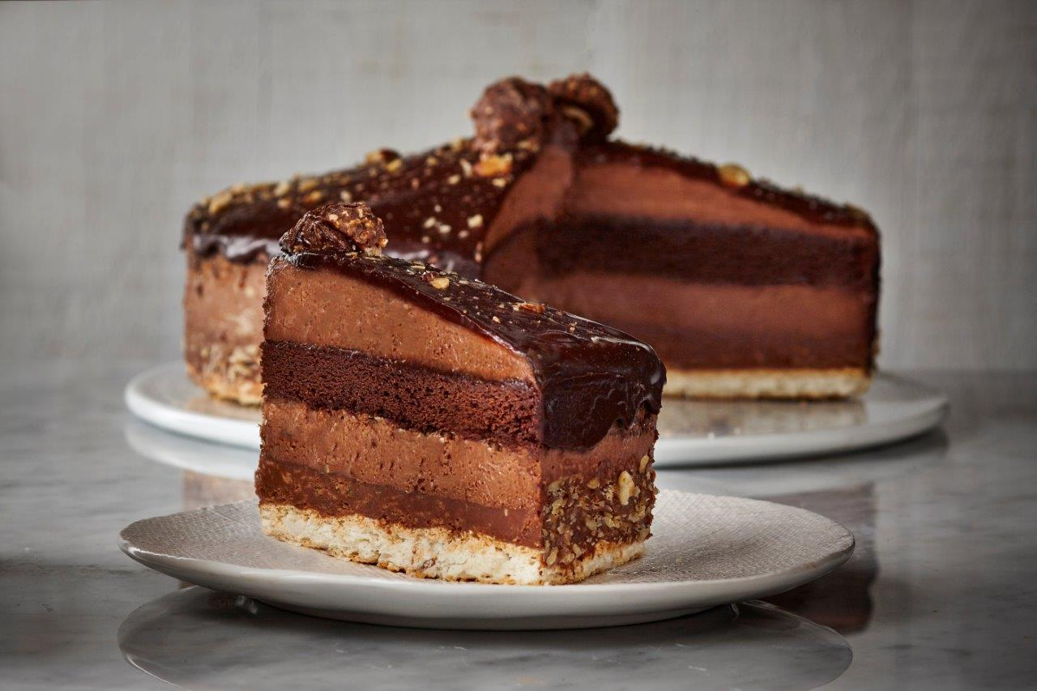
Special Social Event Saturday, September 17 09.30 to 11.00 (+) Café Latte Chino - in the tent 2020 Tenth Line (across from Farm Boy)
The club will be providing Pastries and Beverages
Let’s get (re)acquainted and revive the social dimension of our club!
Meet your executive and let us know your preferences for other in-person activities
You are encouraged to bring along prospective members
https://cafelattecino.com/

Slide 7
2022-23 Speaker and Topics Schedule Programs Director; Marianne Pethke Competitions Director; Lynda Buske

Slide 8
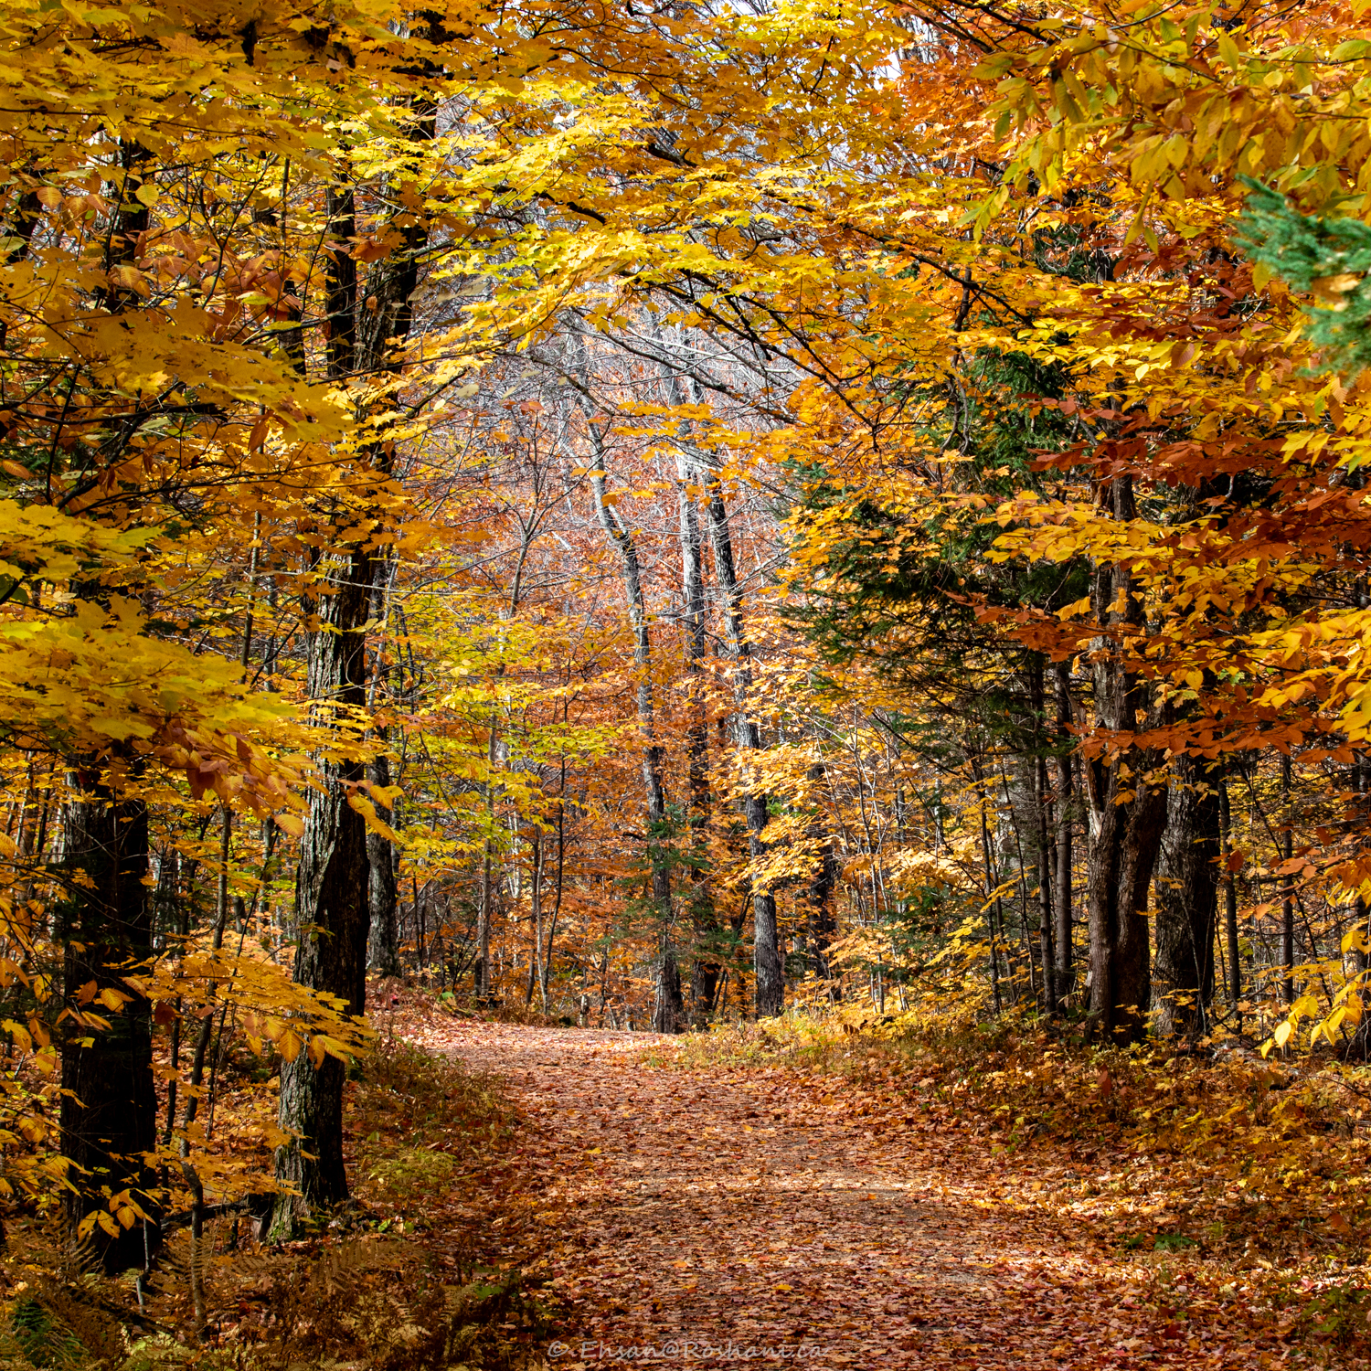
Upcoming Workshop and Outing Programs Director; Marianne Pethke
Workshop; Saturday October 22
Flash Photography with Michael Willems
Outing; Saturday October 29
Ehsan Roshani will lead a group in the Gatineau Park to capture the colours and some of his favourite views
We will announce in a newsletter when the registration page for these activities has been opened on the website
Ehsan Roshani

Slide 9
Changes to Challenges/Competition
Off-topic scoring penalty
Previous method
If on-topic – score is doubled for that judge (max 30 pts)
If off-topic – score is reduced by 50% for that judge (max 7.5 pts)
New scoring penalty
If on-topic – score is doubled for that judge (max 30 pts)
If off-topic – score is not doubled for that judge (max 15 pts)
Archive or Recent Only?
No date restrictions for challenges
Recent images only for club competitions
No date restrictions for the interclub competition

Slide 10
Voting on an image
You are encouraged to vote even if you have not submitted an image
Review the description for the challenge and what is considered to be “off-topic”
When in doubt, vote an image on-topic to avoid penalty (be kind)
Written comments can explain your rating and help people learn.
Review guidelines on how to mark “wow”, “technical” and “composition”
https://cpopc.ca/voting-information-page/

Slide 11
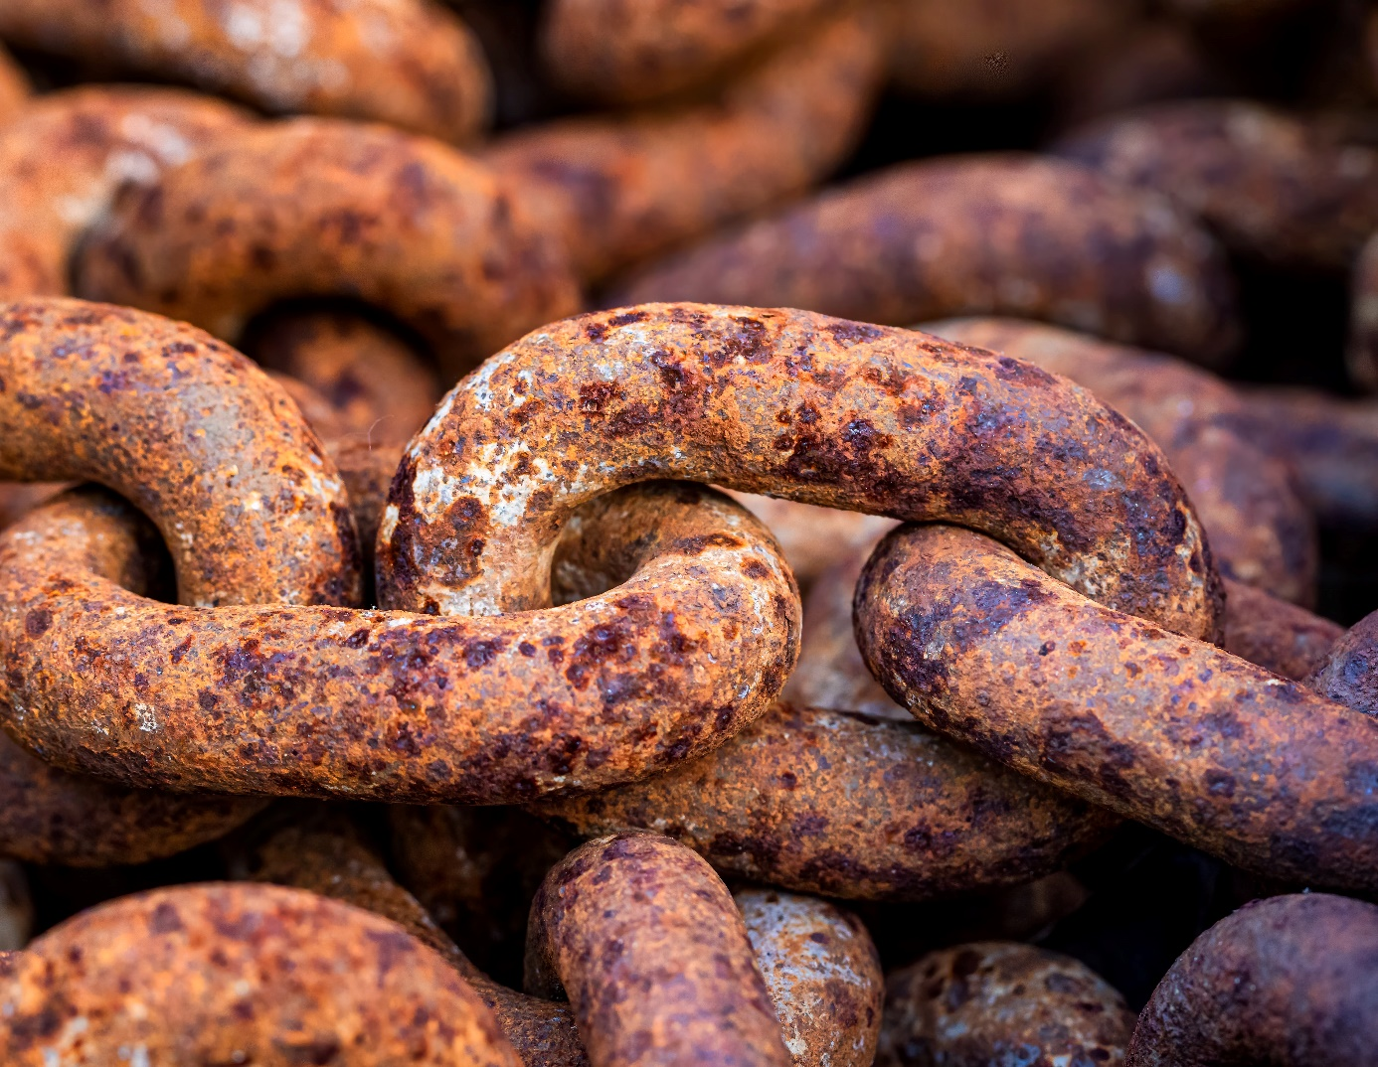
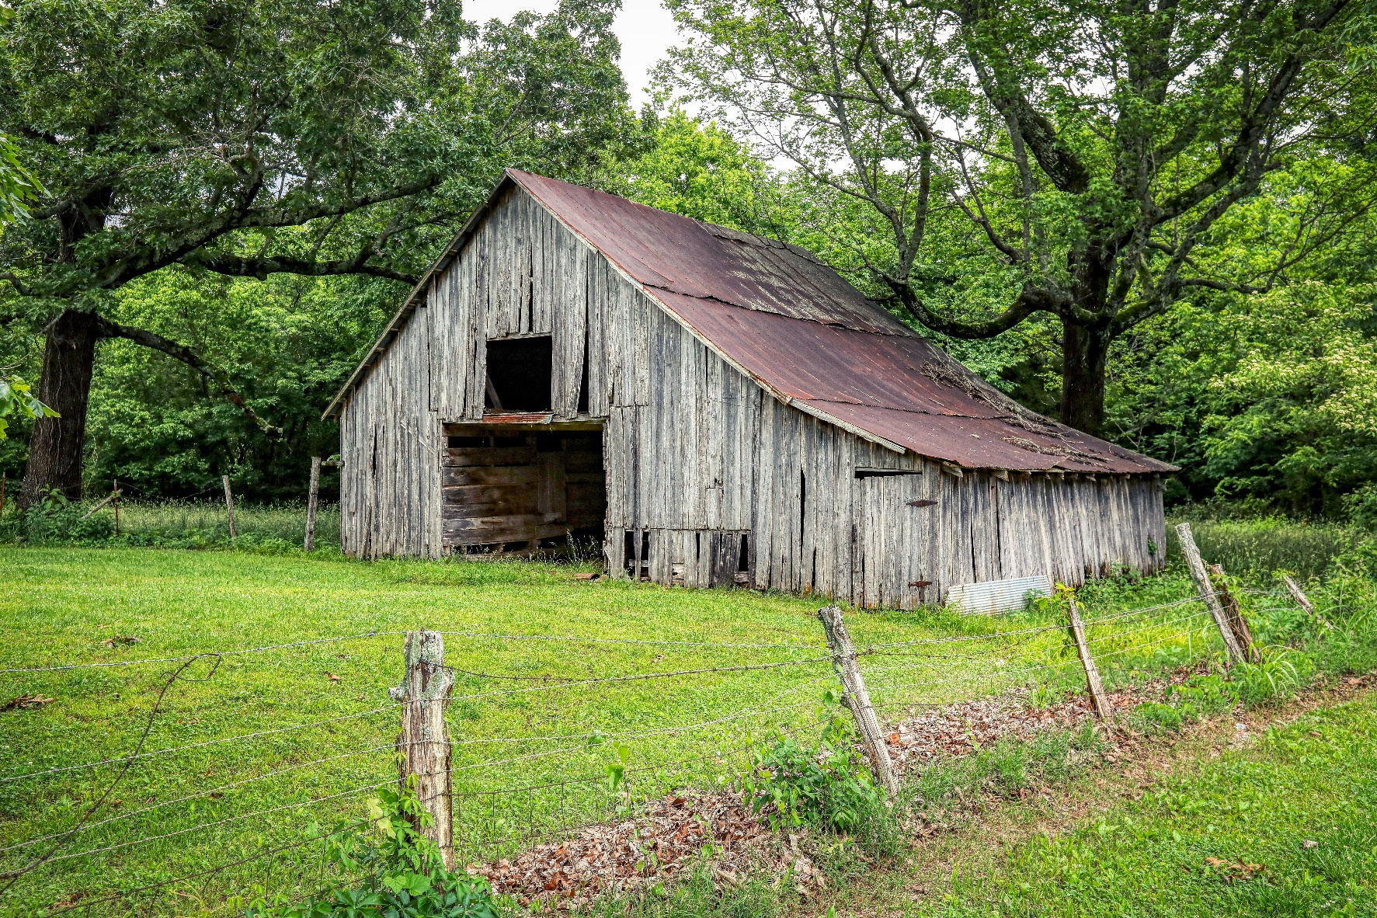
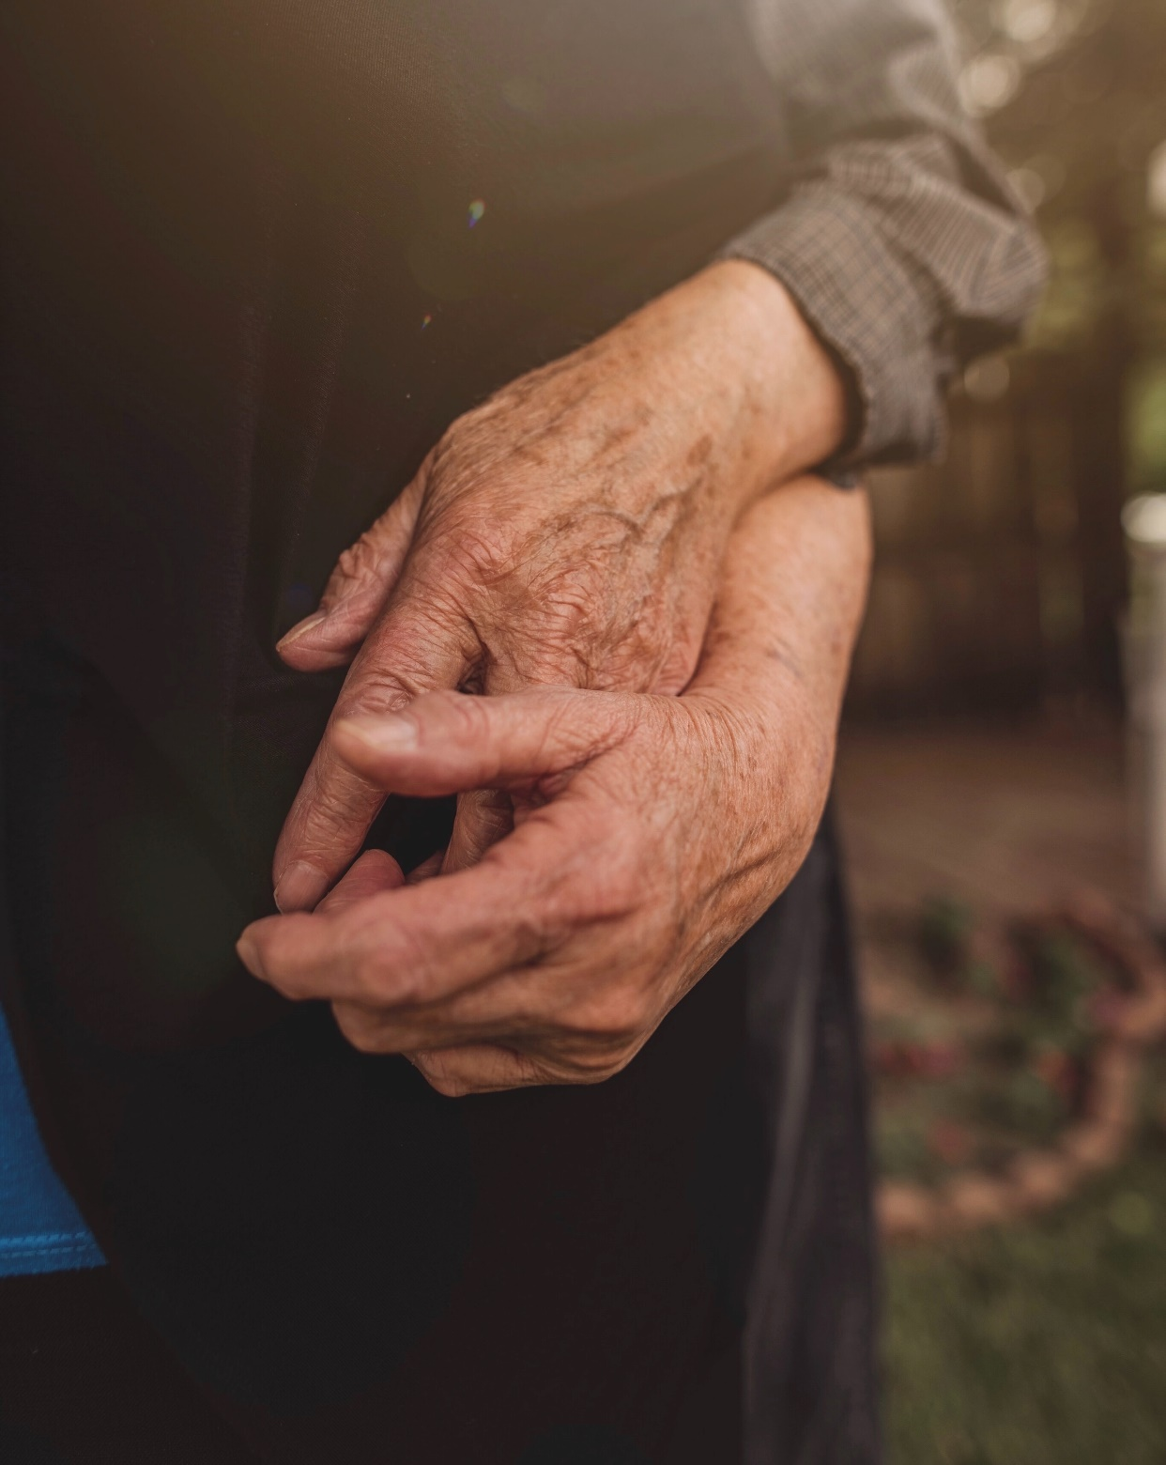
October challenge – Aged or weathered surfaces
Zdenek Machacek
Any object(s) that emphasizes texture caused by age, weather, use, etc. This could include animate or inanimate objects.
Submission deadline: Saturday, October 1, 2022 (midnight)
Voting deadline: Thursday, October 6, 2022 (midnight)
All archived images are allowed.
Mick Haupt
Nina Hill

Slide 12
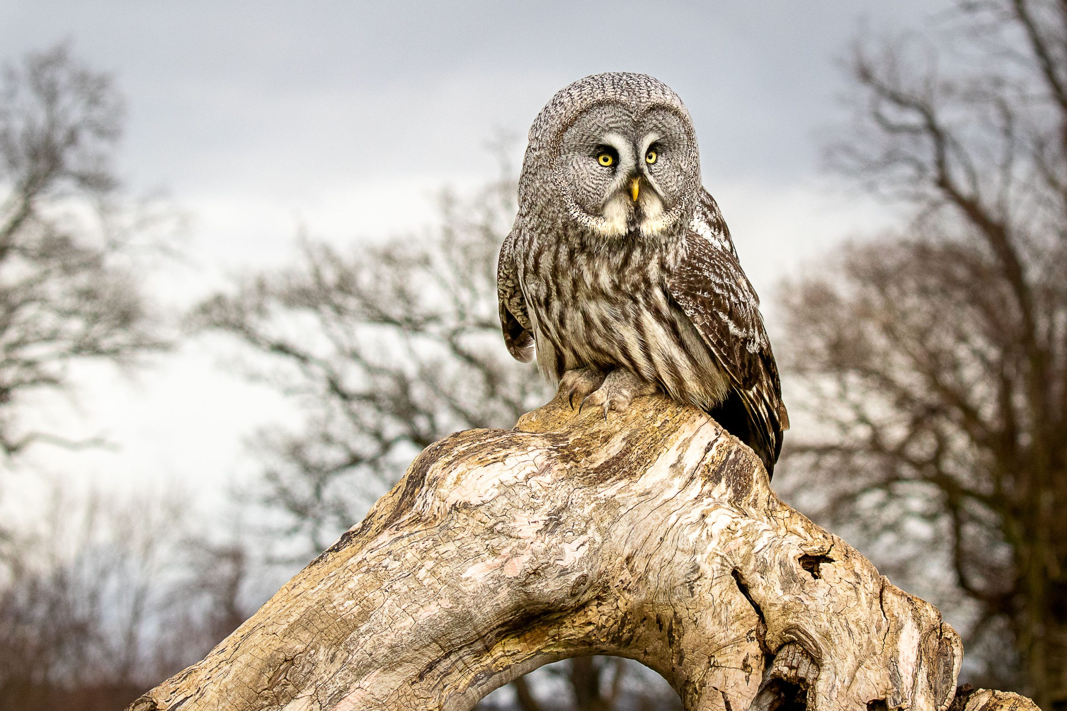
Feedback Group
Ken Udle is not able to continue leading the group this year
The group allowed more in-depth discussion and suggestions for improvement of images than the challenge critiques
We need members to demonstrate interest in continuing this club activity
Alternative formats are being considered
Please contact President@CPOPC.ca if you wish the activity to continue
Image by Johan Carignan

Slide 13
CPOPC on Twitter Vice President; Chris Taylor
@OrleansPhotoClb
We now have a Twitter account
@CPOPC was taken
We will tweet 3 or 4 times a month
upcoming challenges and competitions
meeting announcements
other items likely to be of interest to members
https://twitter.com/OrleansPhotoClb
NOTES; Newsletters will continue as before
Challenge and Competition winners will be posted on our Facebook page
Twitter wouldn’t let us have a “u”

Slide 14
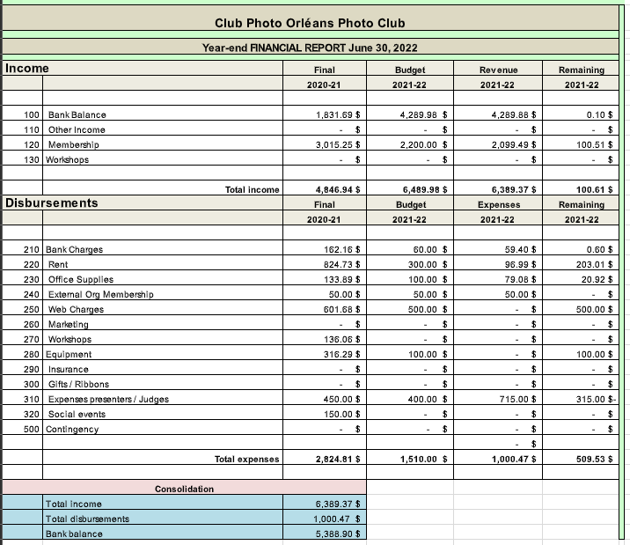
Financial situation and budget
FINANCIAL HIGHLIGHTS
Total income over past year = $2099
Total expenditures = $1000
Bank balance at year end = $5388

Slide 15
Annual Membership Fees; 2022-2023 Secretary and Treasurer; Roger Regimbal
Individual - $50 $25 for new members only joining between Feb. 1 and June 30
Family - $75 $35 for new members only joining between Feb. 1 and June 30
All returning members must pay full price
Full payment is due before November 2023
Access to “Members Only” section of website cut off after November
Please pay online via PayPal using the CPOPC web site “How to Join” page

Slide 16
October Technique - Silhouette
Place your subject in front of a light source or ensure that the background is significantly brighter than the subject.
Typically, a camera will automatically create a silhouette but if your subject makes up a large portion of the photo, you may have to manually underexpose your shot.
Rather than tonalities and colour, pay attention to the shape and outline of your object.
Jonathan Mabey
William Farlow

Slide 17
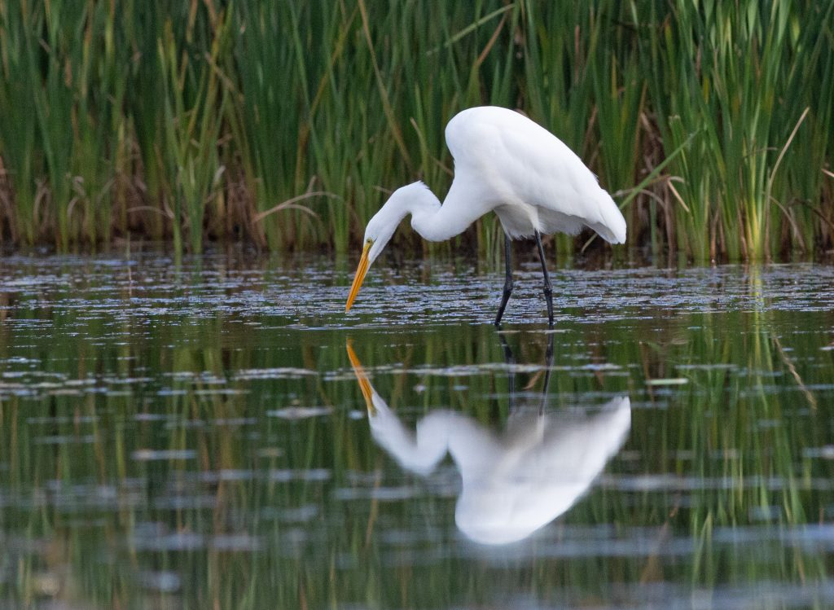
Summer Photo Share
Richard Godin

Slide 18
Photography 101 – Lynda Buske What to do with all those travel pics?
During your trip:
Make daily backups to laptop or cloud.
Set up folders: location? date? camera used?
Use down time/bad weather to start editing pics

Slide 19
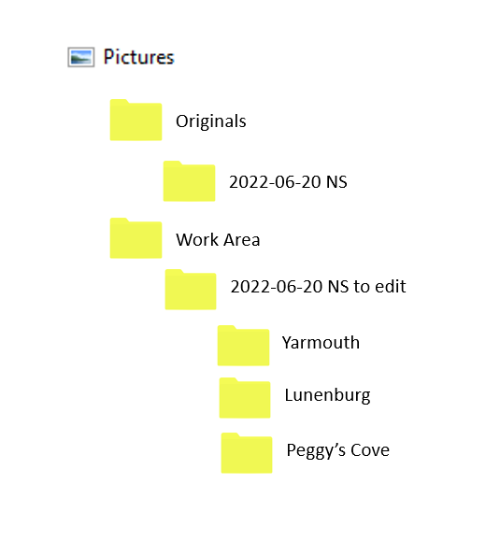
Photography 101
Can add in (or overwrite) the ones you edited on your trip
Create further sub-folders for On-line album, Facebook pics, Prints, Photobook, etc.

Slide 20
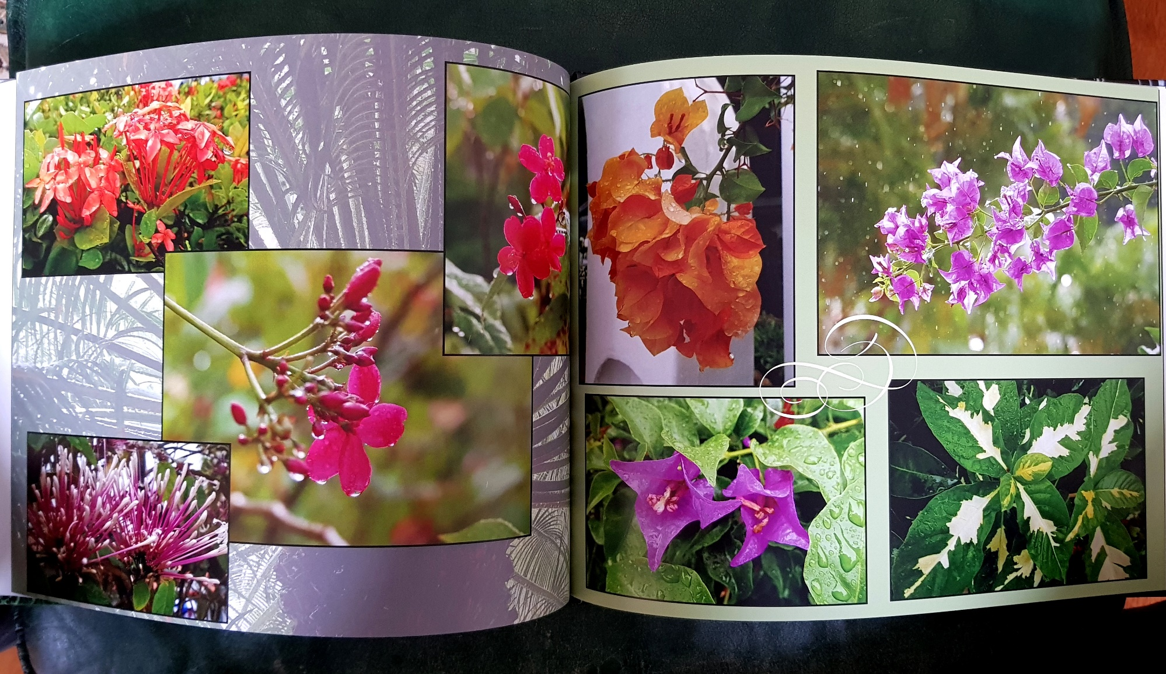
Photography 101
Take the time to compare images and pic the best one with the most potential before editing.
Mark the ones you like in your editing software.
Place no more than 100 images in an on-line photo album. Create multiple albums for a long trip.
Keep Facebook postings to a small number.

Slide 21
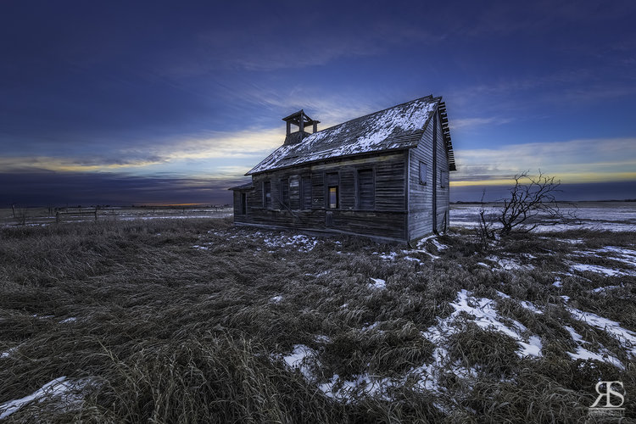
Next Meeting
8 October at 09.30 on Zoom
Featured Presenter:
Robert Scott
Abandoned Photography
October Challenge
Weathered Surfaces
October Technique
Silhouette

