Slide 1
CPOPC October 2023
October 21, 2023

Slide 2
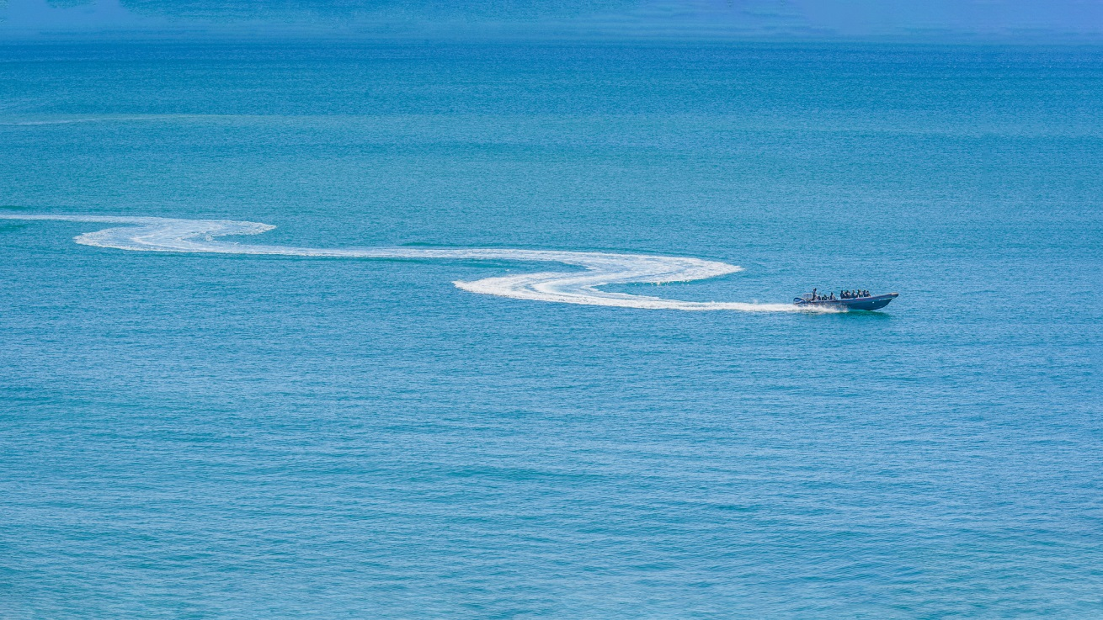
Welcome
Acknowledgement of guests and prospective members
Break between 11am and 11.30
Toilets are upstairs
Please be respectful of others but do join in, ask questions and participate!
Yoline Joseph-Hoskin

Slide 3
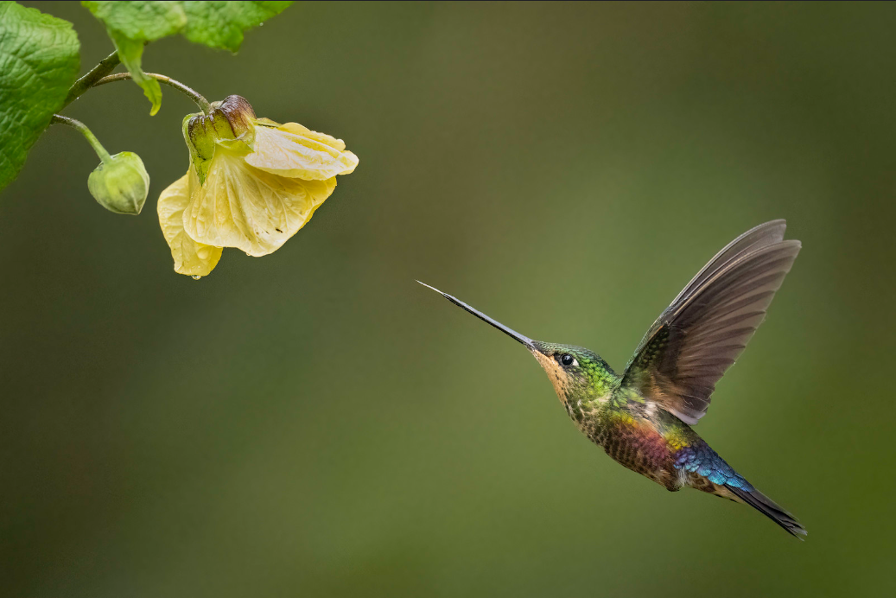
October 2023
Agenda topics
Featured Speaker
Summer Photos (missed)-Johan
Break (with slideshow)
October Challenge and Critique
November challenge and Technique announcement
Member Contribution-Sharon
Gatineau Outing showing
October Technique- Panorama
Photo 101- Blue hour vs. Golden Hour
Notices
Featured Speaker; Daniel Parent
Nature/wildlife photography

Slide 4
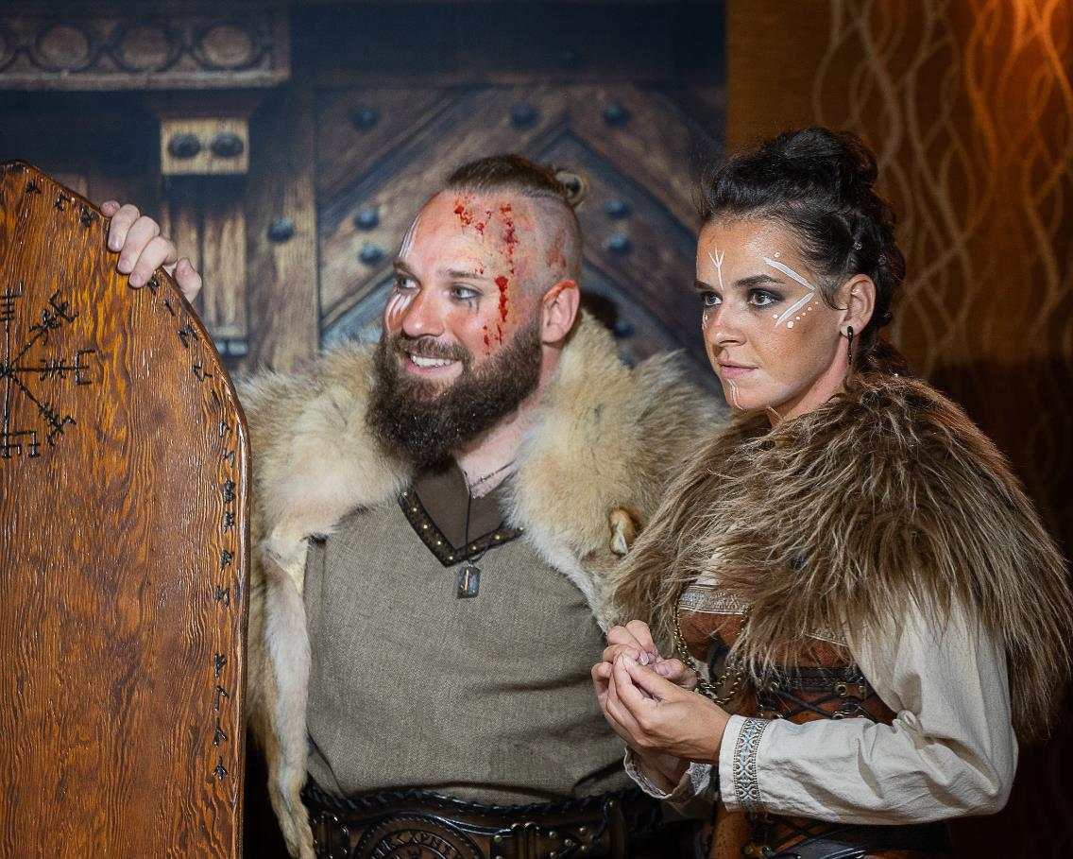
Summer 2023 missed contribution
Johan Carignan

Slide 5
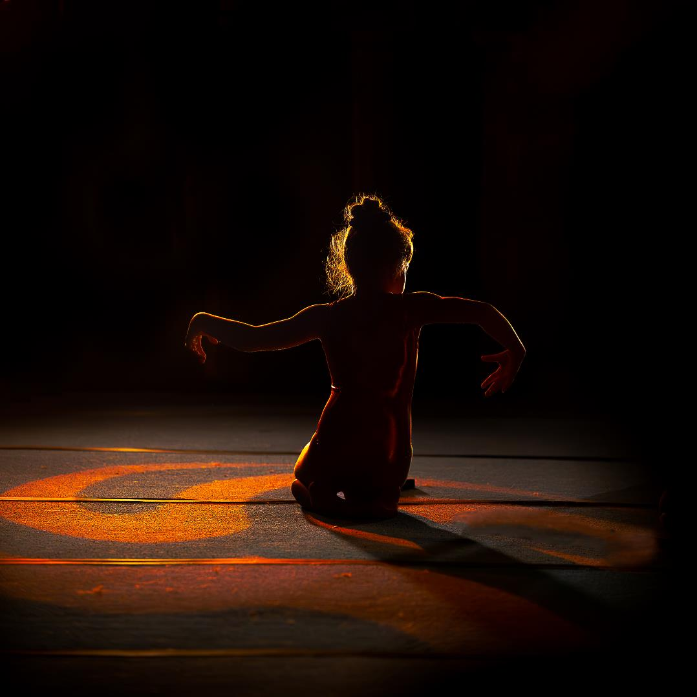

Slide 6
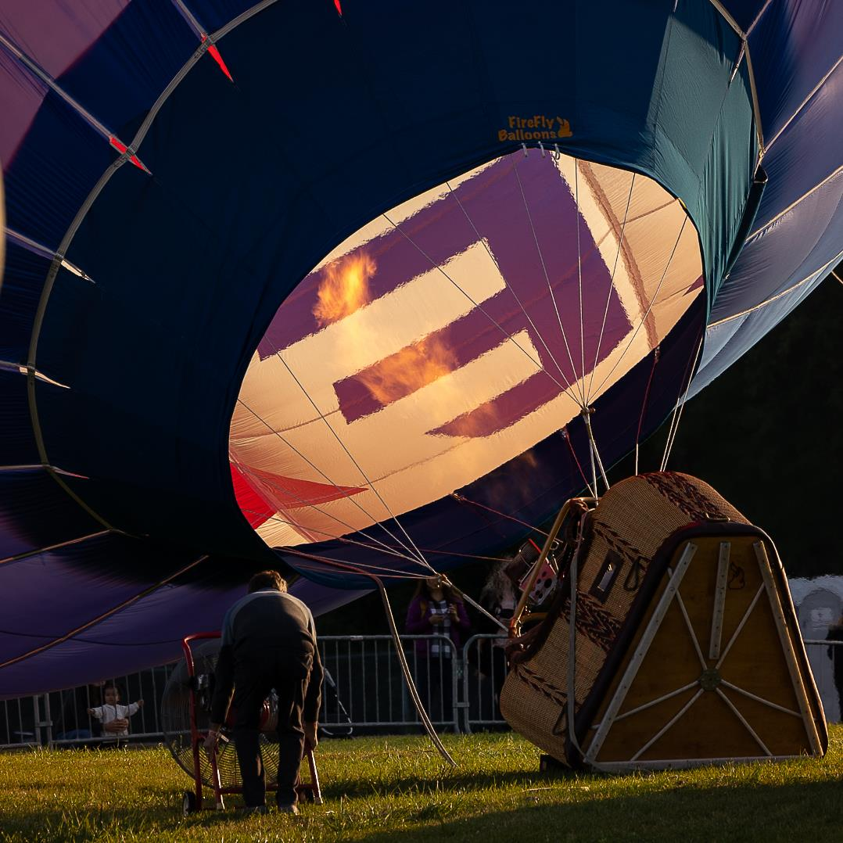

Slide 7
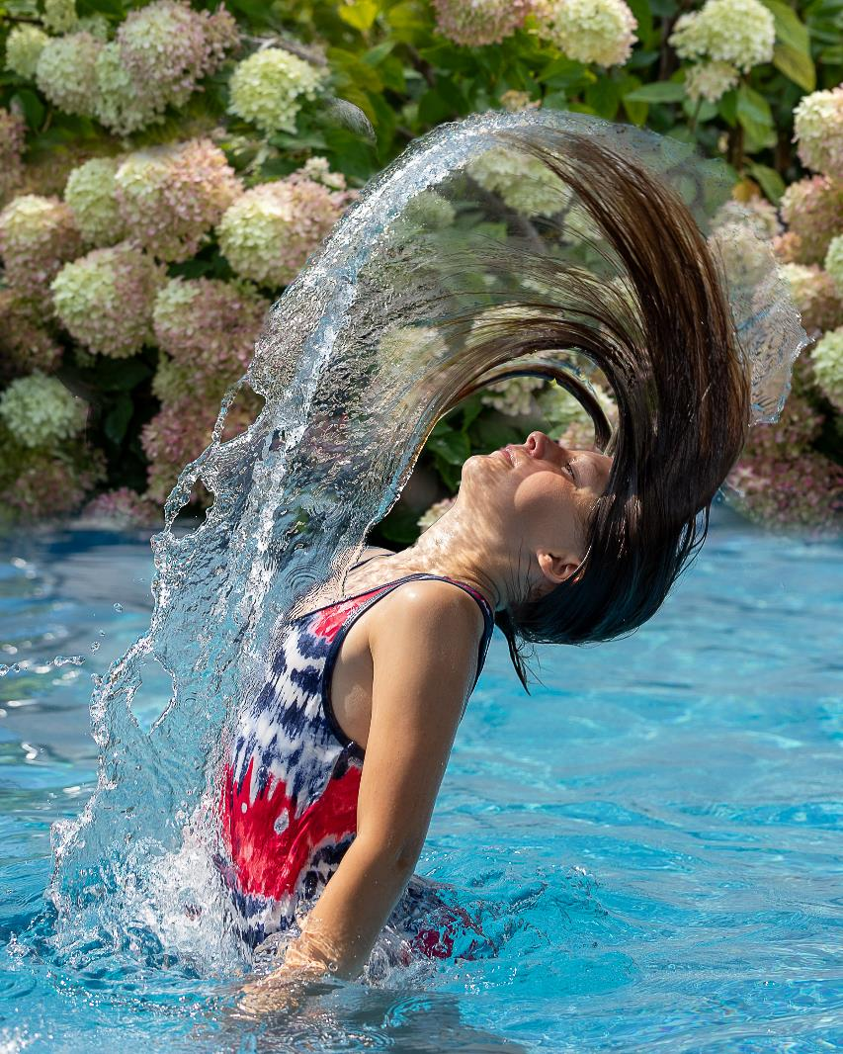

Slide 8
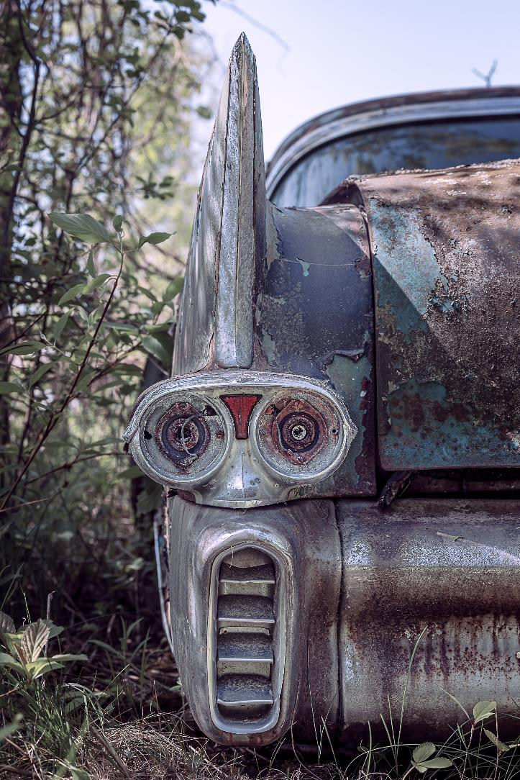

Slide 9
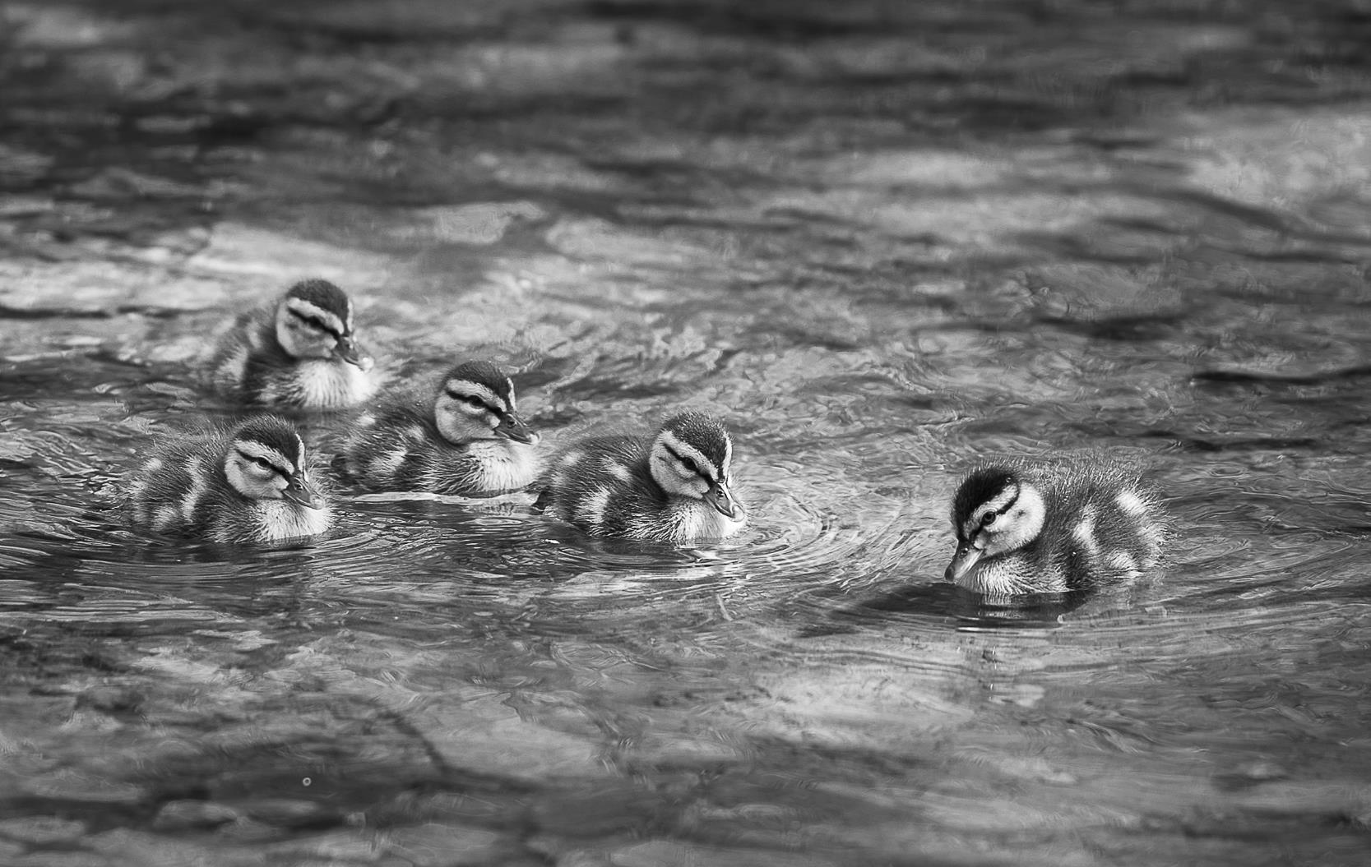

Slide 10
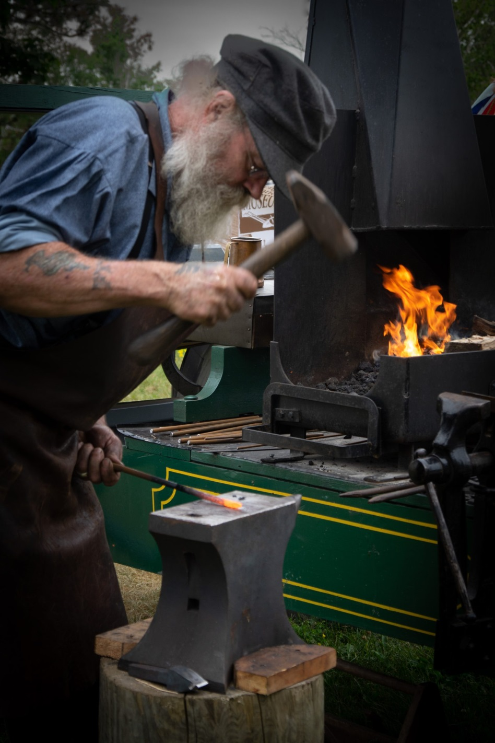
Break
Our Thanks to Dorothy for providing refreshments
Enjoy the slideshow of images from last year’s challenges and competitions
Please make our guests welcome
We will restart in 15 minutes with the October Challenge
Rosie Grigaitis

Slide 11
Challenges and Competitions Award of excellence
The top scoring image (regardless of level) will be awarded a certificate of excellence
There will also be:
1st, 2nd, 3rd place ribbons at Level 1
1st, 2nd, 3rd place ribbons at Level 2
To incorporate into the website, historic results were affected.
The club will not be handing out ribbons or awards retroactively.

Slide 12
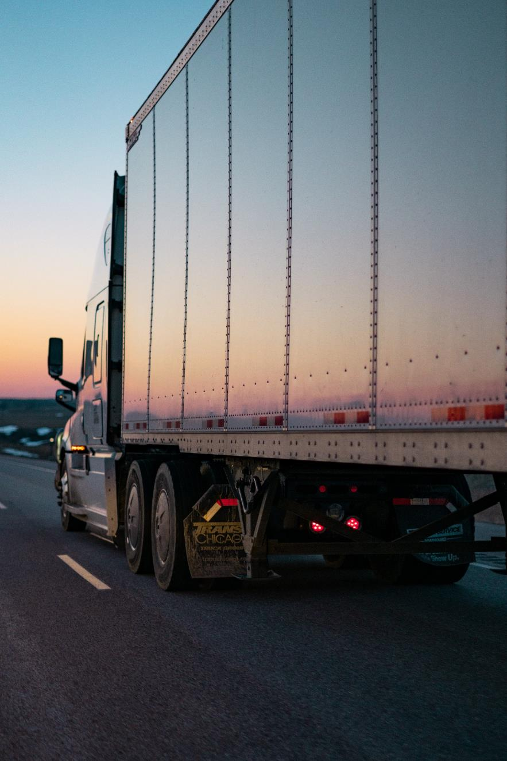
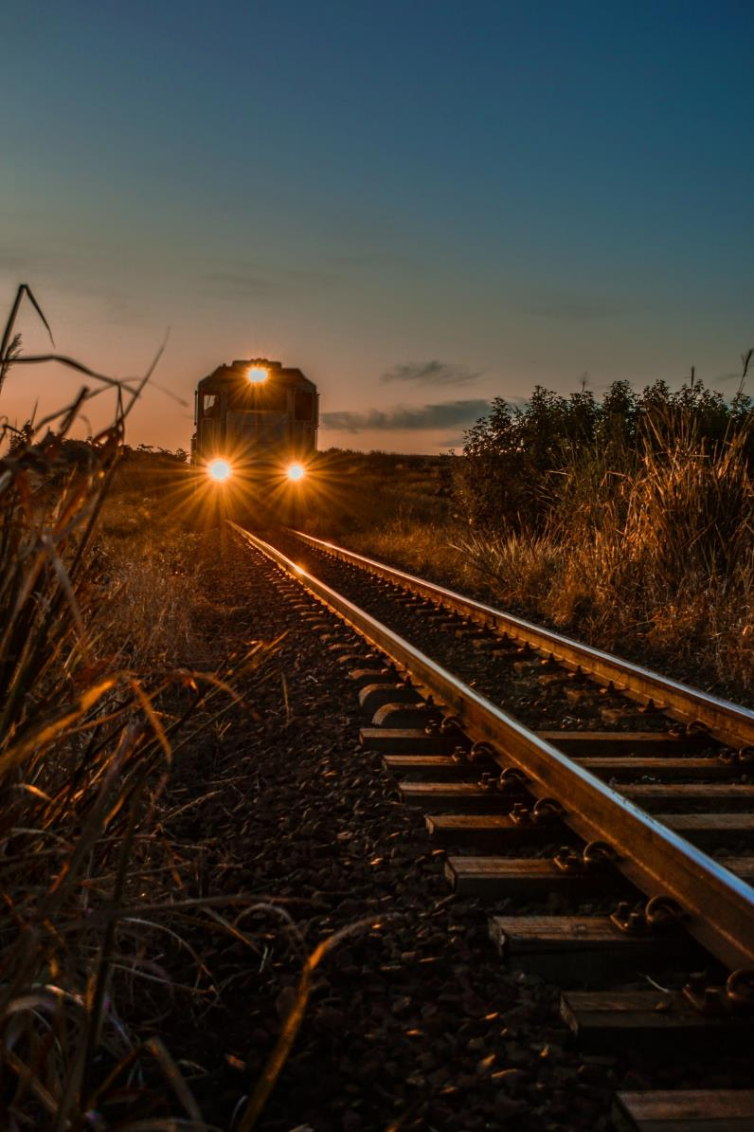
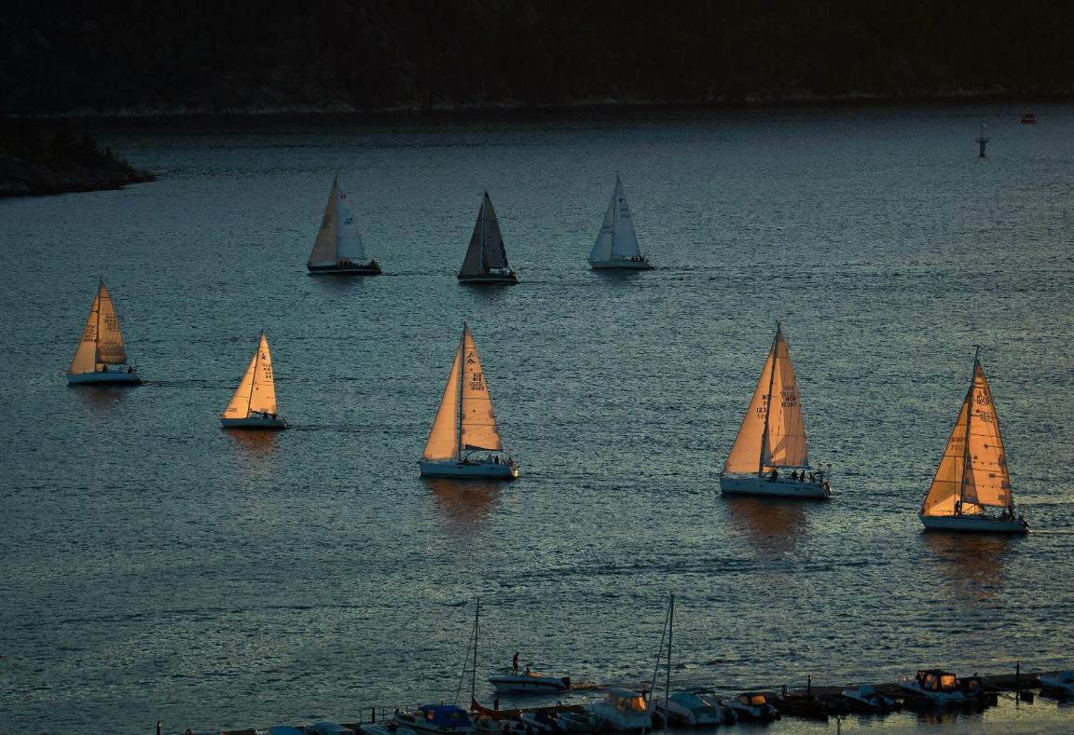
October challenge – Getting around
Caleb Ruiter
Any object(s) that is a man-made means of moving objects, e.g. bikes, trains, boat, etc.
Off topic: Humans or animals acting as modes of transport.
Submission deadline: Saturday, October 14, 2023 (midnight)
Voting deadline: Thursday, October 19, 2023 (midnight)
All archived images are allowed.
Marissa Beletti
Vidar Mathisen

Slide 13
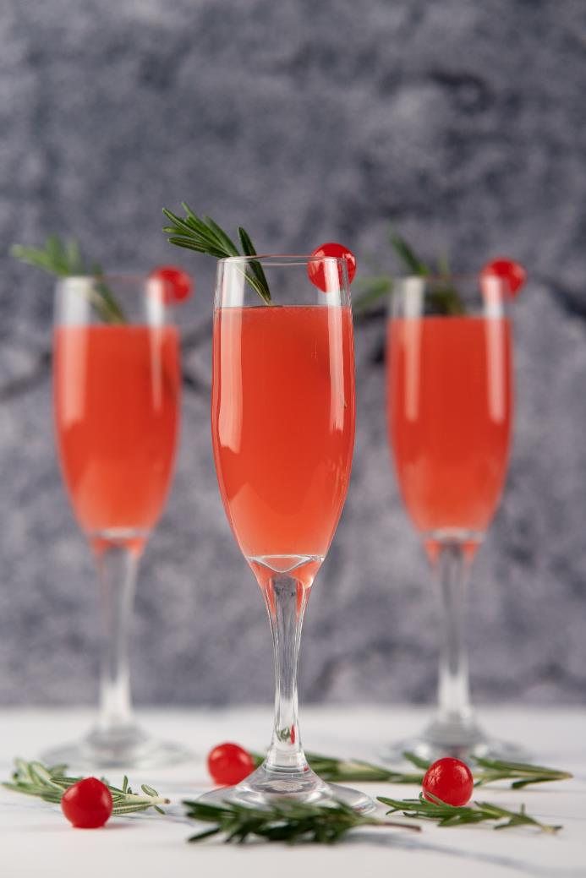
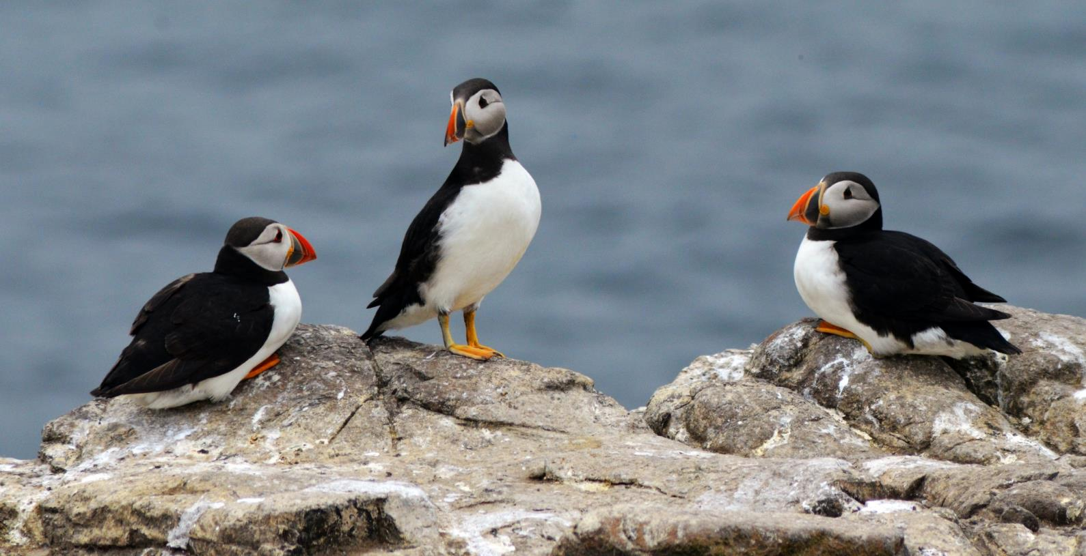
November challenge – Trios
Jess Bailey
Any set of three objects, animate or inanimate.
Off topic: More(or less) than three main subjects.
Submission deadline: Saturday, Nov 11, 2023 (midnight)
Voting deadline: Thursday, Nov 16, 2023 (midnight)
All archived images are allowed.
David Hunter
David Heslop

Slide 14
Fall competition - Simplicity
Photos that are simple and uncomplicated. Showcase “less is more”
Images must have been taken since June 2023
Submit up to three images
Submission deadline: Saturday, Nov 18, 2023 (midnight)
Shane
Sarah Dorweiler
Viktor Forgacs

Slide 15
Inter-Club activities
Inter-club AV Showcase
Clark Hall, RA Centre on Dec 5, 7pm
3-6 min videos, 8 per club
Submit to lbuske@sympatico.ca via a link (e.g. Dropbox)
Deadline – Monday Nov 20th at midnight
Inter-club competition
Clark Hall, RA Centre on April 9, 7pm
Digital and print competitions
Topic : Truly Canadian
One photo is on topic, 2 others can be on topic or general category
Deadline for on-line submission: Tuesday March 12
Note: No Zoom option on either event

Slide 16
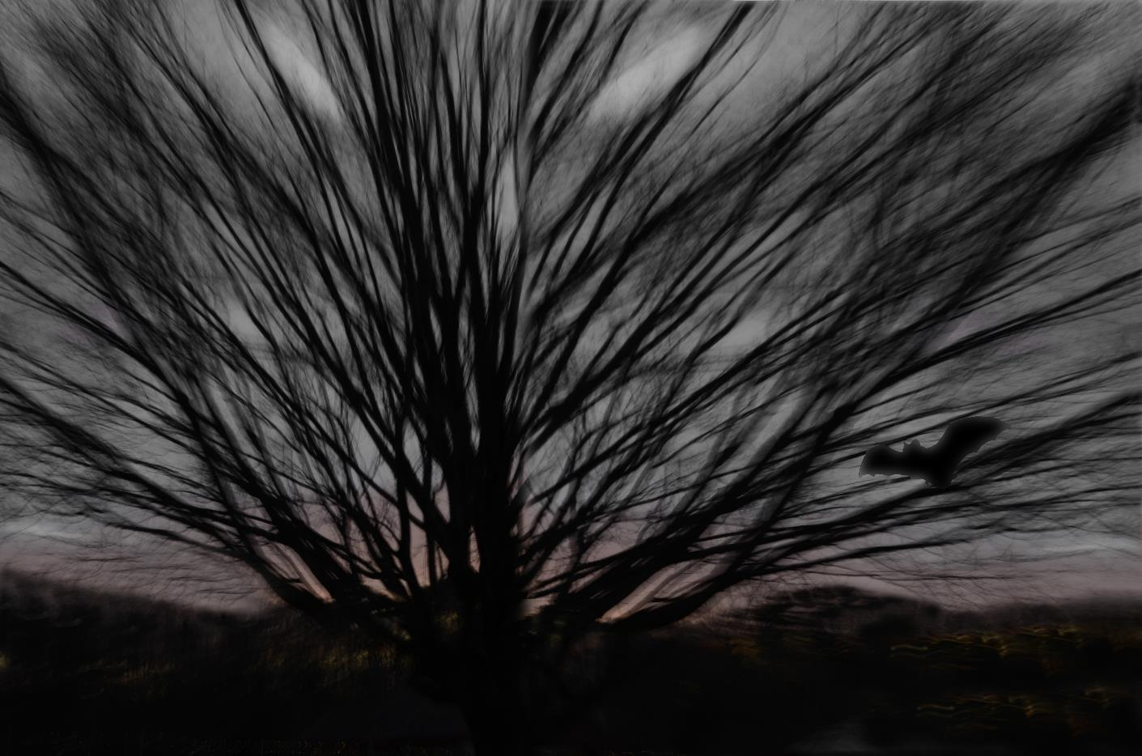
Member contribution – Spooky Halloween!
Sharon Fry

Slide 17
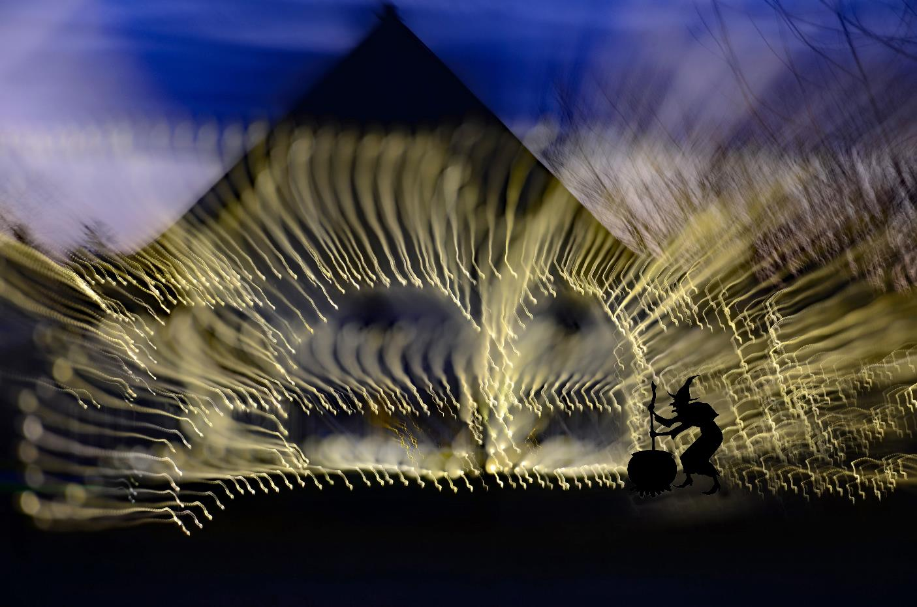

Slide 18
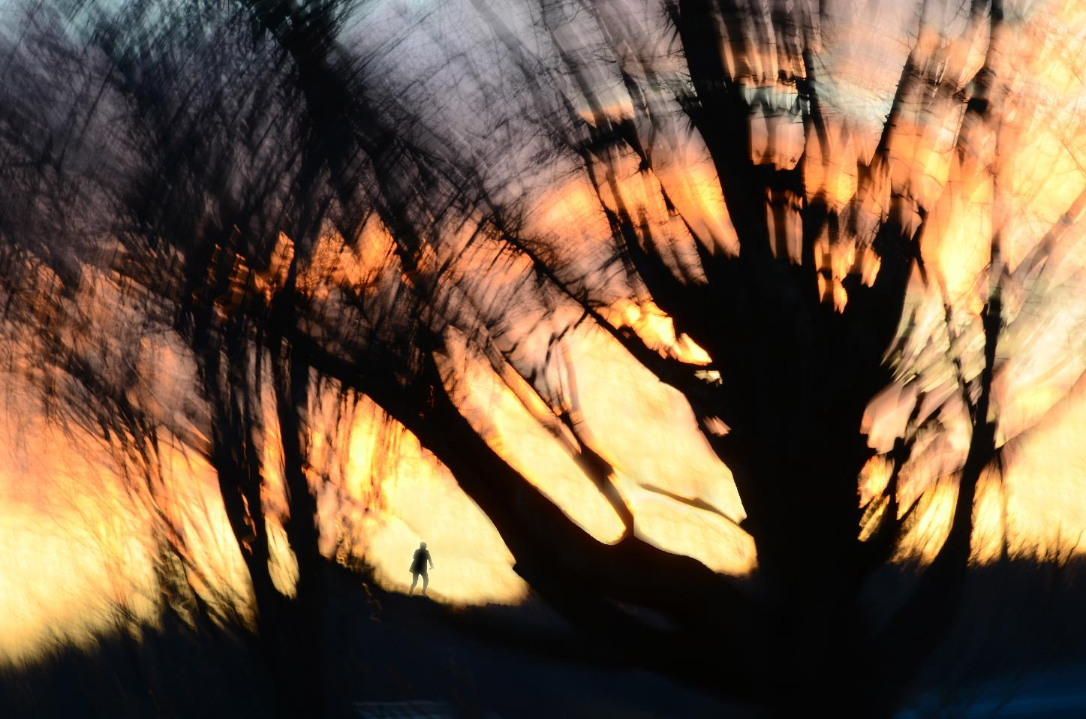

Slide 19
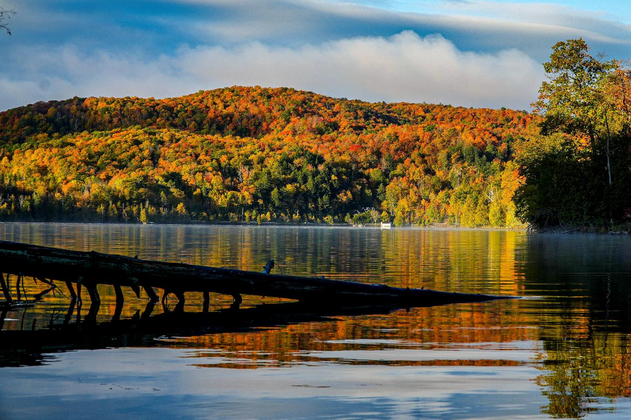
Meech Lake/Carbide Wilson outing – Oct 14
John Ingold

Slide 20
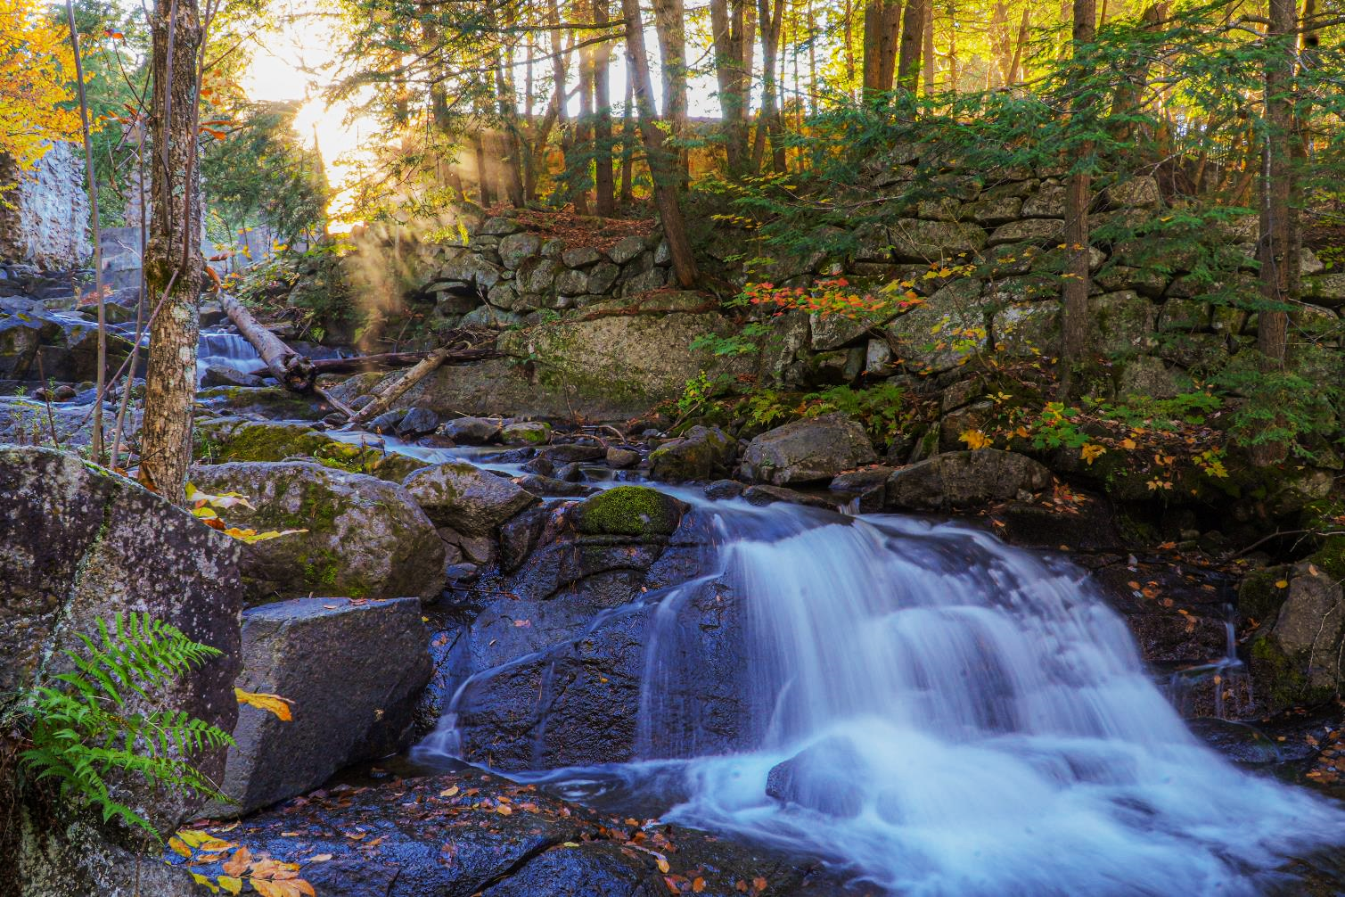
John Ingold

Slide 21
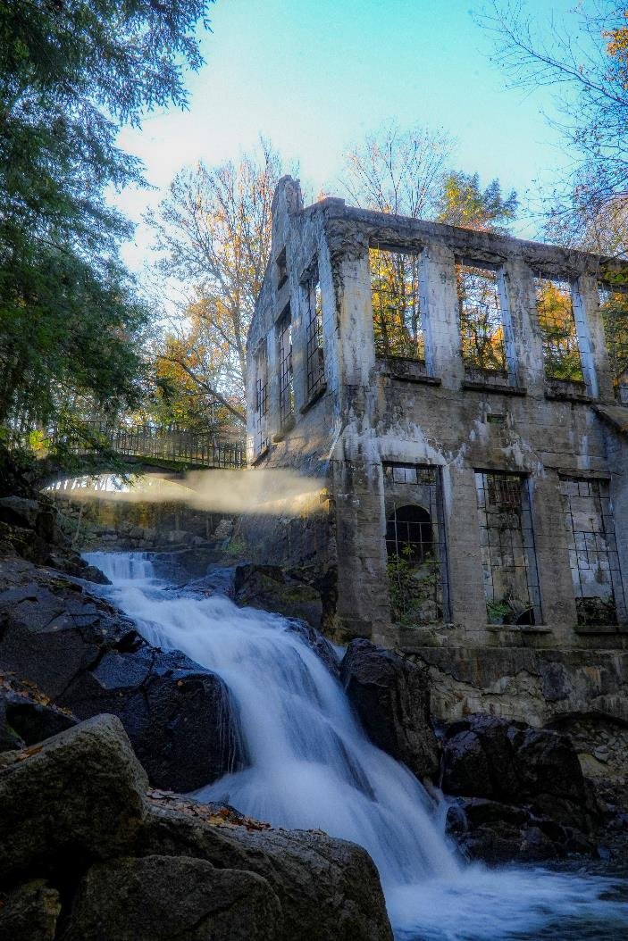
John Ingold

Slide 22
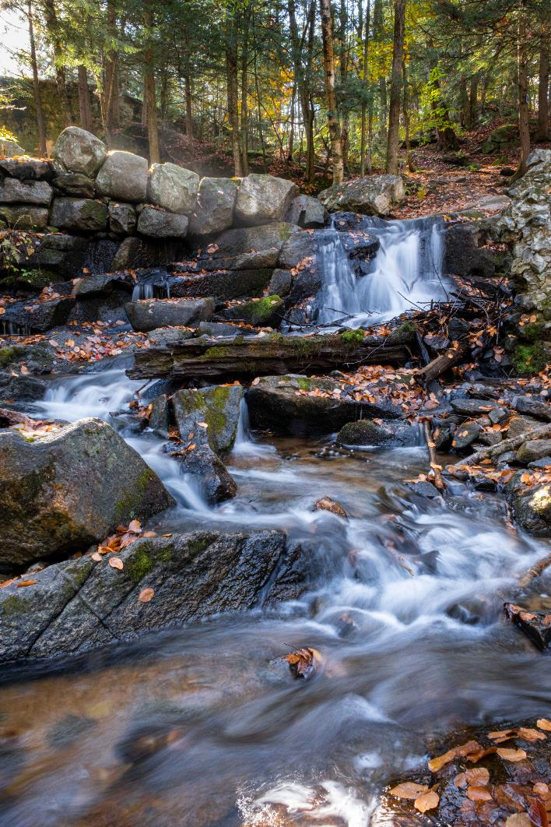
Scott Udle

Slide 23
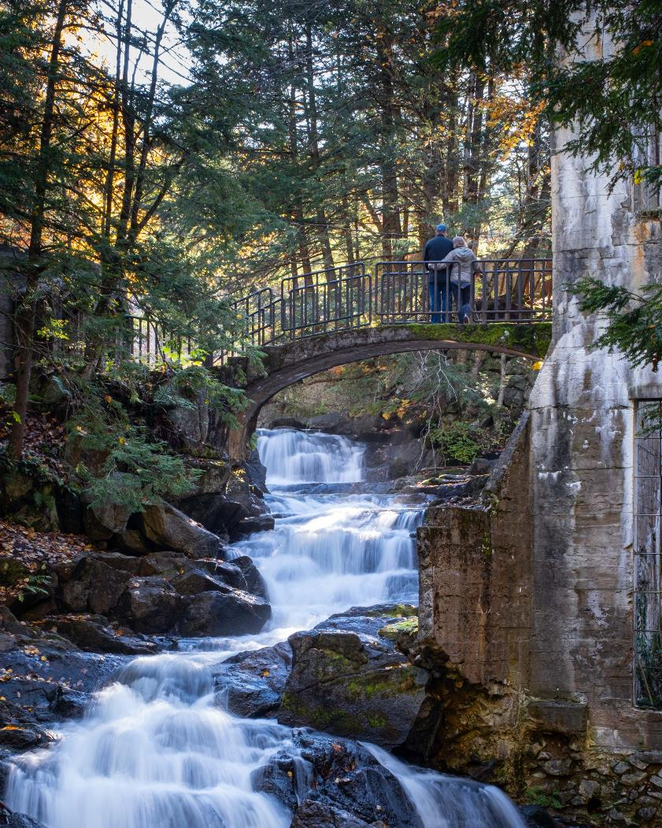
Scott Udle

Slide 24
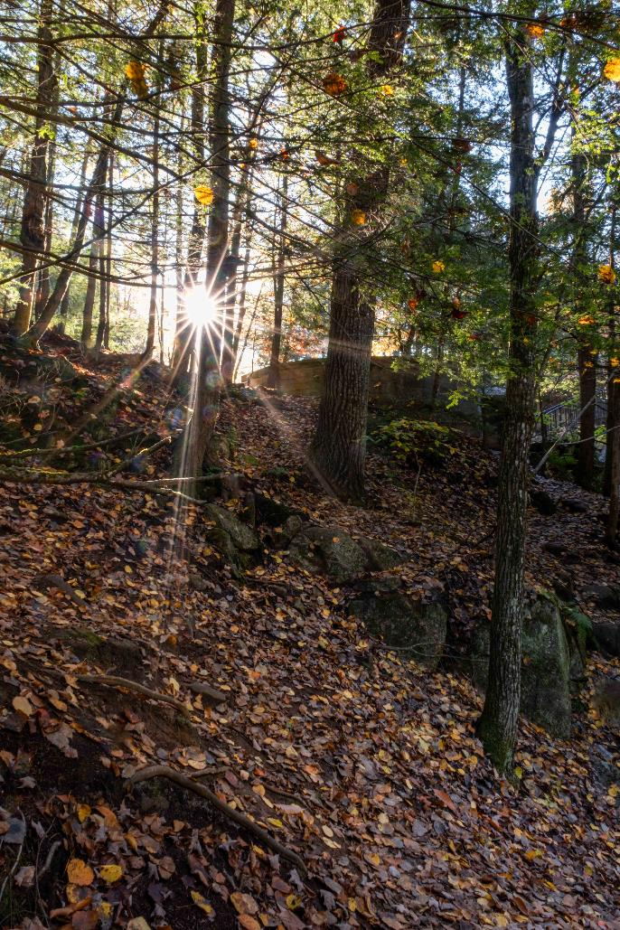
Scott Udle

Slide 25
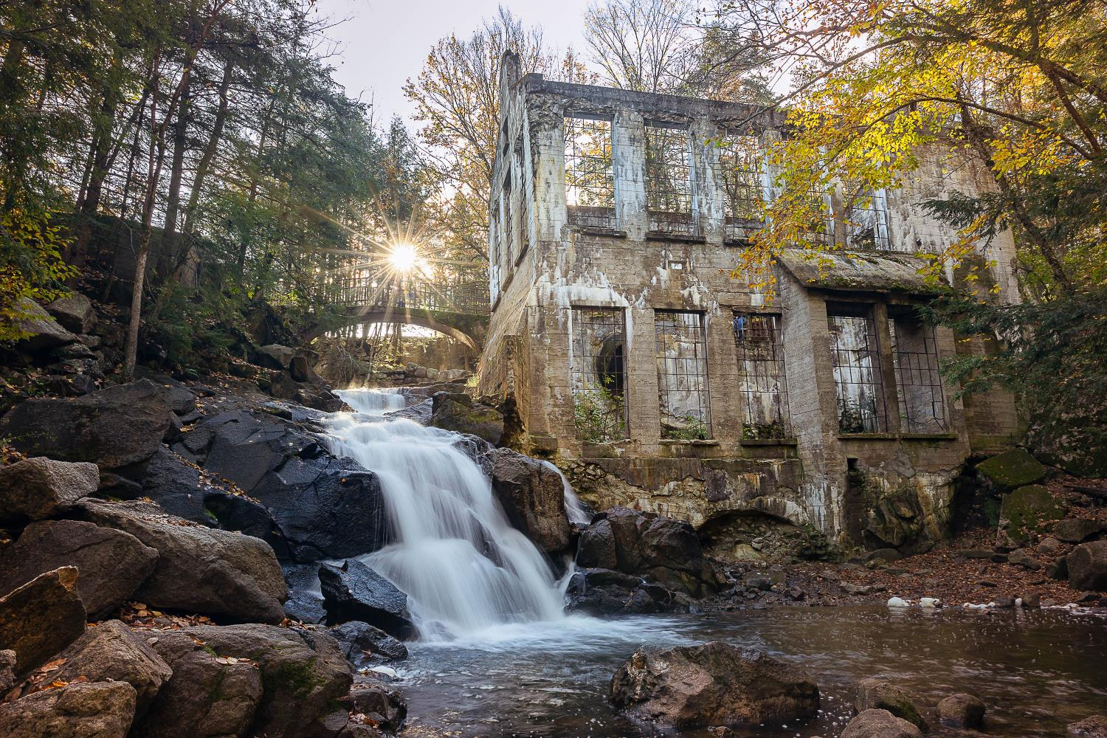
Johan Carignan

Slide 26
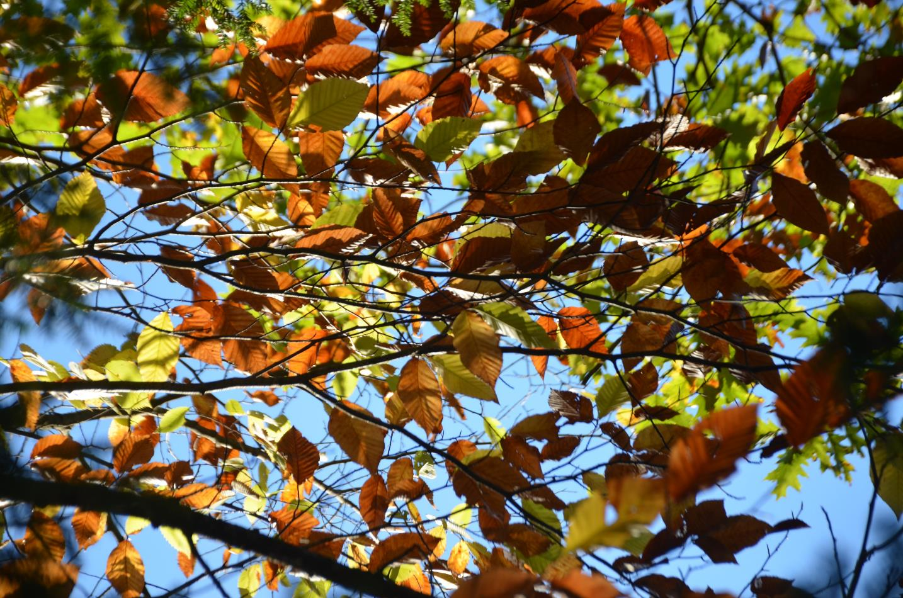
Amy Goodfellow

Slide 27
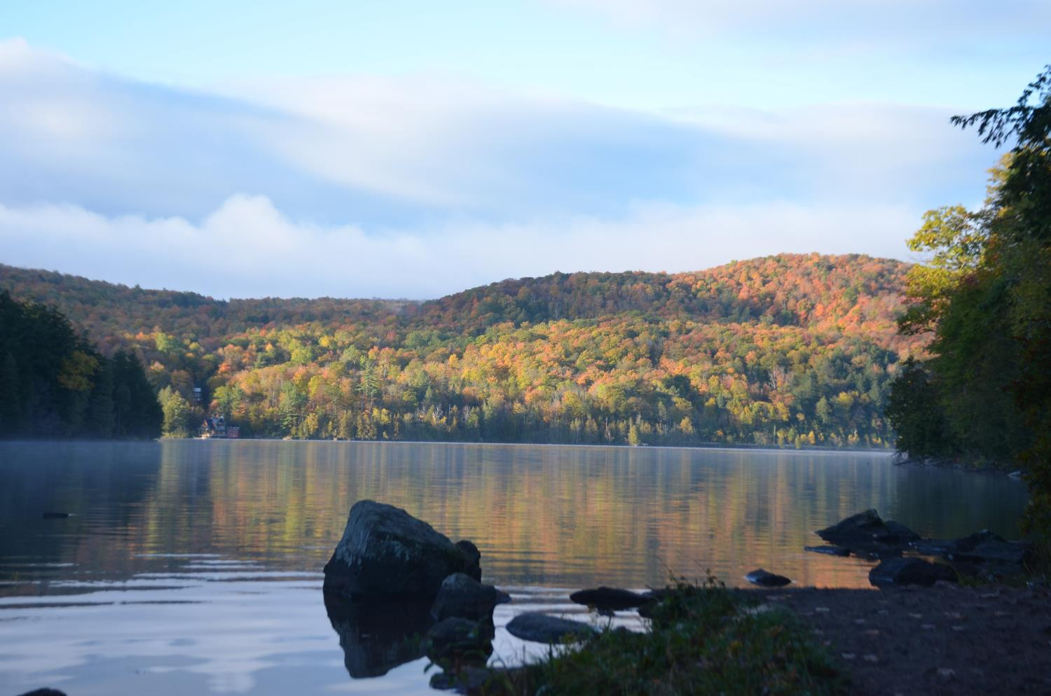
Amy Goodfellow

Slide 28
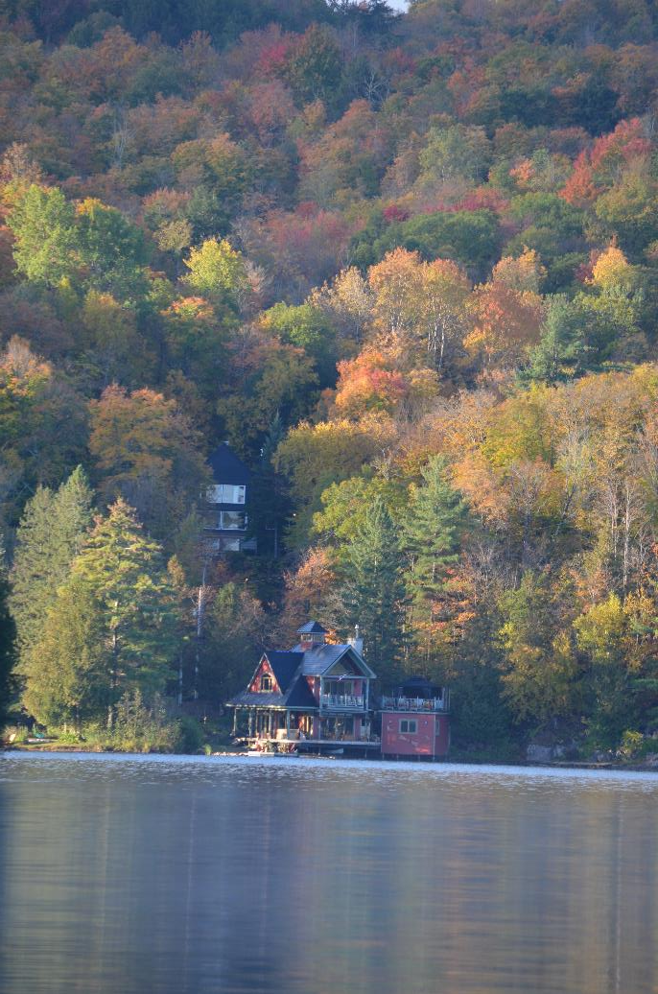
Amy Goodfellow

Slide 29
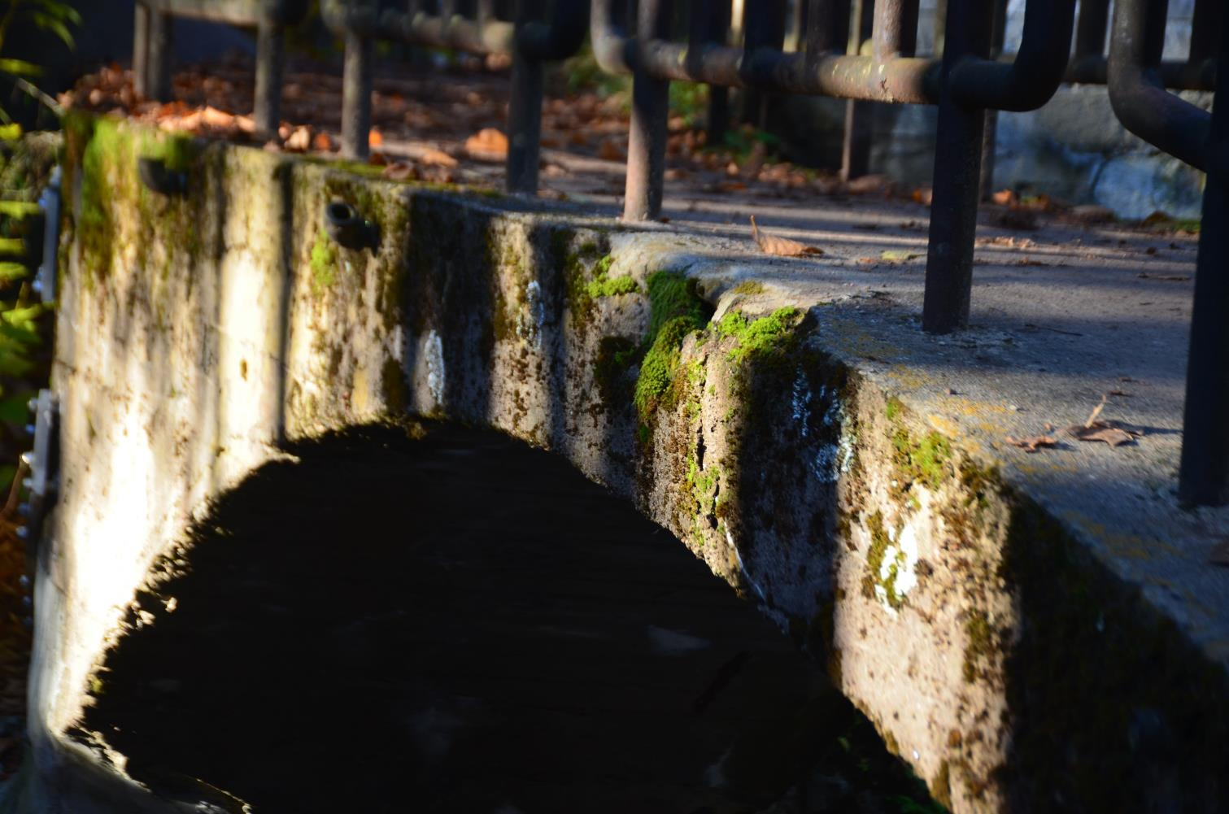
Amy Goodfellow

Slide 30
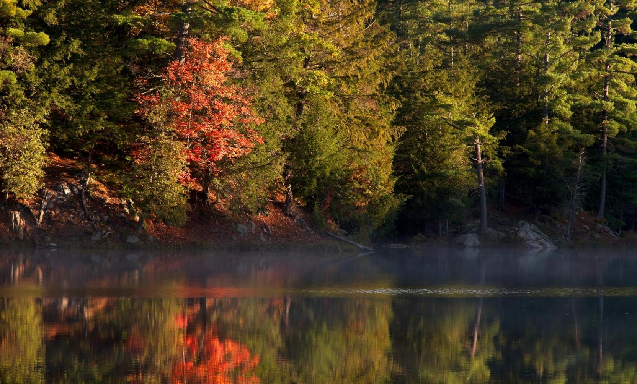
Chris Taylor

Slide 31
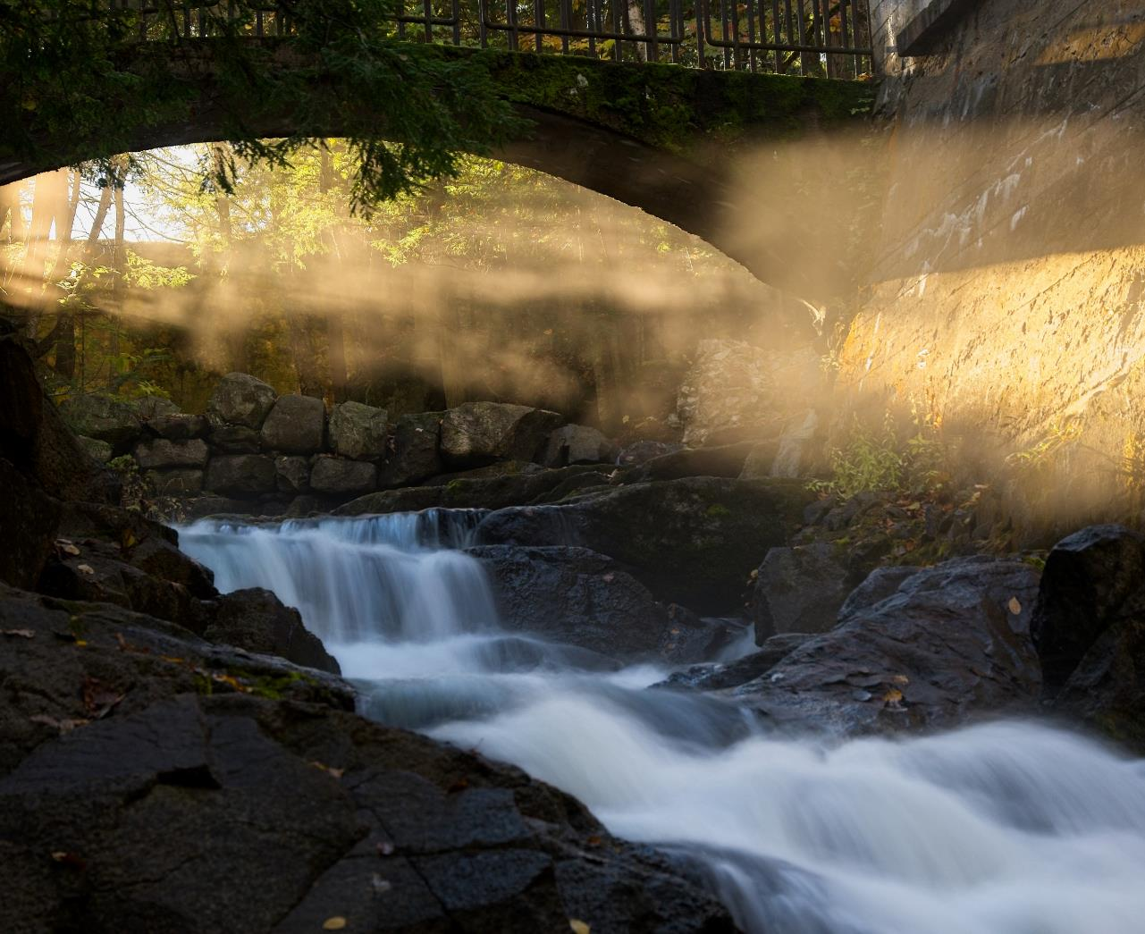
Chris Taylor

Slide 32
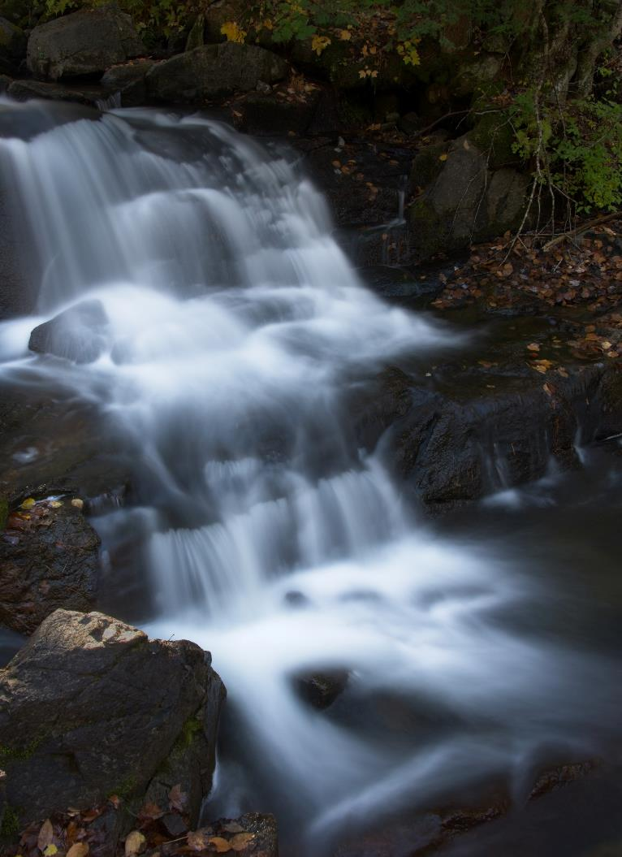
Chris Taylor

Slide 33
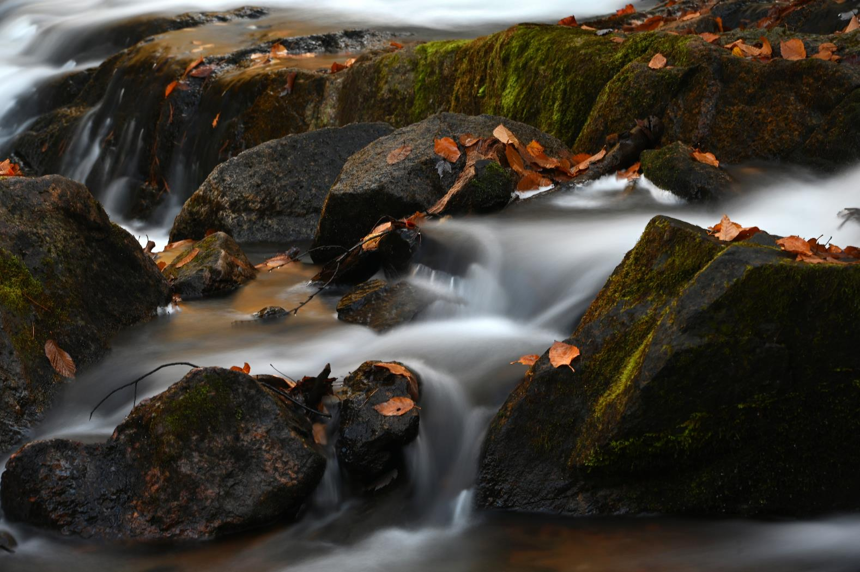
Lynda Buske

Slide 34
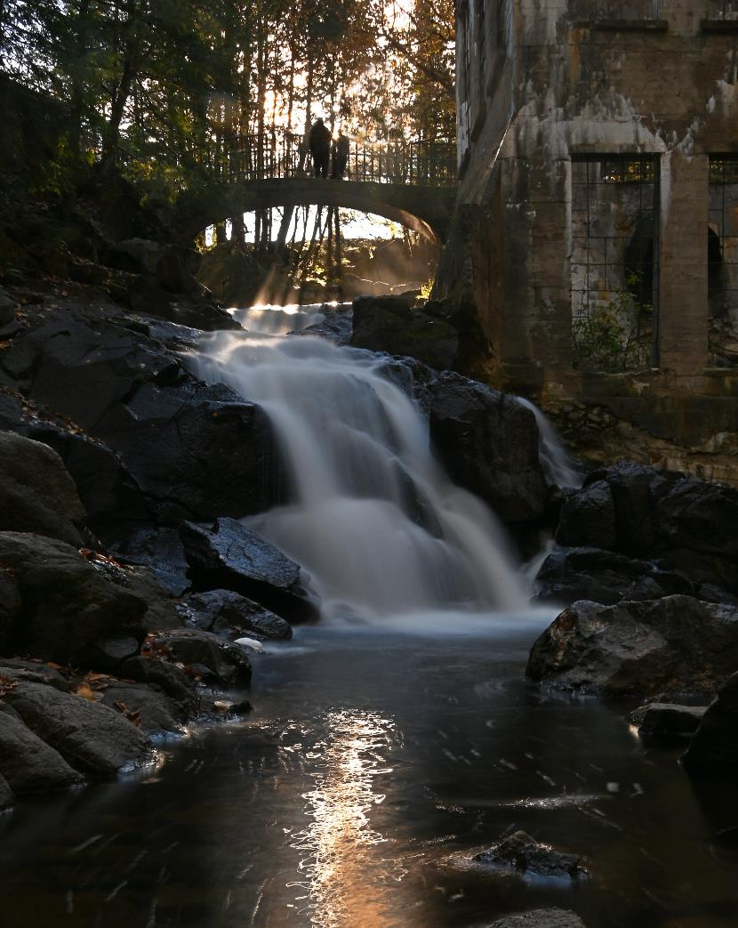
Lynda Buske

Slide 35
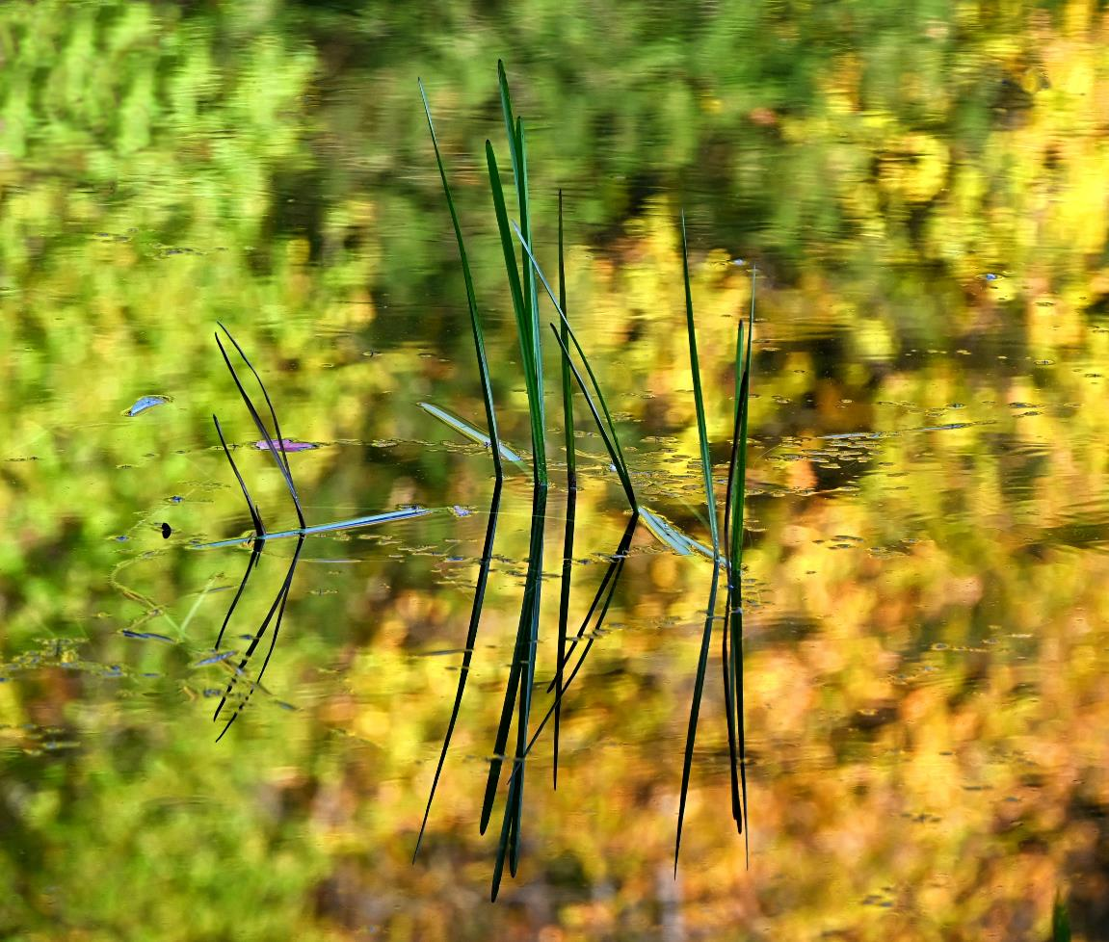
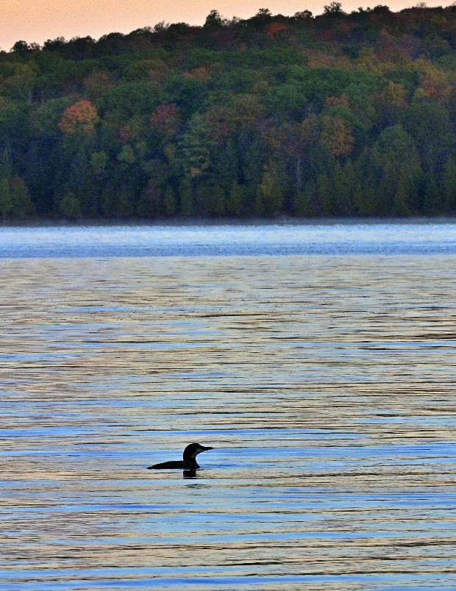
Lynda Buske

Slide 36
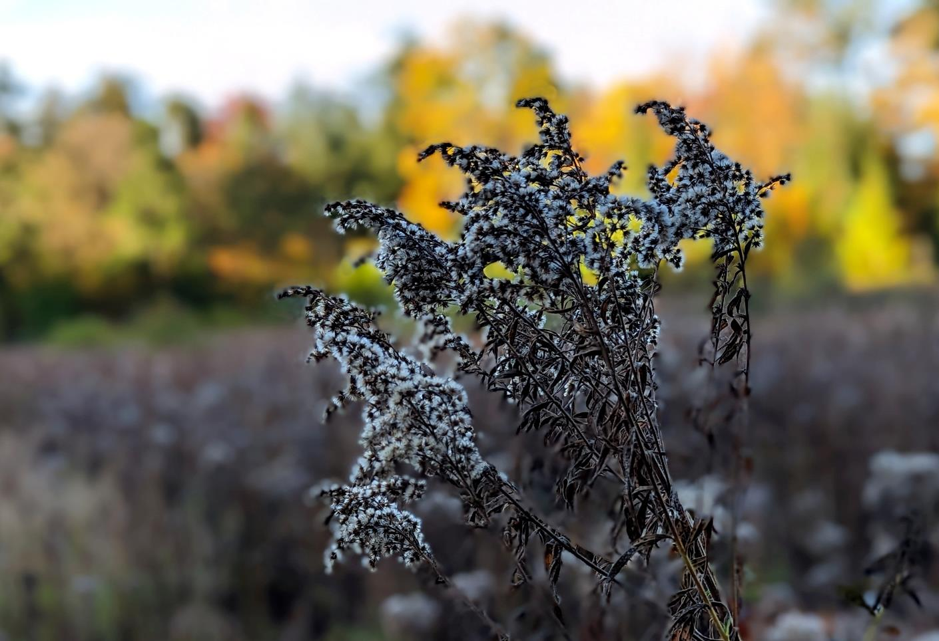
Lynda Buske

Slide 37
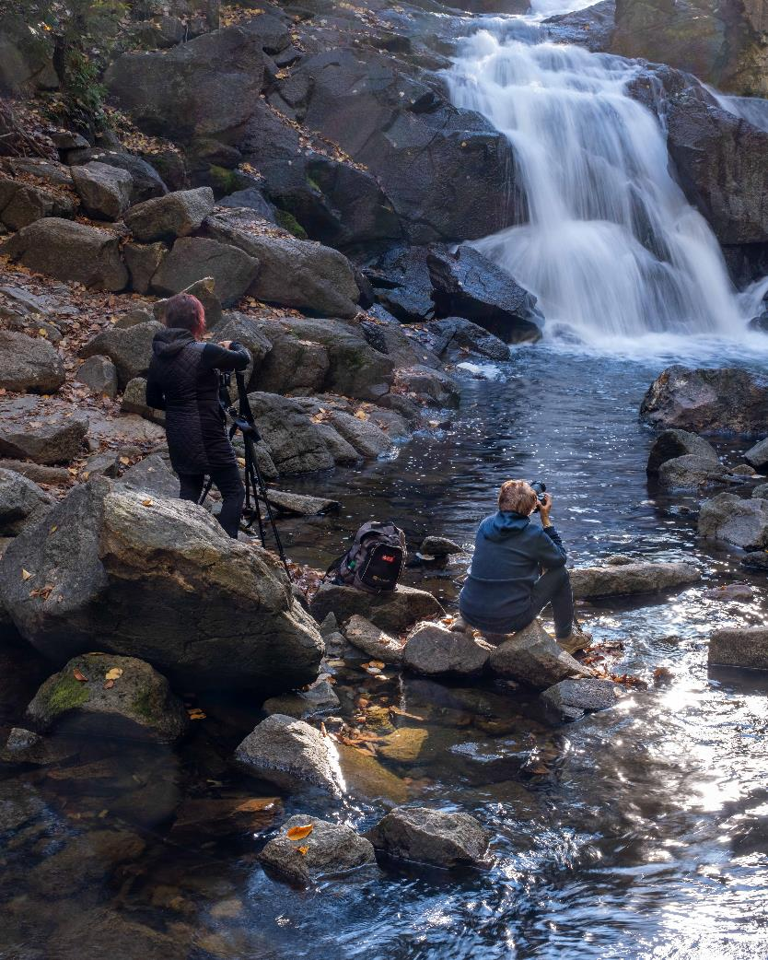
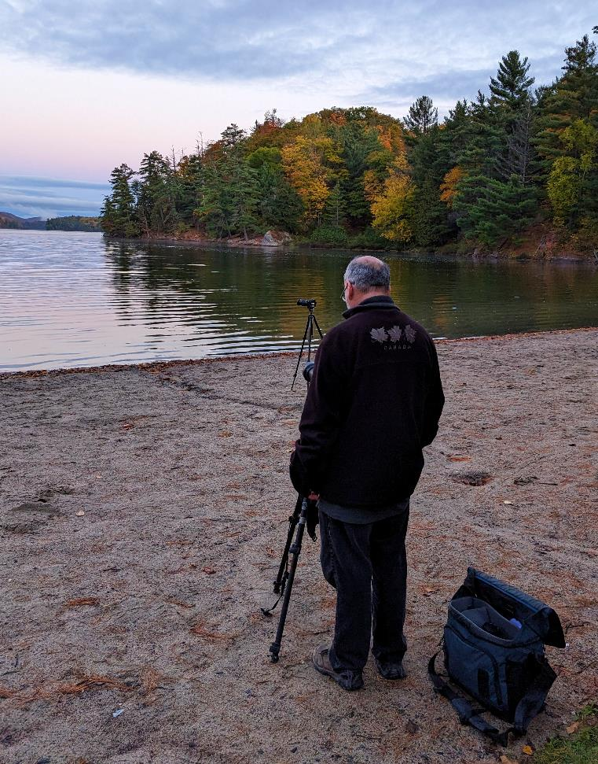

Slide 38
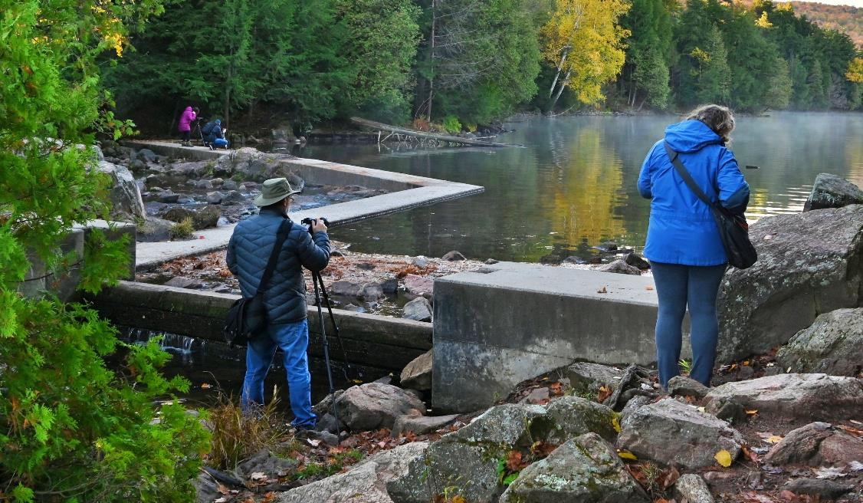
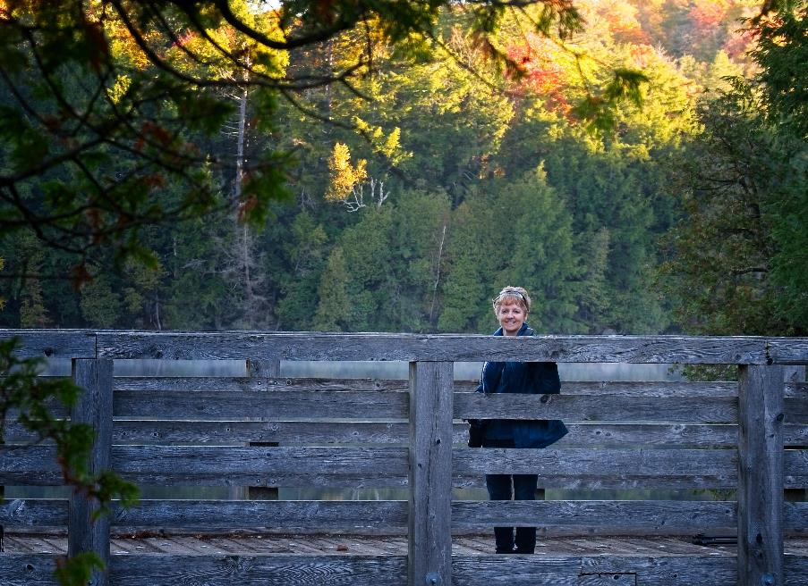

Slide 39
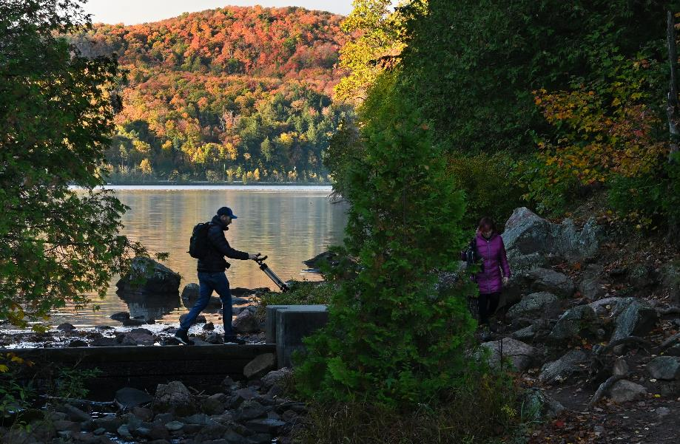
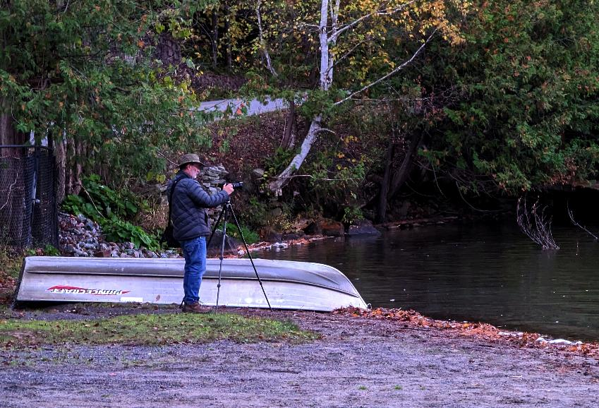
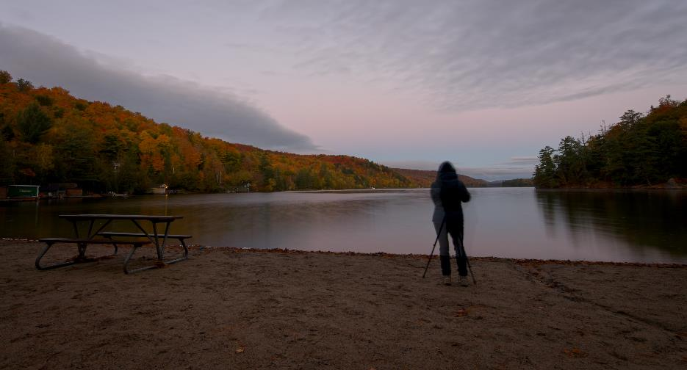

Slide 40
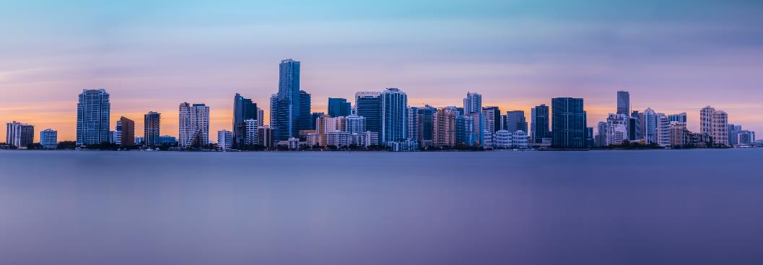
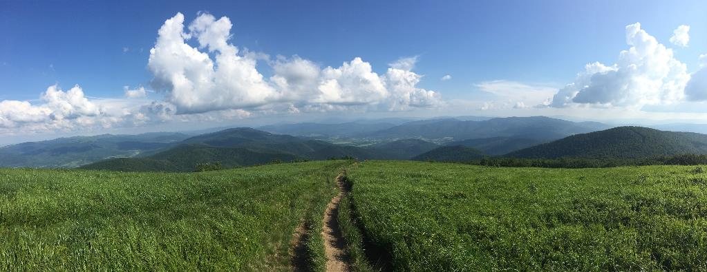
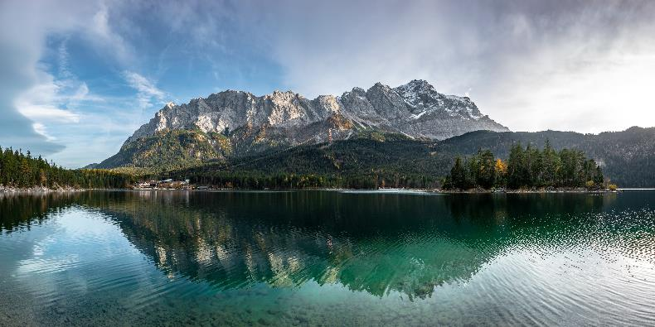
October Technique - Panorama
Everaldo Coelho
Panorama generally means a photo has an aspect ratio of 2:1 or larger, the image being at least twice as wide as it is high. The image takes the form of a wide strip.
Wojciech Portnicki
Daniel Sessler

Slide 41
October Technique - Panorama
John Ingold

Slide 42
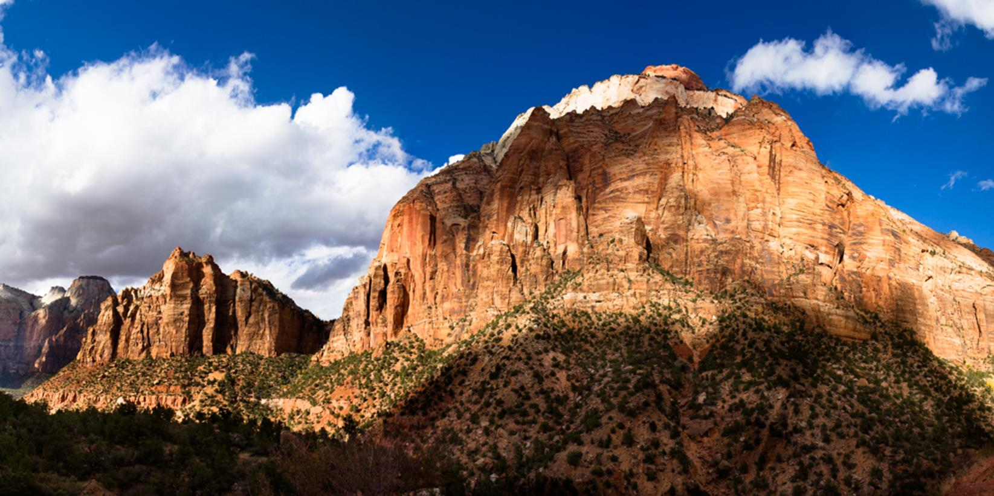
Jean-François Riel

Slide 43
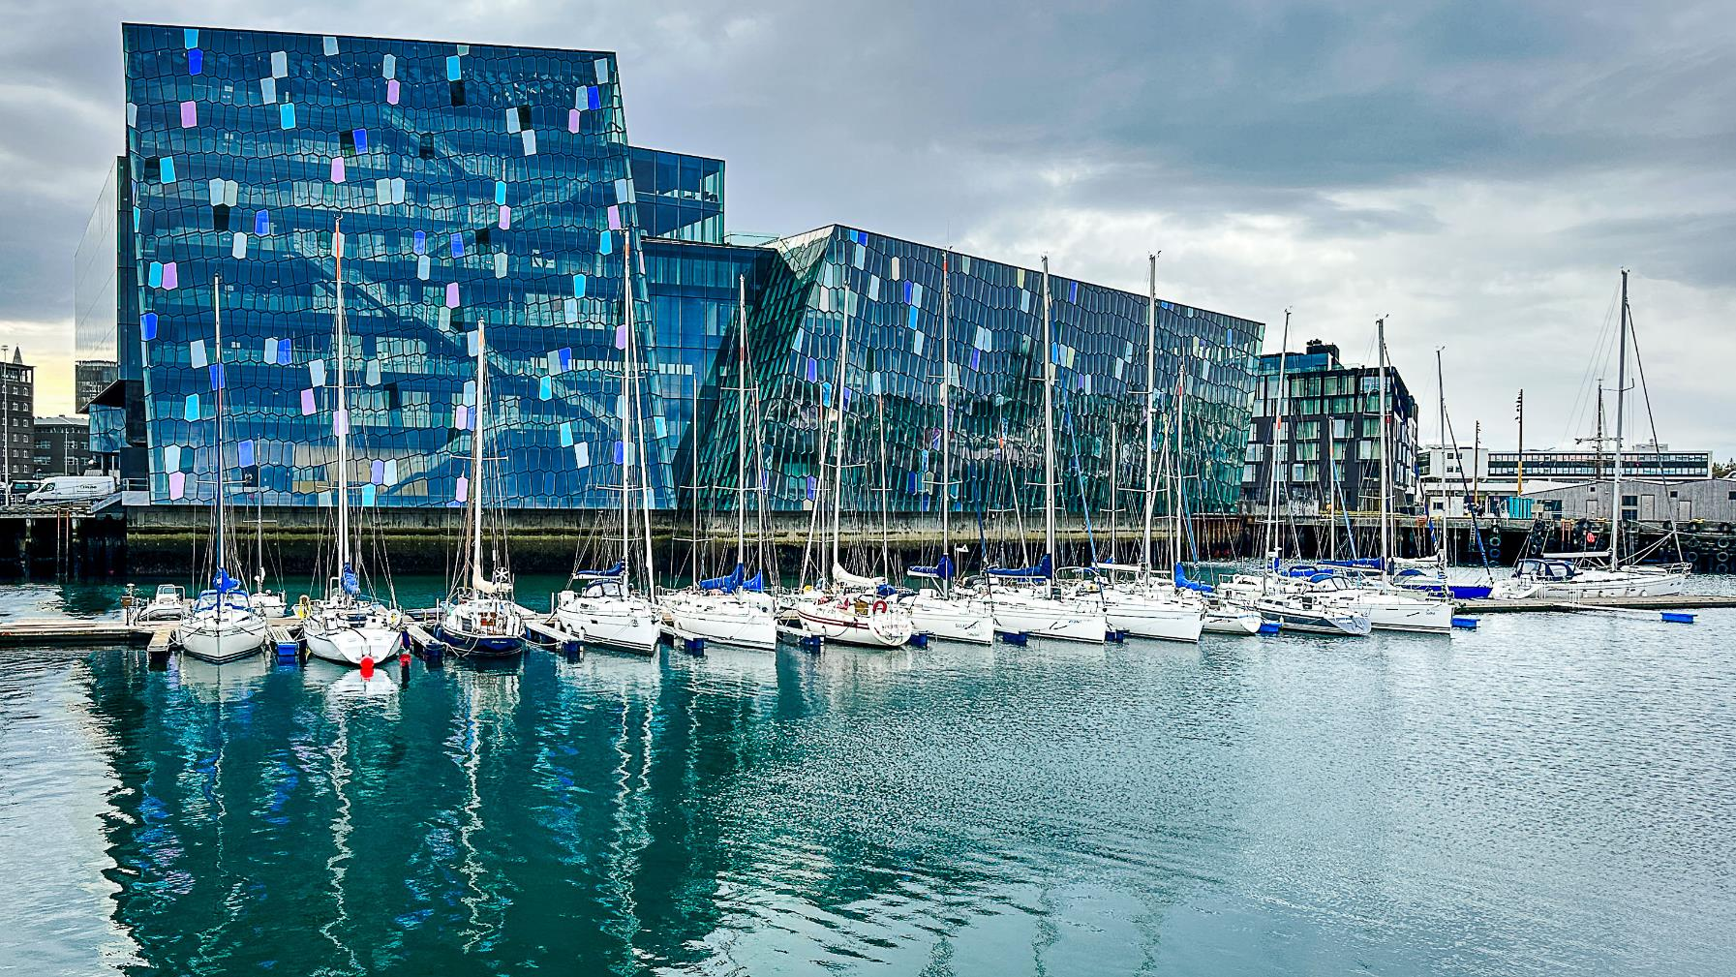
Johan Carignan

Slide 44
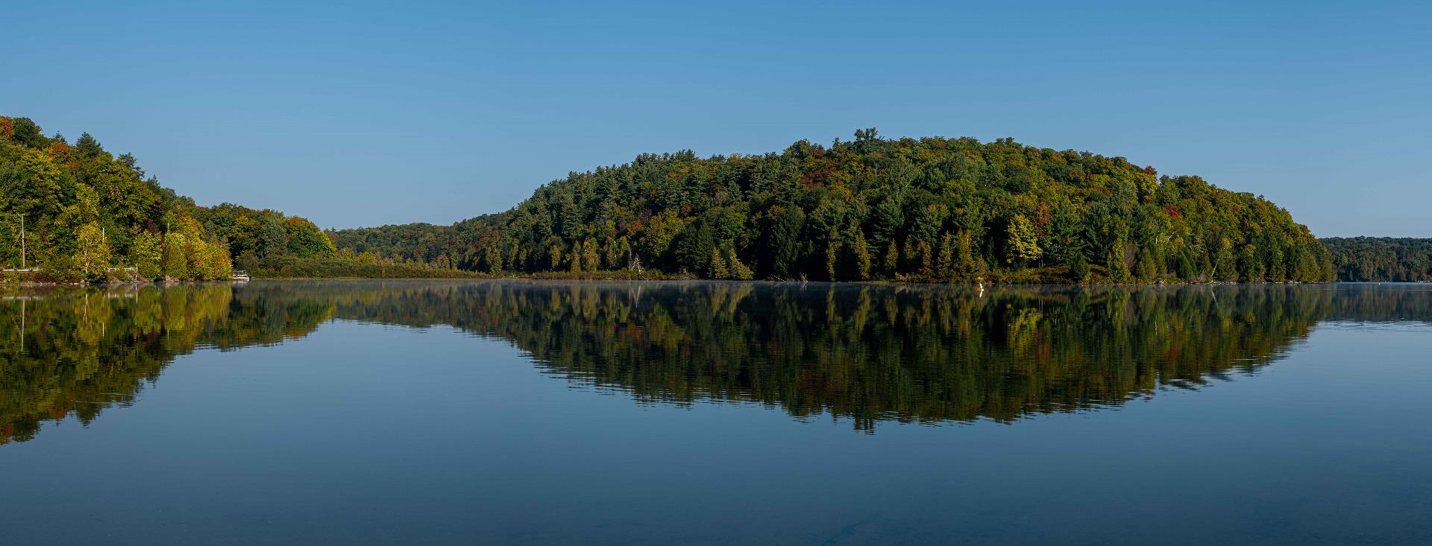
Scott Udle

Slide 45
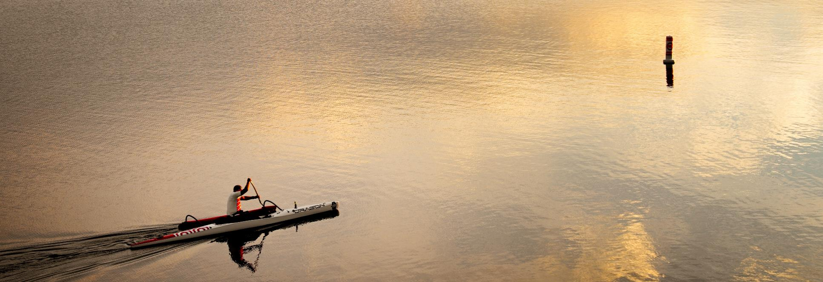
Chris Taylor

Slide 46
Rosie Grigaitis

Slide 47
Alan White

Slide 48
Lynda Buske

Slide 49
November Technique – Looking down
Lily Banse
A down shot is taken from a high angle, above the eye-level of the subject. It may impart a sense of dominance over the subject.
Also termed “bird’s eye view”.
Jules Bassoleil
Mohit Kumar

Slide 50
Photo 101 – Blue & Golden Hours
Blue Hour
The blue hour arrives shortly before sunrise and after sunset, when the sun's position, just below the horizon, produces cooler tones.

Slide 51
Golden hour
The period of time just after sunrise or just before sunset when the light is infused with red and gold tones.

Slide 52
Why I prefer morning blue hour
Dew, mist, fog, frost more likely
Few or no people
Feel safer

Slide 53
Why I prefer pre-dawn over post-sunset
Still water for reflections (no wind, no motor boats)
Small water craft (canoes, kayaks)
No traffic
Lots of parking

Slide 54
Mid-morning
Evening golden hour

Slide 55
Prefer morning golden hour for active birds and catching mist… if you are quick!

Slide 56
Golds look even golder!

Slide 57
Whoa, backup! Effective strategies for keeping your computer files safe​
Notices
Think about everything that is on your PC
all your photos and videos
tax records, documents, music…
If the files don’t exist anywhere else, you really should think about backup
Chris Taylor is giving free presentations through the Ottawa Public Library
Centennial branch , Thursday November 09 at 6:00pm
Greely branch, Thursday November 16 at 5:30pm
North Gloucester branch, Tuesday November 21 at 6:00pm
St-Laurent branch, Monday December 11 at 6:00pm
Ruth E. Dickinson, Wednesday December 13 at 2:00pm
Register for free at https://biblioottawalibrary.ca/en/program?text=whoa

Slide 58
CPOPC online discussion forum
Restricted to CPOPC members and is completely voluntary
For communication with other members on anything photographic
sharing ideas, asking for help & opinions, general photographic discussions, etc.
sharing of images permitted
be considerate of other forum members’ bandwidth & mailbox size
To join, send an email to Chris.Taylor@opcug.ca
request access to the CPOPC-Forum
include your full name, email & mailing address on record with CPOPC
for membership validation
Once approved, you;
will receive an email welcoming you to the forum
can post to the forum by emailing cpopc-forum@googlegroups.com
your email will be distributed to all members of the forum
will receive (via email) any postings made by forum members
subject line will always begin with [CPOPC-Forum]
can reply to any emails that come from the forum
your reply will be sent to all members of the forum
Note: by posting to the forum, you will be exposing your email address to forum subscribers

Slide 59
CPOPC Communications Communications Director: John Ingold
Monthly Newsletter + deadline reminders
Facebook – Orleans Photo Club
Challenge and Competition Winners Photos, Event Updates
https://www.facebook.com/CPOPC
Instagram – Orleans_Photo_Club
Member Contributions Photos, Event Updates
https://www.instagram.com/orleans_photo_club/?hl=en
Thank you to Trish Parsons for helping post member contributions
Twitter - OrleansPhotoClb
Deadlines, Event Updates
https://twitter.com/OrleansPhotoClb

Slide 60
Annual Membership Fees; 2023-2024 Secretary and Treasurer; Roger Regimbal
Individual - $50 $25 for new members only joining between Feb. 1 and June 30
Family - $75 $35 for new members only joining between Feb. 1 and June 30
NEW; Online - $25 – Full online participation + outings
All returning members must pay full price
Full payment is due before end of November 2023
Access to “Members Only” section of website cut off after November
Please pay online via PayPal using the CPOPC web site “How to Join” page

Slide 61
2023-24 Speaker and Topics Schedule Programs Director; Marianne Pethke Workshops; Johan Carignan
Oct – Dan Parent – Nature/Wildlife
Nov – Gareth Jones – Creative Imagery
Jan –
Feb – Peter Fundarek – B2B; The Exposure Triangle
Mar – Mark Bowie – How to photograph trees and forests
April – Mike Giovinazzo – One light portraits
May – Mike Higgins - Landscape photography

Slide 62
2023-24 Outings and Workshops Schedule Programs Director; Marianne Pethke Workshops; Johan Carignan
OUTINGS
Oct - Gatineau park for fall colours
Nov - Scavenger Hunt
Dec - Christmas Lights downtown Ottawa
Jan - Winter (organised by Marianne)
Mar - National Art Gallery/Architecture outing
Jun - Night Sky Photography Basics (how to get stars in focus) outing to Petrie Island

Slide 63
2023-24 Outings and Workshops Schedule Programs Director; Marianne Pethke Workshops; Johan Carignan
WORKSHOPS
17 Feb 24 - Manfred Mueller - Glass Tabletop Workshop
20 Apr 24 - Adrian Duey - Still Life and Food Lighting Workshop
18 May 24 - Suliman Chadirji - Ambient Light Photography (Downtown Ottawa in the evening)

Slide 64
2023-24 Calendar

Slide 65
Next Meeting
18 November
10am Online only
Challenge: Trios (submit by Sat, Nov 11)
Technique: Looking Down
Photo 101: Guideline for Printing
Featured Speaker; Gareth P Jones
Creative Imagery

