Slide 1
CPOPC September 2023 Welcome back! How was your summer?
Alan White - September 9, 2023

Slide 2
Welcome
First meeting of new year
Acknowledgement of guests and prospective members
Break between 11am and 11.30
Toilets are upstairs
Please be respectful of others but do join in, ask questions and participate!
Sandy Menard
Marianne Pethke

Slide 3
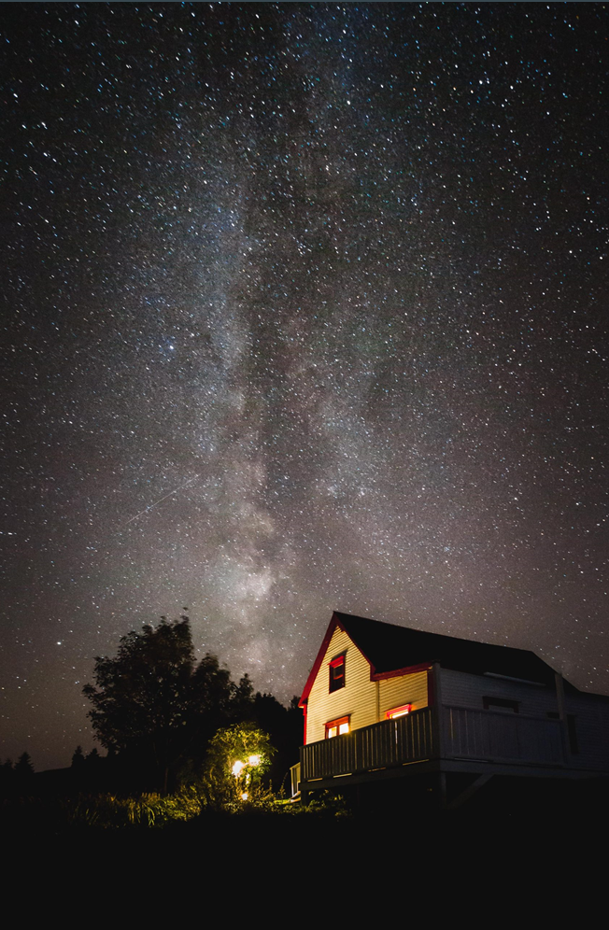
September 2023
Agenda topics
Year Ahead
Summer Images
Break (extended, with slideshow)
Video – Using Curves
Fall competition and October Technique announcements
Photo 101-New camera setup
Notices
Scott Udle

Slide 4
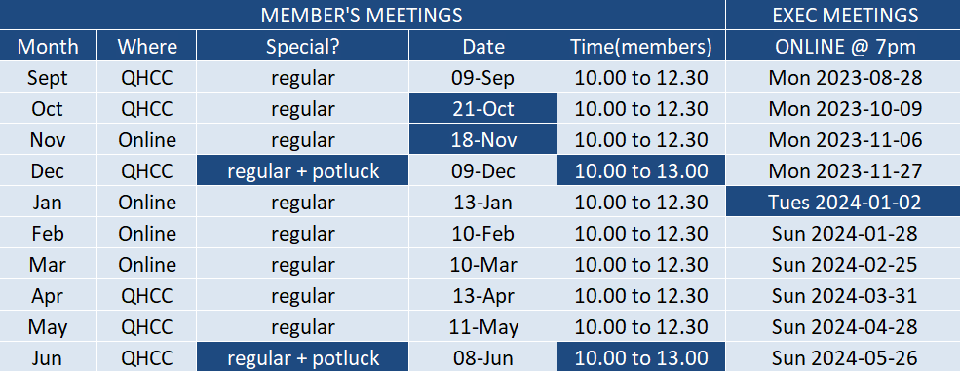
2023-24 Calendar

Slide 5
2023-24 Speaker and Topics Schedule Programs Director; Marianne Pethke Workshops; Johan Carignan
Oct – Dan Parent – Nature/Wildlife
Nov – Gareth Jones – Creative Imagery
Jan –
Feb –
Mar – Mark Bowie – How to photograph trees and forests
April – Mike Giovinazzo – One light portraits
May – Mike Higgins - Landscape photography

Slide 6
2023-24 Outings and Workshops Schedule Programs Director; Marianne Pethke Workshops; Johan Carignan
OUTINGS
Oct - Gatineau park for fall colours
Nov - Scavenger Hunt
Dec - Christmas Lights downtown Ottawa
Jan - Winter (organised by Marianne)
Mar - National Art Gallery/Architecture outing
Jun - Night Sky Photography Basics (how to get stars in focus) outing to Petrie Island

Slide 7
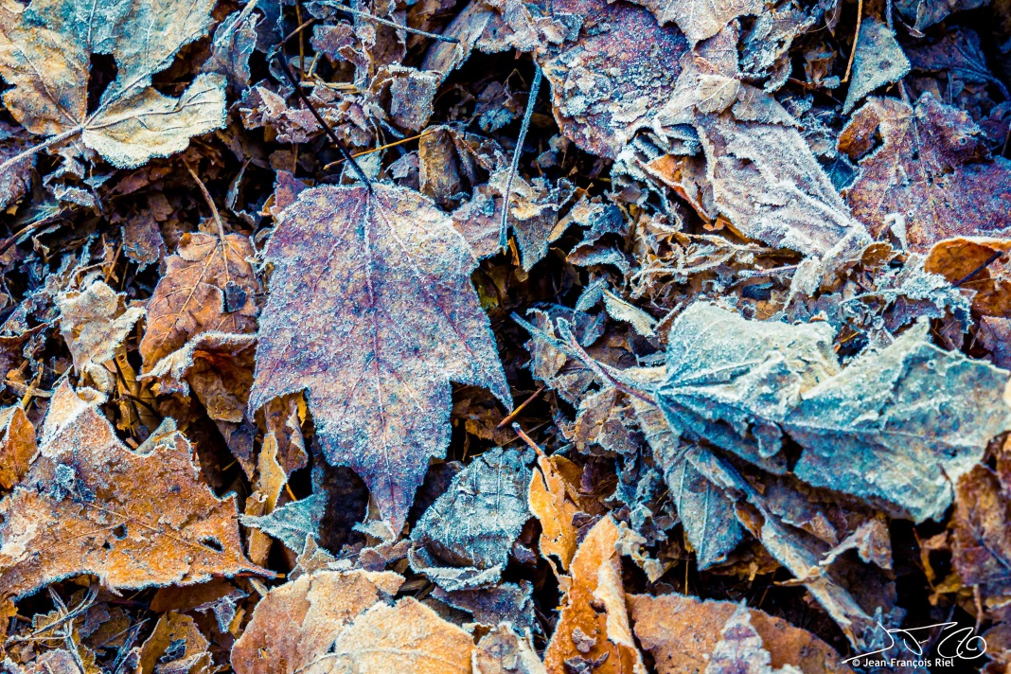
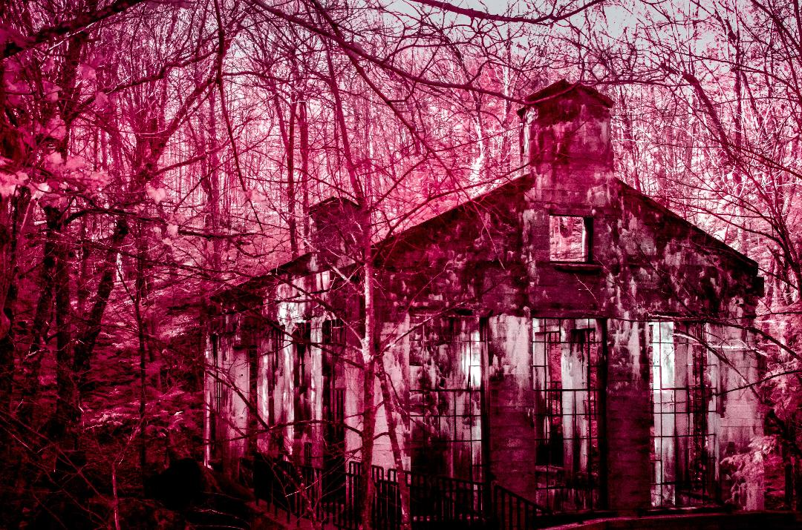
Upcoming Outing Programs Director; Marianne Pethke Workshops; Johan Carignan
Outing; Saturday October 14
Johan will lead a group in Gatineau Park to capture the colours and some of her favourite views
We will announce in a newsletter when the registration page for these activities has been opened on the website
Jean-Francois Riel
Pierre Roy

Slide 8
2023-24 Outings and Workshops Schedule Programs Director; Marianne Pethke Workshops; Johan Carignan
WORKSHOPS
17 Feb 24 - Manfred Mueller - Glass Tabletop Workshop
20 Apr 24 - Adrian Duey - Still Life and Food Lighting Workshop
18 May 24 - Suliman Chadirji - Ambient Light Photography (Downtown Ottawa in the evening)

Slide 9
Annual Membership Fees; 2023-2024 Secretary and Treasurer; Roger Regimbal
Individual - $50 $25 for new members only joining between Feb. 1 and June 30
Family - $75 $35 for new members only joining between Feb. 1 and June 30
All returning members must pay full price
Full payment is due before end of November 2023
Access to “Members Only” section of website cut off after November
Please pay online via PayPal using the CPOPC web site “How to Join” page

Slide 10
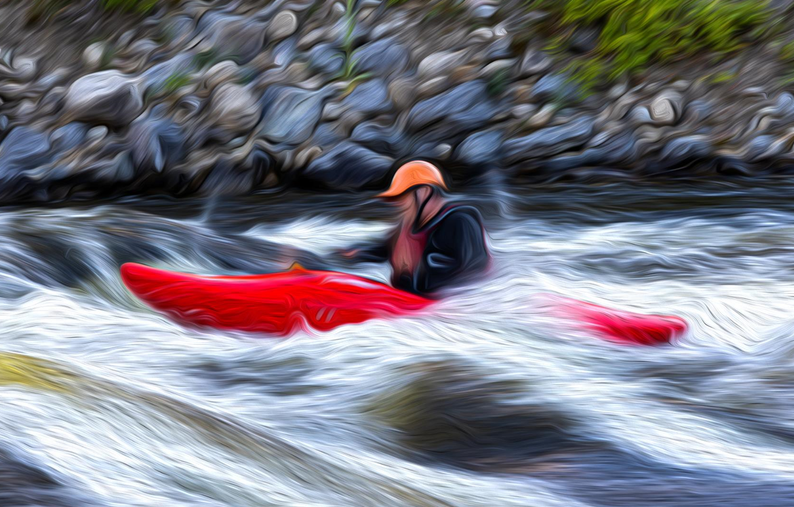
Summer Photo Share
Jean Francois Riel

Slide 11
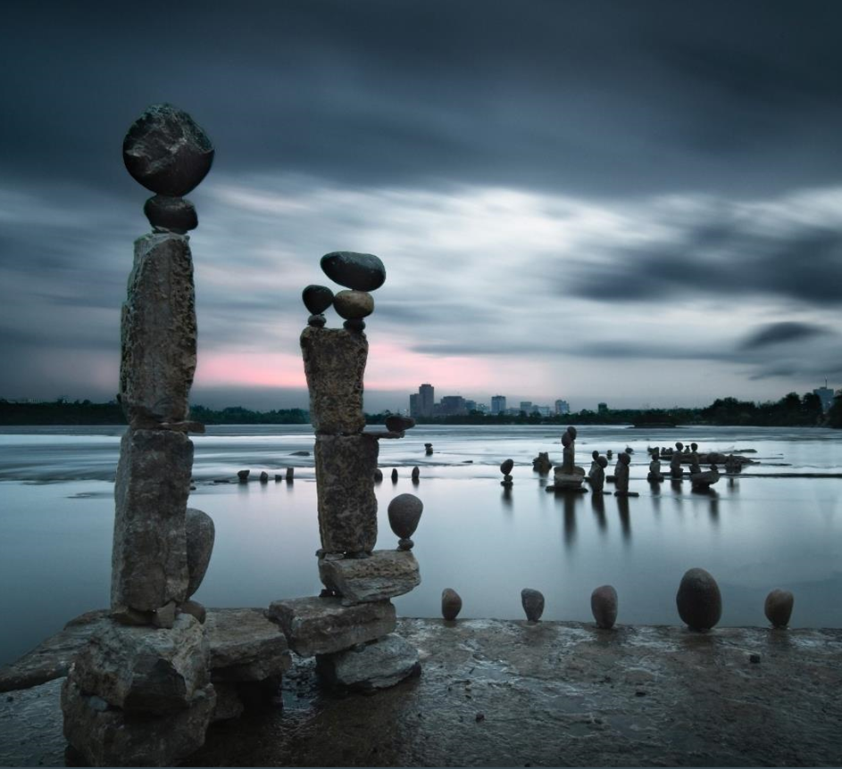
Break
Enjoy the slideshow of last year’s challenges and competitions
Chris Taylor

Slide 12
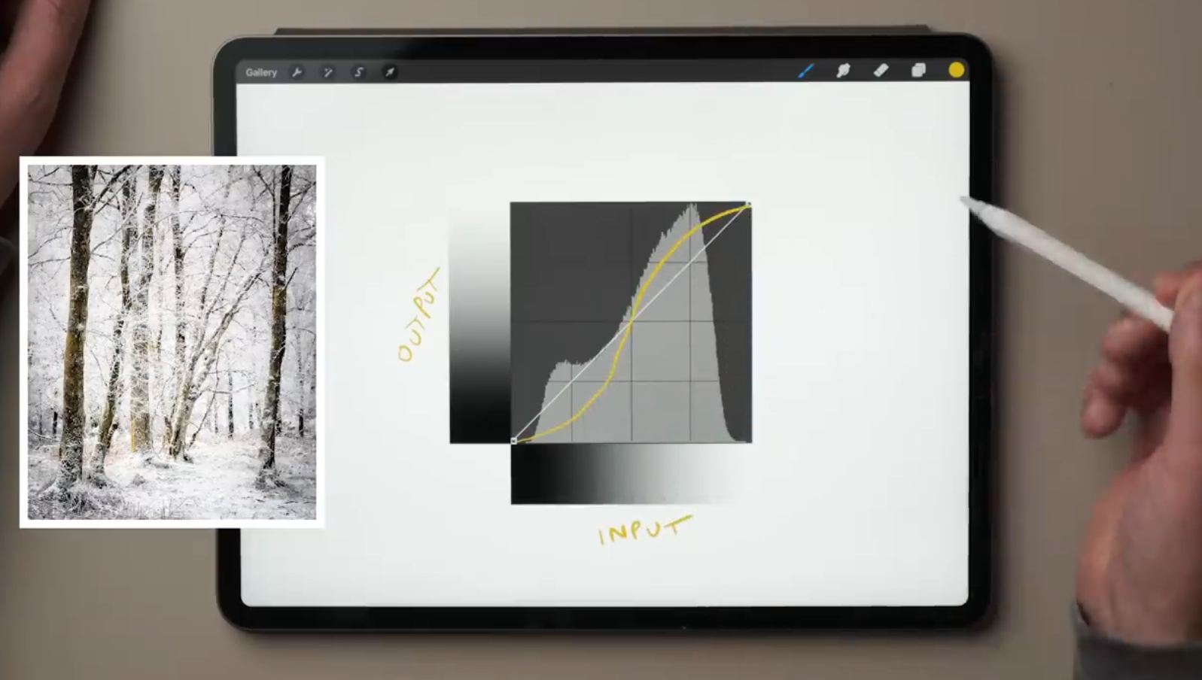
Video
Simple Guide to Lightroom CURVES |Photography Basics
Nigel Danson
https://www.youtube.com/watch?v=G7vZ0N11CbM
Chris Taylor

Slide 13
Topics for 2023-24 Challenges/Competitions Competitions Director; Lynda Buske
October challenge – Getting around (modes of transportation)
November challenge – Trios
December FALL COMPETITION – Simplicity
January challenge - Truly Canadian (same topic as for interclub competition)
February challenge - All creatures great and small
March challenge - Glass
INTERCLUB COMPETITION – Truly Canadian
April challenge - Ruins
May challenge - Veiled images (fog, snow, mesh, vegetation, etc.)
June SPRING COMPETITION - Vertical landscape (portrait format)
Notes: All challenges will allow archives; Fall and Spring competitions will be images taken since June 2023.
Maximum 1 image for challenges, 3 images for competitions

Slide 14
Fall competition - Simplicity
Photos that are simple and uncomplicated. Showcase “less is more”
Images must have been taken since June 2023
Submit up to three images
Submission deadline: Saturday, Nov 18, 2023 (midnight)
Shane
Sarah Dorweiler
Viktor Forgacs

Slide 15
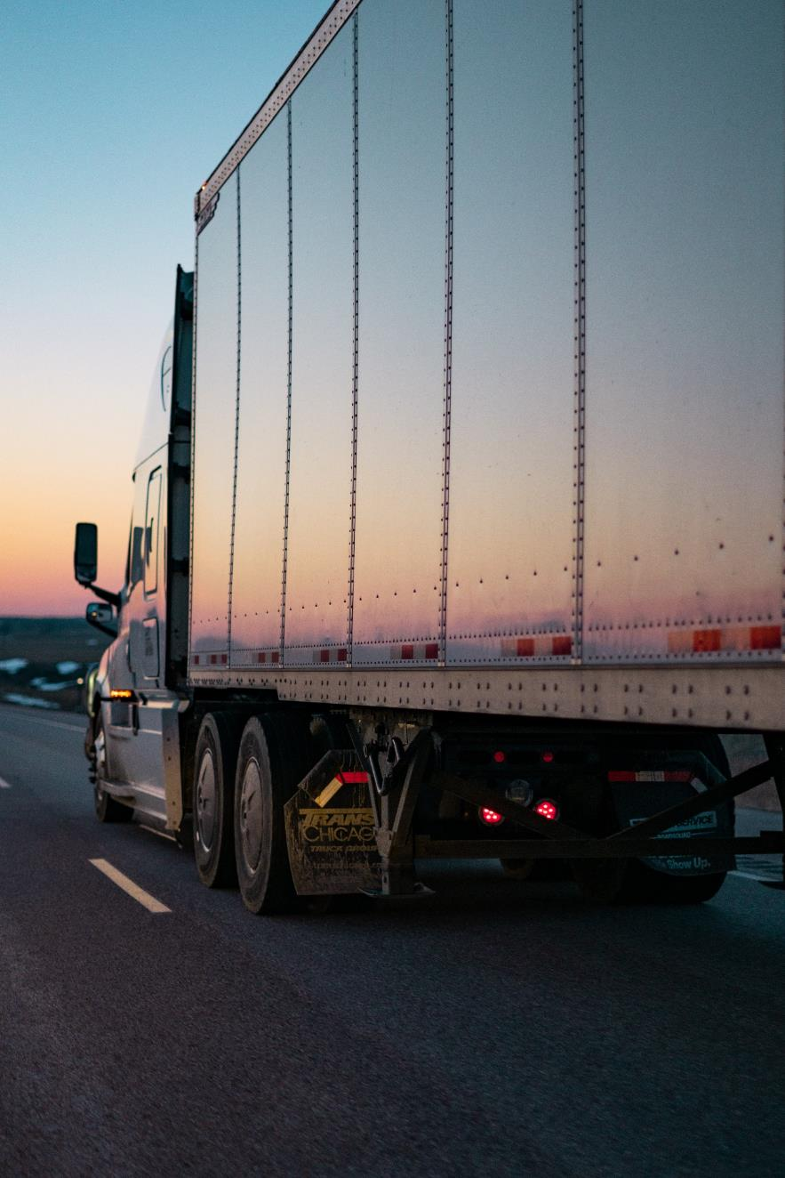
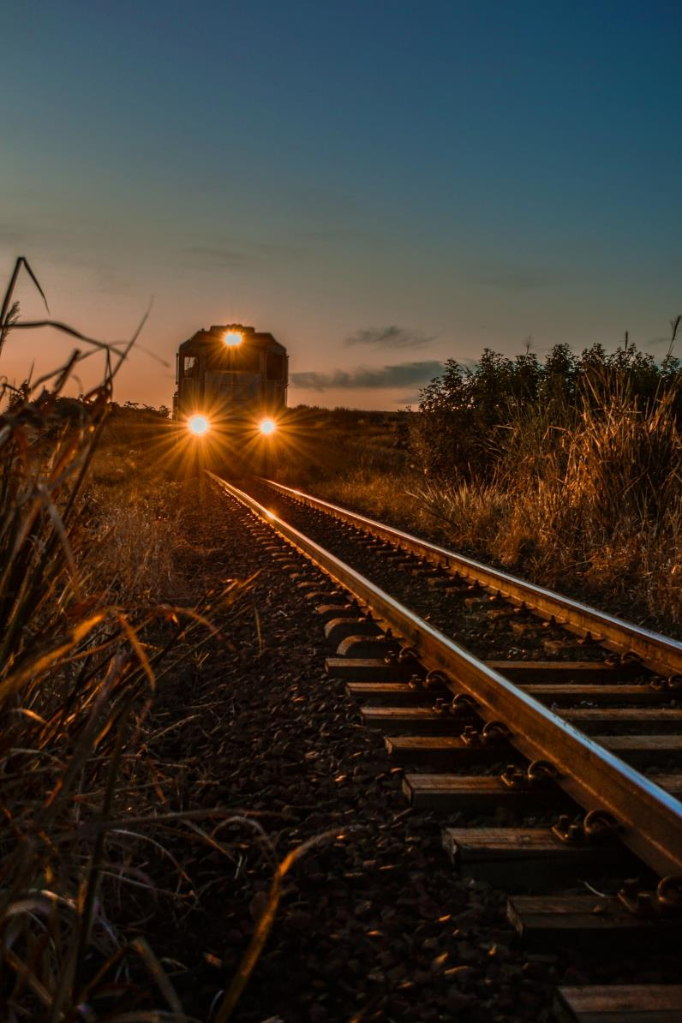
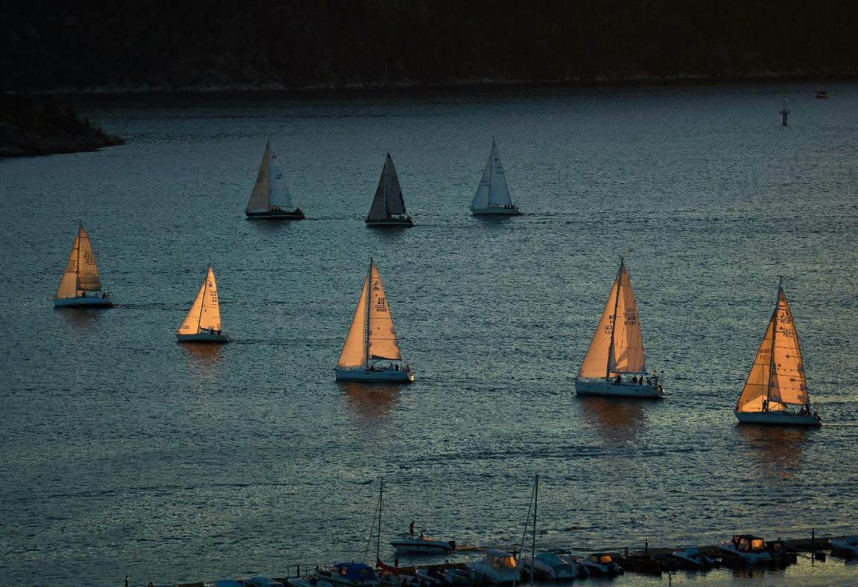
October challenge – Getting around
Caleb Ruiter
Any object(s) that is a man-made means of moving objects, e.g. bikes, trains, boat, etc.
Off topic: Humans or animals acting as modes of transport.
Submission deadline: Saturday, October 14, 2023 (midnight)
Voting deadline: Thursday, October 19, 2023 (midnight)
All archived images are allowed.
Marissa Beletti
Vidar Mathisen

Slide 16
New rules for graduation from Level 1 to Level 2
Previous rule:
Three ribbons of any colour in one season
OR six ribbons over multiple seasons
New rule:
Each ribbon will be assigned a point with greater weight being given to higher placements.
First place ribbon = 3 points
Second place ribbon = 2 points
Third place ribbon = 1 point
A member must accumulate either 9 points in a single season or 18 points over multiple seasons to qualify for graduation to Level 2.

Slide 17
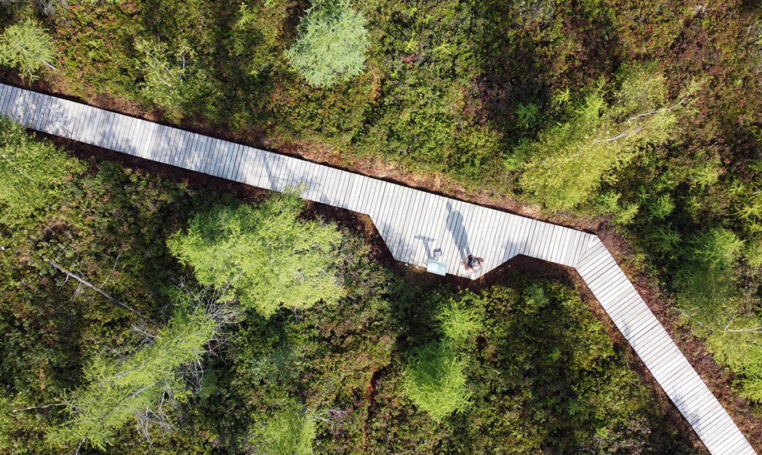
Use of drones
Starting now, drone photography will be allowed for all
club challenges and competitions.

Slide 18
CAPA (and CPOPC) position on AI (Artificial Intelligence)
An image created from scratch by an AI system that contains no image captured by the entrant will not be accepted.
AI sky replacement is permitted providing the new sky was captured by the entrant.
Permissible AI features are limited to: clear, de-noise, masking, sharpening, subject selection, tone adjustments, upsizing.

Slide 19
Levelling the playing field
A method has been designed to level the field so that there is a greater range of people winning ribbons.
An Award of Excellence would be given to the highest scoring image regardless of the photographer’s level. This award would be in addition to first, second, third place ribbons at each level.
Feasibility of website modifications is being studied.

Slide 20
Voting on an image
You are encouraged to vote even if you have not submitted an image
Review the description for the challenge and what is considered to be “off-topic”
When in doubt, vote an image on-topic to avoid penalty (be kind)
Written comments can explain your rating and help people learn.
Review guidelines on how to mark “wow”, “technical” and “composition”
https://cpopc.ca/voting-information-page/

Slide 21
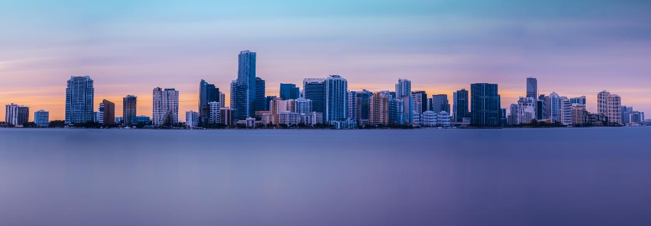
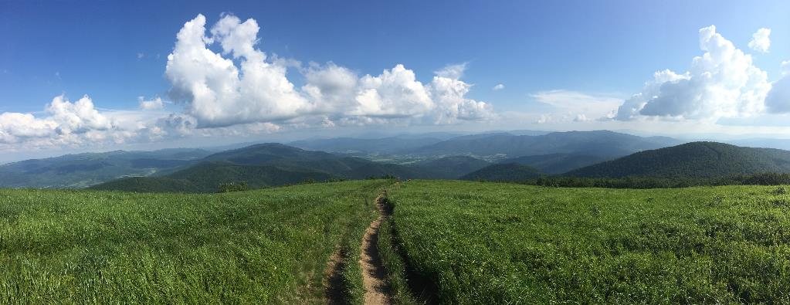
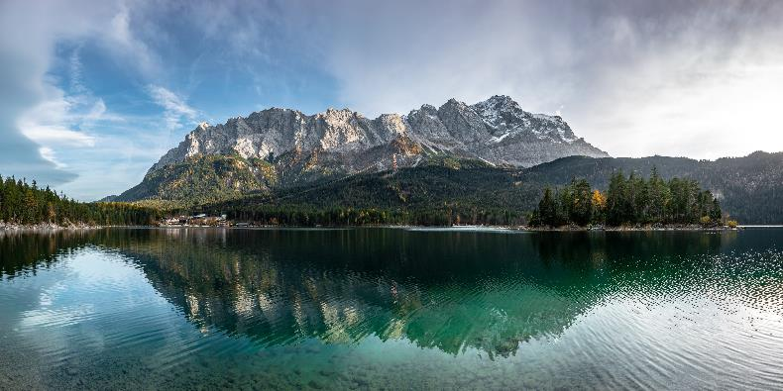
October Technique - Panorama
Everaldo Coelho
Panorama generally means a photo has an aspect ratio of 2:1 or larger, the image being at least twice as wide as it is high. The image takes the form of a wide strip.
Wojciech Portnicki
Daniel Sessler

Slide 22
CPOPC online discussion forum
Restricted to CPOPC members and is completely voluntary
For communication with other members on anything photographic
sharing ideas, asking for help & opinions, general photographic discussions, etc.
sharing of images permitted
be considerate of other forum members’ bandwidth & mailbox size
To join, send an email to Chris.Taylor@opcug.ca
request access to the CPOPC-Forum
include your full name, email & mailing address on record with CPOPC
for membership validation
Once approved, you;
will receive an email welcoming you to the forum
can post to the forum by emailing cpopc-forum@googlegroups.com
your email will be distributed to all members of the forum
will receive (via email) any postings made by forum members
subject line will always begin with [CPOPC-Forum]
can reply to any emails that come from the forum
your reply will be sent to all members of the forum
Note: by posting to the forum, you will be exposing your email address to forum subscribers

Slide 23
Recent forum activity
9 members subscribed to forum
76 postings in 45 topics
Essential Photography Apps in 2023
Using Photoshop's generative fill to restore old photos
13 Fog Photography Tips for Magical Images
How choosing a camera height has a HUGE impact on your photography
Less is more...sometimes
The most important habit in photography
Long exposure photography
Intentional Camera Movement
How to use tone curves in photo editing
AI advancements in photography
New podcast from PetaPixel
Are you envious of folks with higher megapixel sensors?
How to Overcome a Creative Block
And more!

Slide 24
CPOPC Communications Communications Director: John Ingold
Monthly Newsletter + deadline reminders
Facebook – Orleans Photo Club
Challenge and Competition Winners Photos, Event Updates
https://www.facebook.com/CPOPC
Instagram – Orleans_Photo_Club
Member Contributions Photos, Event Updates
https://www.instagram.com/orleans_photo_club/?hl=en
Thank you to Trish Parsons for helping post member contributions
Twitter - OrleansPhotoClb
Deadlines, Event Updates
https://twitter.com/OrleansPhotoClb

Slide 25
Photo 101 Setting up a new camera
Orleans Photo Club 2023-09-09
Chris.Taylor@opcug.ca

Slide 26
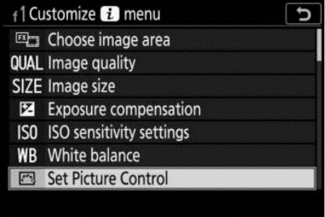
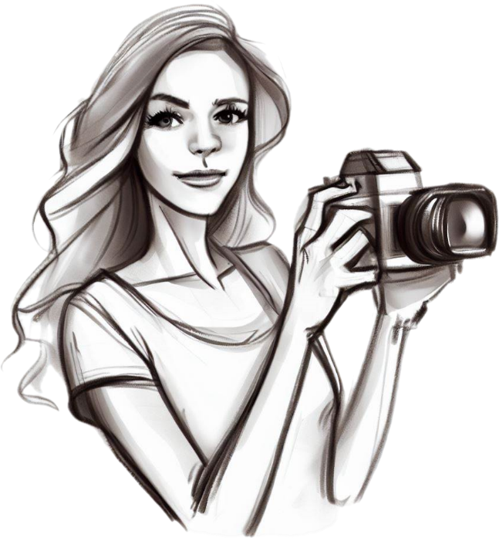
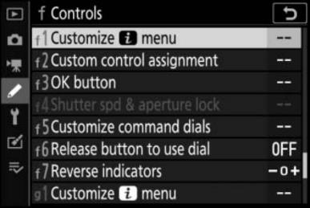
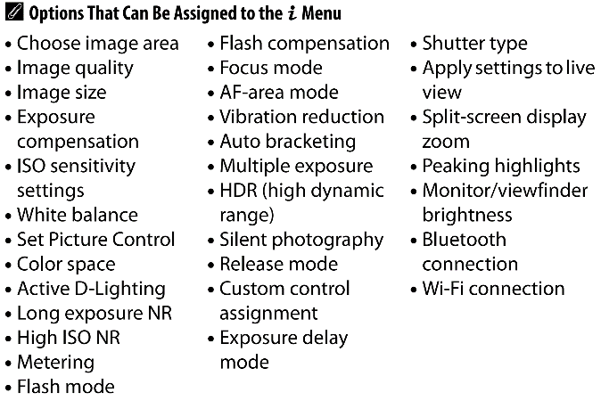
Shiny new camera
Plethora of configuration options in modern cameras
Get the basic settings you want right at the start

Slide 27
First things first
Get complete manual from manufacturer’s website
much more info than normally included in the box even with pro-level cameras
browse entire manual so you know what’s possible
If a used camera, reset all settings to factory defaults
never know how previous owner had things configured
When first turned on, typically prompted for
language: menus can be in a variety of languages
date/time & time zone
Update firmware (check manufacturer’s website)
bug fixes and enhanced features

Slide 28
Second things second
Format memory cards in-camera
not always required, but always recommended
Set file format
RAW, JPEG, or both
Set image size and quality
set to maximum: offers most flexibility
Adjust viewfinder diopter
make sure everything in the viewfinder is sharp
Adjust screen/EVF brightness
default may be fine
know how to adjust for different lighting conditions

Slide 29
More second things
Turn off beeps that might
annoy other people
scare off wildlife
Disable ability to take photos without a memory card to avoid;
forget to put card back in camera
shoot all day
discover you have no images!
Set colour space (doesn’t affect RAW format)
sRGB – most appropriate for general sharing on email, the web, etc.
Adobe RGB – more appropriate for high-end printing

Slide 30
Digging down a bit deeper
Set back-button focus
decouples focus from the shutter-release button
even if you don’t think it is a good idea, try it for a week
https://photographylife.com/back-button-focus
Set autofocus mode
most cameras allow you to choose autofocus options such as single-point, matrix, continuous, subject tracking, face/eye detect, etc.
Set release mode
single-shot vs. burst mode & frames per second
Set shooting mode
aperture-priority automatic, shutter priority automatic, manual, auto, program

Slide 31
Extras
Copyright info
many cameras can embed in metadata
not a panacea
might help get a lost camera returned
Change generic file name prefix (IMG, DSC,…)
your initials, e.g. CJT_1324.JPG
camera identifier, e.g. NZ6_5436.NEF
Replace strap
treat yourself to a comfortable and useful strap
Spare memory cards and batteries

Slide 32
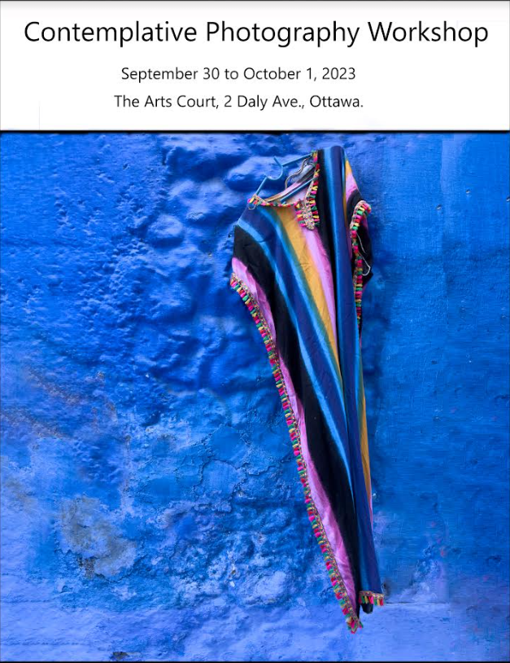
Notices
“Contemplative photography encourages a heightened awareness of the world that surrounds us, enabling us to perceive not just the grand and striking moments, but also the subtle, ordinary, and everyday elements that often escape our attention as potential subjects for photography. This transformative workshop is thoughtfully designed to accommodate photographers of all skill levels.”
Cost $225, Max 10 participants
https://www.henryfernando.com/workshops
Henry Fernando

Slide 33
Notices
Friends of Petrie Island
By popular demand - another Nature Photography Walk with Michael Ricco September 16 9:30 am Meet at the tent. (Registration is not required)

Slide 34
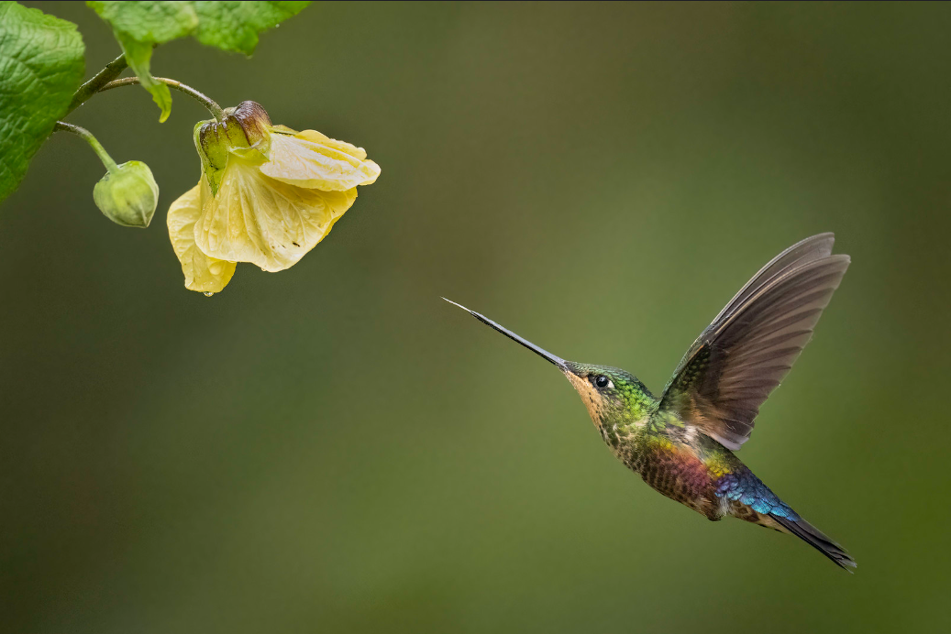
Next Meeting
21 October
10am at QHCC
Challenge: Getting Around (submit by Sat Oct 14)
Technique: Panoramas
Photo 101: Blue Hour – AM or PM?
Featured Speaker; Daniel Parent
Nature/wildlife photography

