Slide 1
CPOPC November 2023
November 18, 2023

Slide 2
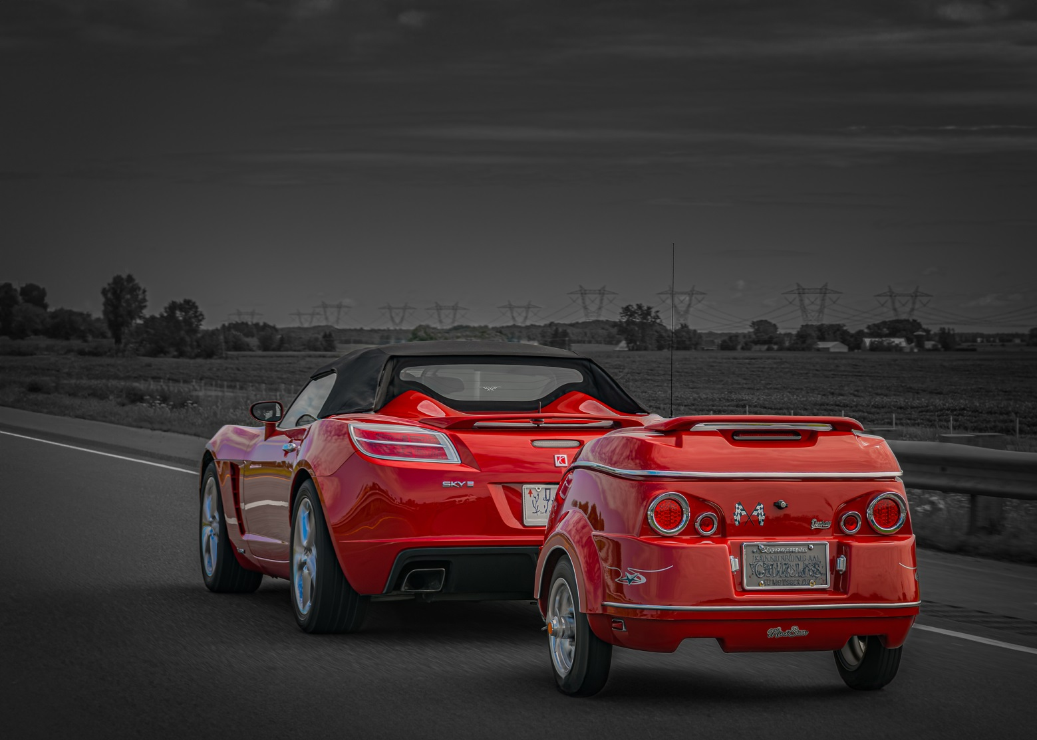
Welcome
Acknowledgement of guests and prospective members
Break between 11am & 11:30
Please be respectful of others but do
join in
ask questions
participate
Yoline Joseph-Hoskin

Slide 3
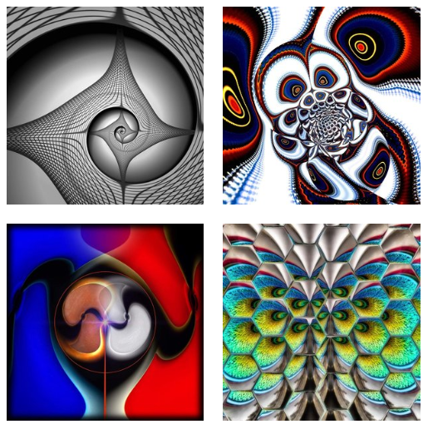
November 2023 Agenda topics
Featured speaker
Break
November Challenge and Critique
Scavenger Hunt
November Technique: Looking Down
December Technique announcement
Photo 101: Blue hour and Golden Hour
Notices
Next Meeting
Featured Speaker: Gareth Jones
Creative Imagery

Slide 4
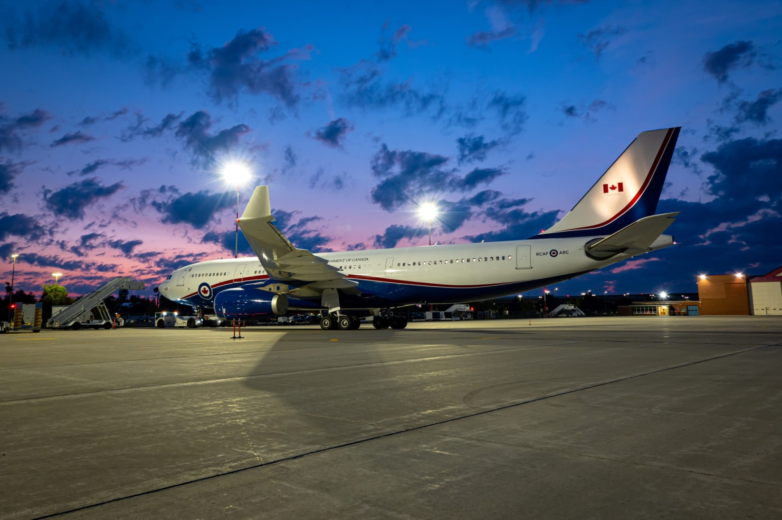
Break
We will restart in 15 minutes with the November Challenge
Nick Ingold

Slide 5
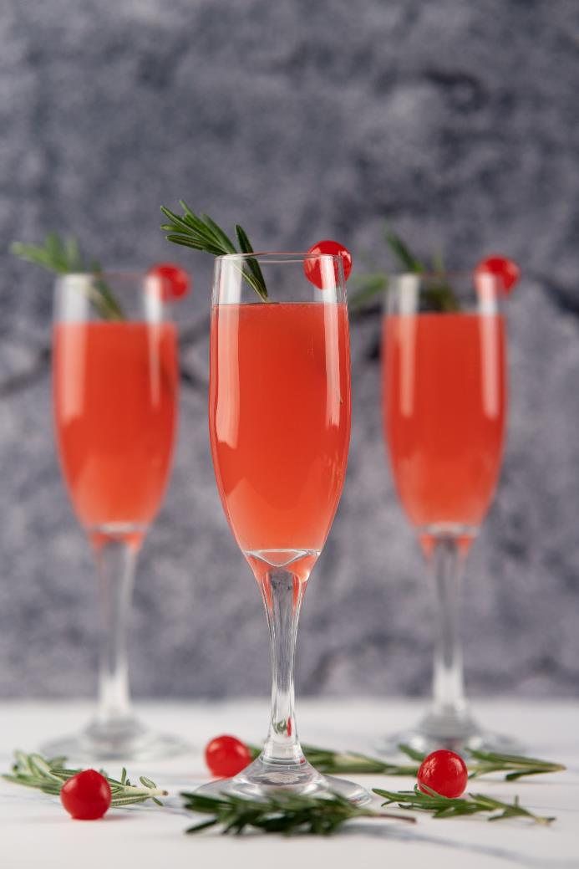
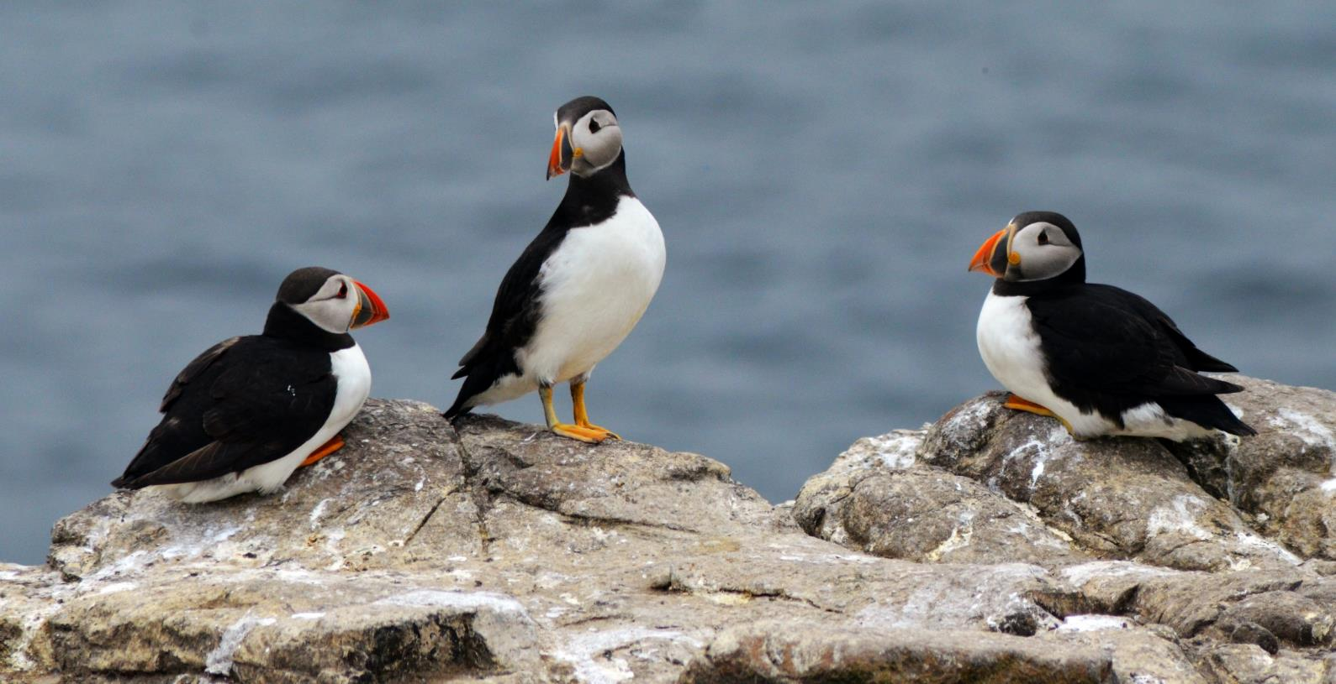
November challenge – Trios
Jess Bailey
Any set of three objects, animate or inanimate
Off topic: more (or less) than three main subjects
Archived images are allowed
David Hunter
David Heslop

Slide 6
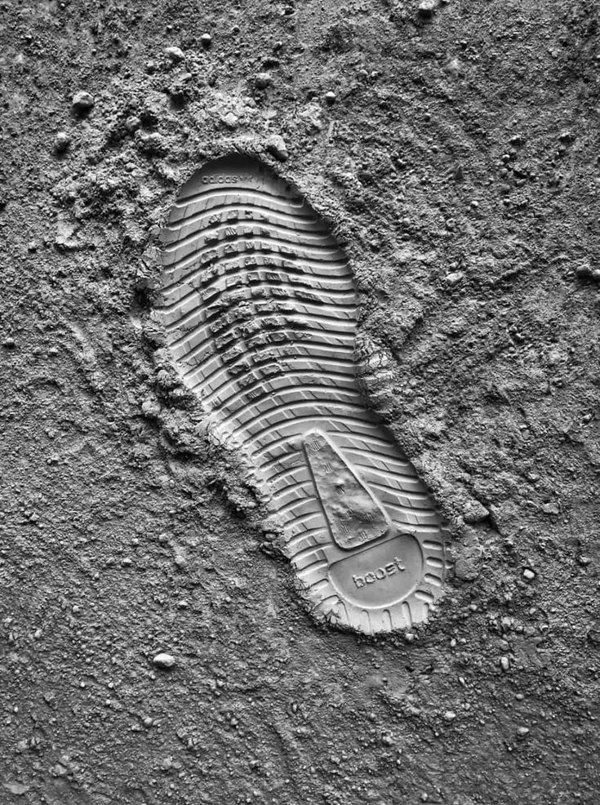
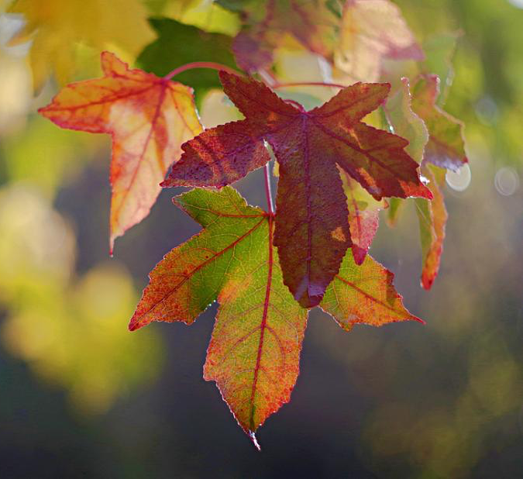
Scavenger Hunt
Leave a print
Scavenger Hunt topics released last Friday November 10th
Participating members had up to Sunday November 12th at midnight to capture images
By midnight December 1st, 2023, upload your six best photos
The resulting photos will be shown in a presentation during our December meeting
Page leaves
Leaves
Notes:
I hope you all had a chance to use your imagination! The topics were varied and thinking outside the box was not necessary but could be fun.

Slide 7
Fall competition - Simplicity
Photos that are simple and uncomplicated
Showcase “less is more”
Images must have been taken since June 2023
Submit up to three images
Submission deadline: Saturday, Nov 18, 2023 (midnight)
Shane
Sarah Dorweiler
Viktor Forgacs

Slide 8
Inter-Club activities
Inter-club AV Showcase
Clark Hall, RA Centre on December 5th, 7pm
3-6 min videos, 8 per club
Submit to lbuske@sympatico.ca via a link (e.g. Dropbox)
Deadline – Monday November 20th at midnight
Inter-club competition
Clark Hall, RA Centre on April 9th, 7pm
Digital and print competitions
Topic : Truly Canadian
One photo must be on topic
2 others can be on topic or general category
Deadline for on-line submission: Tuesday March 12th
Note: No Zoom option on either event

Slide 9
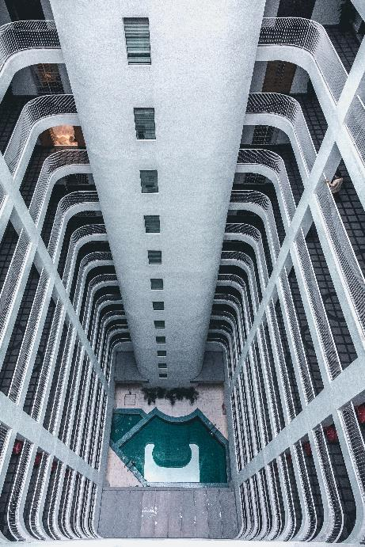
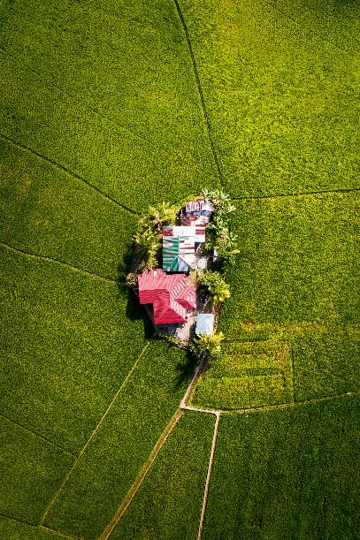
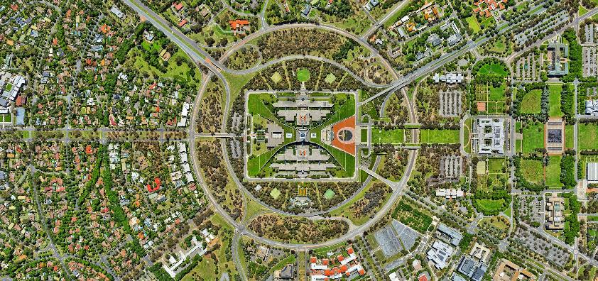
November Technique: Looking down
A down shot is taken from a high angle, above the eye-level of the subject
It may impart a sense of dominance over the subject
Also termed “bird’s eye view”
Lily Banse
Jules Bassoleil
Mohit Kumar

Slide 10
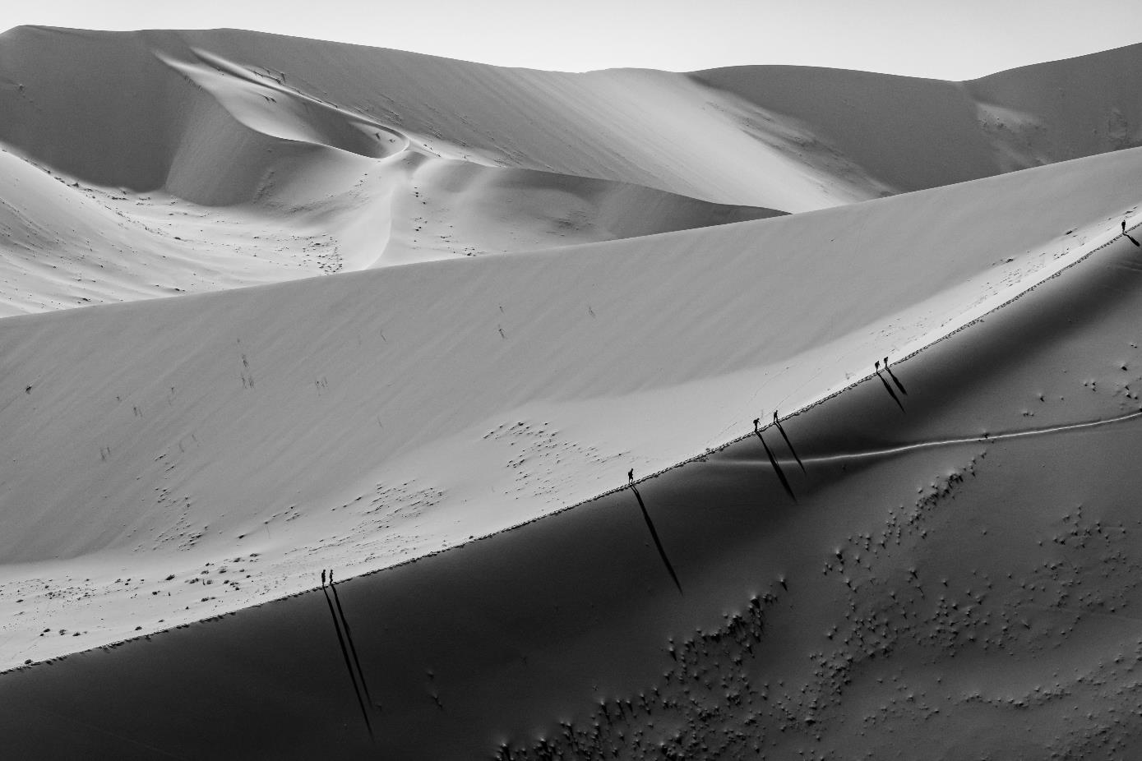
Nicholas Ingold

Slide 11
Johann Carignan

Slide 12
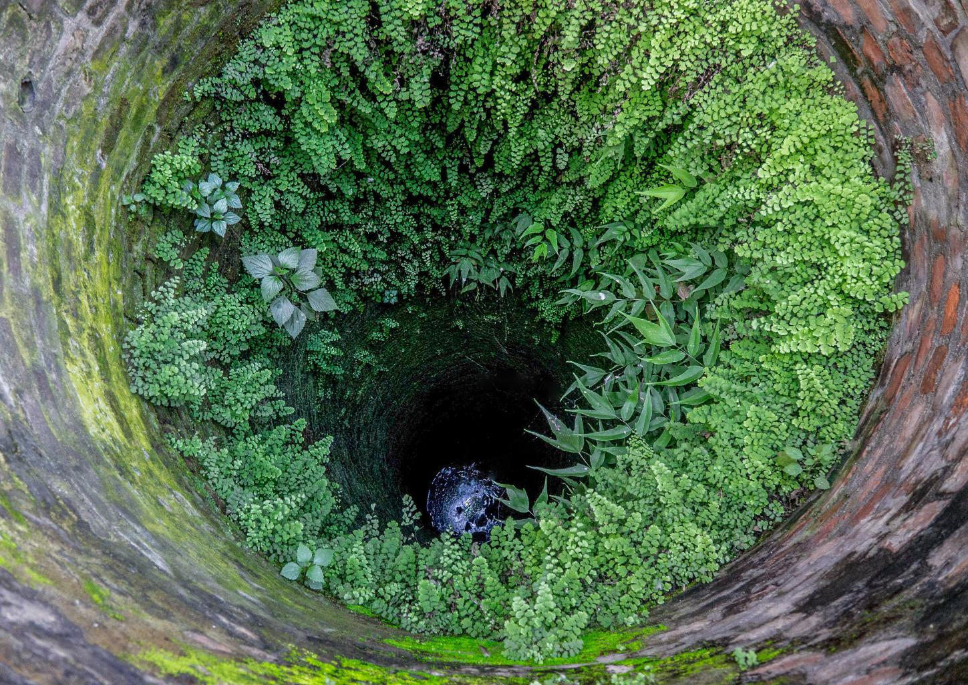
Alan White

Slide 13
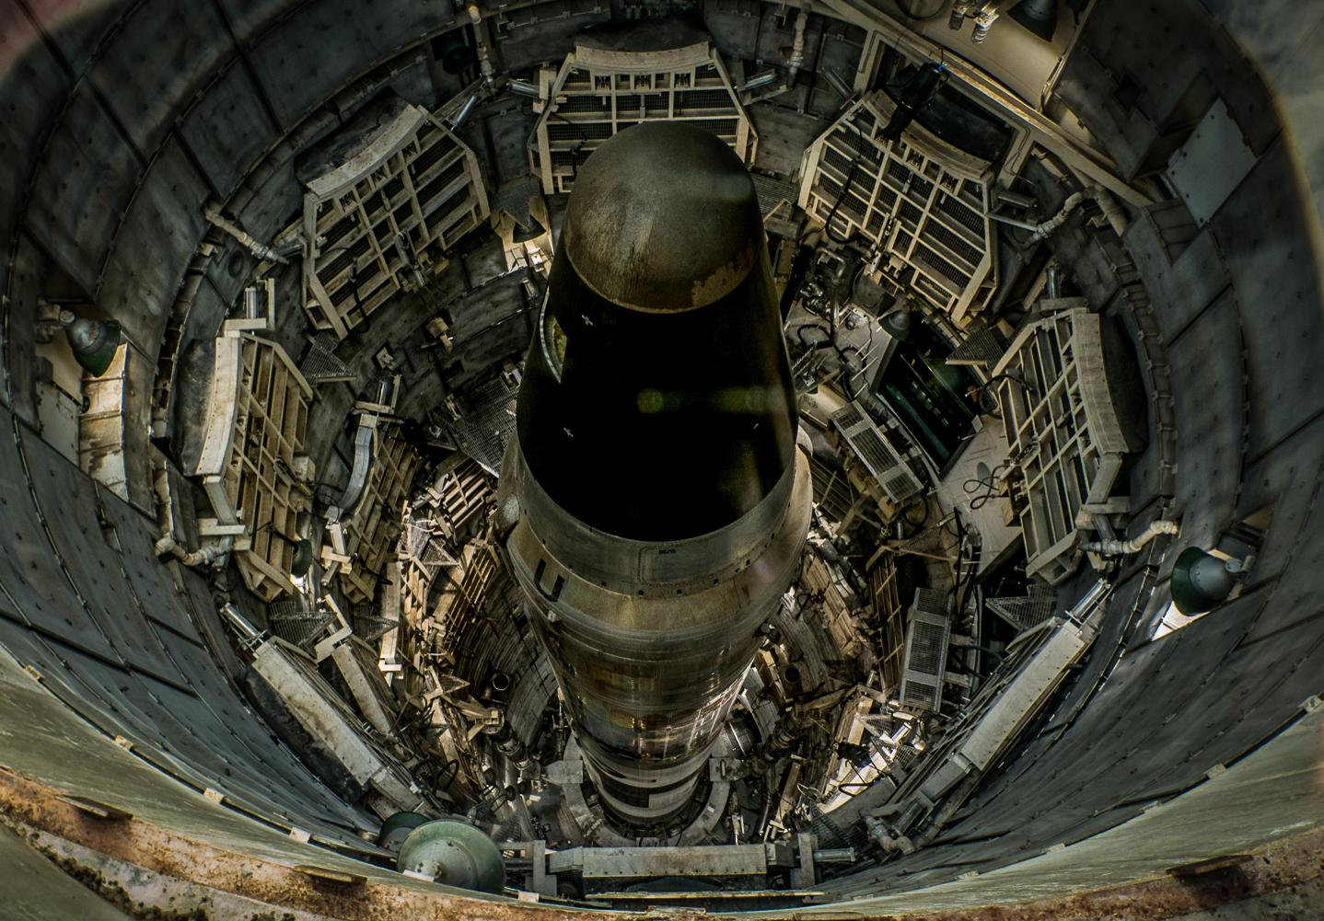
Alan White

Slide 14
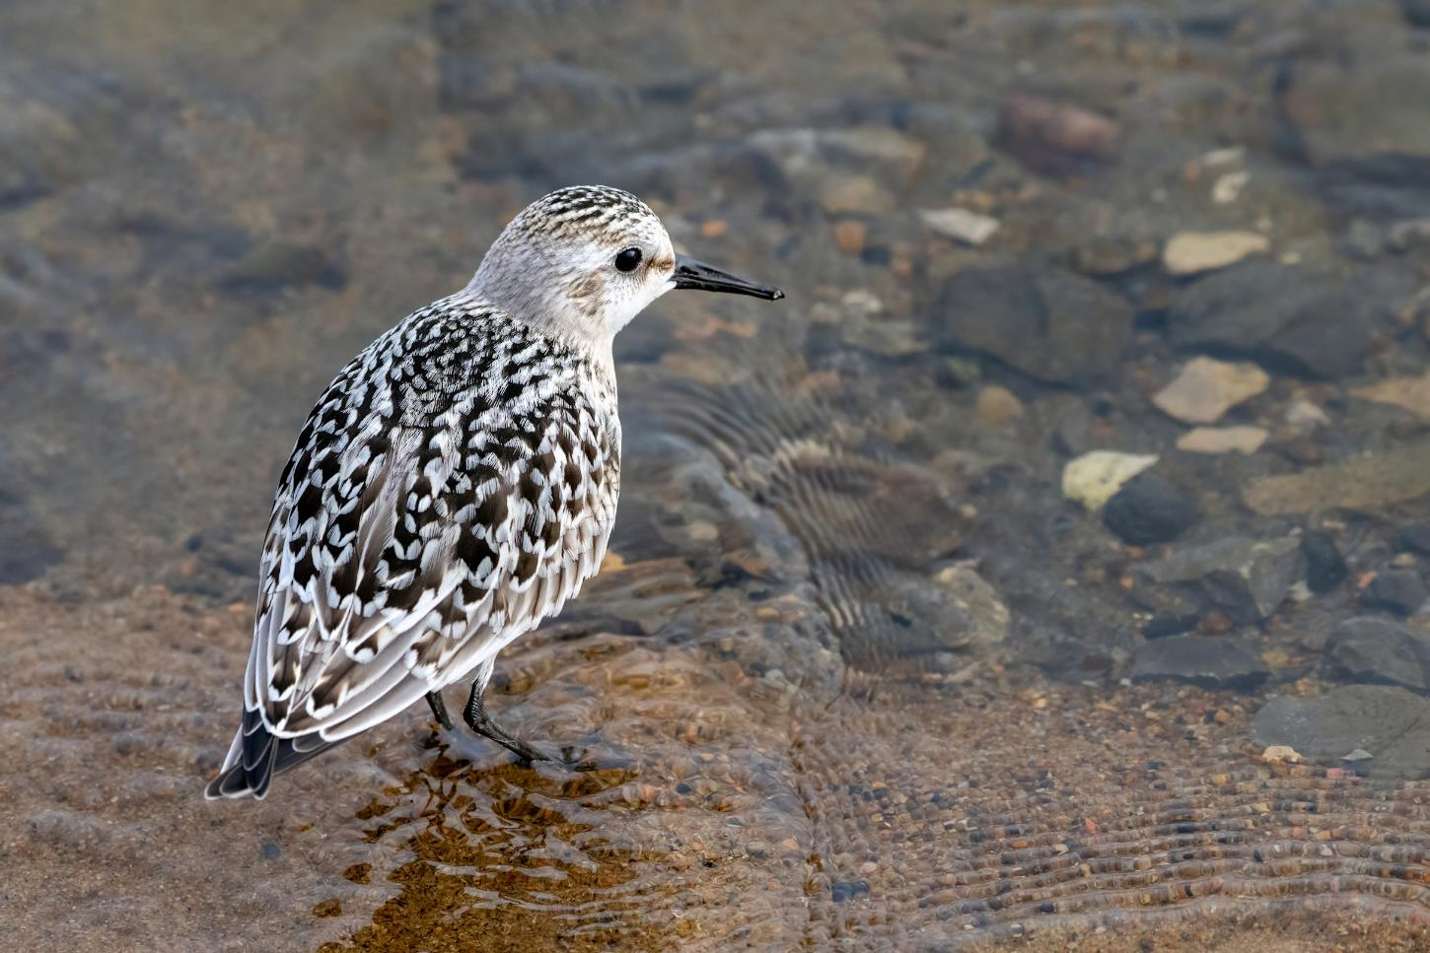
Marianne Pethke

Slide 15
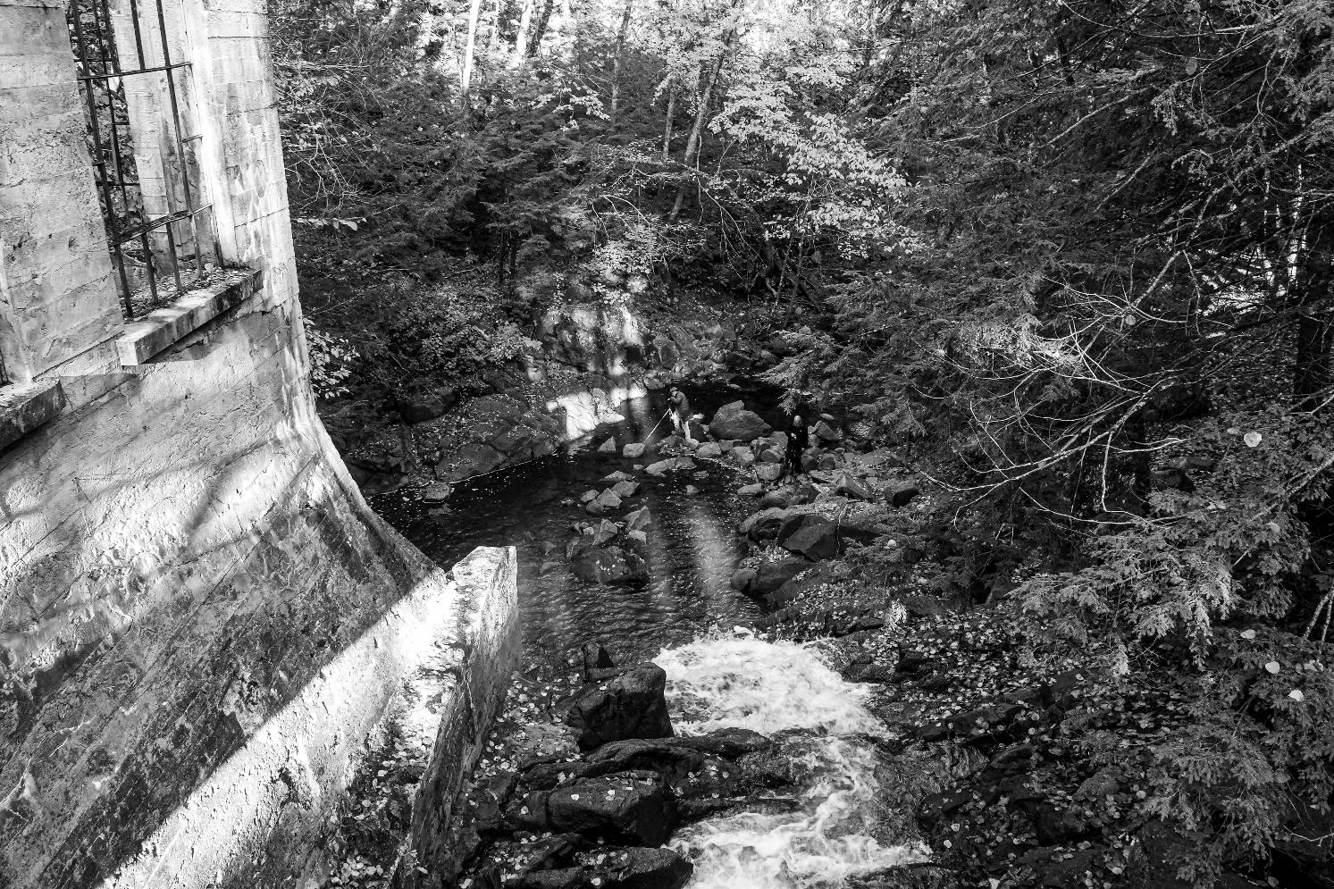
John Ingold

Slide 16
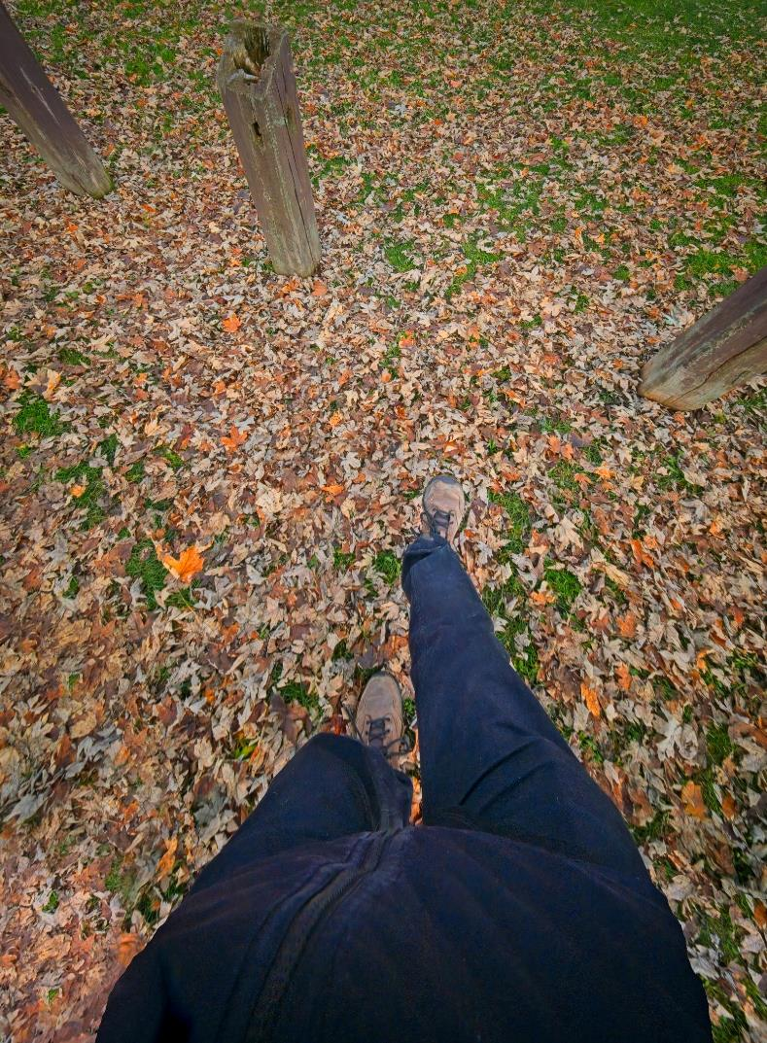
Chris Taylor

Slide 17
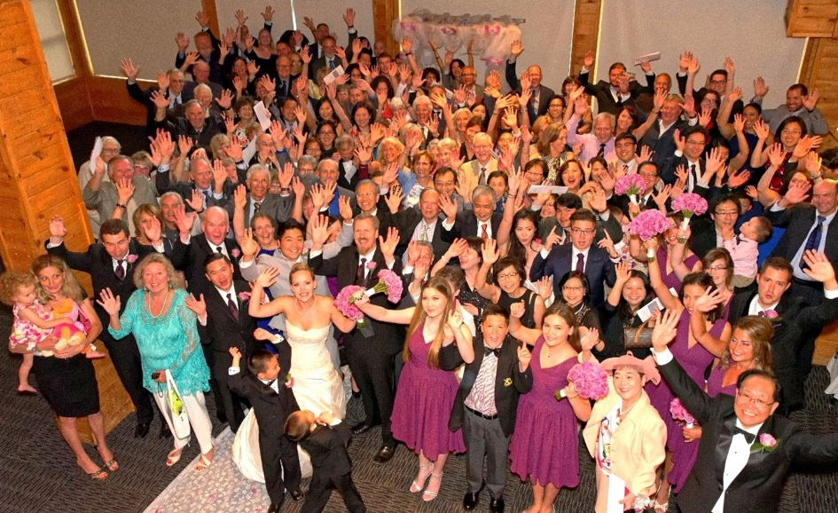
Lynda Buske

Slide 18
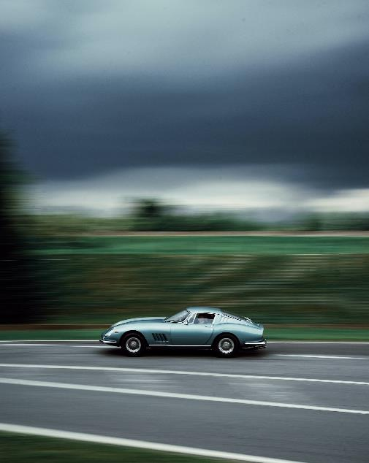
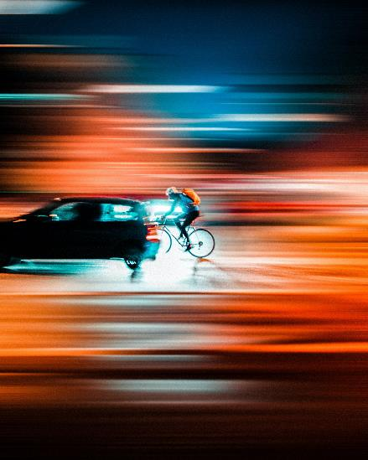
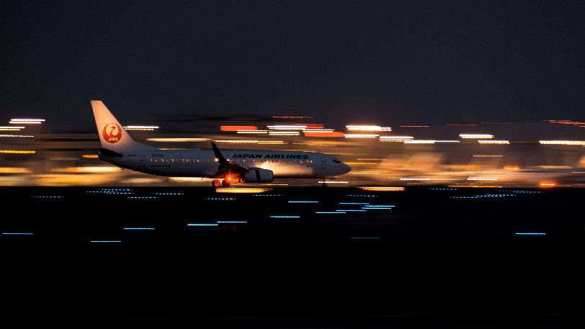
December Technique: Panning
Panning combines a slow shutter speed with camera motion to create a sense of speed around a moving object
It typically keeps the subject in sharp focus while blurring the rest of the image
Sinor Iohamann
Samuele Piccarini
Submit by
Wednesday, December 6th
Sora Sagano

Slide 19
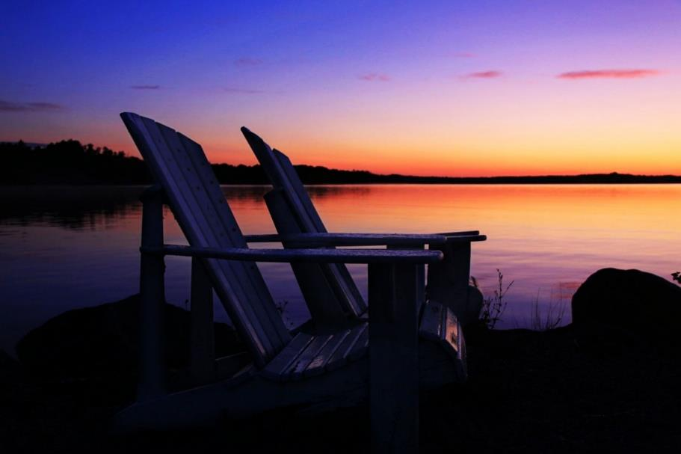
Photo 101 – Blue & Golden Hours
Blue Hour
The blue hour arrives shortly before sunrise and after sunset, when the sun's position, just below the horizon, produces cooler tones.

Slide 20
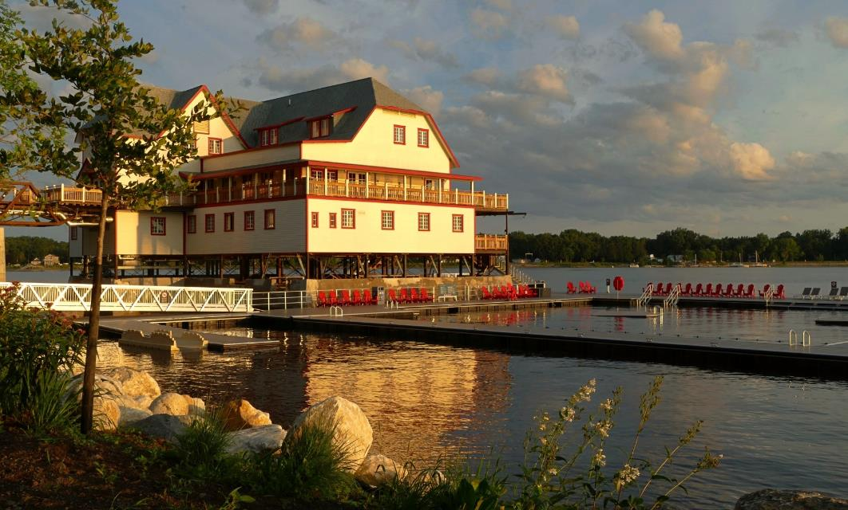
Golden hour
The period of time just after sunrise or just before sunset when the light is infused with red and gold tones.

Slide 21
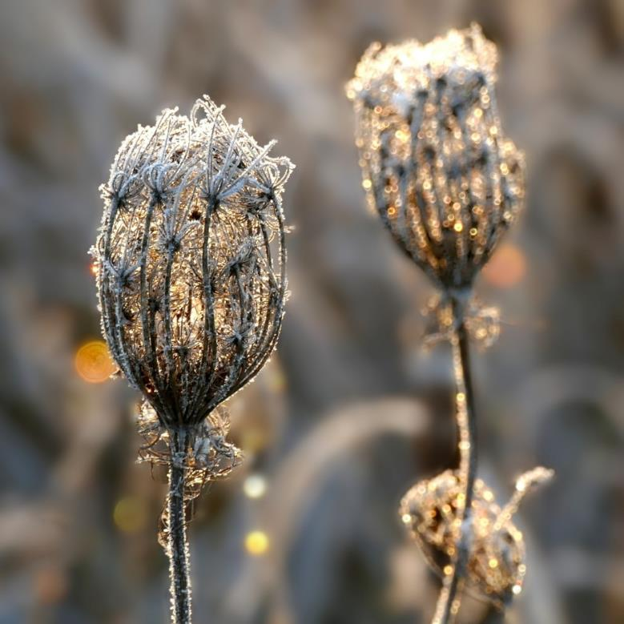
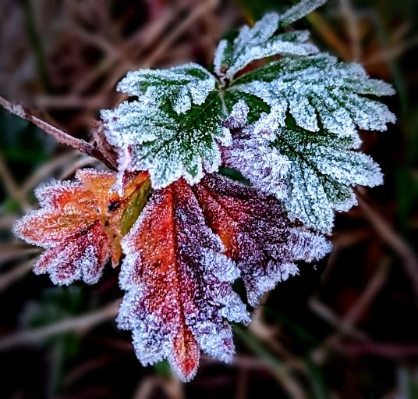
Why I prefer morning blue hour
Dew, mist, fog, frost more likely
Few or no people
Feel safer

Slide 22
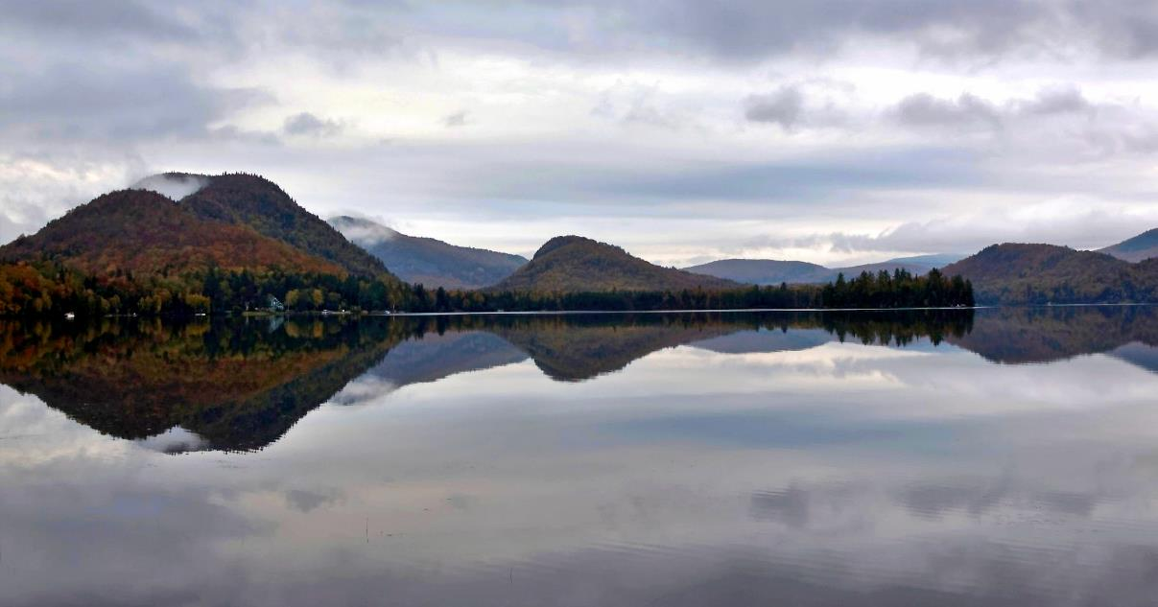
Why I prefer pre-dawn over post-sunset
Still water for reflections (no wind, no motor boats)
Small water craft (canoes, kayaks)
No traffic
Lots of parking

Slide 23
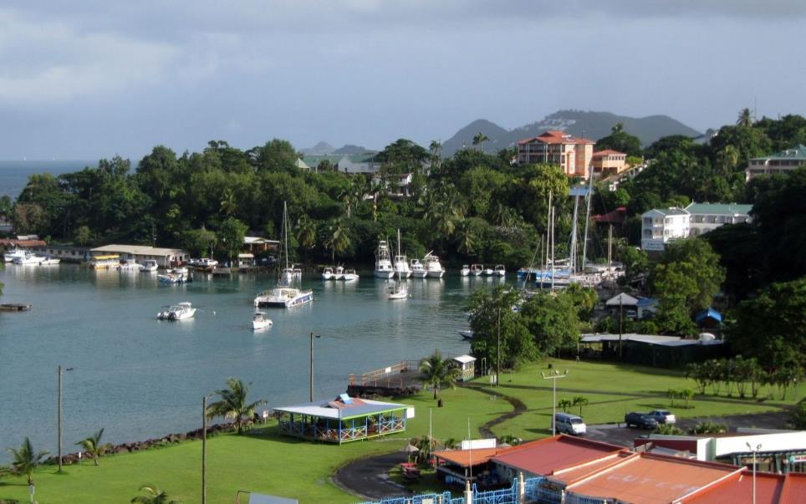
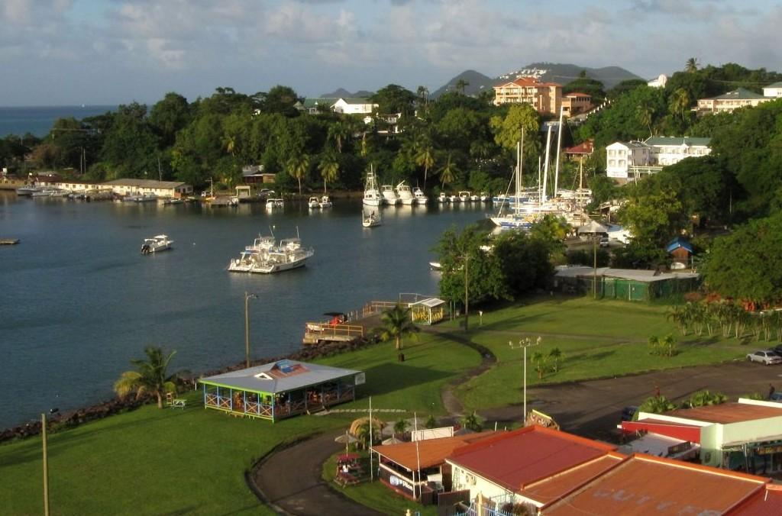
Mid-morning
Evening golden hour

Slide 24
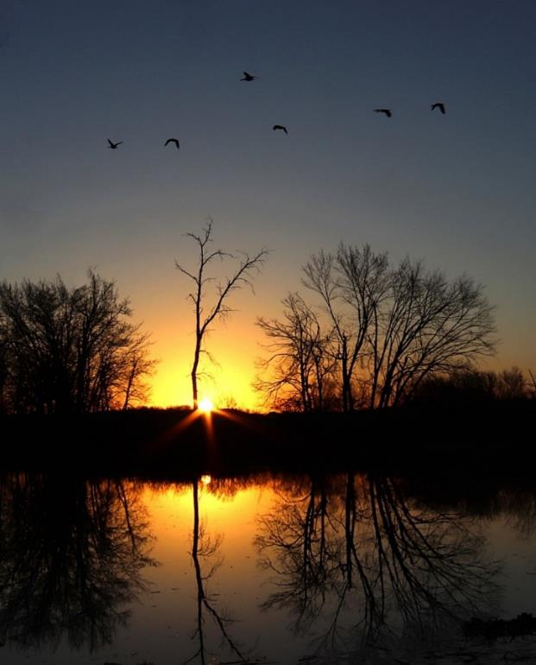
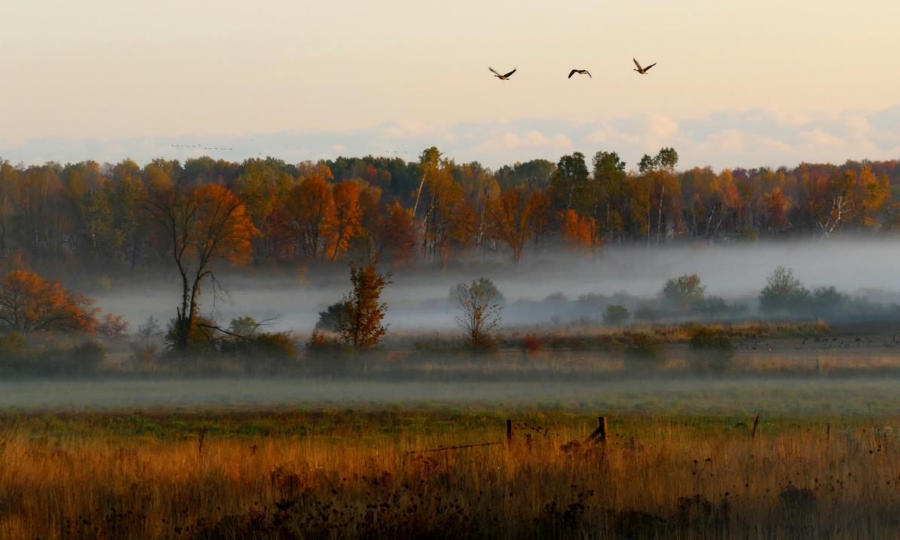
Prefer morning golden hour for active birds and catching mist… if you are quick!

Slide 25
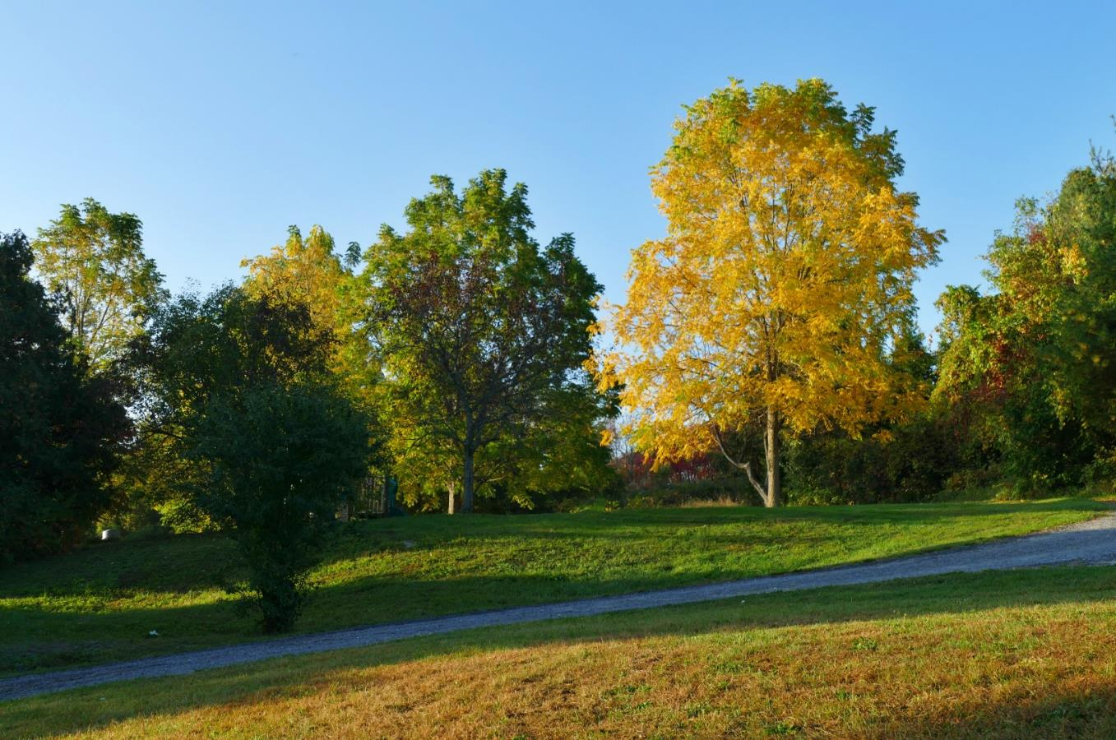
Golds look even golder!

Slide 26
Whoa, backup! Effective strategies for keeping your computer files safe​
Notices
Think about everything that is on your PC
all your photos and videos
tax records, documents, music…
If the files don’t exist anywhere else, you really should think about backup
Chris Taylor is giving free presentations through the Ottawa Public Library
North Gloucester branch, Tuesday November 21 at 6:00pm
St-Laurent branch, Monday December 11 at 6:00pm
Ruth E. Dickinson, Wednesday December 13 at 2:00pm
Register for free at https://biblioottawalibrary.ca/en/program?text=whoa

Slide 27
CAPA Membership
Notices
CPOPC is becoming a member of CAPA
This now entitles our members to a free limited membership in CAPA
You have to register yourself as a member of a CAPA club
You will be able to read the Canadian Photography magazine and submit articles to it

Slide 28
CPOPC Communications Communications Director: John Ingold
Monthly Newsletter + deadline reminders
Facebook: Orleans Photo Club
Challenge and Competition winners’ photos, event updates
https://www.facebook.com/CPOPC
Instagram: Orleans_Photo_Club
Member contributions photos, event updates
https://www.instagram.com/orleans_photo_club/?hl=en
Thank you to Trish Parsons for helping post member contributions
Twitter: OrleansPhotoClb
Deadlines, event updates
https://twitter.com/OrleansPhotoClb

Slide 29
Annual Membership Fees; 2023-2024 Secretary and Treasurer: Roger Regimbal
Individual: $50 $25 for new members only joining between Feb. 1 and June 30
Family: $75 $35 for new members only joining between Feb. 1 and June 30
NEW Online $25 – full online participation + outings
All returning members must pay full price
Full payment is due before end of November 2023
Access to “Members Only” section of website cut off after November
Please pay online via PayPal using the CPOPC web site “How to Join” page

Slide 30
2023-24 Speaker and Topics Schedule Programs Director: Marianne Pethke Workshops: Johan Carignan
October Dan Parent Nature/Wildlife
November Gareth Jones Creative Imagery
January
February Peter Fundarek B2B: The Exposure Triangle
March Mark Bowie How to photograph trees & forests
April Mike Giovinazzo One light portraits
May Mike Higgins Landscape photography

Slide 31
2023-24 Outings and Workshops Schedule Programs Director: Marianne Pethke Workshops: Johan Carignan
OUTINGS
October Gatineau park for fall colours
November Scavenger Hunt
December Christmas Lights downtown Ottawa
January Winter (organised by Marianne)
March National Art Gallery/Architecture outing
June Night Sky Photography (how to get stars in focus)
outing to Petrie Island

Slide 32
2023-24 Outings and Workshops Schedule Programs Director: Marianne Pethke Workshops: Johan Carignan
WORKSHOPS
17 February Manfred Mueller Glass Tabletop Workshop
20 April Adrian Duey Still Life and Food Lighting Workshop
18 May Suliman Chadirji Ambient Light Photography (downtown Ottawa in the evening)

Slide 33
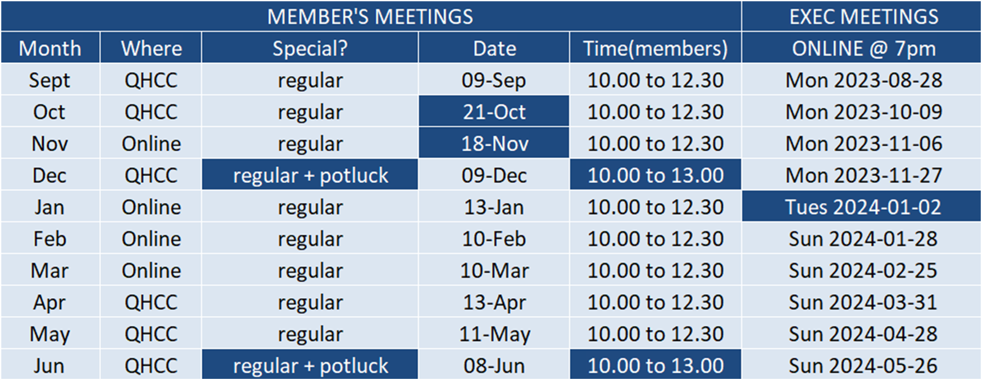
2023-24 Calendar

Slide 34
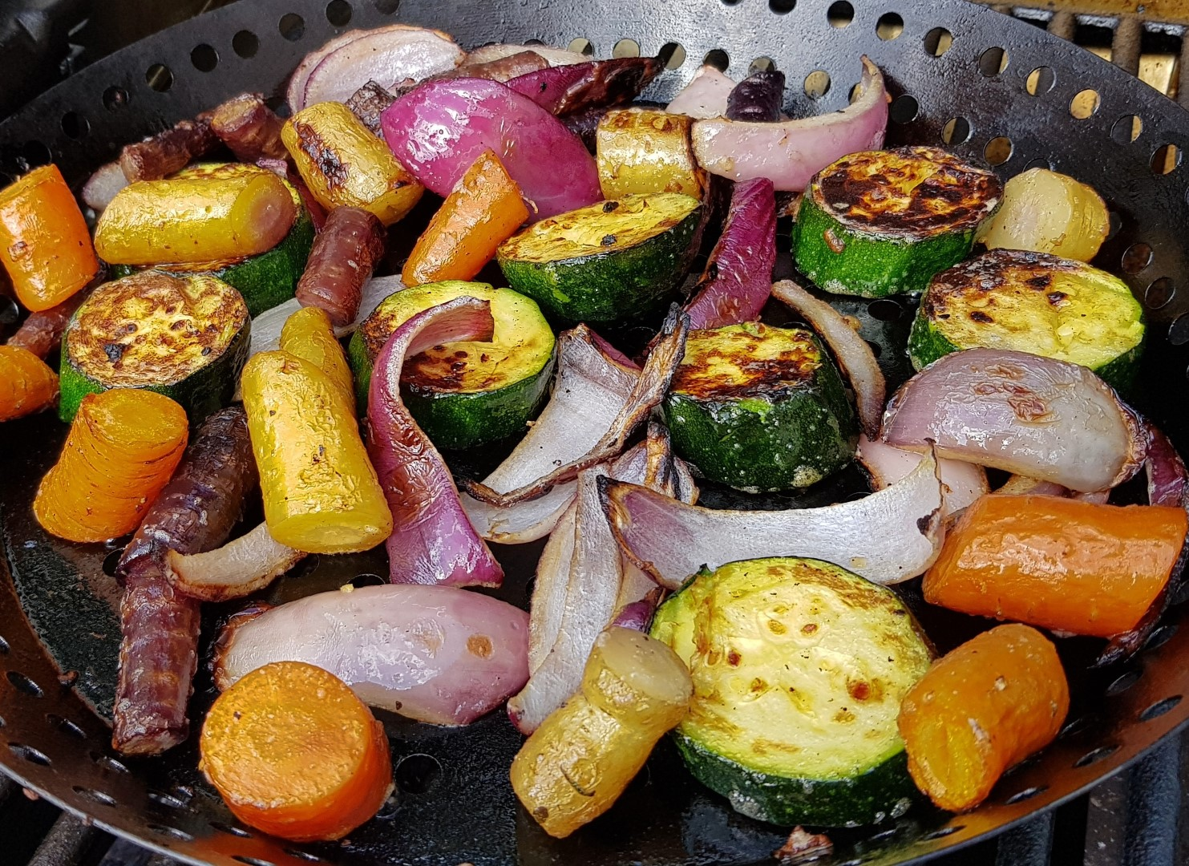
Next Meeting
9 December, 10am Live at QHCC
Competition: Simplicity (submit by midnight tonight)
Technique: Panning
Photo 101: Printing
Potluck social
Lynda Buske

