Slide 1
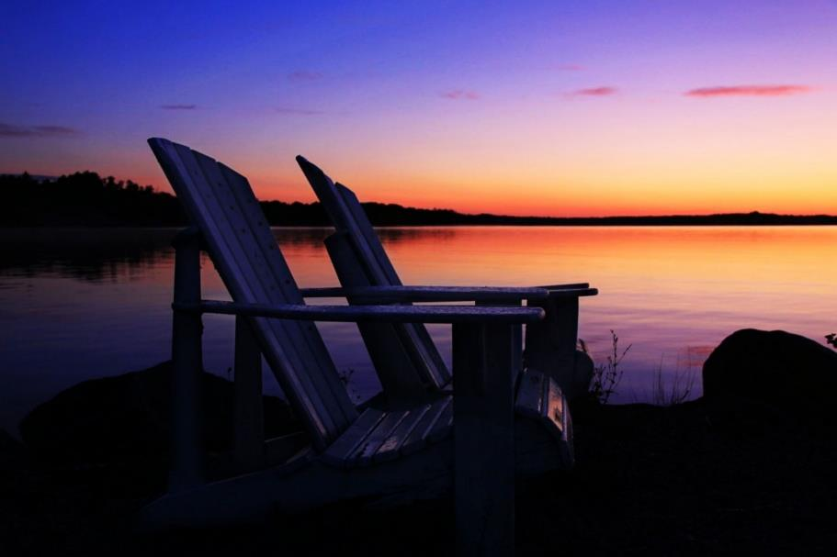
Photo 101 – Blue & Golden Hours
Blue Hour
The blue hour arrives shortly before sunrise and after sunset, when the sun's position, just below the horizon, produces cooler tones.

Slide 2
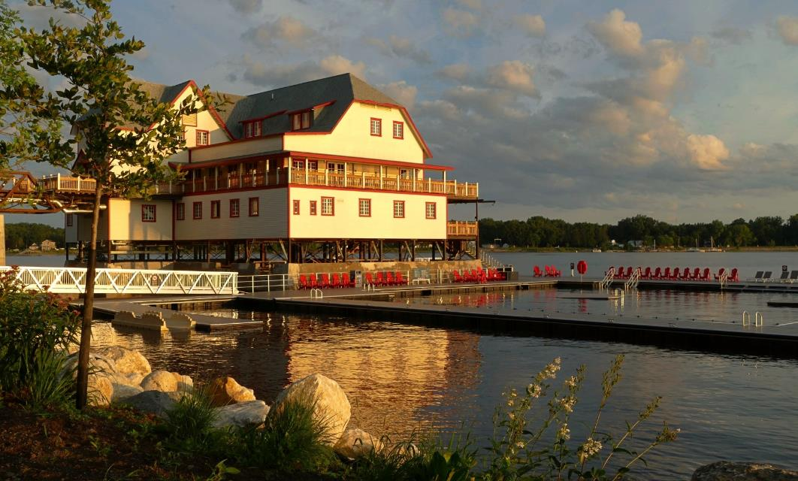
Golden hour
The period of time just after sunrise or just before sunset when the light is infused with red and gold tones.

Slide 3
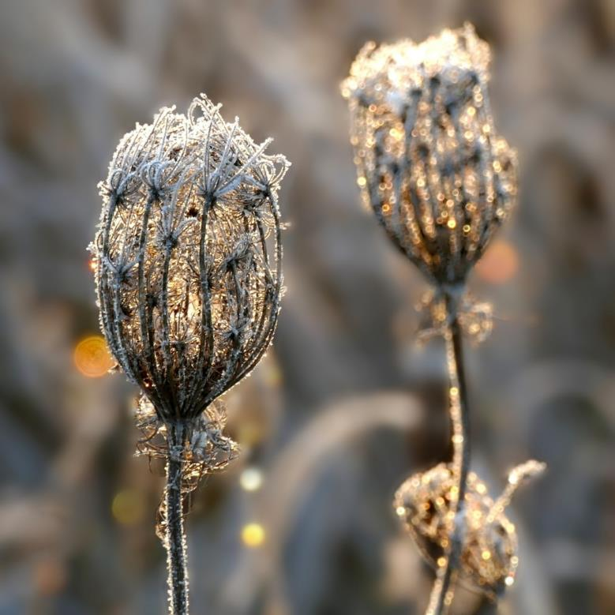
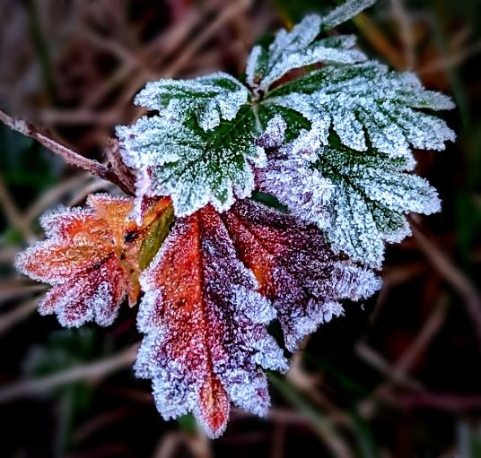
Why I prefer morning blue hour
Dew, mist, fog, frost more likely
Few or no people
Feel safer

Slide 4
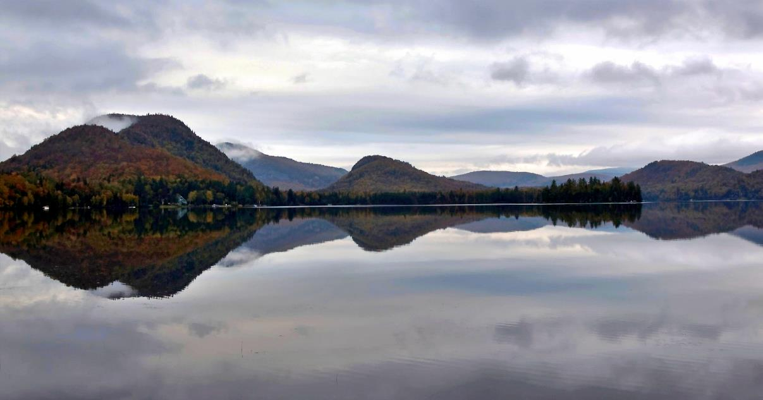
Why I prefer pre-dawn over post-sunset
Still water for reflections (no wind, no motor boats)
Small water craft (canoes, kayaks)
No traffic
Lots of parking

Slide 5
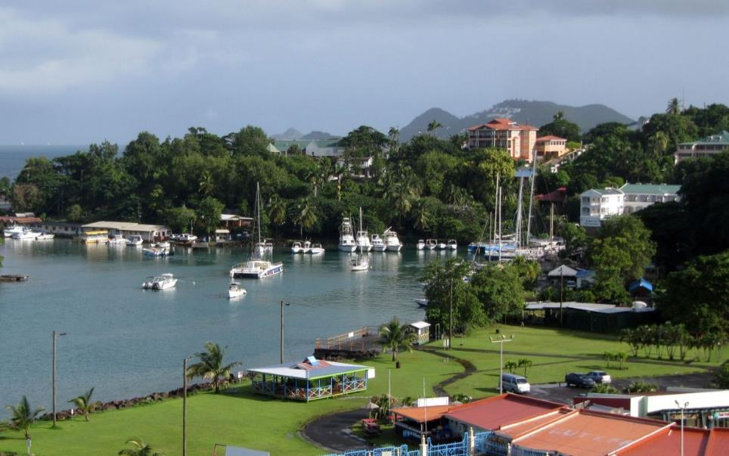
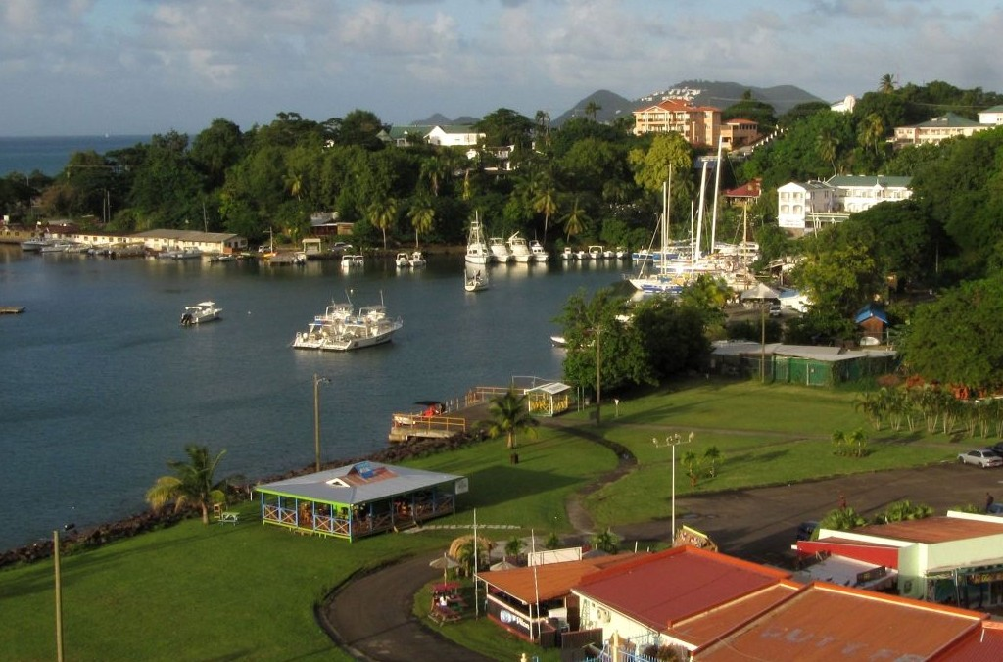
Mid-morning
Evening golden hour

Slide 6
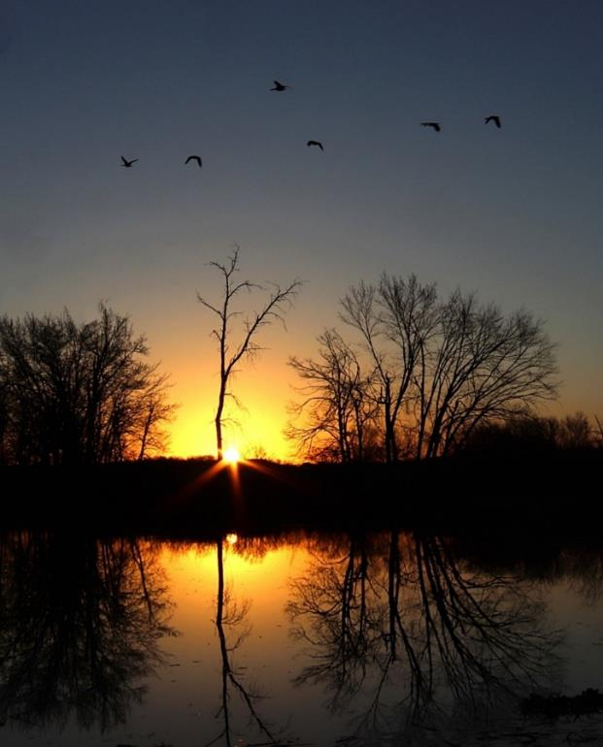
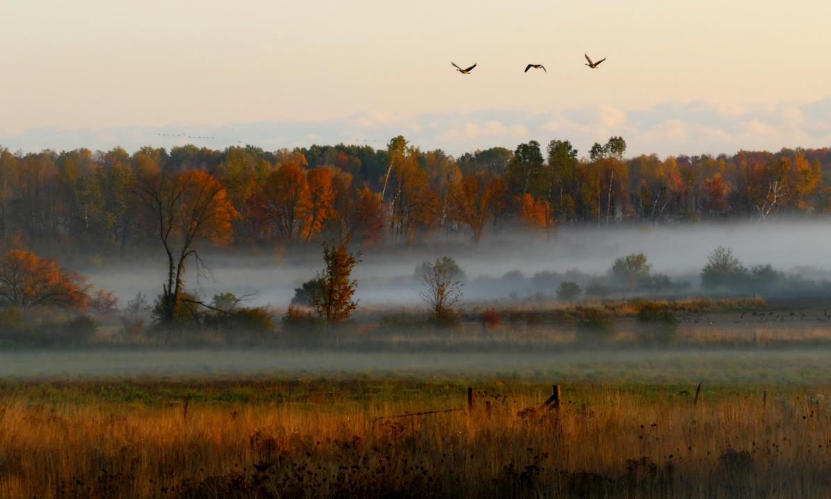
Prefer morning golden hour for active birds and catching mist… if you are quick!

Slide 7
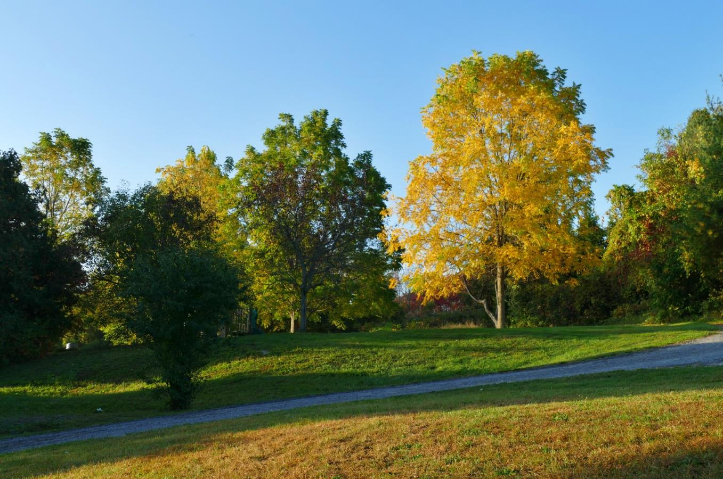
Golds look even golder!

