Slide 1
CPOPC December 2023
December 9, 2023

Slide 2
Welcome
Acknowledgement of guests and prospective members
Break between 11am & 11:30am
Please be respectful of others but do
join in
ask questions
participate

Slide 3
December 2023 Agenda topics
Fall Competition—Simplicity
Break: 15 minutes
Christmas Outing
Scavenger Hunt
December Technique—Panning
January Technique announcement
Photo 101—Printing your Images
Notices
Next Meeting

Slide 4
Fall competition—Simplicity
Photos that are simple and uncomplicated
Showcase “less is more”
Images must have been taken since June 2023
Up to three images
Shane
Sarah Dorweiler
Viktor Forgacs

Slide 5
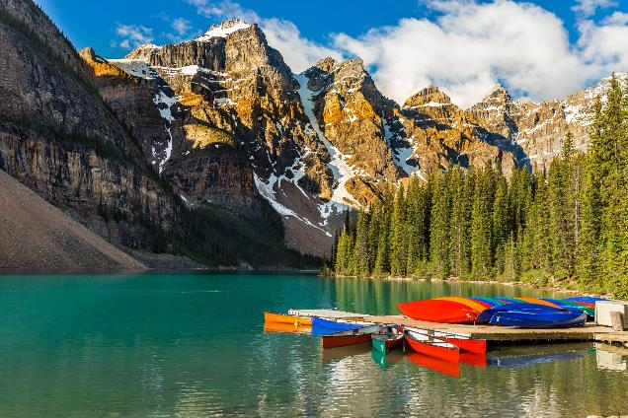
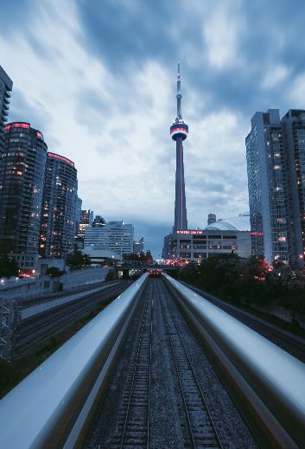
January challenge—Truly Canadian
A feature of Canada (geography, wildlife, people, etc.) that makes you proud to live here
Off topic: Any photo that was taken outside of Canada
Submission deadline—Saturday, Jan 6, 2024 (midnight)
Voting deadline—Thursday, Jan 11, 2024 (midnight)
All archived images are allowed
Andy Holmes
Stanley Dai
Touann Gatouilla

Slide 6
Break
We will restart in 15 minutes with the Scavenger Hunt.

Slide 7
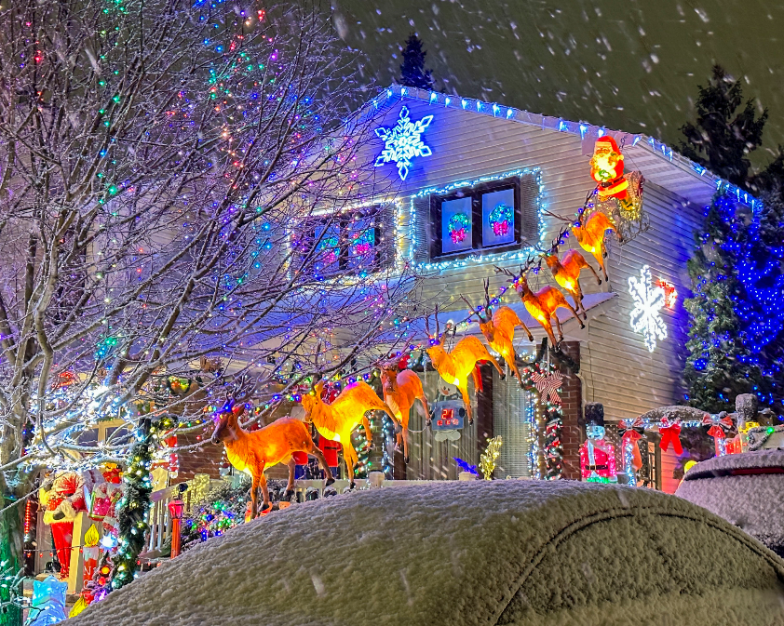
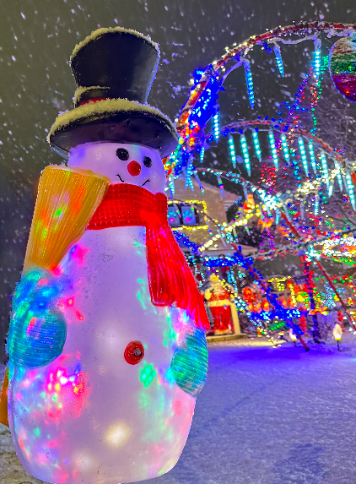
Christmas Outing
Taffy Lane, Orleans
Sunday 17 December 3:30 PM
Meet in the parking of the Orleans United Church at the corner of Orleans Blvd & Sugar Creek Way
Bring your Tripod and telephoto lens or a wide angle lens

Slide 8
Scavenger Hunt 2023
Topics

Slide 9
Scavenger Hunt 2023
Co-Program Director - Johan Carignan

Slide 10
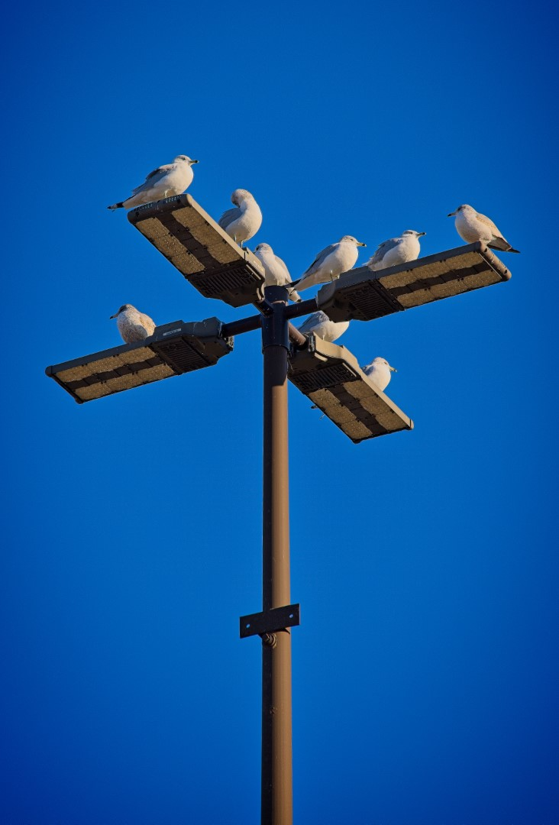
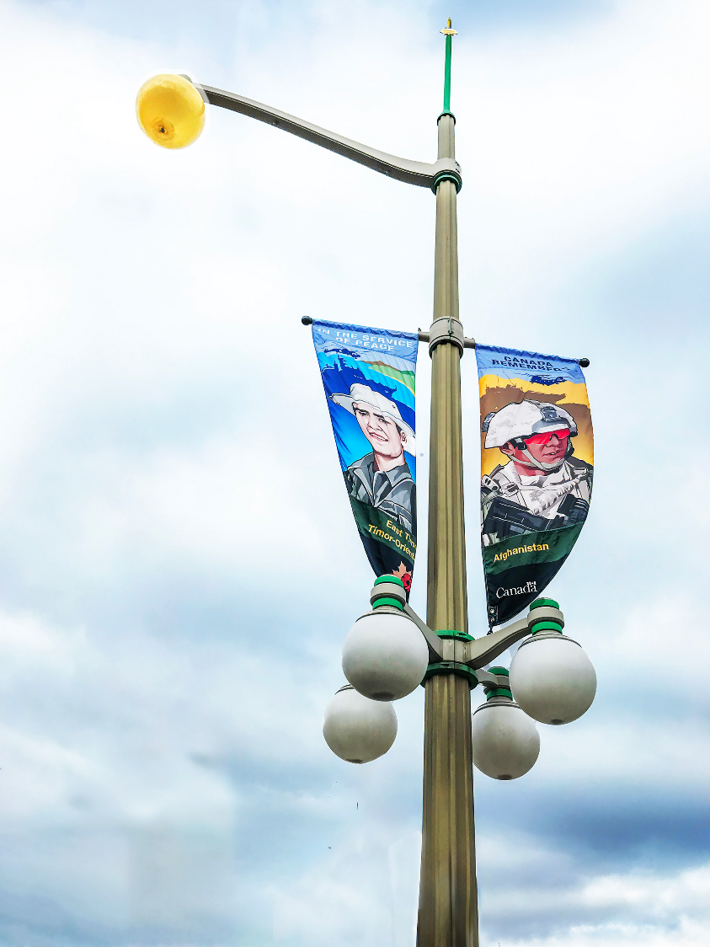
S
t
r
e
e
t
L
I
g
h
t
Ramesh Chauhan
Chris Taylor

Slide 11
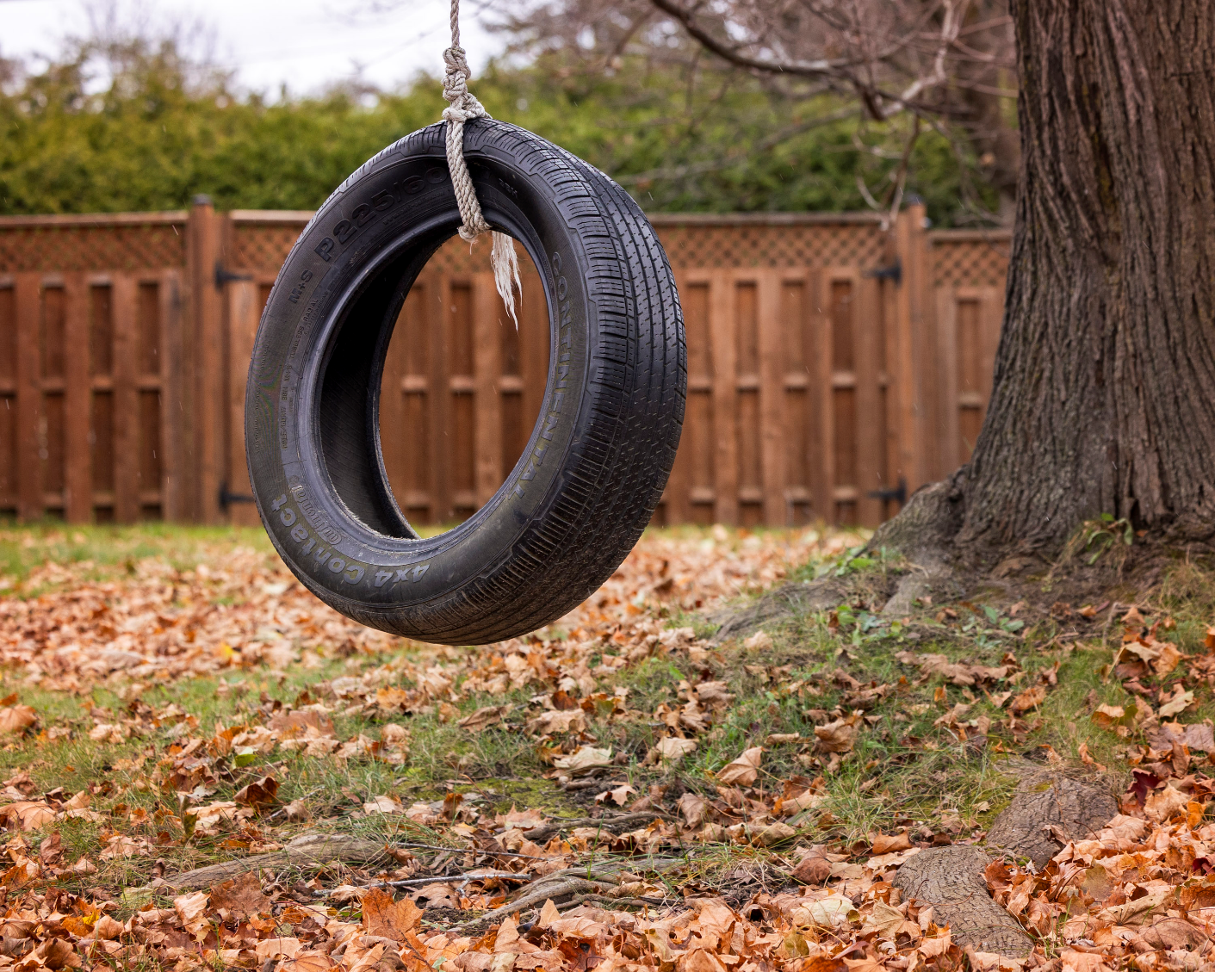
Swing
Johan Carignan

Slide 12
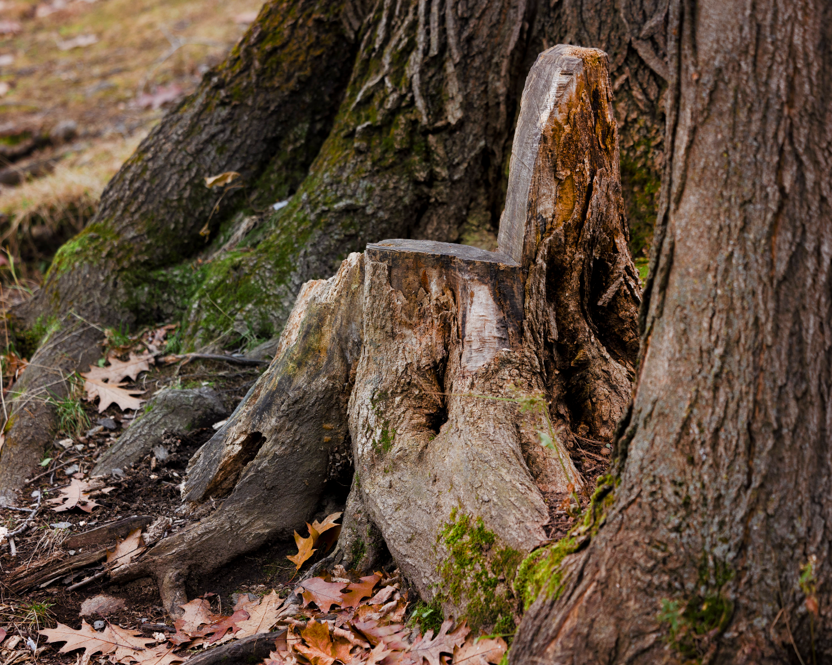
Bench
Johan Carignan

Slide 13
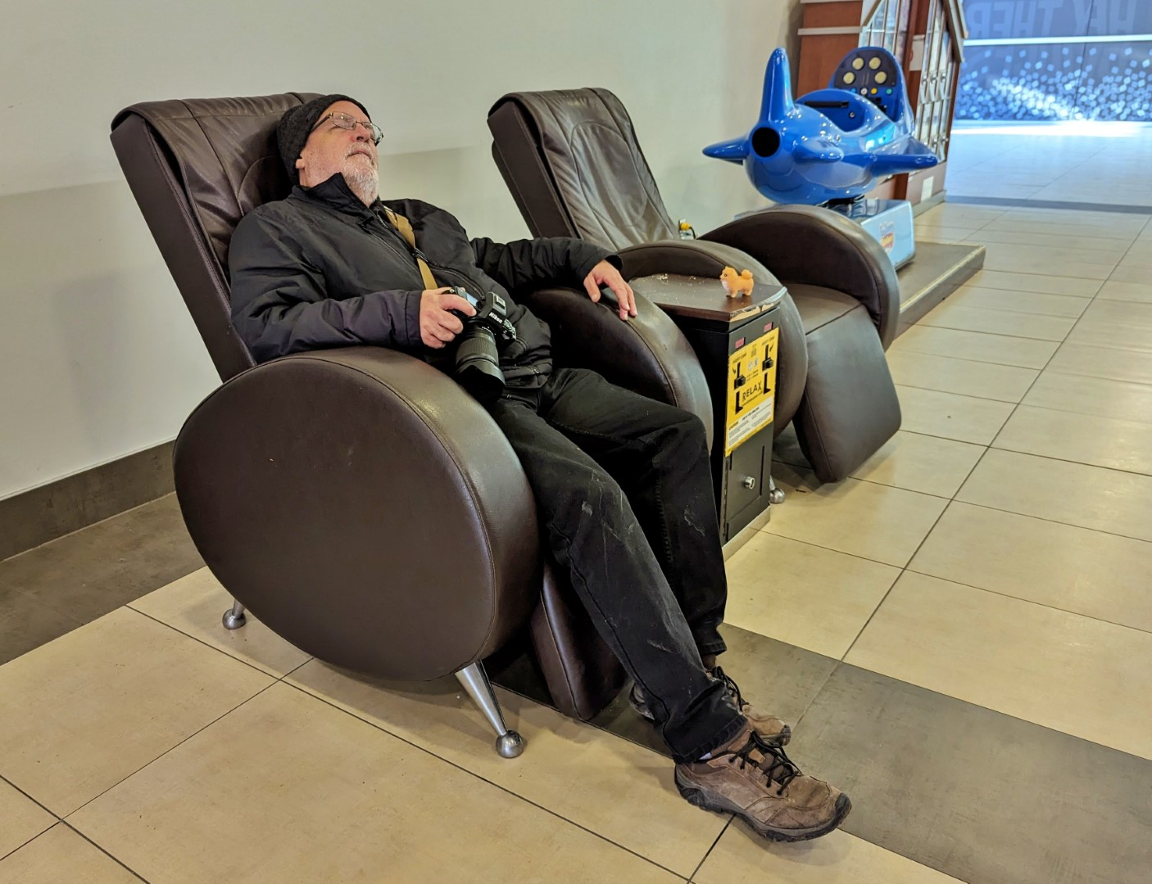
Relaxing
Place
Lynda Buske

Slide 14
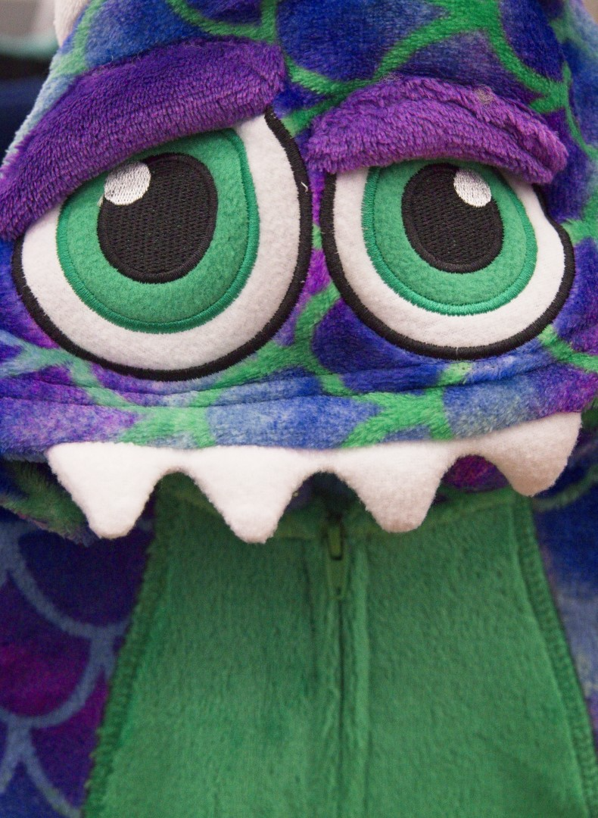
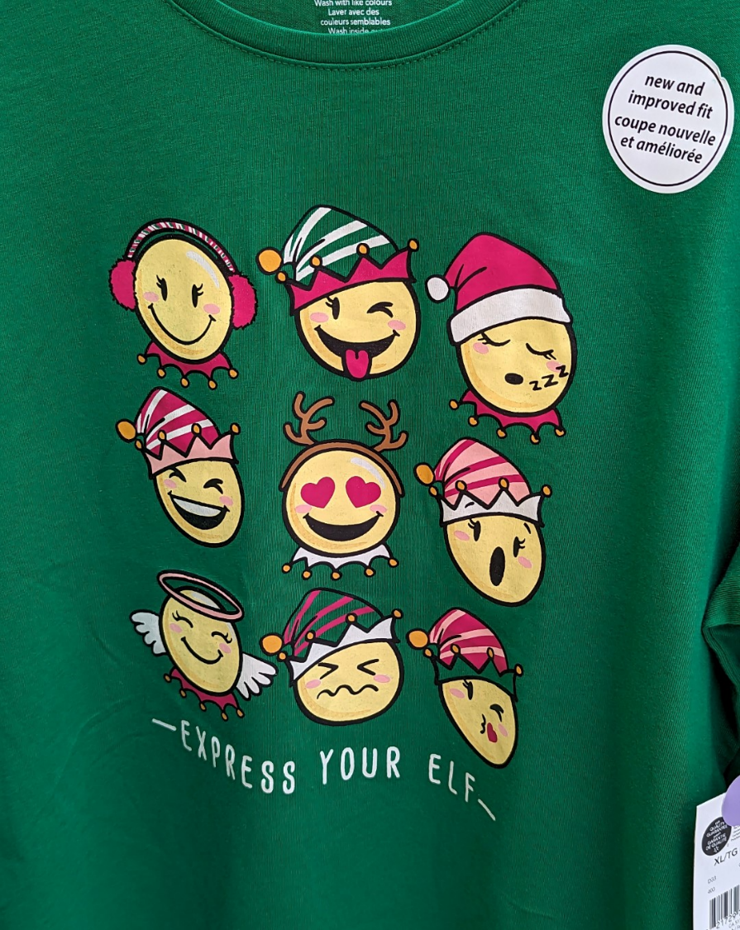
Funn i es t
Th I ng
Lynda Buske
Chris Taylor

Slide 15
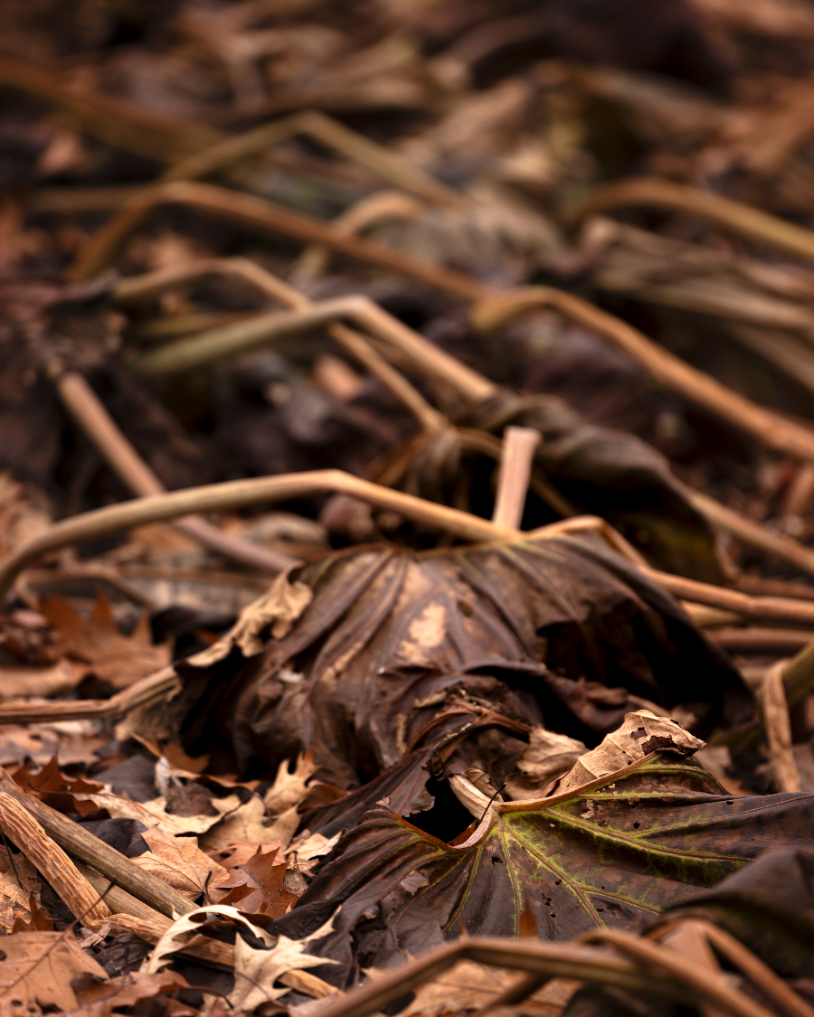
Leaves
Johan Carignan

Slide 16
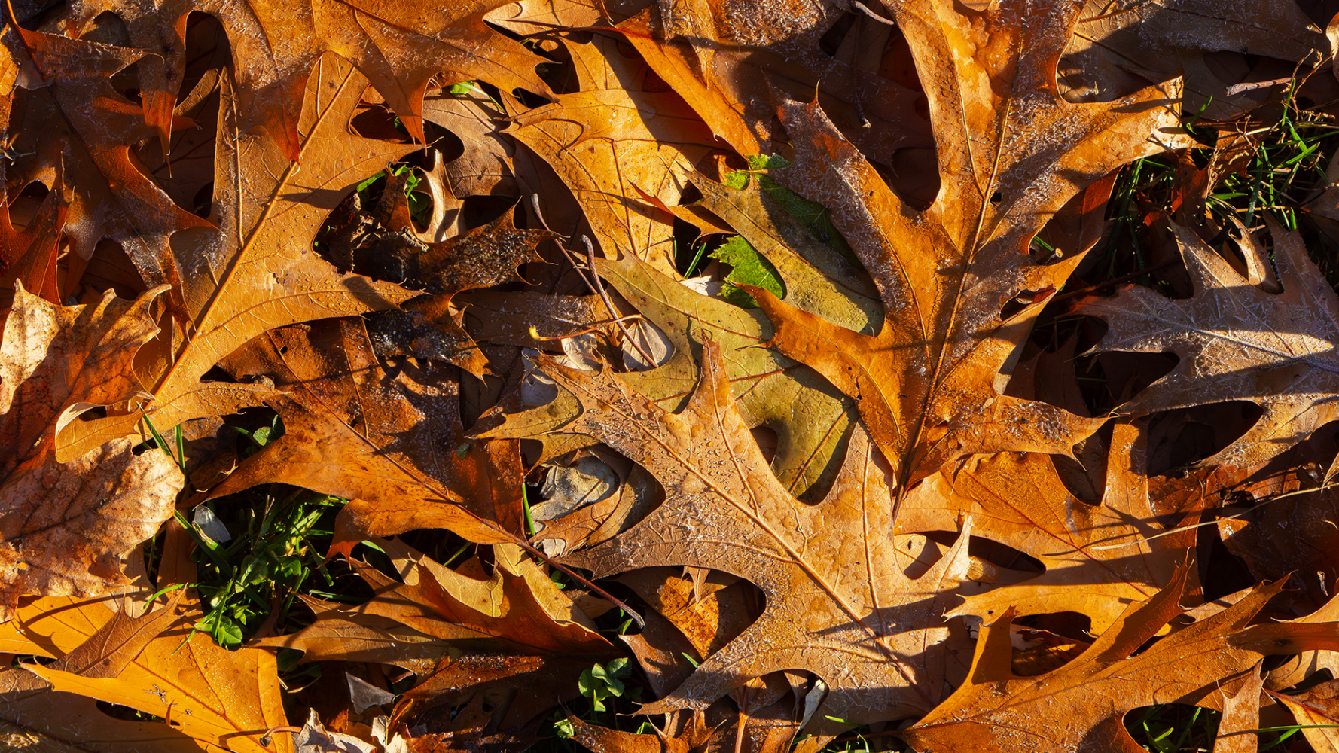
Ramesh Chauhan

Slide 17
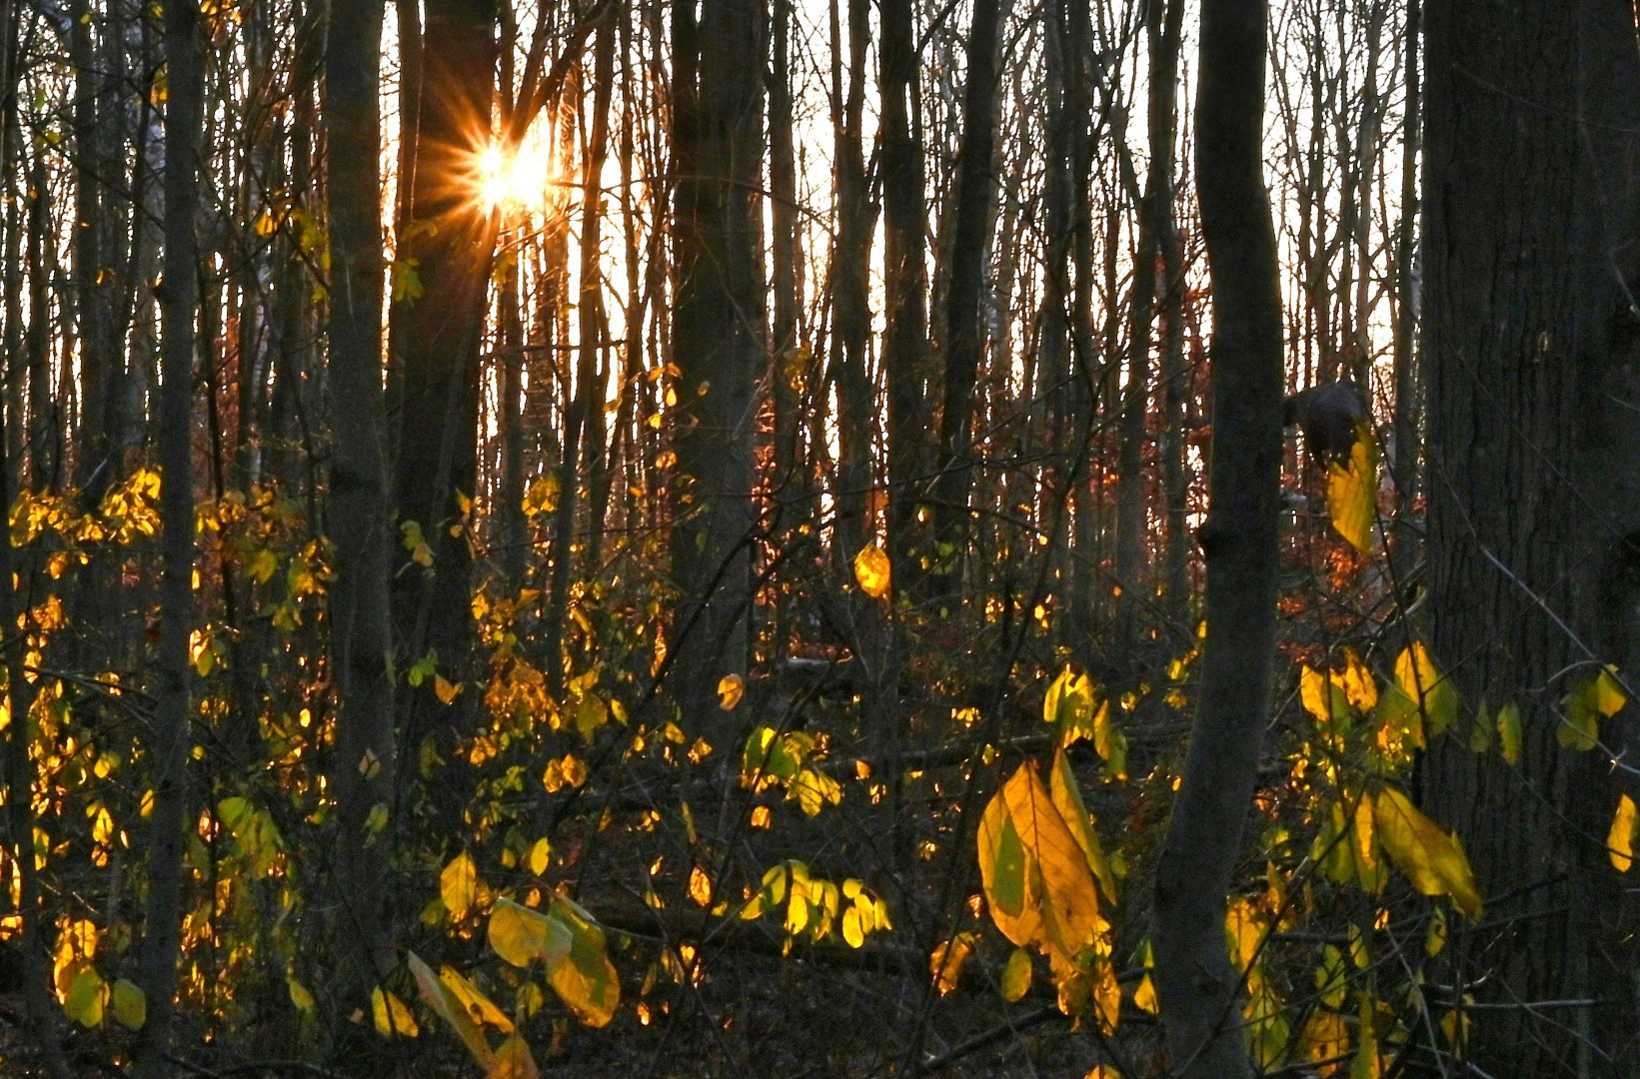
Lynda
Buske

Slide 18
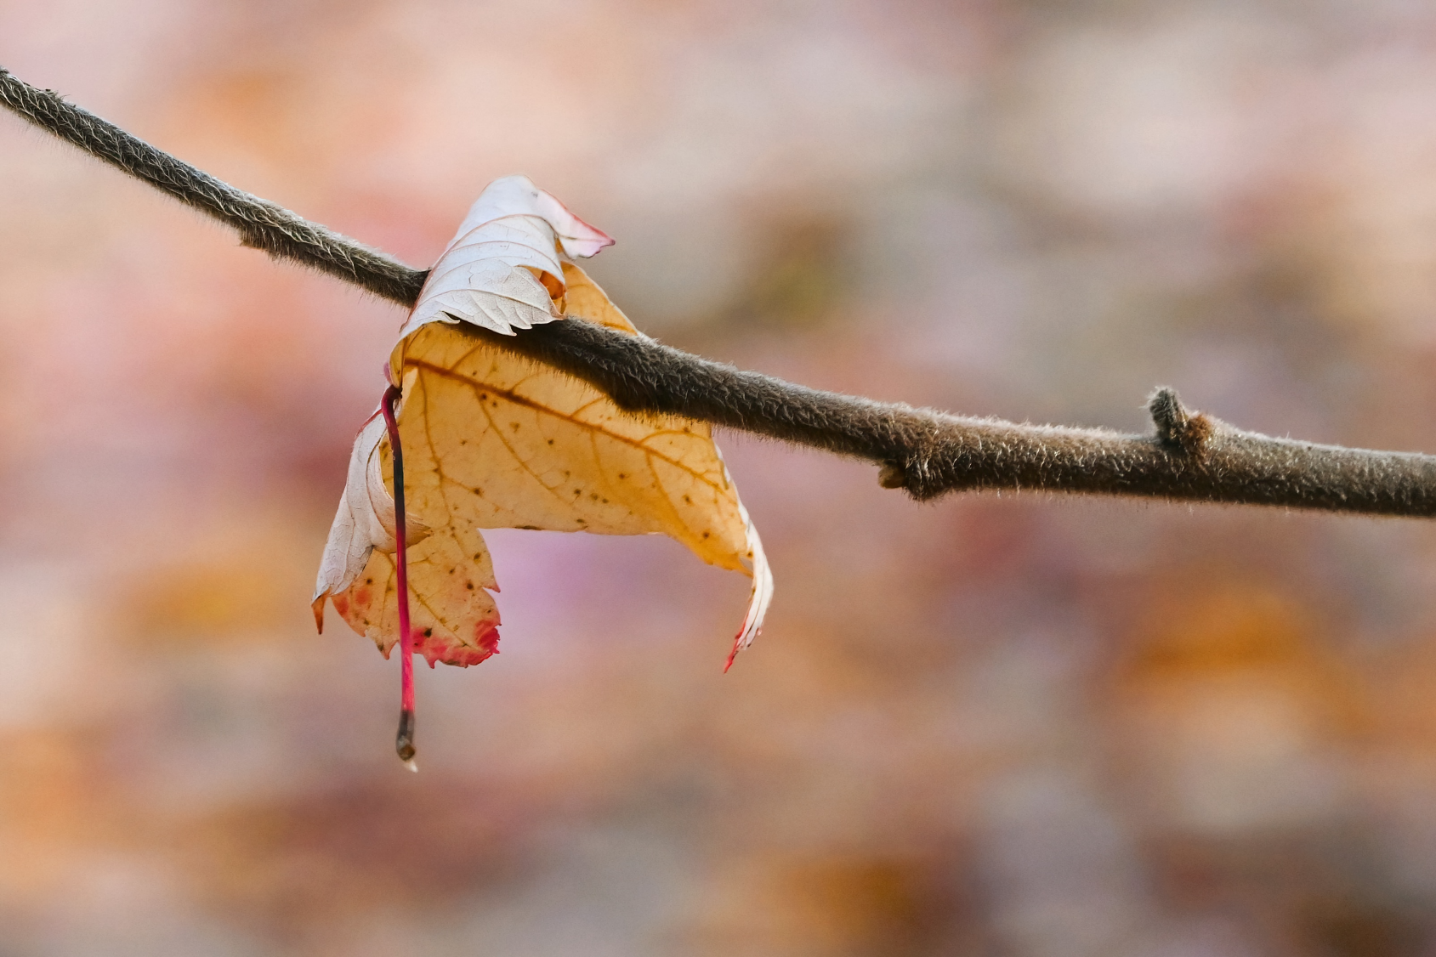
Ma r i anne
Pe t hke

Slide 19
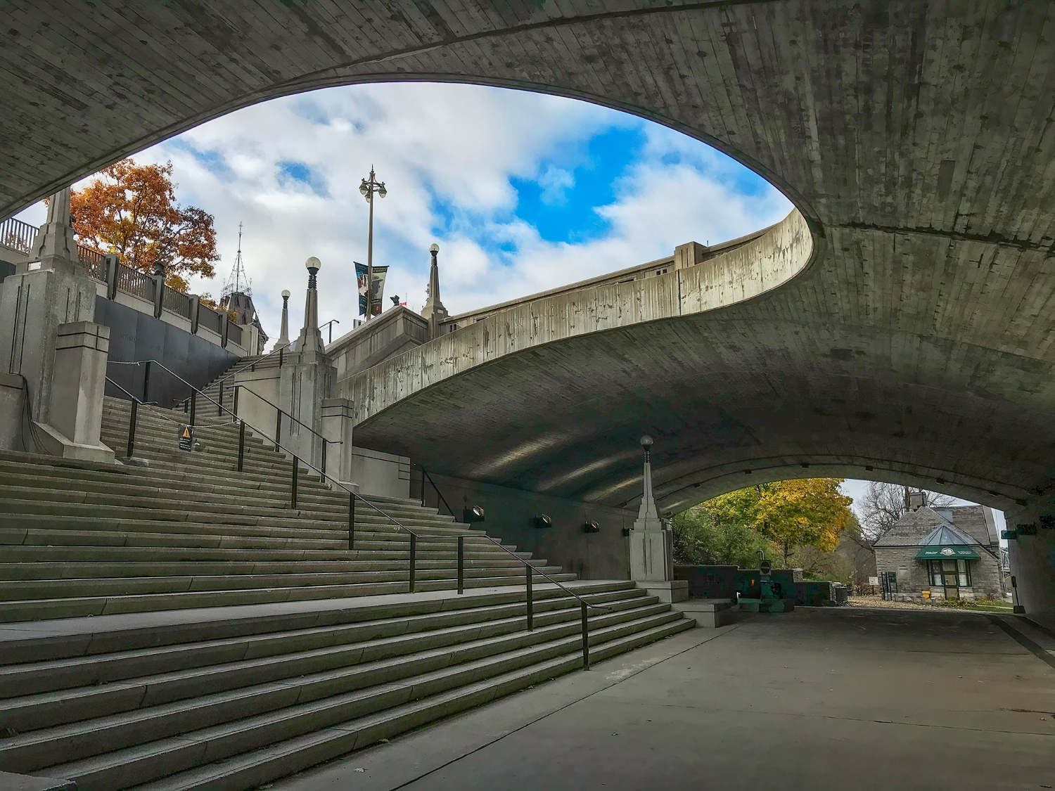
Inside/ Outside
Ramesh Chauhan

Slide 20
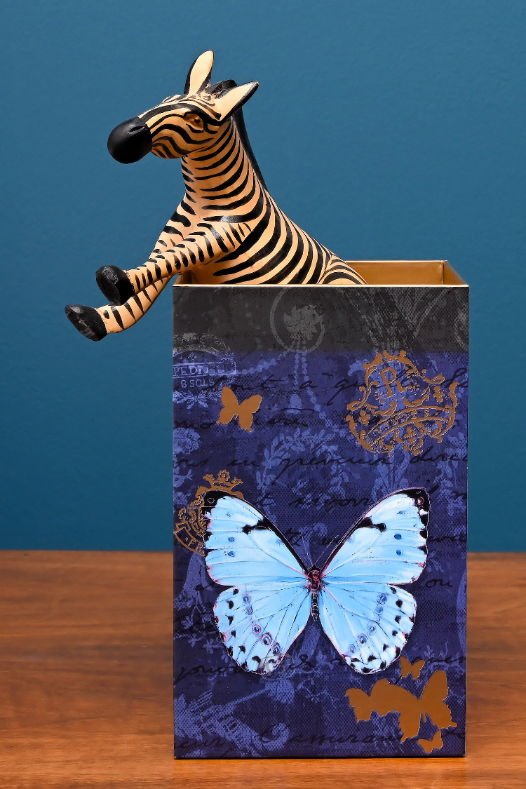
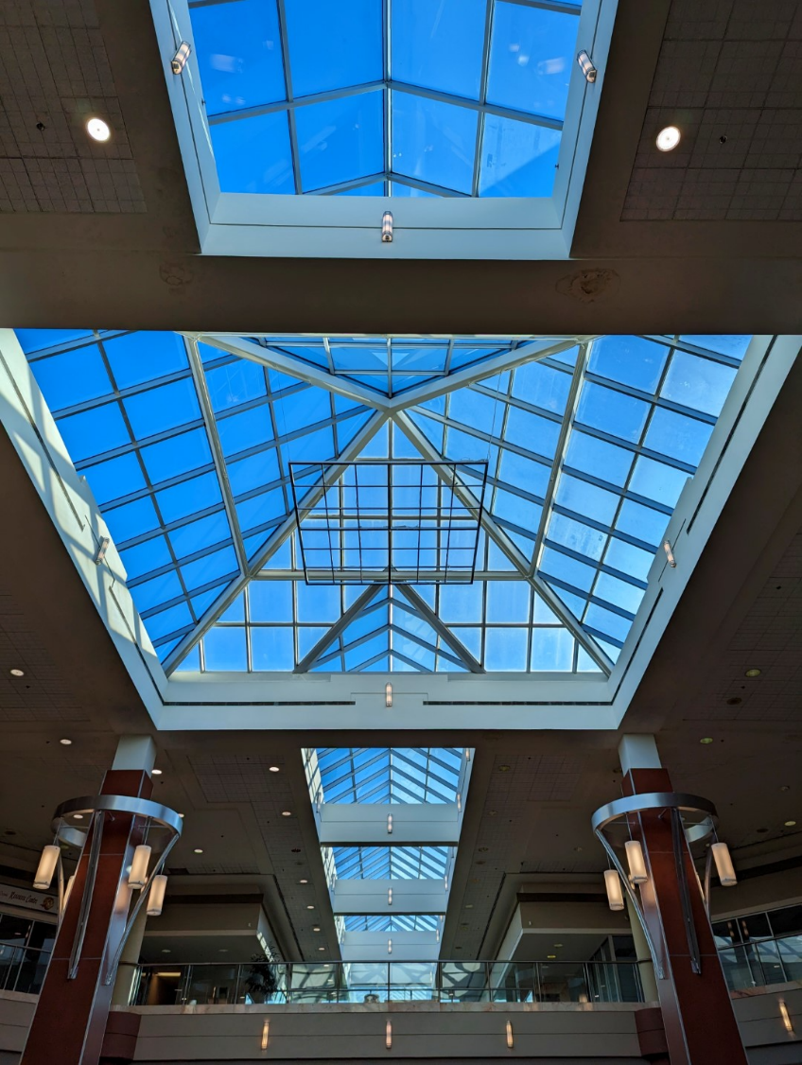
I ns i de/ Ou t s i de
Lynda Buske
Marianne Pethke

Slide 21
Candlel ight
Ramesh
Chauhan

Slide 22
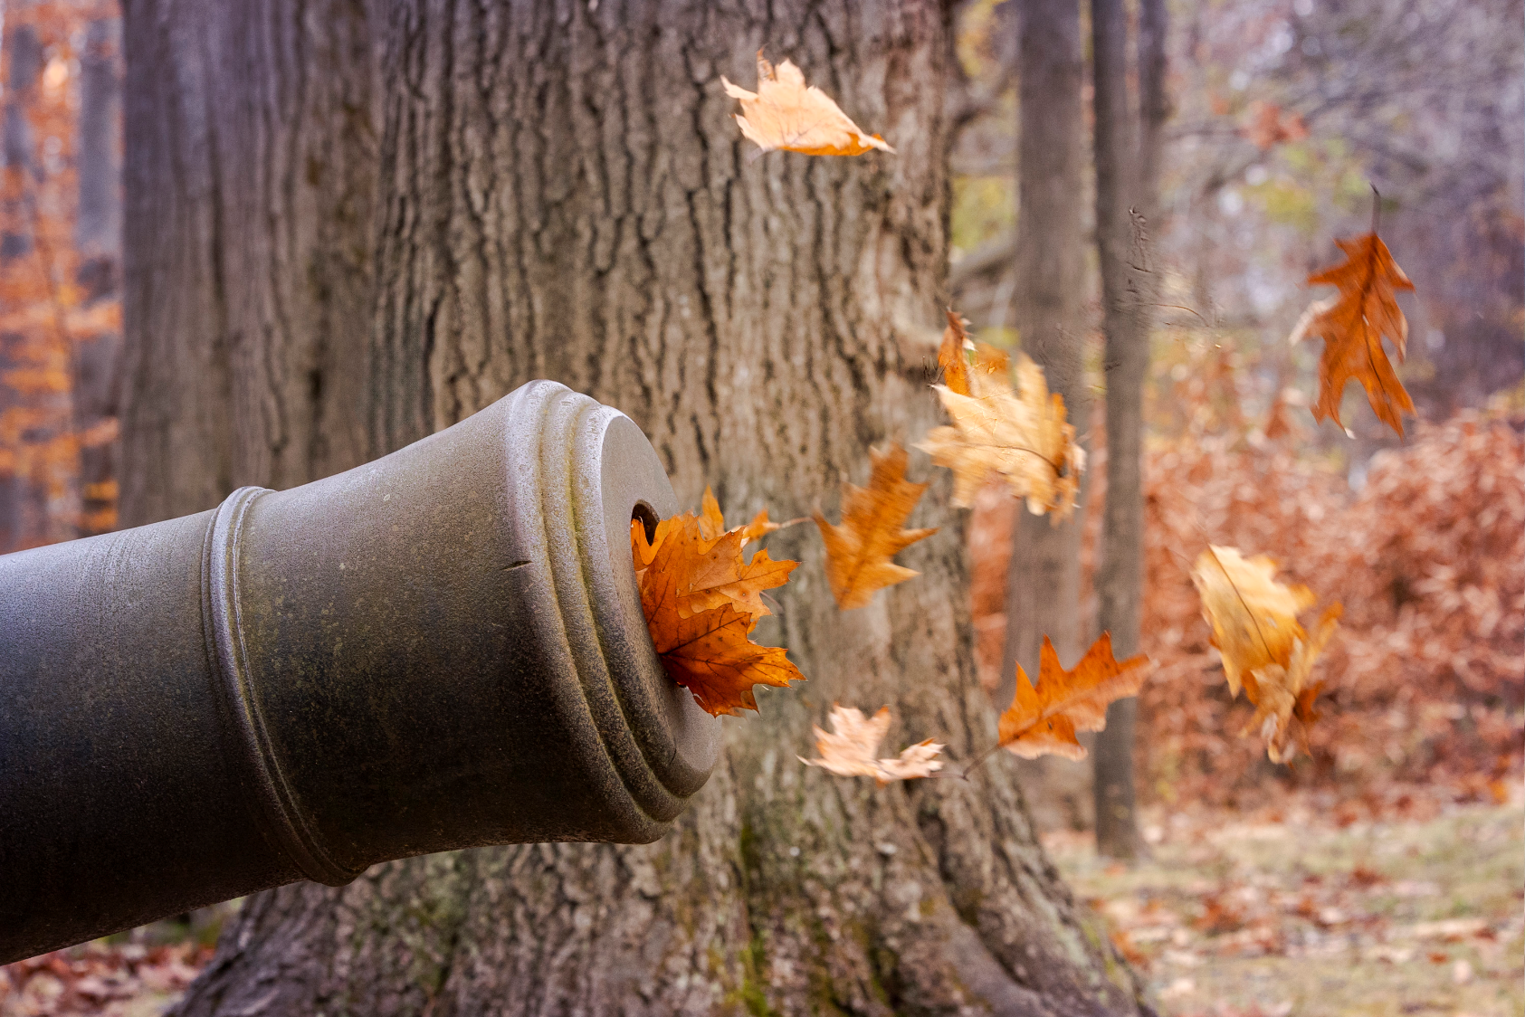
Fire
Johan
Car ignan

Slide 23
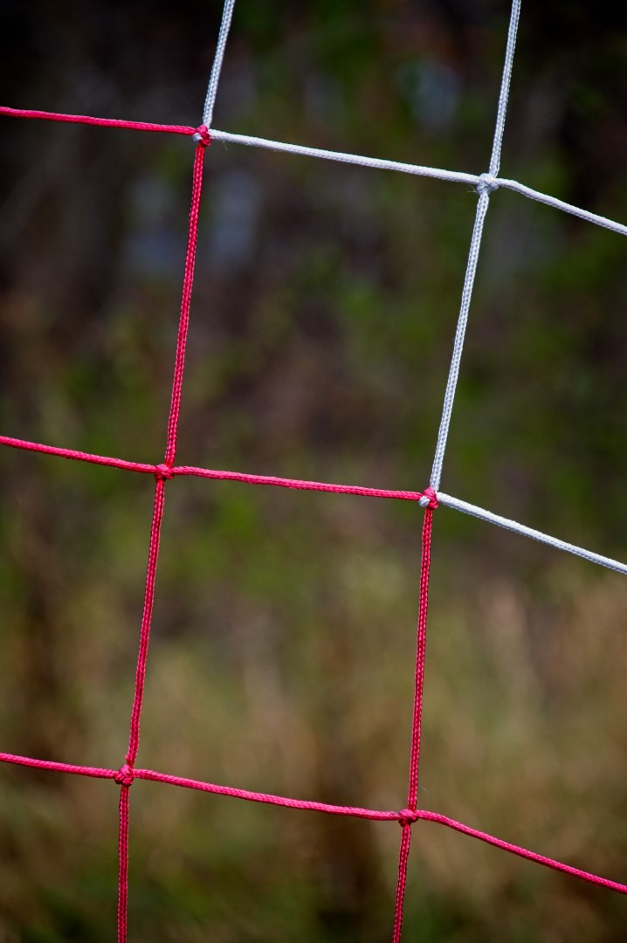
A Pattern
Chris Taylor

Slide 24
Johan Carignan

Slide 25
Mar ianne
Pethke

Slide 26
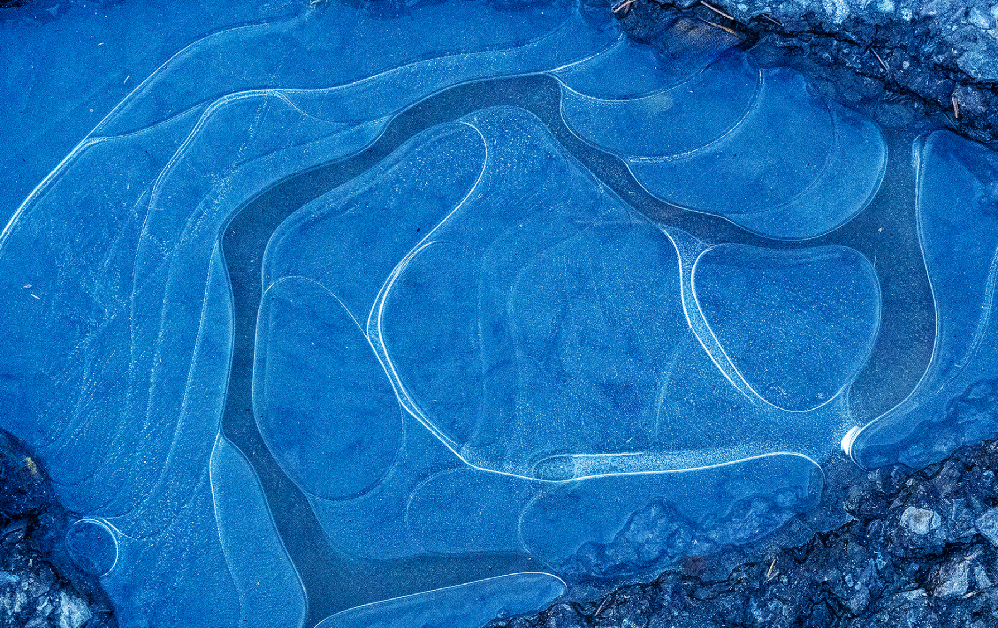
Ramesh
Chauhan

Slide 27
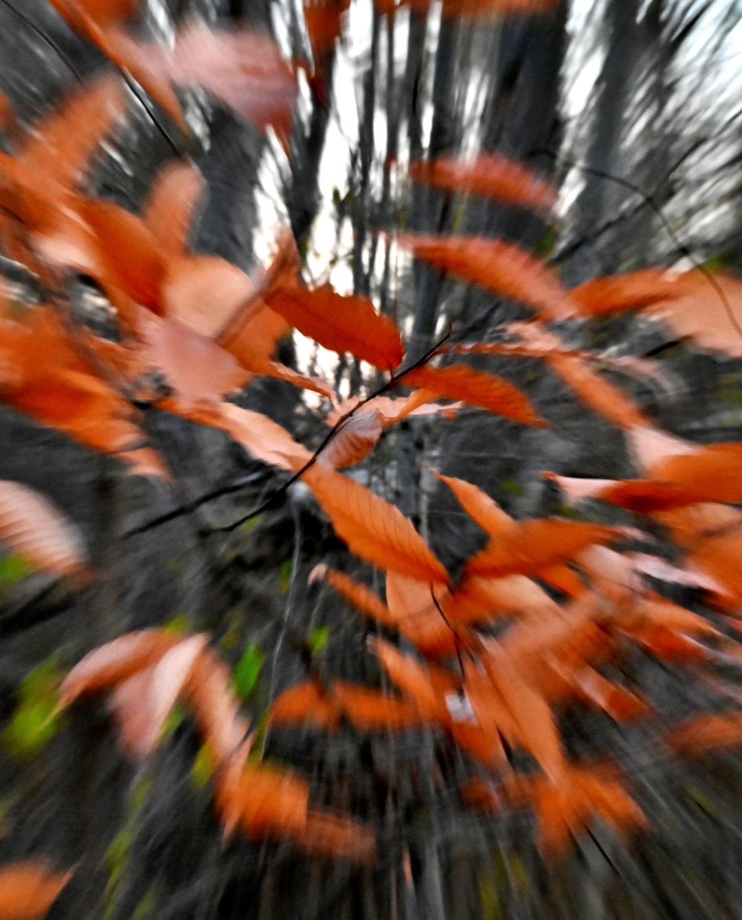
Zoom
Lynda Buske

Slide 28
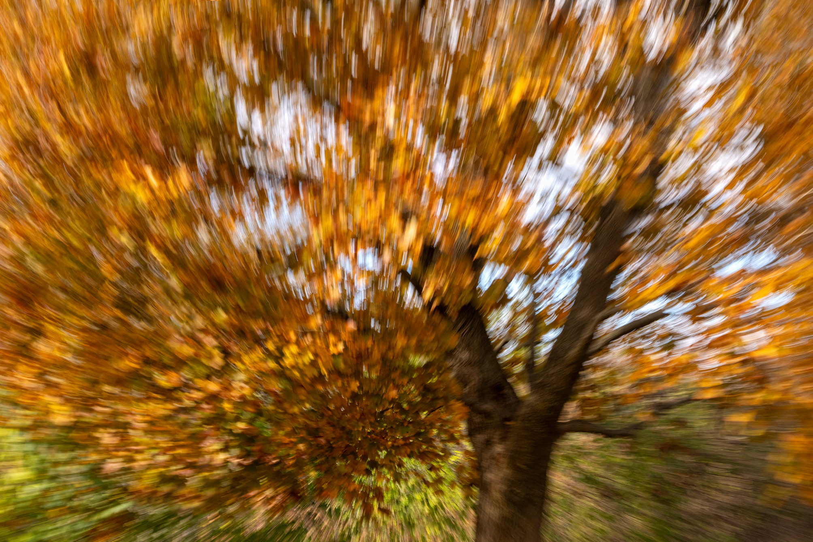
Mar ianne
Pethke

Slide 29
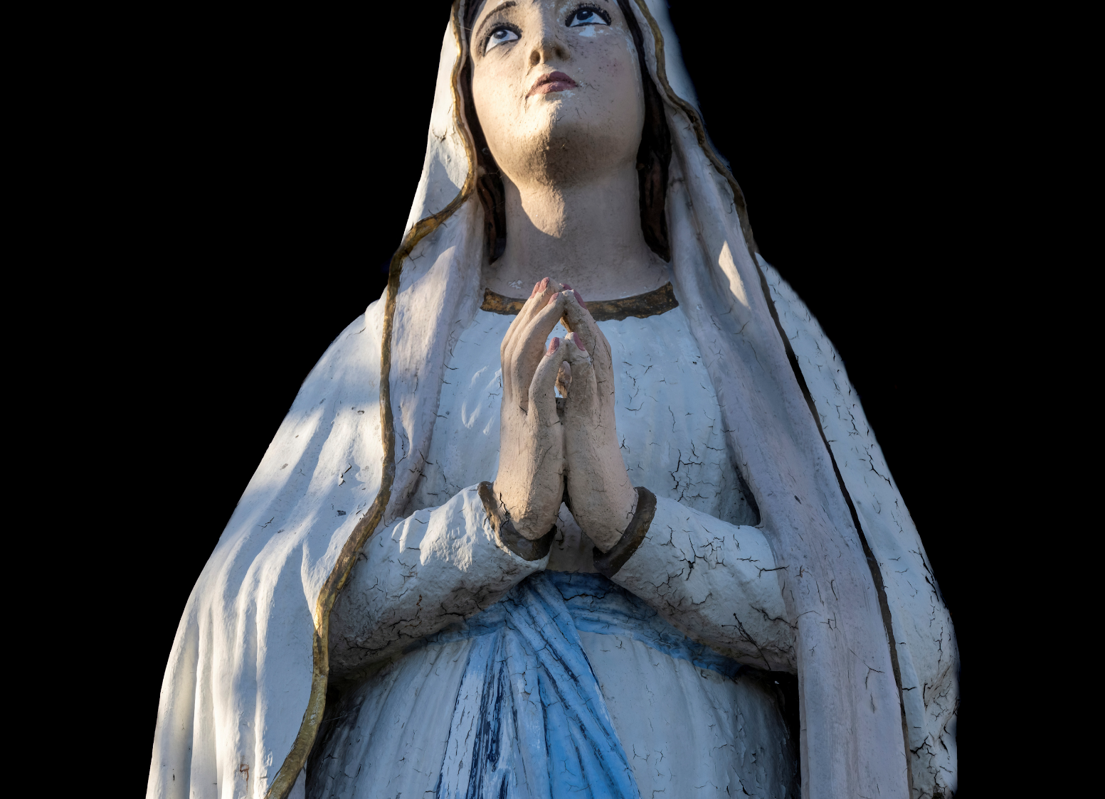
Hands
Marianne Pethke

Slide 30
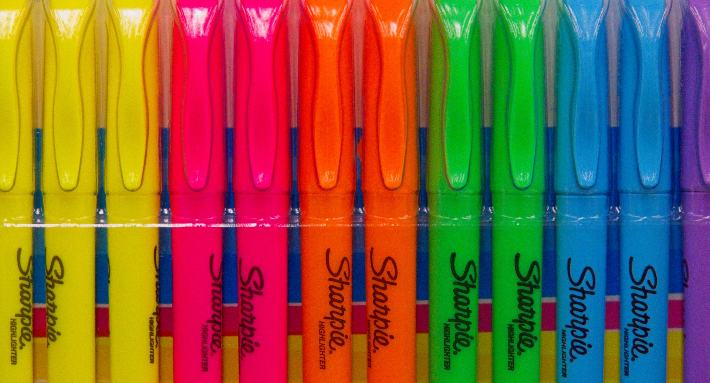
So Colourful
Chris Taylor

Slide 31
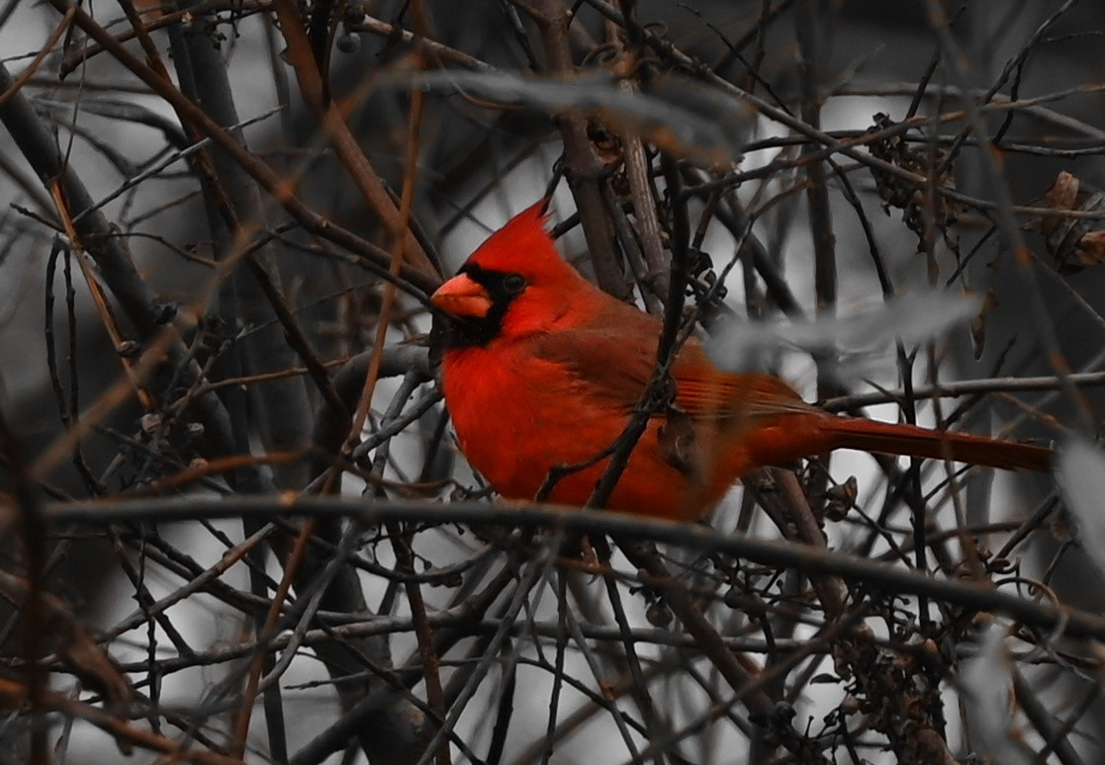
Lynda Buske

Slide 32
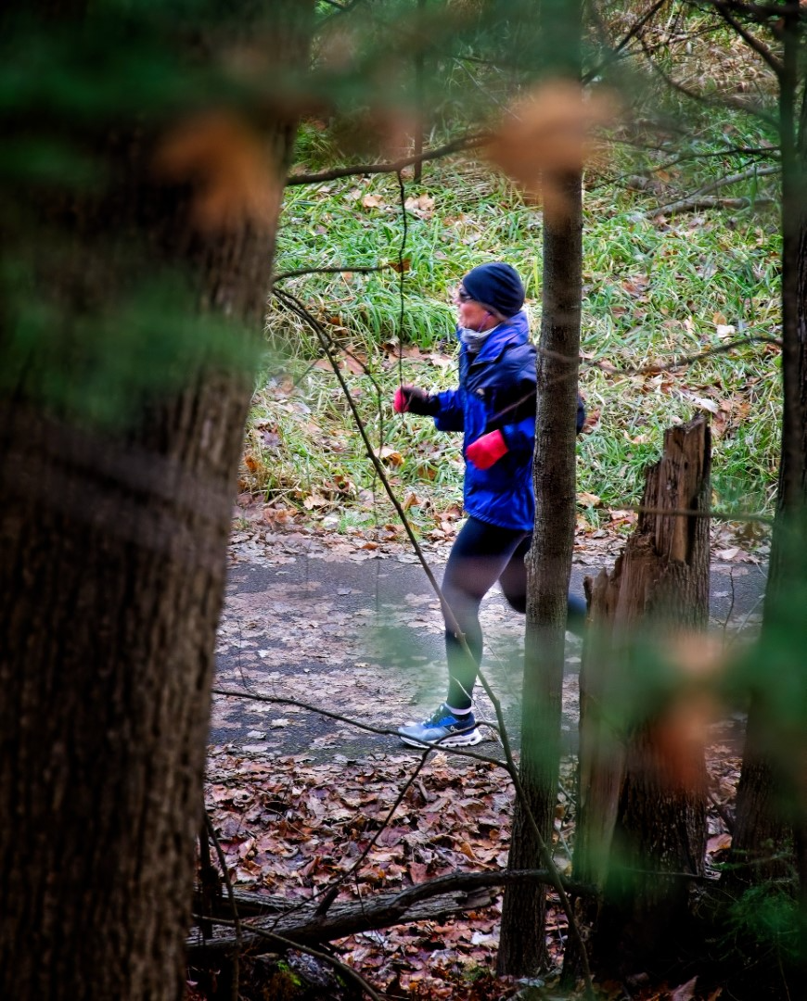
Strangers
Chris Taylor

Slide 33
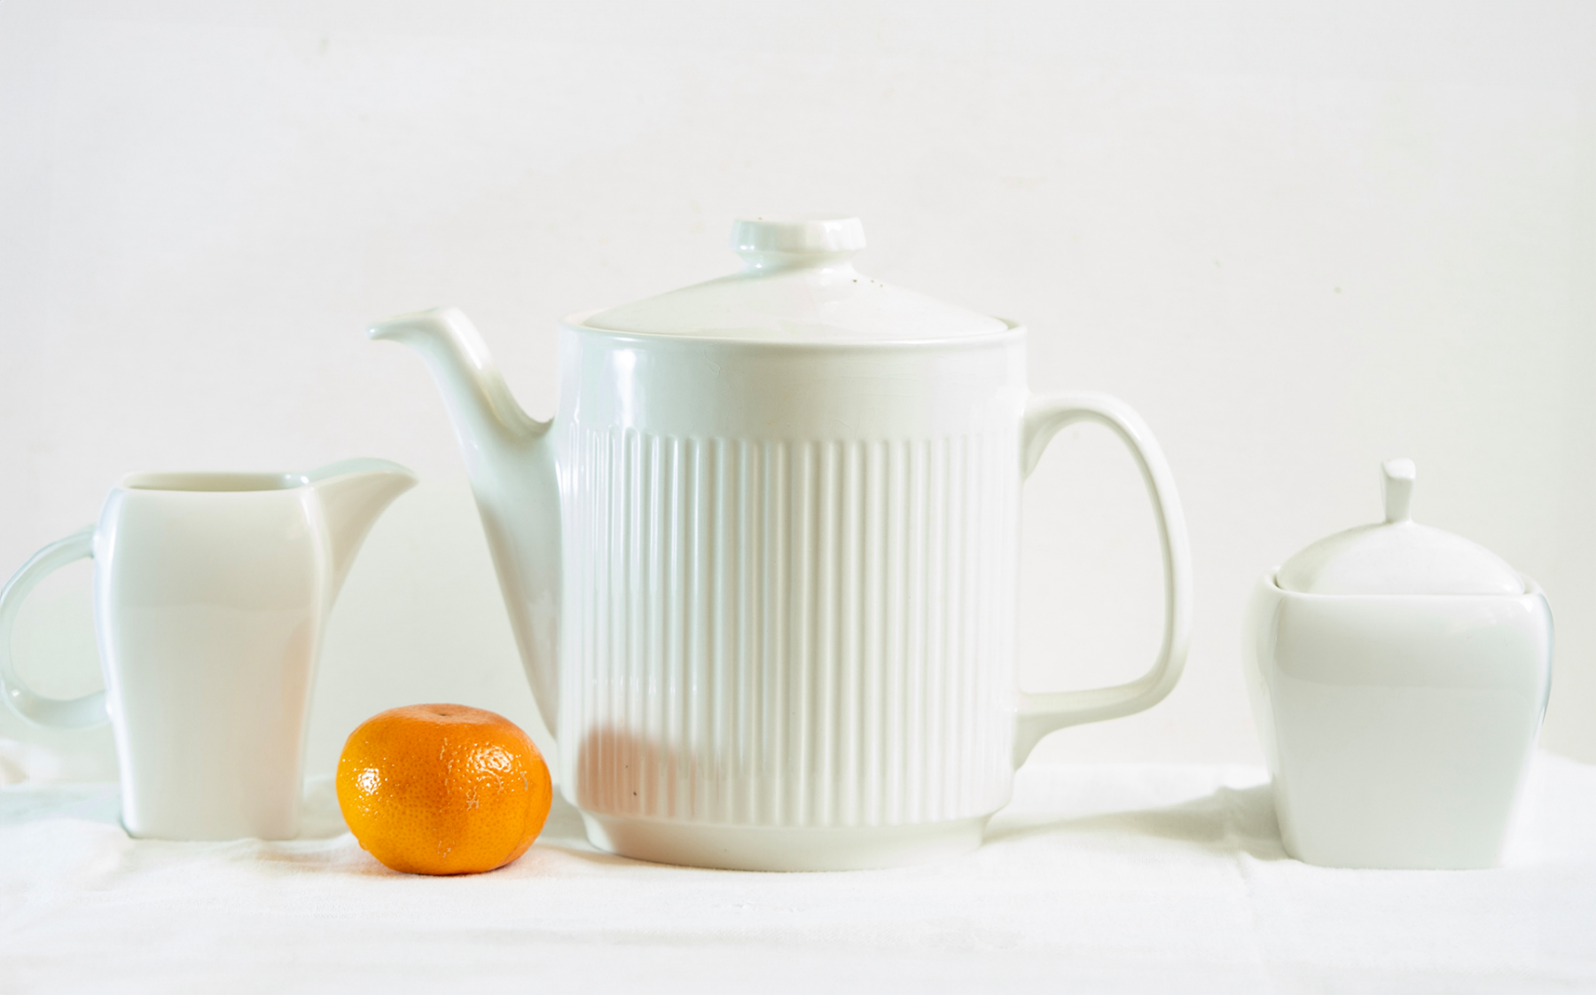
Ramesh
Chauhan

Slide 34
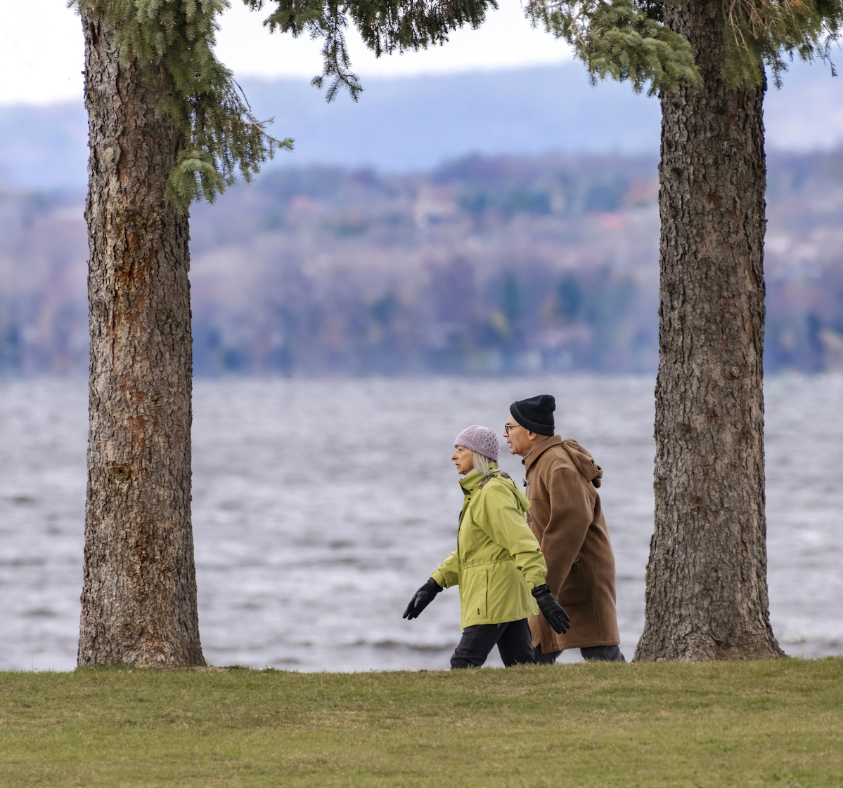
Frame in a Frame
Marianne Pethke

Slide 35
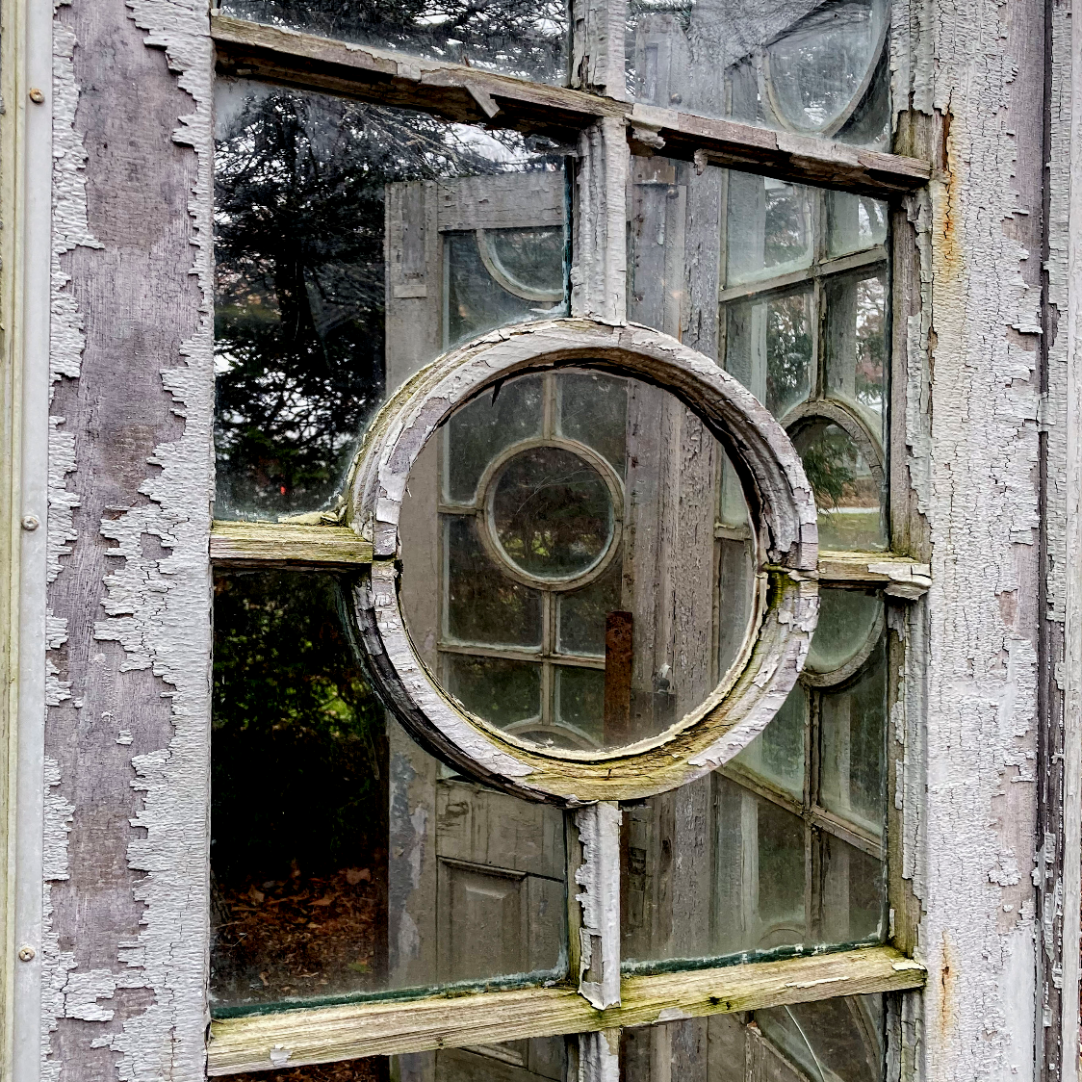
Frame in a Frame
Johan Carignan

Slide 36
Scavenger Hunt
What do you want to see for next year:
Easier topics? Or not challenging enough?
Another wknd in November? Or another month?
In a group? Or remain as individuals?

Slide 37
Inter-Club activities
Inter-club competition
Clark Hall, RA Centre on April 9, 7pm
Digital and print competitions
Topic : Truly Canadian
One photo is on topic, 2 others can be on topic or general category
RA website for photo submission opens January 27
Deadline for on-line submission: Tuesday March 12
Note: No Zoom option for event

Slide 38
December Technique – Panning
Panning combines a slow shutter speed with camera motion to create a sense of speed around a moving object. It typically keeps the subject in sharp focus while blurring the rest of the image.

Slide 39
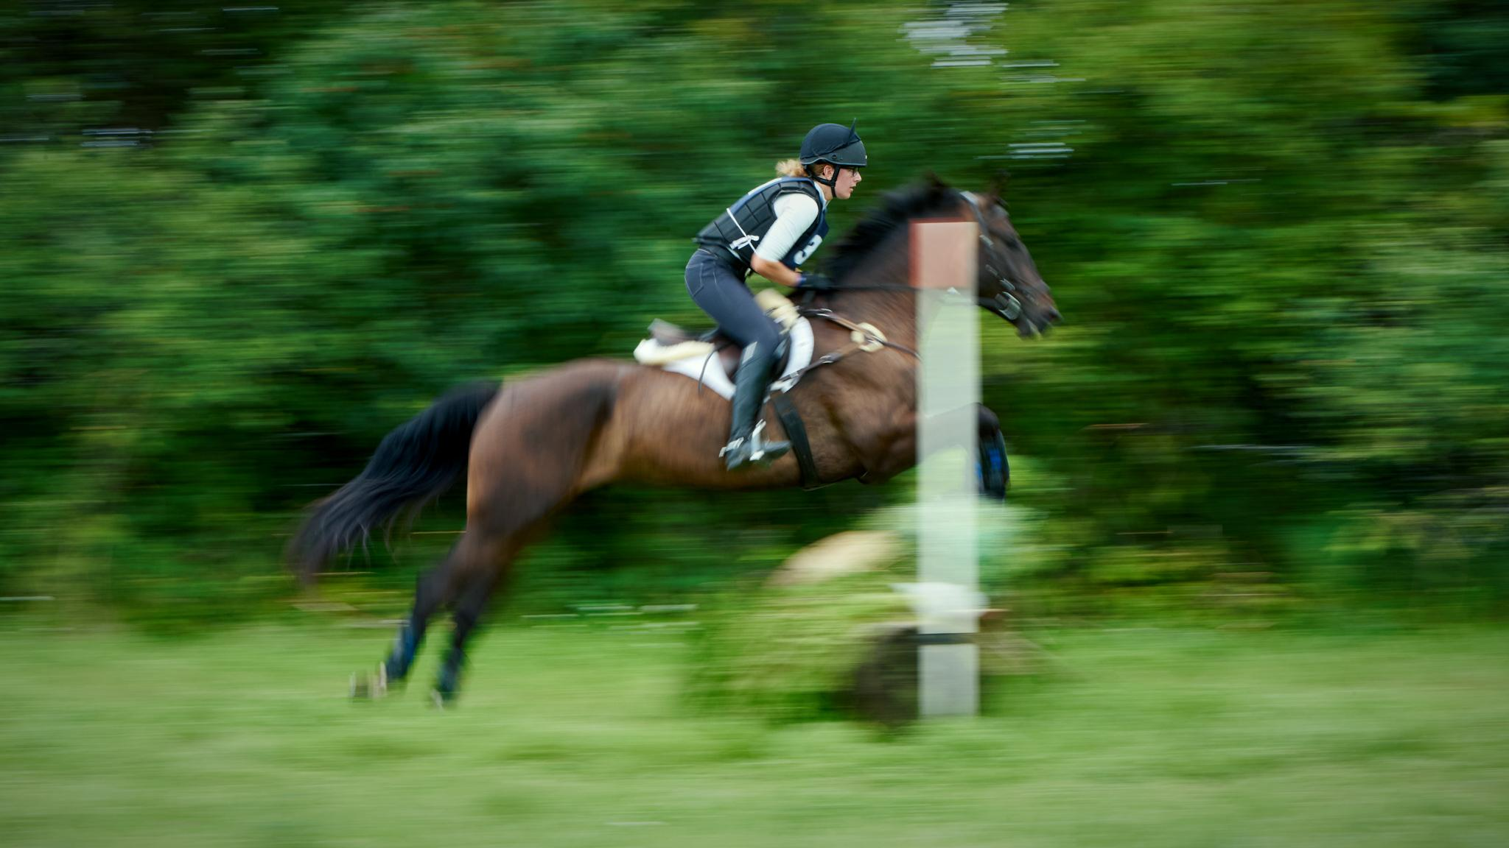
Robert de Wit

Slide 40
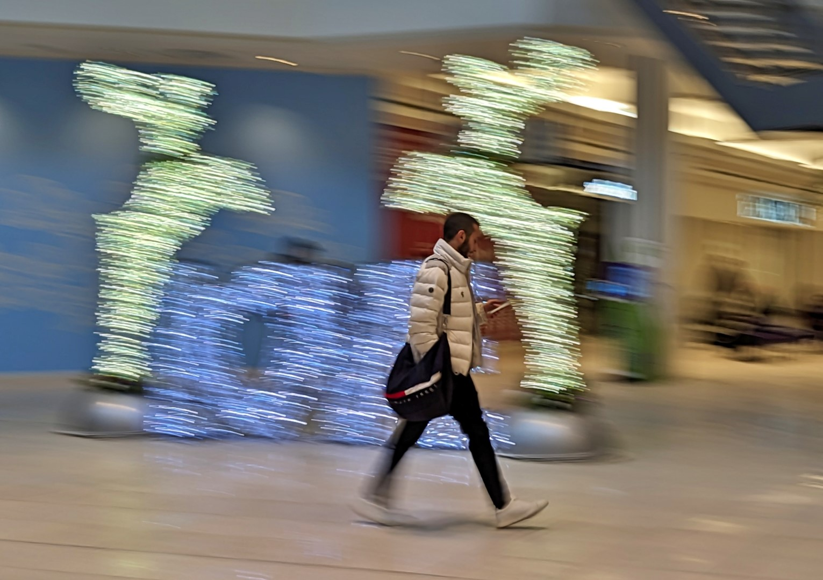
Lynda Buske

Slide 41
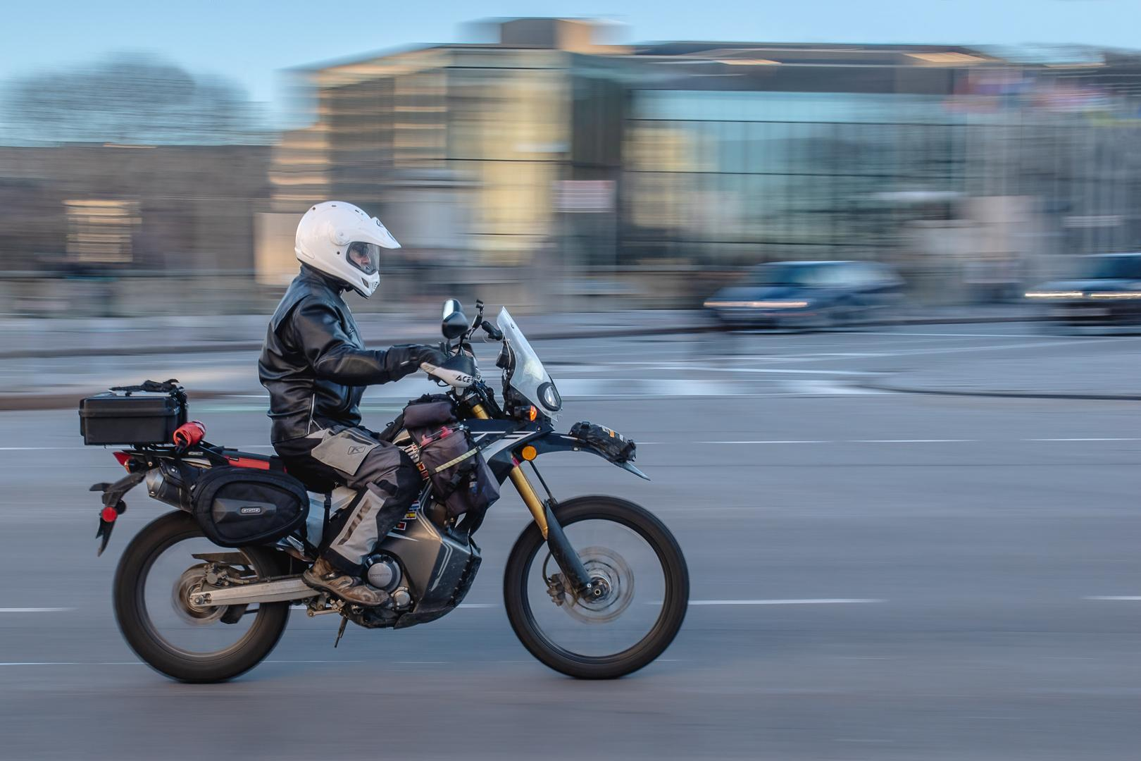
Marianne Pethke

Slide 42
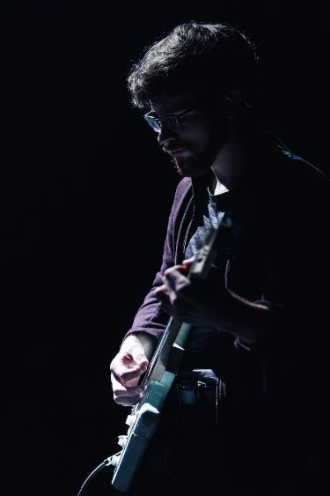
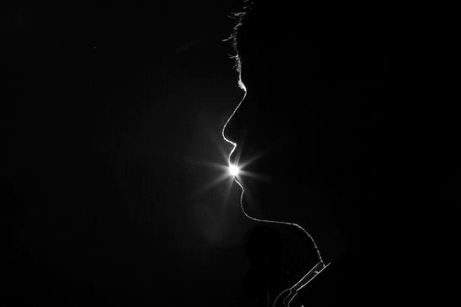
January Technique—Rim lighting
When the main light is behind a subject
Exposes the outline of the subject with light
Highlights contours of a subject
Can create a dramatic and mysterious effect
Matthew Ball
on Unsplash
DALL●E 3
photo of a leaf with rim lighting
Uncredited public domain image

Slide 43
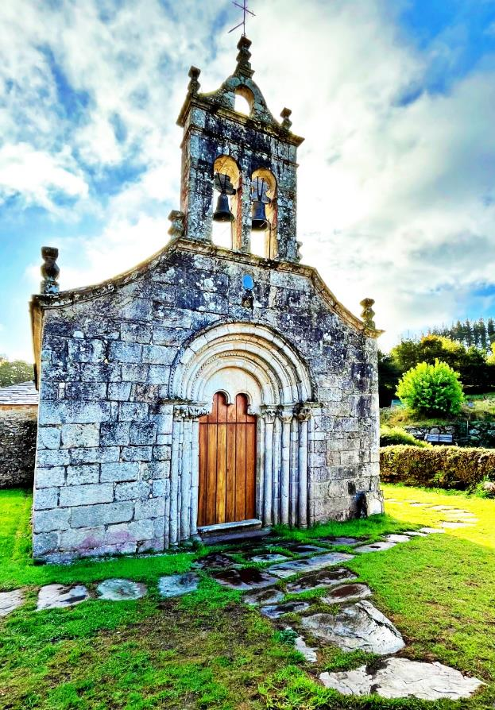
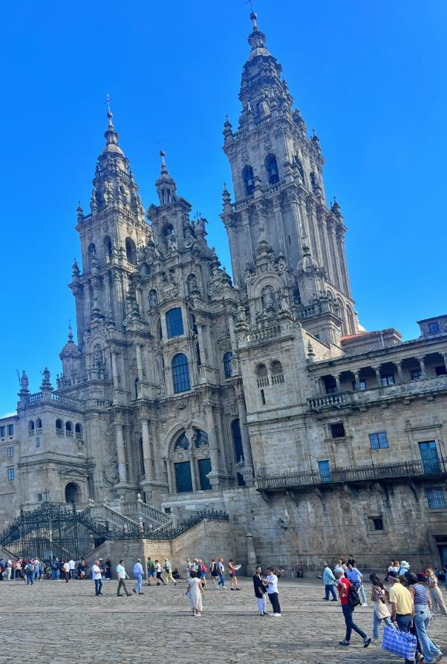
Walk along the El Camino trail in Spain
Photos by Andrea Fisher

Slide 44
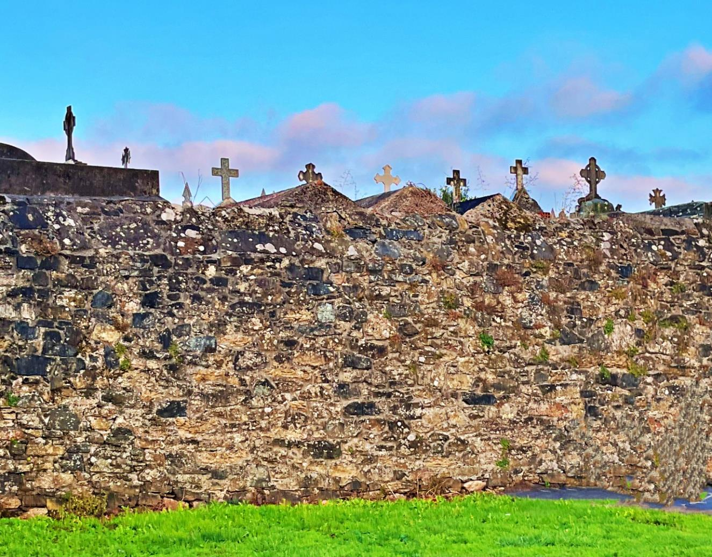

Slide 45
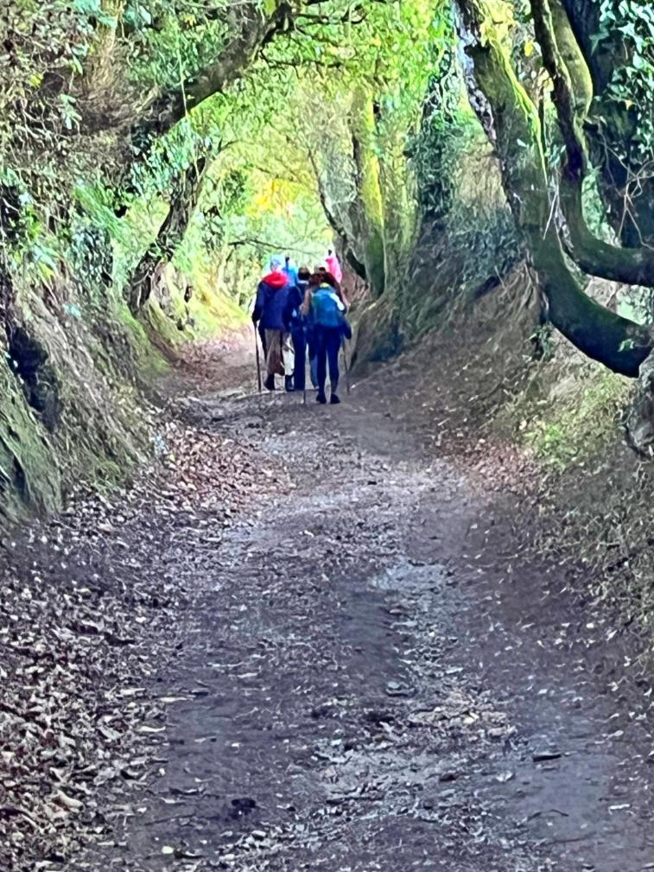

Slide 46
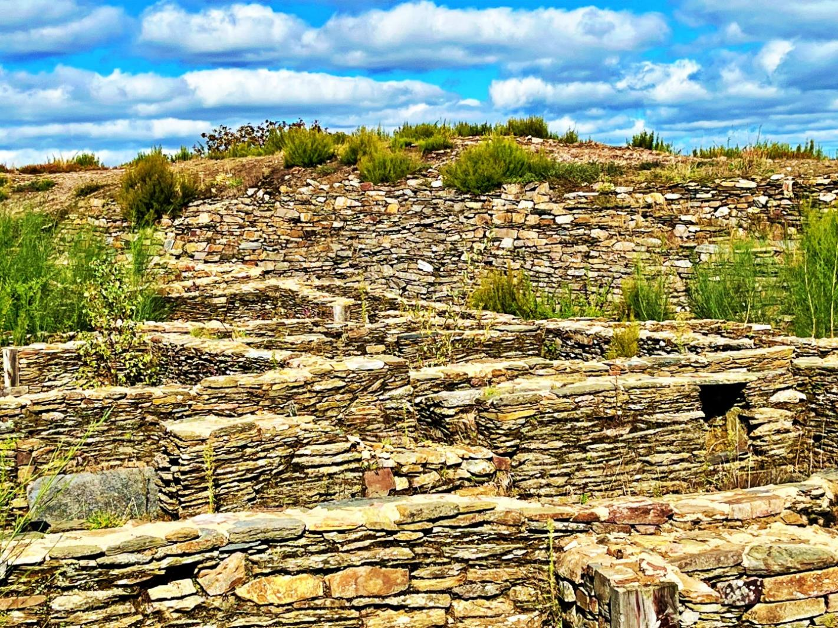

Slide 47
Toronto International Salon
400 participants from all over the world
Had to score in the top 25% of all submissions to be accepted
7 of Ramesh Chauhan’s 16 images were accepted
One image was from Burano, an island off Venice…
It won a silver medal in cityscape category!

Slide 48
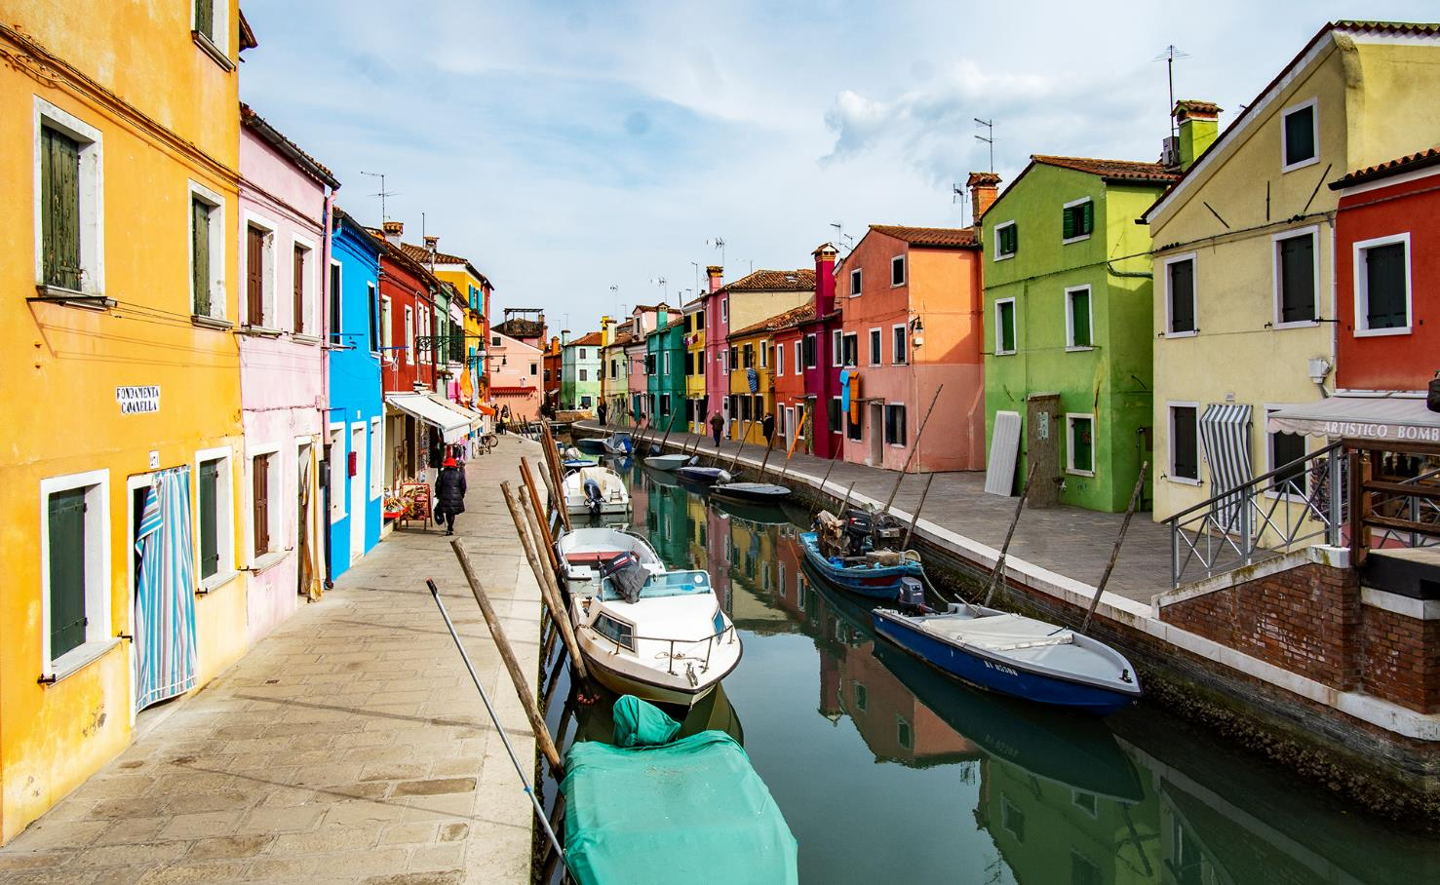
Congratulations Ramesh!!

Slide 49
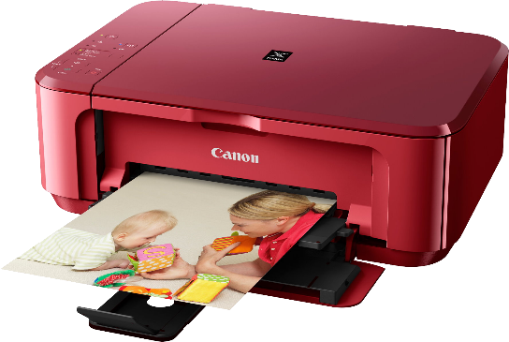
Photo 101 – Printing guidelines
All digital cameras and phones have enough resolution (out of camera) for a 4x6 or 5x7 print.
Max of many printers is 300 dpi (or 300 pixels). For an 8x10, you need a length of at least 300x10=3000 pixels.
E.g., 24 MP camera makes a 4000 x 6000 pixel image. Lots of leeway to crop but check dimensions before printing.
Other consideration is viewing distance:
Close to your eyes?
On a far wall or behind furniture?

Slide 50
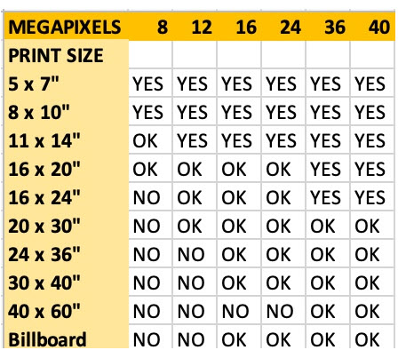
With
no cropping!
Source: Shotkit.com

Slide 51
Camera resolution | Sensor resolution (pixels) | Max print size at 300 dpi
8 megapixels 12 megapixels 16 megapixels 24 megapixels 42 megapixels | 3456 x2304 4240 x 2832 4608 x 3456 4240 x2832 3456 x2304 | 8 x 10 8 x 14 11 x 14 16 x 20 24 x 18

Slide 52
Printing at home
Consider what is the maximum size you want to print.
Inkjet usually superior quality to colour laser.
Research options for minimizing costs when replenishing ink.
Inkjet print heads can get gummed up quickly and waste lots of ink to clear. Printing something that uses all colours at least once a week can help keep print heads clear.
You may wish to calibrate your computer screen to your printer. Or print a small 4x6 before an enlargement. https://www.dpreview.com/articles/6848926575/intro-to-color-calibration-how-monitor-calibration-actually-works
Best to buy quality photo paper designed for the printer brand.

Slide 53
Test a printing company with single prints of each size
Shutterfly (can register as Costco member) but delivery fees (approx. $15 USD). Shutterfly free shipping sales do not apply to Canada.
4x6 = $0.20 USD 11 x 14 = $11.00 USD
8x10 = $4.00 USD 16 x 20 = $20.00 USD
Photobook Canada in CDN $ but significant shipping costs ($12 for a few 8x10s).
Examples

Slide 54
Examples
Staples has good prices if you submit on-line and wait 5 days. Free pick up at a local outlet.
4x6 = $0.16 11x14= $7.49
8x10 = $2.00 16x20 = $18.79
Walmart – quick turn around but poor quality 8x10 prints
4x6 prints actually 4"x 5^{⅞}"

Slide 55
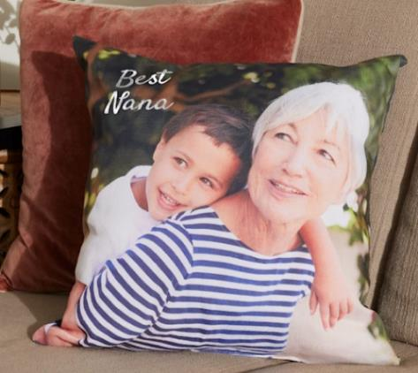
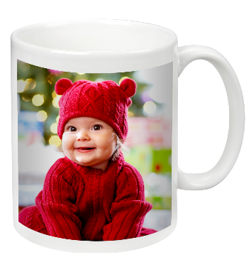
Printing choices:
Surface: gloss, matte, lustre, etc.
Textures: linen, pebble, canvas, etc.
Mounted on a surface such as acrylic, metal, wood, textile (e.g. pillow), ceramic (e.g. mug).

Slide 56
Notices Whoa, backup!
Effective strategies for keeping your computer files safe
Think about everything that is on your PC
all your photos and videos
tax records, documents, music…
If the files don’t exist anywhere else, you really should think about backup
Chris Taylor is giving free presentations through the Ottawa Public Library
St-Laurent branch, Monday December 11 at 6:00pm
Ruth E. Dickinson, Wednesday December 13 at 2:00pm
Register for free at https://biblioottawalibrary.ca/en/program?text=whoa

Slide 57
Notices CAPA Membership
CPOPC is becoming a member of CAPA
This entitles our members to a free limited membership in CAPA
You have to register yourself as a member of a CAPA club
You will be able to read the Canadian Photography magazine and submit articles to it
Details to come!

Slide 58
Ontario Council of Camera Clubs (O3C.ca)
Access to speakers registry and judges list
Access to judging courses
2023-24 Open Challenge with many topics
Discounted photo tours in 2024 to Antarctica, Costa Rica

Slide 59
CPOPC Communications Communications Director: John Ingold
Monthly Newsletter + deadline reminders
Facebook: Orleans Photo Club
Challenge and Competition winners’ photos, event updates
https://www.facebook.com/CPOPC
Instagram: Orleans_Photo_Club
Member contributions photos, event updates
https://www.instagram.com/orleans_photo_club/?hl=en
Thank you to Trish Parsons for helping post member contributions
Twitter: OrleansPhotoClb
Deadlines, event updates
https://twitter.com/OrleansPhotoClb

Slide 60
Annual Membership Fees; 2023-2024 Secretary and Treasurer: Roger Regimbal
Individual: $50 $25 for new members only joining between Feb. 1 and June 30
Family: $75 $35 for new members only joining between Feb. 1 and June 30
NEW Online $25 – full online participation + outings
All returning members must pay full price
Full payment was due before end of November 2023
Access to “Members Only” section of website cut off after November
Please pay online via PayPal using the CPOPC web site “How to Join” page

Slide 61
2023-24 Speaker and Topics Schedule Programs Director: Marianne Pethke Workshops: Johan Carignan
Meeting topics
October Dan Parent Nature/Wildlife
November Gareth Jones Creative Imagery
January Carol Anne Bell-Smith Impressionist Photography
February Peter Fundarek B2B: The Exposure Triangle
March Mark Bowie How to photograph trees & forests
April Mike Giovinazzo One light portraits
May Mike Higgins Landscape photography

Slide 62
2023-24 Speaker and Topics Schedule Programs Director: Marianne Pethke Workshops: Johan Carignan
Outings
October Gatineau park for fall colours
November Scavenger Hunt
December Christmas Lights downtown Ottawa
January Winter (organised by Marianne)
March National Art Gallery/Architecture
June Night Sky Photography (how to get stars in focus) Petrie Island

Slide 63
2023-24 Speaker and Topics Schedule Programs Director: Marianne Pethke Workshops: Johan Carignan
Workshops
17 February Manfred Mueller Glass Tabletop
20 April Adrian Duey Still Life and Food Lighting
18 May Suliman Chadirji Ambient Light Photography (downtown Ottawa in the evening)

Slide 64
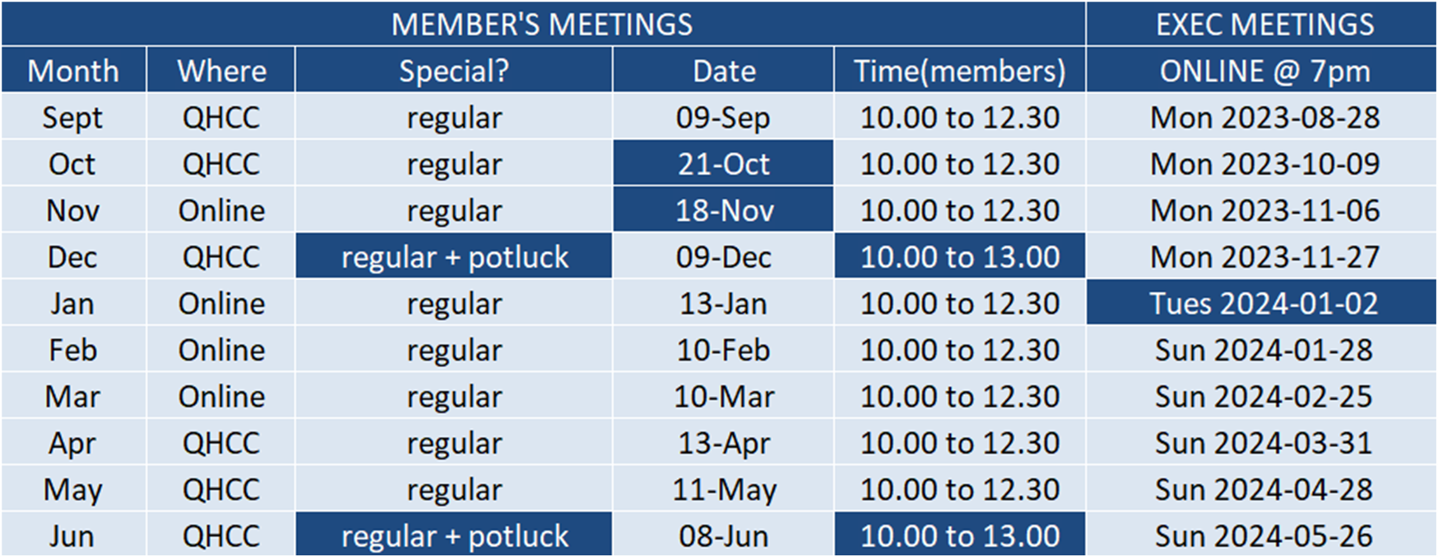
2023-24 Calendar

Slide 65
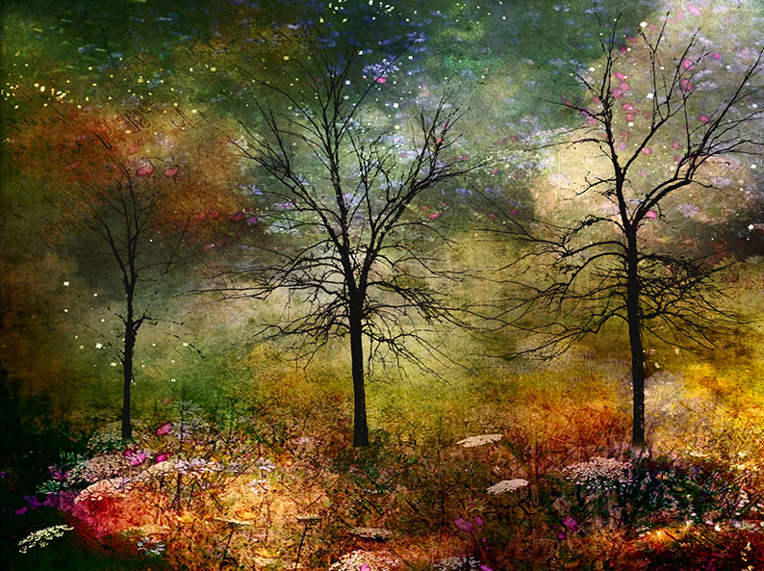
Next Meeting
13 January, 10am ONLINE on Zoom
Challenge: Truly Canadian (submit by Saturday, 6 January)
Technique:
Photo 101: Tips for Winter Photography
Featured Speaker: Carol Anne Bell-Smith
Art of Impressionist Photography

