Slide 1
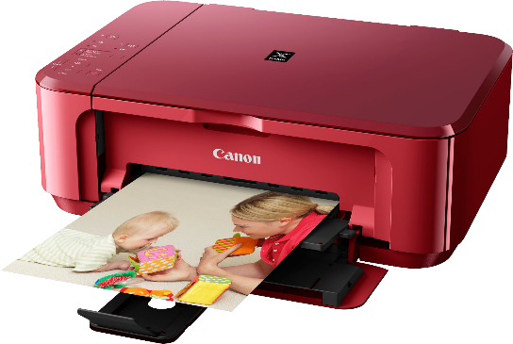
Photo 101 – Printing guidelines
All digital cameras and phones have enough resolution (out of camera) for a 4x6 or 5x7 print.
Max of many printers is 300 dpi (or 300 pixels). For an 8x10, you need a length of at least 300x10=3000 pixels.
E.g., 24 MP camera makes a 4000 x 6000 pixel image. Lots of leeway to crop but check dimensions before printing.
Other consideration is viewing distance:
Close to your eyes?
On a far wall or behind furniture?

Slide 2
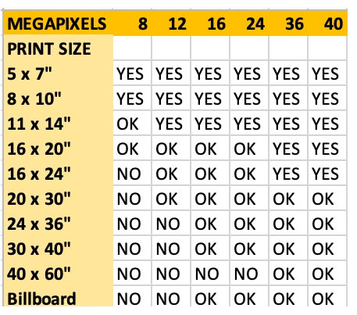
With
no cropping!
Source: Shotkit.com

Slide 3
Camera resolution | Sensor resolution (pixels) | Max print size at 300 dpi
8 megapixels 12 megapixels 16 megapixels 24 megapixels 42 megapixels | 3456 x2304 4240 x 2832 4608 x 3456 4240 x2832 3456 x2304 | 8 x 10 8 x 14 11 x 14 16 x 20 24 x 18

Slide 4
Printing at home
Consider what is the maximum size you want to print.
Inkjet superior to colour laser. Research options for minimizing replacement costs. Cartridges can get gummed up quickly and waste lots of ink to clear.
You may wish to calibrate your computer screen to your printer. Or print a small 4x6 before an enlargement. https://www.dpreview.com/articles/6848926575/intro-to-color-calibration-how-monitor-calibration-actually-works
Best to buy quality photo paper designed for the printer brand.

Slide 5
Test a printing company with single prints of each size
Shutterfly (can register as Costco member) but delivery fees (approx. $15 USD). Shutterfly free shipping sales do not apply to Canada.
4x6 = $0.20 USD 11 x 14 = $11.00 USD
8x10 = $4.00 USD 16 x 20 = $20.00 USD
Photobook Canada in CDN $ but significant shipping costs ($12 for a few 8x10s).
Examples

Slide 6
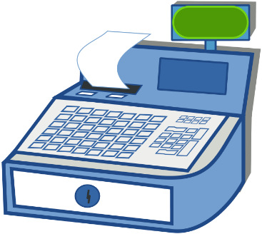
Examples
Staples has good prices if you submit on line and wait 5 days. Free pick up at a local outlet.
4x6 = $0.16 11x14= $7.49
8x10 = $2.00 16x20 = $18.79
Walmart – quick turn around but poor quality 8x10s and 4x6s actually 4”x 5 7/8”.

Slide 7
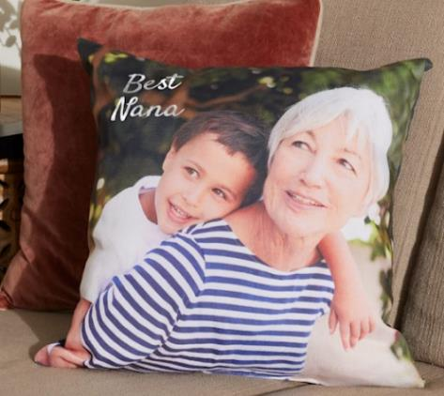
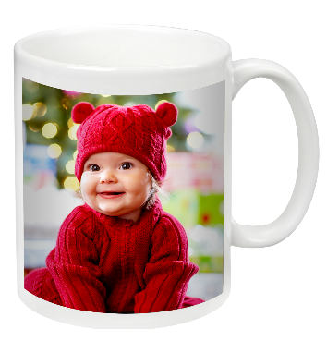
Printing choices:
Surface: gloss, matte, lustre, etc.
Textures: linen, pebble, canvas, etc.
Mounted on a surface such as acrylic, metal, wood, textile (e.g. pillow), ceramic (e.g. mug).

